Slide 1
Software Security
CSC 481/681/781
Principles of Computer Security
Ref: Textbook, Section 3.4

Slide 2
Software Security vs. OS Security
Before we dive into software security, let’s first clarify how it relates to operating system security:
Do software security and OS security overlap?
Where does a buffer overflow vulnerability belong—software or OS security?
Both domains have vulnerabilities—how do their Common Vulnerabilities and Exposures (CVE) focus areas differ?
If a program contains a buffer overflow bug but cannot be exploited, is it still a security problem?

Slide 3
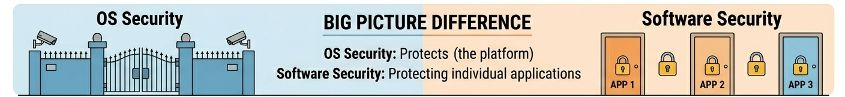
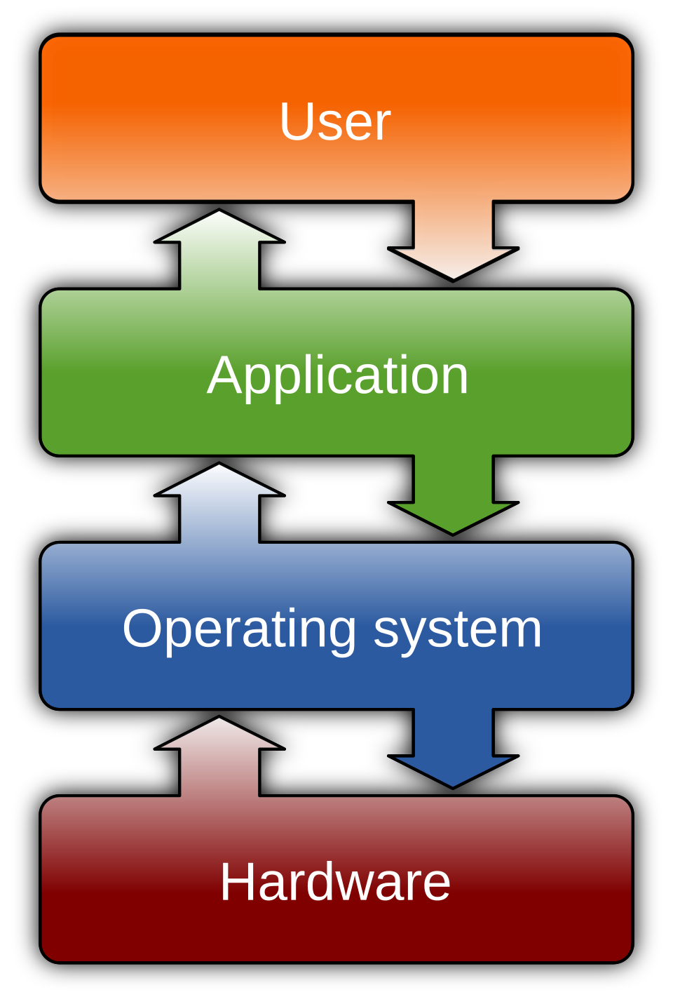
Software Security vs. OS Security
“If a program has a buffer overflow bug but cannot be exploited, is it still a security problem?”
Software security says yes (bug exists)
OS security says maybe less severe (mitigated)
Prevents vulnerabilities
limits vulnerabilities impact

Slide 4
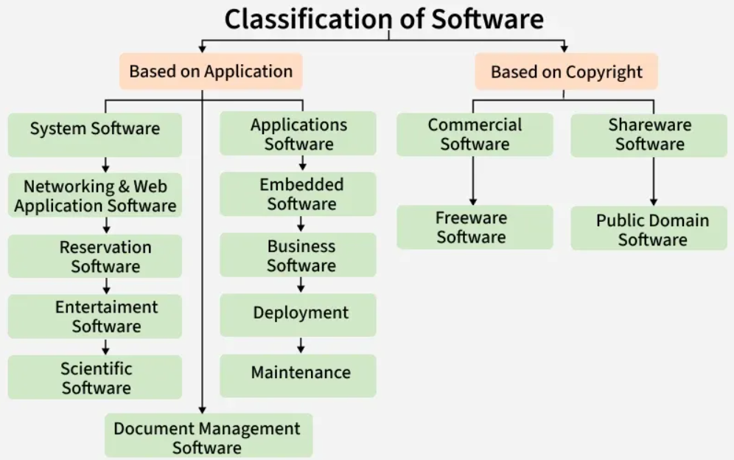

Terminology in Software Security
Software is a collection of instructions and data that tell a computer how to work.

Slide 5
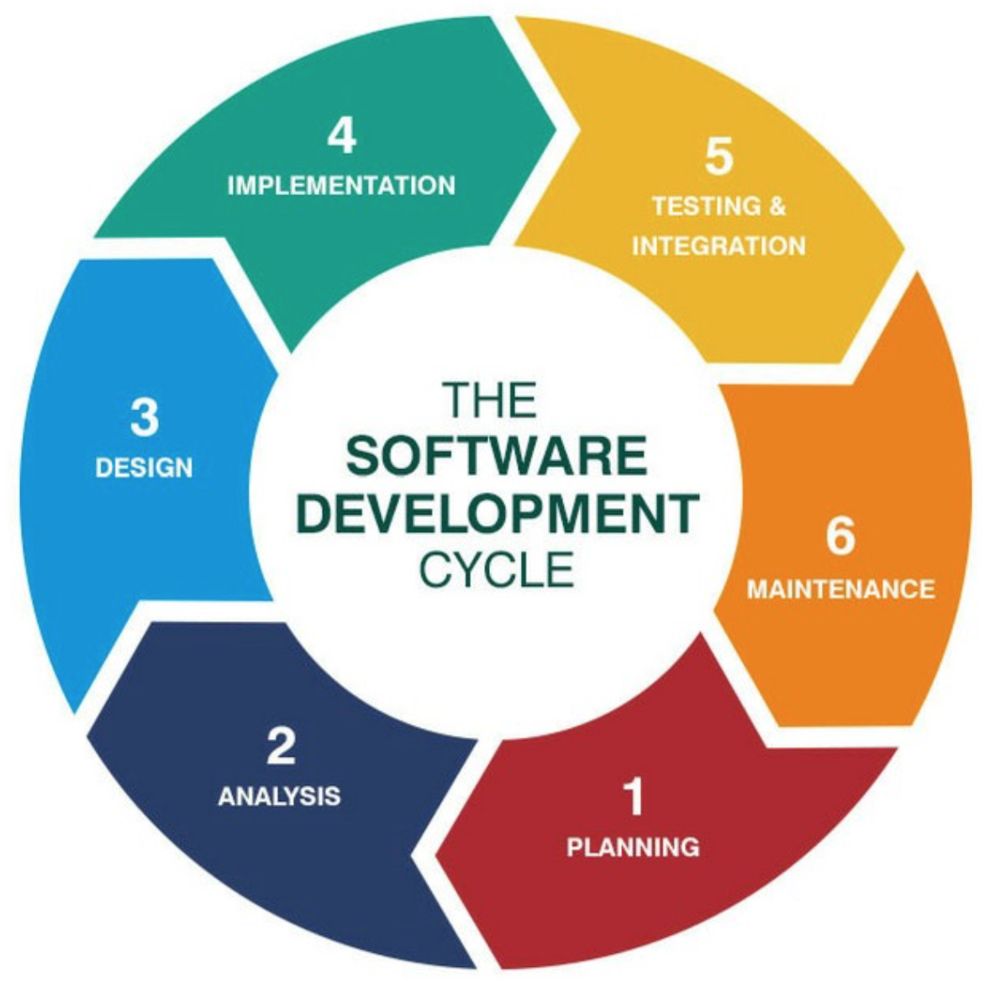
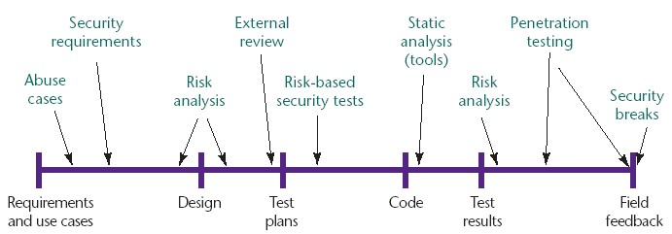
Terminology in Software Security
Software development life cycle (SDLC) describes phases of the software development cycle and the order in which those phases are executed. Each phase produces deliverables required by the next phase in the life cycle.
[Source: Gary McGraw, Software security, Security & Privacy Magazine, IEEE, Vol 2, No. 2, pp. 80-83, 2004. ]

Slide 6
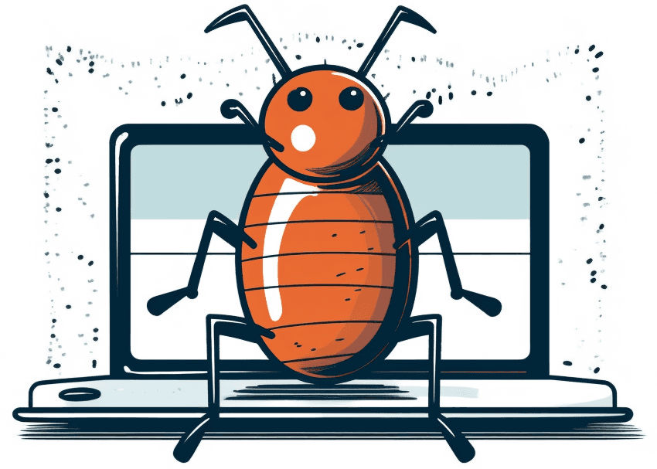
Terminology in Software Security
Software bugs are errors, flaws, mistakes, or oversights in programs that result in unexpected and typically undesirable behavior.
Software vulnerabilities are specific flaws or oversights in a piece of software that allow attackers to do something malicious – expose or alter sensitive information, disrupt or destroy a system, or take control of a computer system or program.
A bug is a mistake in code; a vulnerability is a bug that can be exploited to break security.

Slide 7
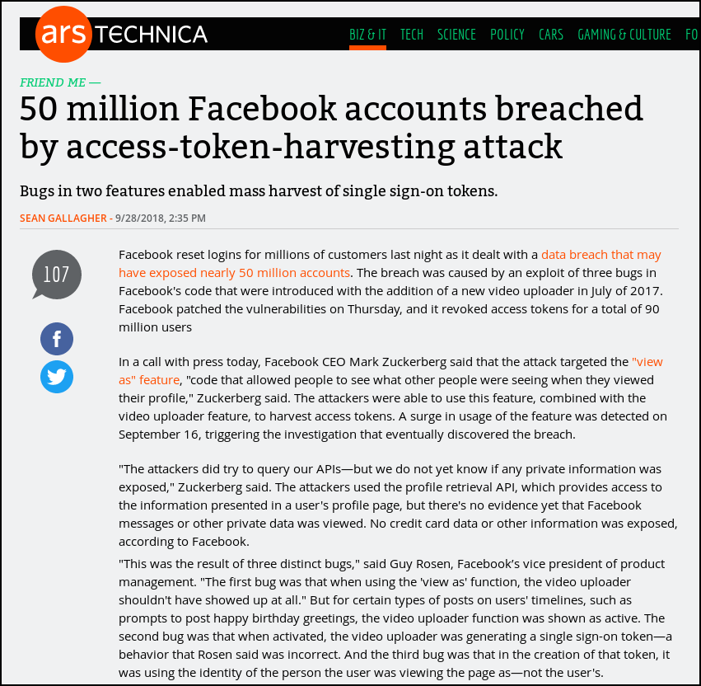
How Common Are Software Vulnerabilities?
A sampling (just a sample!) of recent issues...
Website breaches are almost always due to programming errors…
Facebook breach
Combined 3 different bugs
Single sign-on magnifies effect
https://arstechnica.com/information-technology/2018/09/50-million-facebook-accounts-breached-by-an-access-token-harvesting-attack/

Slide 8
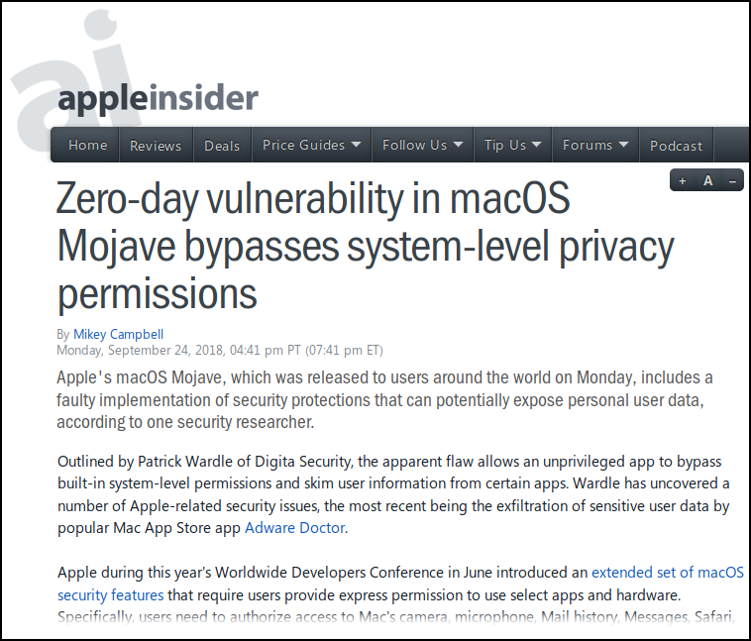
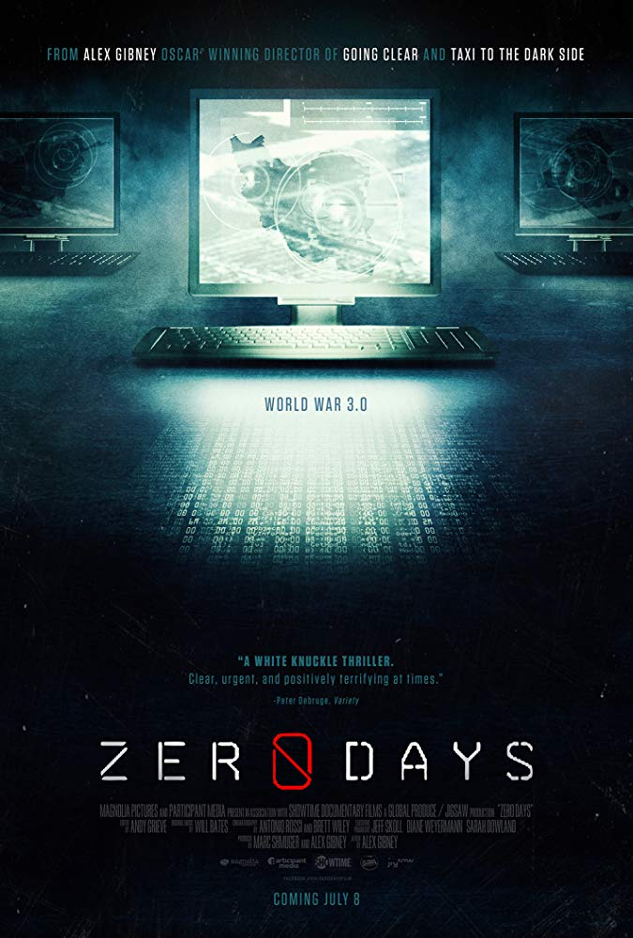
How Common Are Software Vulnerabilities?
A sampling (just a sample!) of recent issues...
Zero-day: Companies (vendors, anti-virus software, etc.) have had 0 days to create fixes or protections.
https://appleinsider.com/articles/18/09/24/zero-day-vulnerability-in-macos-mojave-bypasses-system-level-privacy-permissions

Slide 9
Finding Security Bugs Can Be Profitable!
Bug Bounty Programs - amounts from March 2025
Many groups offer rewards for finding vulnerabilities
Google - Security Rewards Program
Programs for Google applications, Chrome, Android
Also for security improvements for open source software
Rewards up to $1,000,000 (for “Pixel Titan M with Persistence, Zero click”)
Microsoft - Bug Bounty Program
Programs for MS Identity, Azure, Hyper-V, Mitigation Bypass, …
Rewards up to $250,000 (critical remote code execution in Hyper-V)
Other company programs: Facebook, Mozilla, …
Multi-company bug bounty management programs
HackerOne - 461 active bounty programs as of March 19, 2025
“Rewards up to …” is a little misleading - most are much smaller.

Slide 10
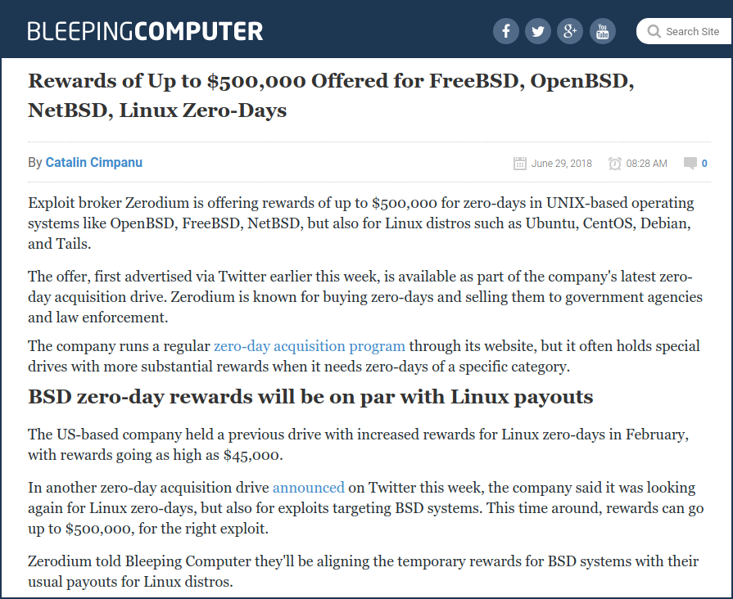
Finding Bugs Can Be Profitable!
And on the “Gray Market”...
Markets for exploits
Bought by
Governments
Companies
And some by criminals
(many brokers don’t…)
https://www.bleepingcomputer.com/news/security/rewards-of-up-to-500-000-offered-for-freebsd-openbsd-netbsd-linux-zero-days/

Slide 11
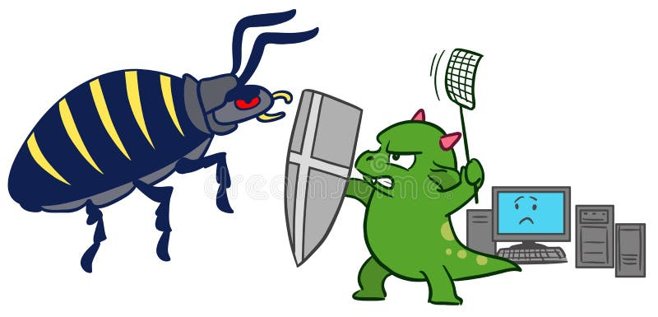
Terminology in Software Security
Software security is the application of techniques that assess, mitigate, and protect software systems from vulnerabilities and attacks.
Security is always a secondary concern
- primary goal of software is to provide some functionality or services
- managing the associated risks is only a derived or secondary concern
There is often a trade-off/conflict between security functionality & convenience.

Slide 12
Terminology in Software Security
Software security is the application of techniques that assess, mitigate, and protect software systems from vulnerabilities and attacks.
"The only system which is truly secure is one which is switched off and unplugged, locked in a titanium-lined safe, buried in a concrete bunker, and surrounded by nerve gas and very highly paid armed guards.
Even then, I wouldn't stake my life on it”
-- Gene Spafford

Slide 13
Terminology in Software Security
Software security is the application of techniques that assess, mitigate, and protect software systems from vulnerabilities and attacks.
What may cause security issues?
At a high-level: not understanding the security requirements and threats
At a low-level: silly little program bugs or flaws that introduce vulnerabilities

Slide 14
How Do We Manage Vulnerabilities
Design systems to avoid design vulnerabilities.
Write secure code to reduce the number of implementation vulnerabilities.
Add mitigation techniques to address implementation vulnerabilities.
Analyze and test systems to find operational vulnerabilities.
Software design principles
Common vulnerabilities, Secure coding
Code auditing, code analysis tools, software security testing

Slide 15

Secure Software Design Principles
At a high-level:
Seriously consider security requirements and threats before building systems
Perform threat modeling and define security goals early in the design phase

Slide 16
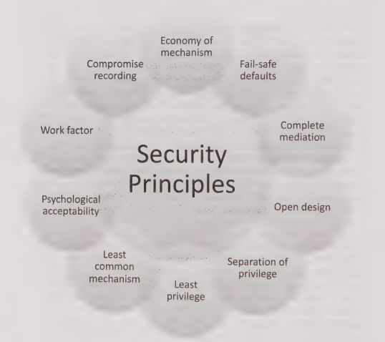
Secure Software Design Principles
Let’s review “Principles to guide design of secure systems (Saltzer & Schroeder)”
Economy of mechanism
Fail-safe defaults
Complete mediation
Open design
Separation of privilege
Least privilege
Least common mechanism
Psychological acceptability
Work factor
Compromise recording (i.e., logging or audit)

Slide 17
Secure Software Design Principles
IEEE Center for Secure Design, ”Avoiding the Top 10 Software Security Design Flaws”
Earn or Give, but Never Assume, Trust
Use an Authentication Mechanism that Cannot be Bypassed or Tampered With
Authorize after You Authenticate
Strictly Separate Data and Control Instructions, and Never Process Control Instructions Received from Untrusted Source
Define an Approach that Ensures all Data are Explicitly Validated
Use Cryptography Correctly
Identify Sensitive Data and How They Should Be Handled
Always Consider the Users
Understand How Integrating External Components Changes Your Attack Surface
Be Flexible When Considering Future Changes to Objects and Actors

Slide 18

Secure Software Design Principles
Earn Or Give, But Never Assume, Trust
Software should check all inputs and the results of all security-relevant actions.
Even if users are known, they are susceptible to social engineering attacks and insider threat.
Make sure all data received from an untrusted client are properly validated before processing

Slide 19
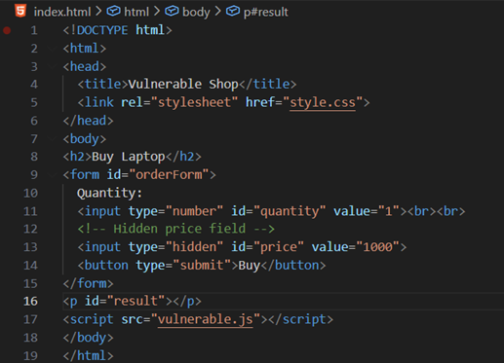
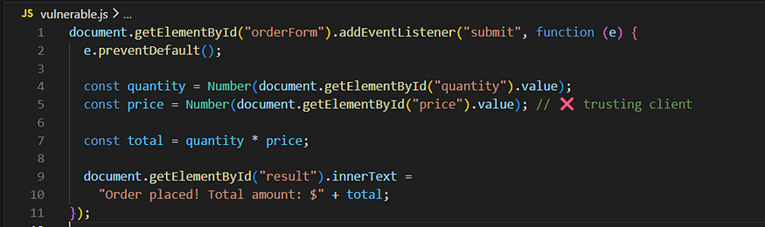
Secure Software Design Principles
Earn Or Give, But Never Assume, Trust

Slide 20
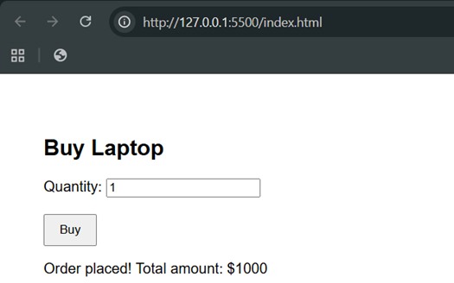
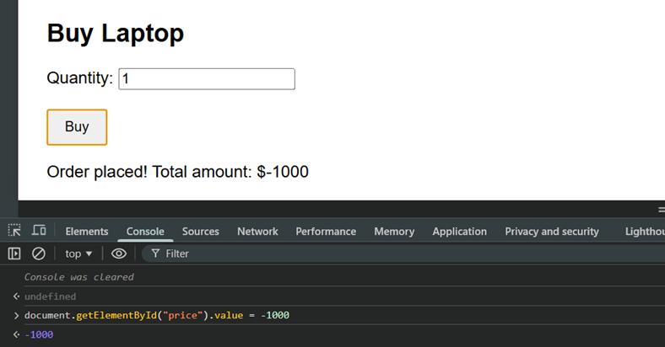
Secure Software Design Principles
Earn Or Give, But Never Assume, Trust

Slide 21
Secure Software Design Principles
Earn Or Give, But Never Assume, Trust
Example:
A web app trusts a hidden form field like isAdmin=true → attacker modifies it and gains admin access.
Demo:
https://www.hack-yourself-first.com/

Slide 22
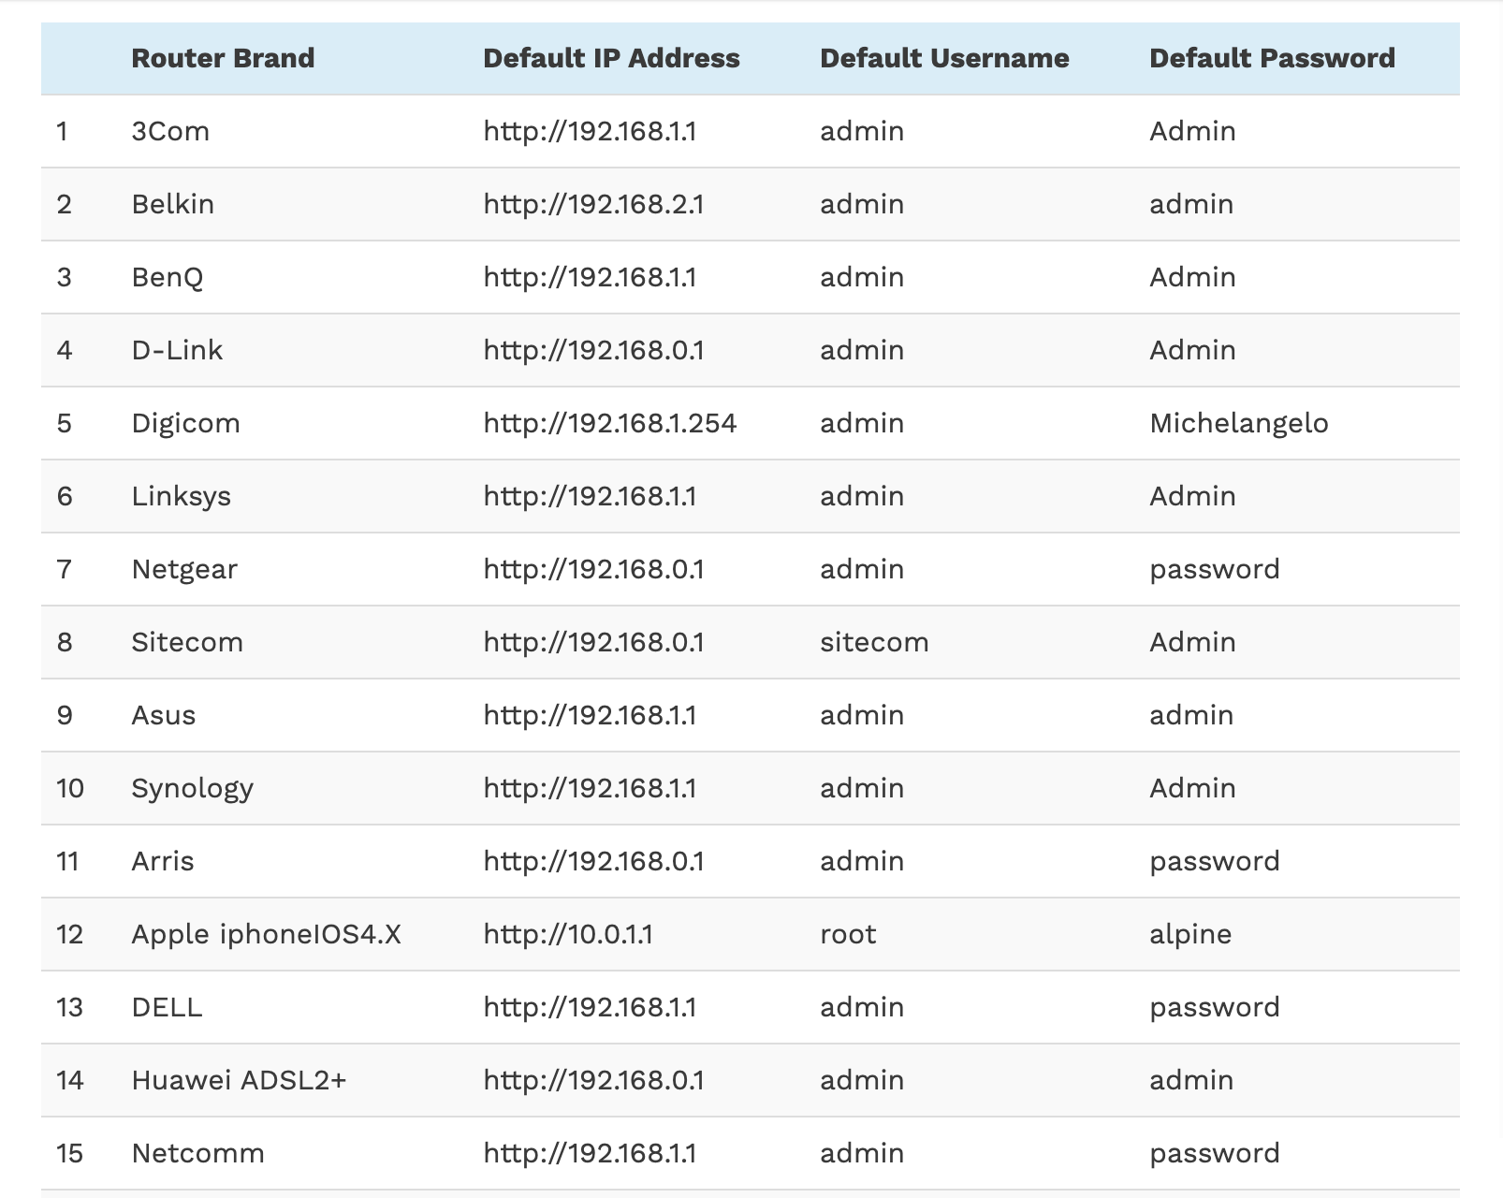

Secure Software Design Principles
Use An Authentication Mechanism That Cannot Be Bypassed Or Tampered With
Default router username and password list.

Slide 23

Secure Software Design Principles
Authorize after you authenticate
Verify identity first, then check permissions
Example:
A logged-in user accesses /user/123/profile and changes 123 to 124 → sees another user’s data

Slide 24
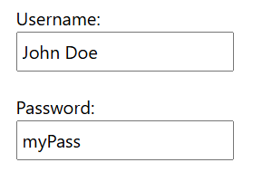
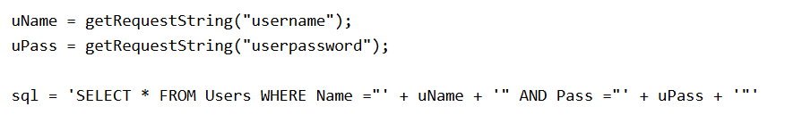
Secure Software Design Principles
Strictly Separate Data and Control Instructions, and Never Process Control Instructions Received from Untrusted Source
Never treat user input as executable commands
Example: SQL Injection Based on OR ""="" is Always True

Slide 25
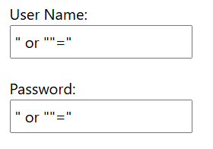
Secure Software Design Principles
Strictly Separate Data and Control Instructions, and Never Process Control Instructions Received from Untrusted Source
Never treat user input as executable commands
Example: SQL Injection Based on OR ""="" is Always True
The SQL above is valid and will return ALL rows from the "Users" table, since OR ""="" is always TRUE.

Slide 26
Secure Software Design Principles
Define an Approach that Ensures all Data are Explicitly Validated
Assume all input is malicious
Constrain, reject, and sanitize your input
Centralize your input filtering approach
Encrypt sensitive data
Use whitelist
...

Slide 27
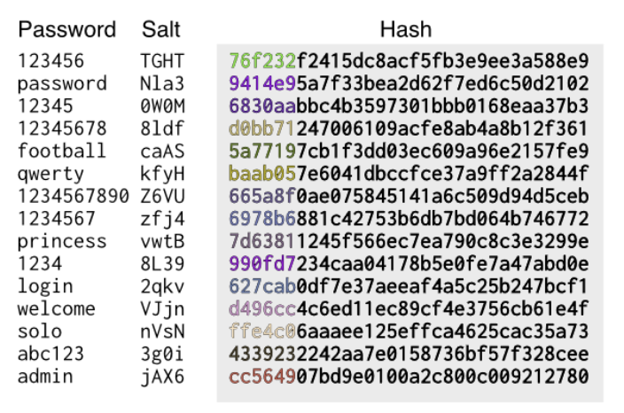
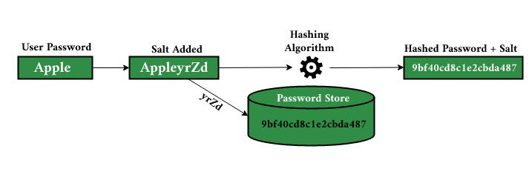
Secure Software Design Principles
Use Cryptography Correctly
Don’t “roll your own crypto” or misuse it
Storing passwords with plain hash instead of salted hash → easily cracked using rainbow tables

Slide 28
Secure Software Design Principles
Use Cryptography Correctly
Don’t create your own cryptographic algorithms or implementations.
Misuse of libraries and algorithms
Poor key management
hard-coding keys into software (often observed in embedded devices and application software)
failure to allow for the revocation and/or rotation of keys
use of cryptographic keys that are weak (such as keys that are too short )
weak key distribution mechanisms

Slide 29
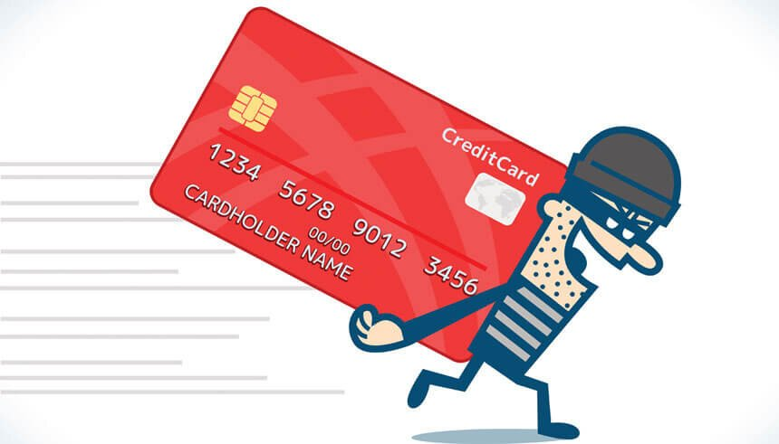
Secure Software Design Principles
Identify Sensitive Data and How They Should Be Handled
Comes from many sources
Users input
Personally-identifiable information (PII) of users
Data computed
Sensors (e.g. geolocation, accelerometer)

Slide 30
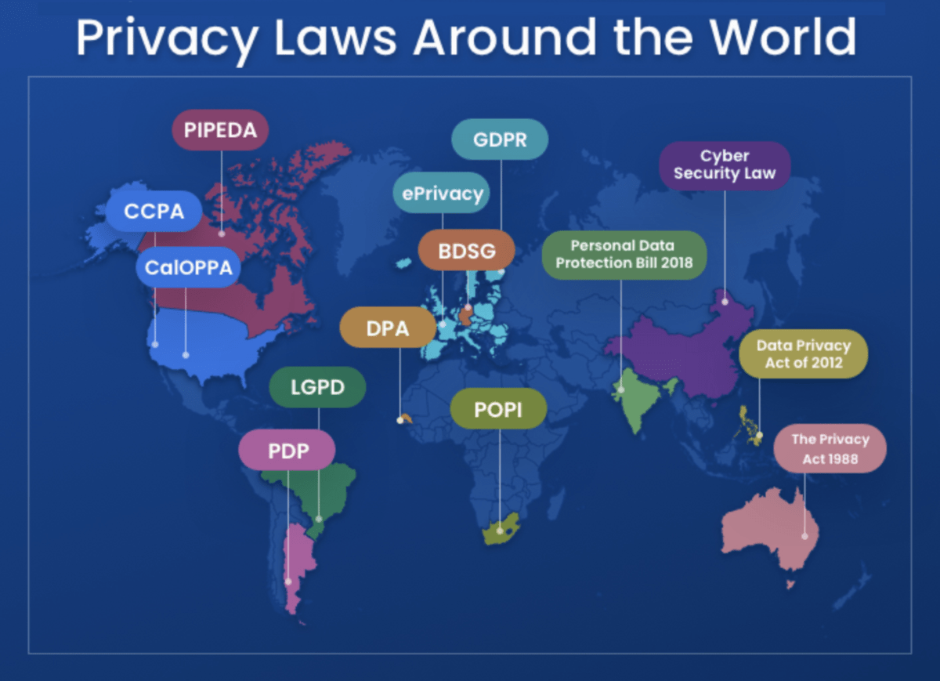
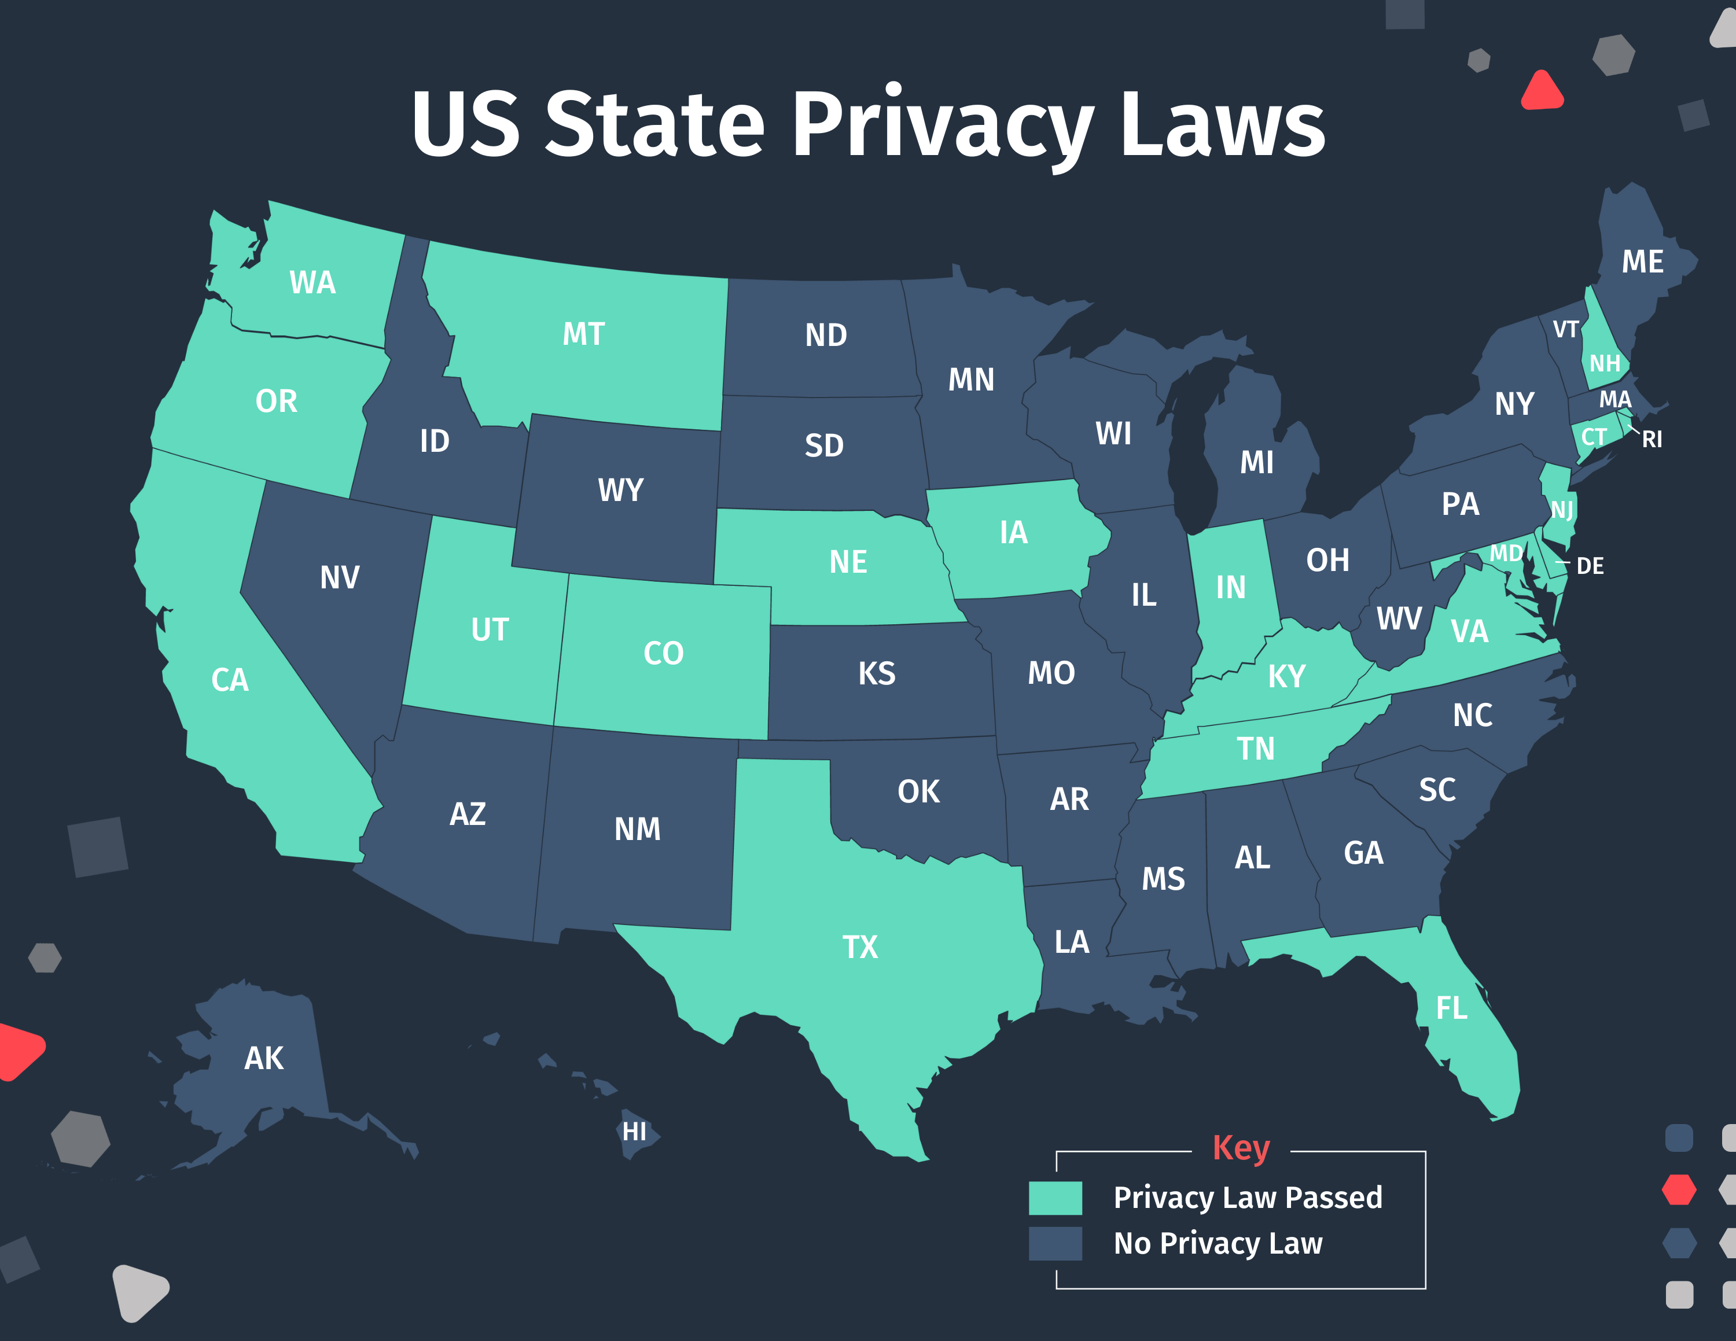
Secure Software Design Principles
Identify Sensitive Data and How They Should Be Handled

Slide 31
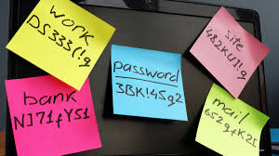
Secure Software Design Principles
Always Consider the Users
Security must align with user behavior
Very complex password rules → users write passwords on sticky notes → reduces security

Slide 32
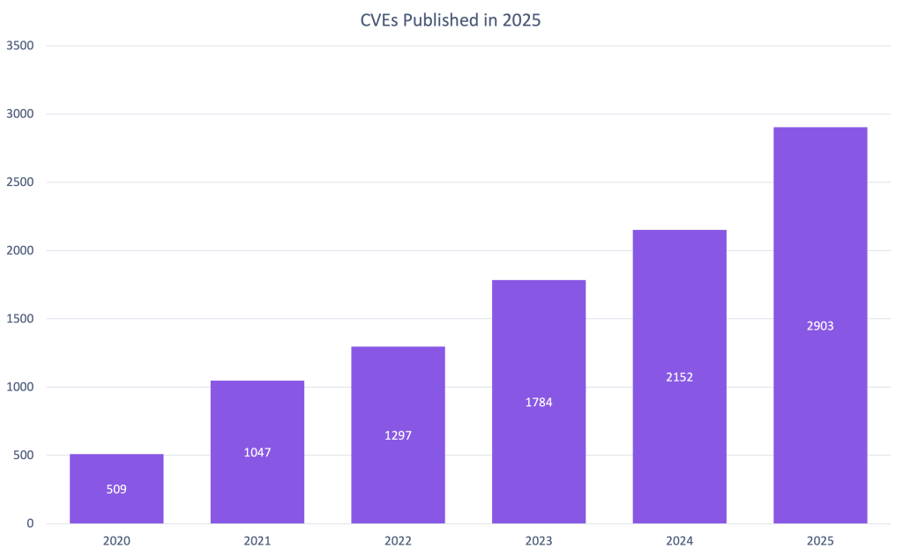
Secure Software Design Principles
Understand How Integrating External Components Changes Your Attack Surface
Third-party libraries introduce risks
The GitHub Advisory Database provides a comprehensive list of known security vulnerabilities and malware affecting open-source packages.

Slide 33
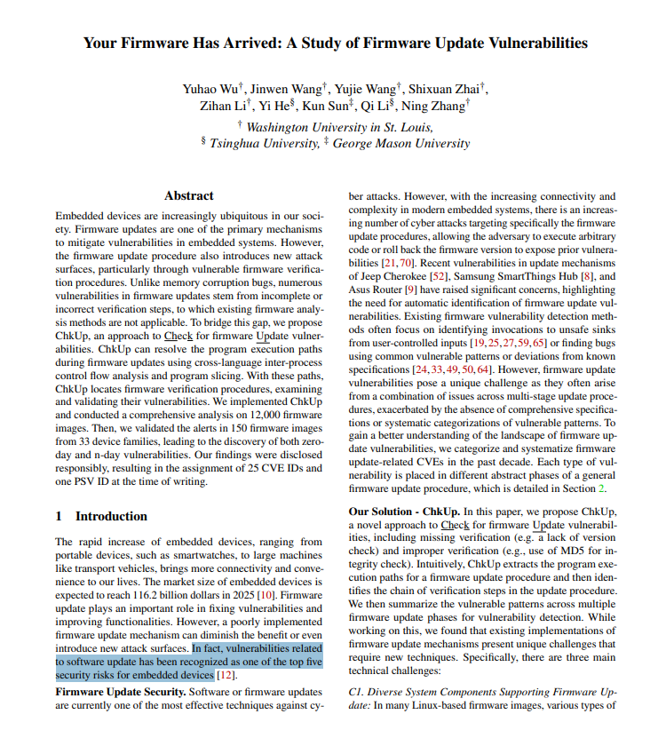

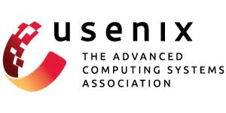
Secure Software Design Principles
Be Flexible When Considering Future Changes to Objects and Actors
Design systems that remain secure when updated
https://www.usenix.org/system/files/sec23winter-prepub-484-wu-yuhao.pdf

