Slide 1
Physical Security
CSC 481/681/781
Principles of Computer Security
Reference: Goodrich and Tamassia: Sections 2.1-2.5

Slide 2
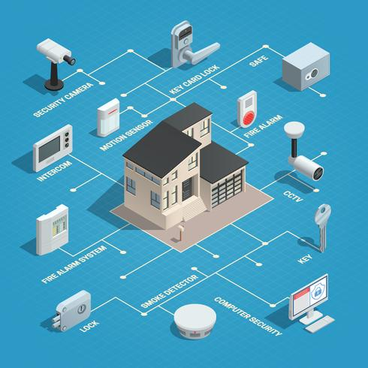
Physical Security
Physical Security - A set of security measures that we put in place to protect our people, equipment, and facilities.
Physical security is the protection of physical items, objects or areas from unauthorized access and misuse.
Physical security involves the protection of three main categories of assets:
  People
  Equipment
  Data
Physical security is often underemphasized by security experts when discussing strategies for protecting critical resources

Slide 3
Physical Security Threats
Weather: Tornadoes, hurricanes, floods, fire, snow, ice, heat, cold, humidity, and so forth
Fire/chemical: Explosions, toxic waste/gases, smoke, and fire
Earth movement: Earthquakes, and mudslides
Structural failure: Building collapse because of snow/ice or moving objects (cars, trucks, airplanes, and so forth)
Energy: Loss of power, radiation, magnetic wave interference, and so forth
Biological: Virus, bacteria, infestations of animals or insects.
Human: Strikes, sabotage, terrorism, and war

Slide 4
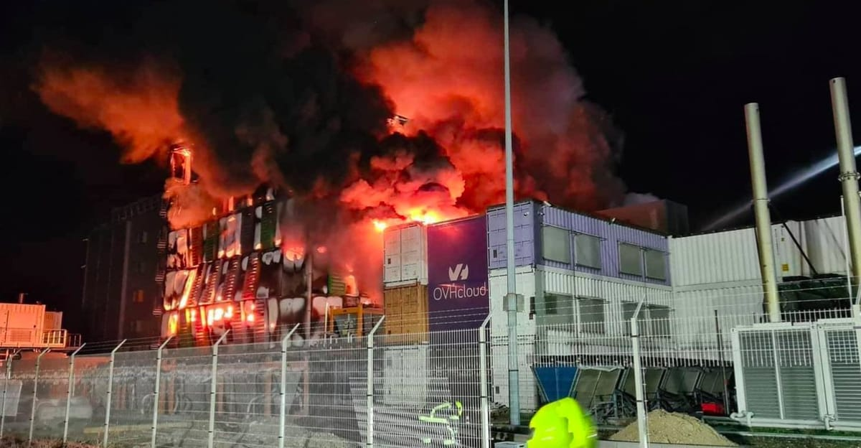
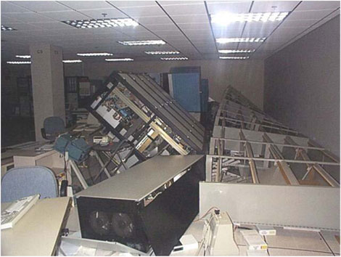
Physical Security Threats
In 2021, an OVH Cloud data center in France burned down, many customer websites and data were permanently lost.
2011 Japan earthquake damaged many enterprise data centers, companies lost entire server floors.

Slide 5
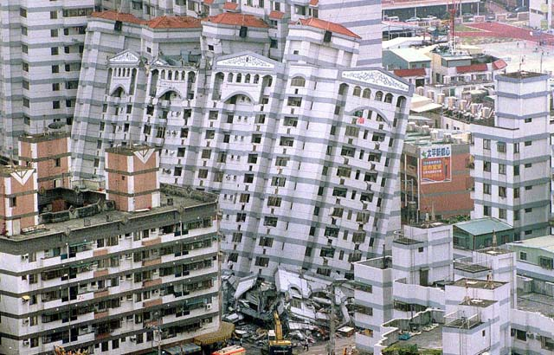
Physical Security Threats
A Taiwan bank had storage racks collapse during an earthquake (1999 Jiji earthquake).
Backup tapes were physically broken and scattered outside the secure vault.
Some tapes were later found by civilians — exposing customer transaction records.

Slide 6



Physical Security Threats
Gift Card Tampering & Draining Attack
The criminals carefully open the packaging and record the card number + PIN;
They reseal the package, so it looks brand new
A legitimate customer buys the card and load money onto the card;
Criminals immediately drain the funds;
Never attempt anything like this in real life! Gift card fraud can be a felony!

Slide 7
Physical Security for Storage Devices
Efficient space management can leave security vulnerabilities...
Physical access gives raw access to disk sectors
  Unless: Self-Encrypting Drives (SEDs) (or other disk encryption)
Disk sector issues
  Deleting a file doesn’t erase data! Just re-sets pointers.
    Good O.S. will not let old data be seen – normally!
      Bypass O.S. protections with physical access / Live CD
    Norton made a lot of money with “undelete” utilities!
    Forensics software good at recovering traces of old data
    Windows with “recycle bin” even worse!
  “Slack space” issues: Even if sector reused, may contain old data past the end of the file

Slide 8
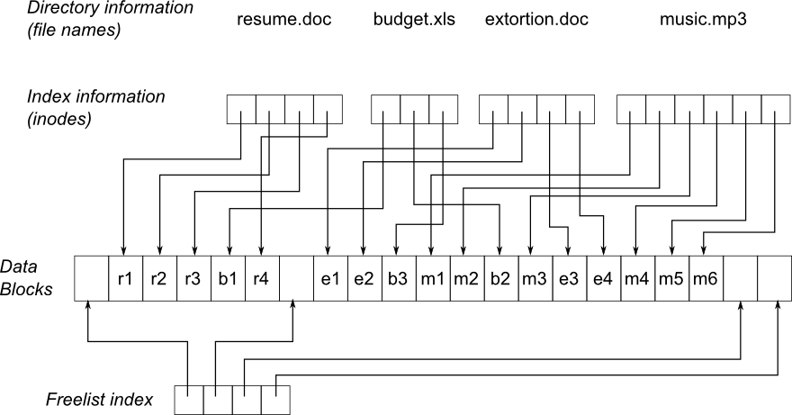
What happens when you delete a file?
(and really delete - not just move to trash can!)
Typical filesystem - Uh Oh! Better delete extortion.doc!

Slide 9
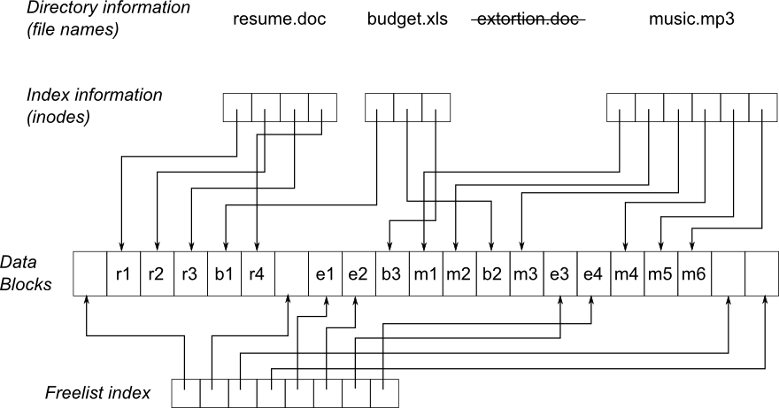
What happens when you delete a file?
(and really delete - not just move to trash can!)
What really happened? Removed name and shifted data blocks to the free list.

Slide 10
More on Physical Storage Media
Magnetic/Optical Remanence for traditional hard drives
  Even if a file has been overwritten, traces may still be there
    Disk heads move, and probably aren’t in exactly the same place on a write and an overwrite
  Secure delete utilities should be used
    Re-formatting is not enough!
    Typical: Overwrite with 0’s, then 1’s, then random data (repeat!)
    Example: GNU utility “shred” – careful with some filesystems!
  For very sensitive data: Physically destroy device
  Optical Media (CD-R, etc.) – can get shredders for this!
Story 1: Research study bought 100 hard disks from on-line auction site – 70% had recoverable, sensitive data
Story 2: 2nd hand computer sold by bank in 2000 had Paul McCartney’s banking details on it!

Slide 11
Physical Security Controls
Physical Security Controls : are the devices, systems, people, and methods you put in place to ensure your physical security.
Classification by Security Function:
Deterrent controls - discourage people from violating the security controls.
Detective controls - sense and report undesirable events.
Preventive controls - physical means to keep unauthorized entities from breaching your physical security.

Slide 12
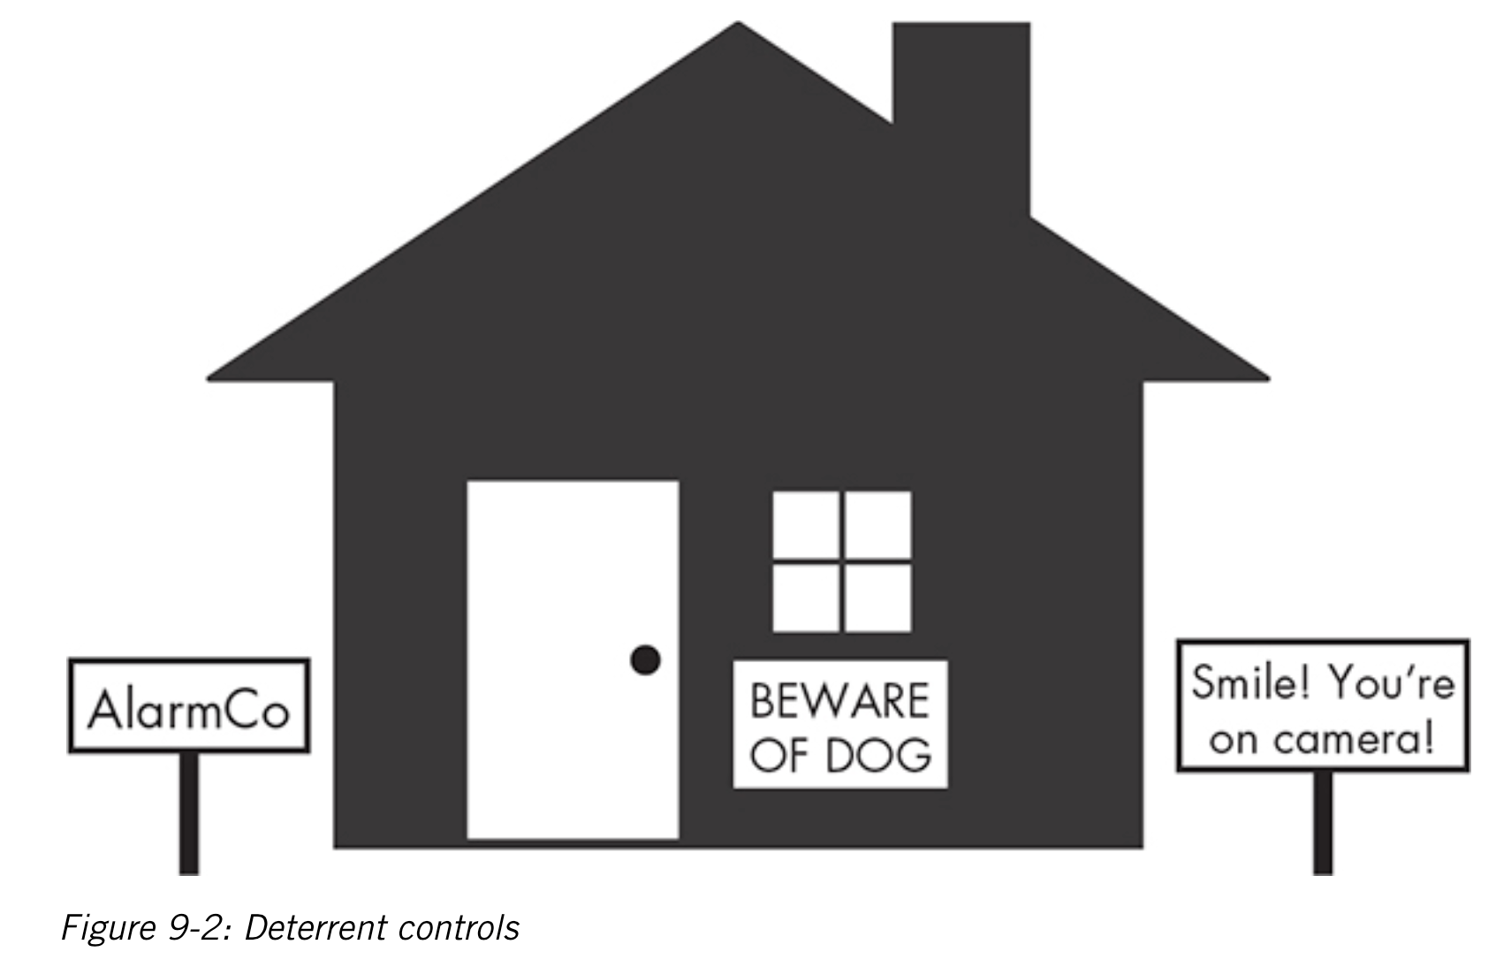
Physical Security Controls
Deterrent Controls
Deterrent controls - discourage people from violating the security controls.
These controls do not prevent people from acting in an undesirable fashion.

Slide 13
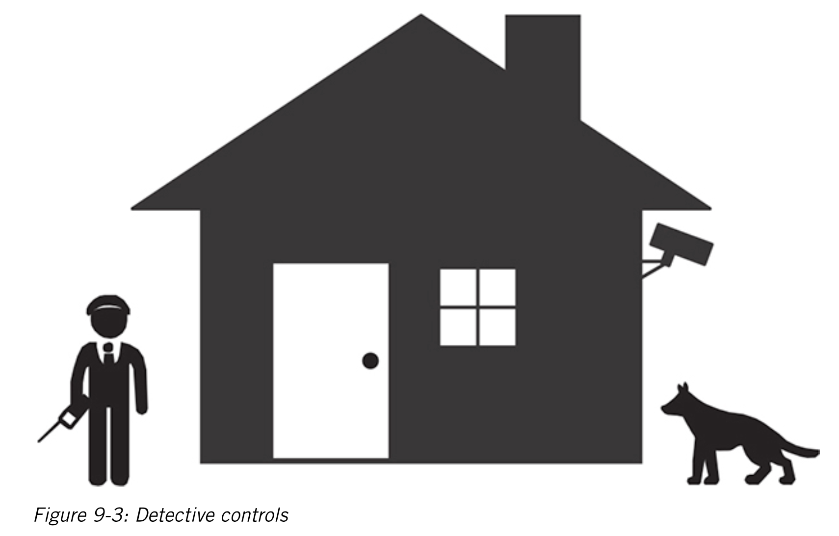
Physical Security Controls
Detective Controls
Detective controls - sense and report undesirable events.
These systems typically check for indicators of unauthorized activities.

Slide 14
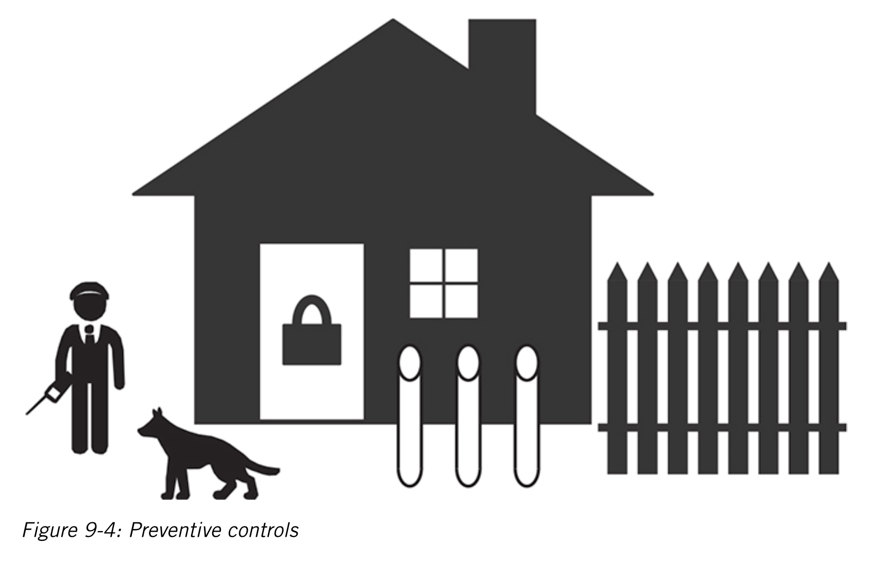
Physical Security Controls
Preventive Controls
Preventive controls - physical means to keep unauthorized entities from breaching your physical security.

Slide 15
Physical Security Controls
Physical Security Controls : are the devices, systems, people, and methods you put in place to ensure your physical security.
Classification by Control Type:
Educating personnel
Administrative controls
Physical security controls
Technical controls
Environmental/Life-safety control

Slide 16

Physical Security Controls
Educating Personnel
An educated staff is the best weapon a company can have against illegitimate and accidental acts by others
– Being mindful of physical and environmental considerations required to protect the computer systems
– Adhering to emergency and disaster plans;
– Monitoring the unauthorized use of equipment and services;
– Recognizing the security objectives of the organization;
– Accepting individual responsibilities associated with their own security as well as the equipment they use

Slide 17
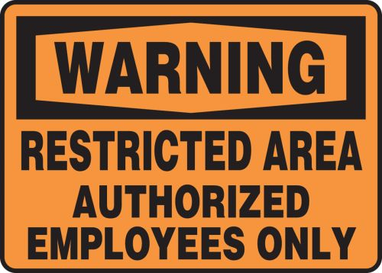
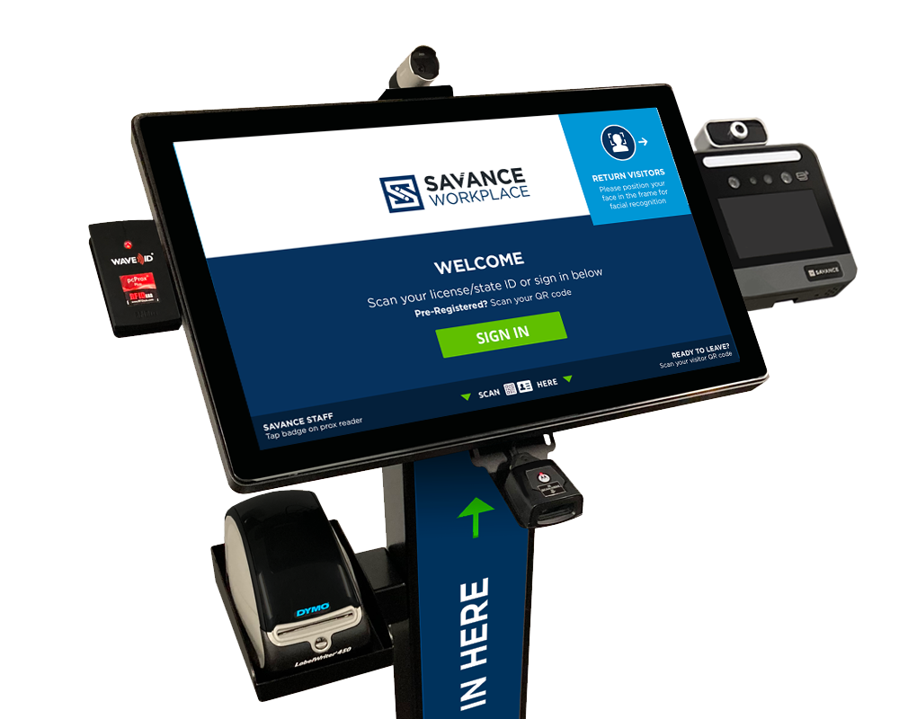
Physical Security Controls
Administrative Access Controls
Restricting Work Areas
Escort Requirements and Visitor Control
Site Selection
– Visibility
– Locale considerations
– Natural disasters
– Transportation

Slide 18
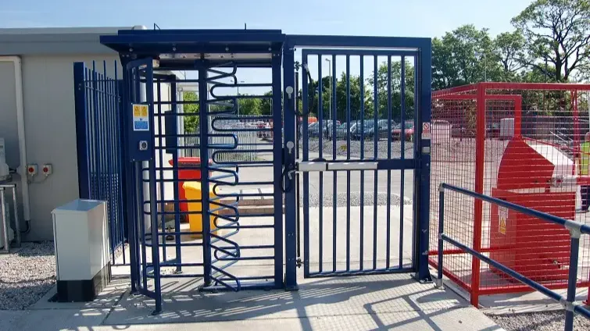

Physical Security Controls
Physical Security Controls
Perimeter Security Controls
– prevent unauthorized access to the facility
Include gates, fences, turnstiles, and mantraps
Badging
– The photo identification badge not only authenticates an individual but also continues to identify the individual while inside the facility
Keys and Combination Locks
– Keys and combination locks are the least complicated and least expensive devices
Security Dogs
Lighting

Slide 19
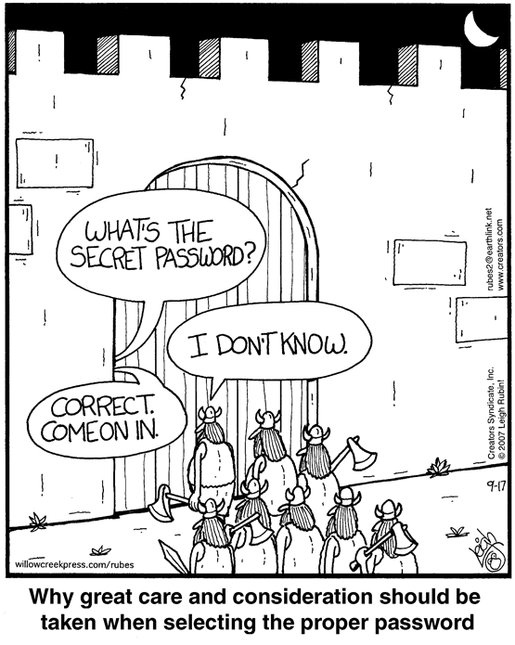
About passwords
Benefits
Don’t need physical object
Hard to steal
  Easy to extort though...
Drawbacks
Memorability vs Guessability
What if you forget?!?
  Alternative access method?
Passive (observation) attacks

Slide 20
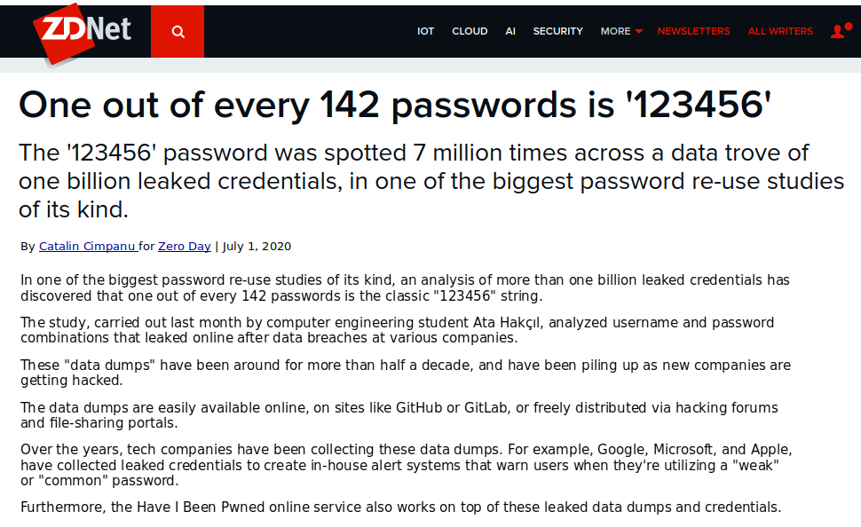
Something You Know
About passwords…
People pick bad passwords if they are allowed to

Slide 21
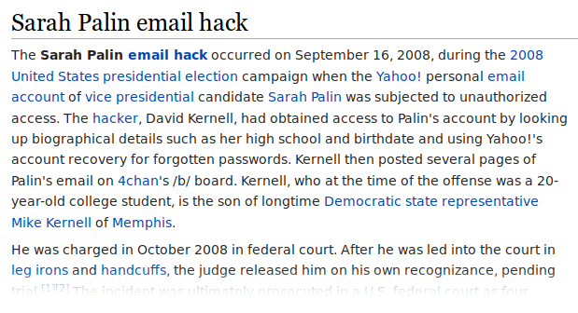
Something You Know
Warning about “alternative access methods”
But even strong passwords don’t work if easy alternative method...

Slide 22
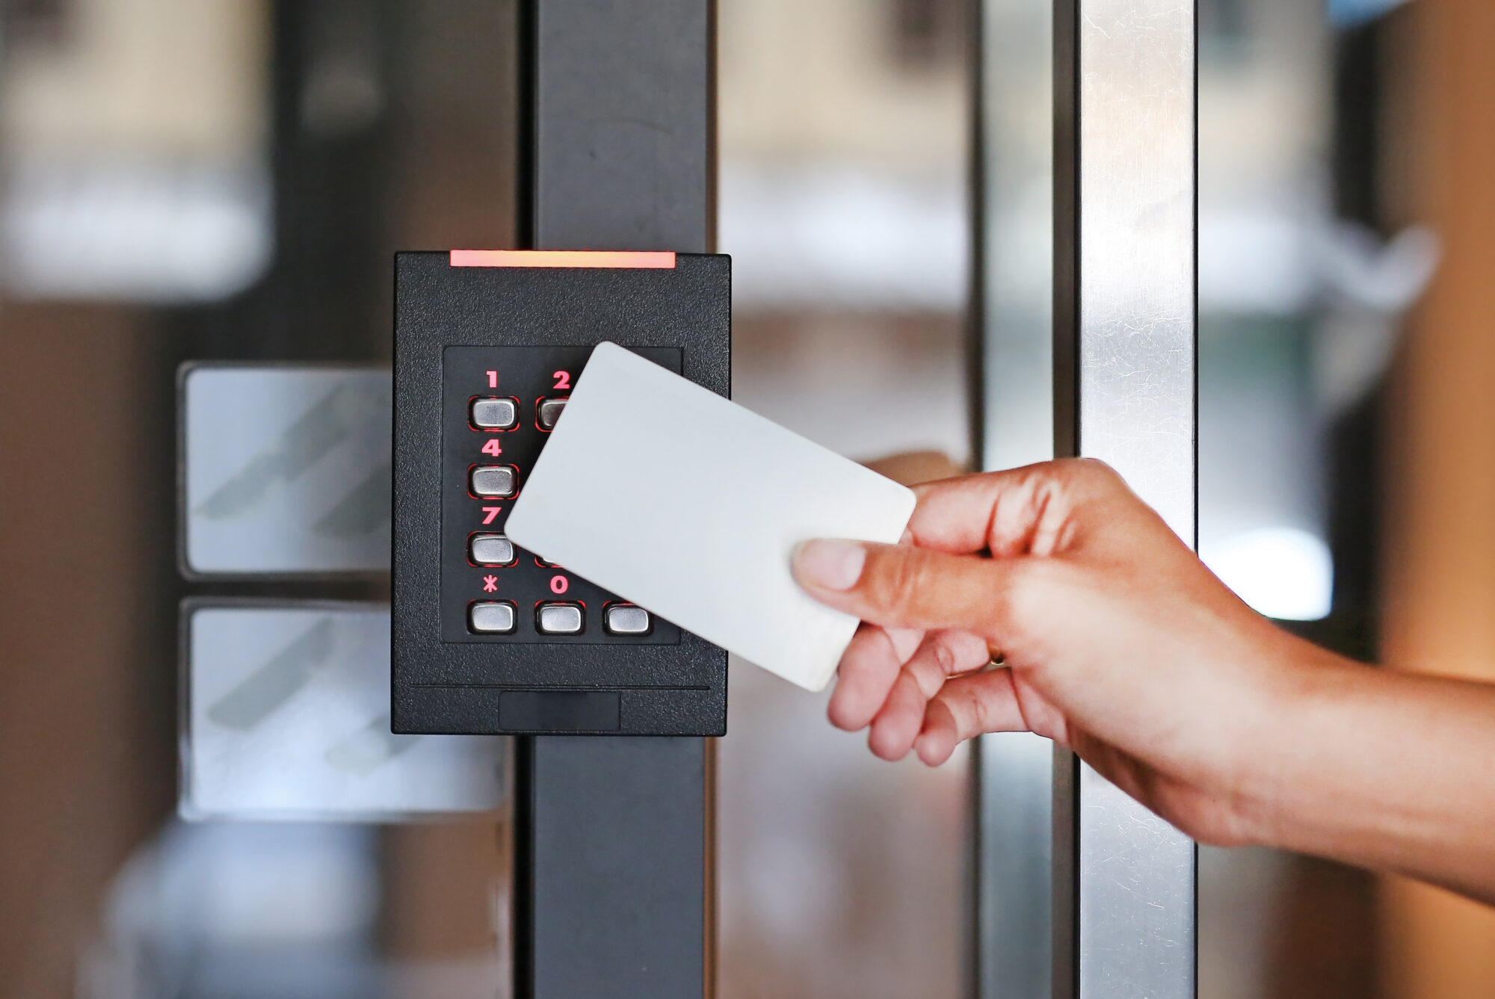
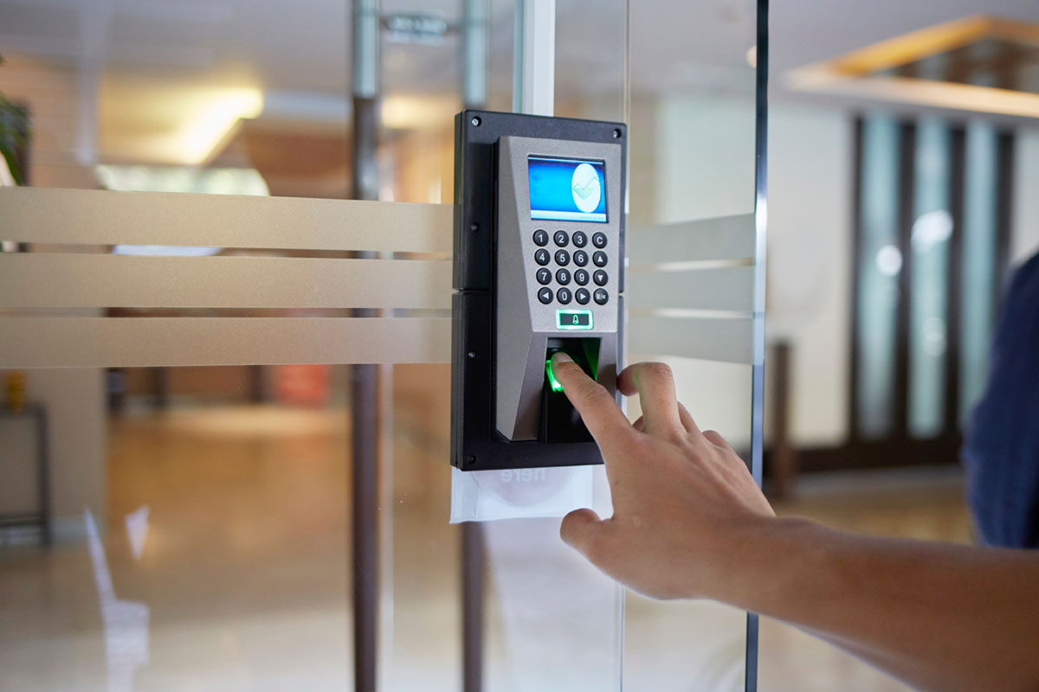


Physical Security Controls
Technical Controls
The more prominent technical controls include
– Smart/Dumb cards
– Audit trails/access logs
– Intrusion detection
– Biometric access controls

Slide 23



Physical Security Controls
Environmental/Life-Safety Controls
The three most critical areas are
– Power (electrical, diesel)
– Fire detection and suppression
- Fire types
- Fire detectors
- Fire-extinguishing systems
– Heating, ventilation, and air conditioning

Slide 24
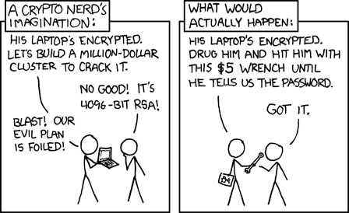
Protecting Physical Security
Protecting People
During an emergency, you should prioritize evacuating people from the facility, not saving the equipment.

Slide 25
Protecting Physical Security
Protecting Data
We need to keep the physical storage media safe against attackers, unfavorable environmental conditions, and other threats.
Physical concerns for data:
Magnetic media - strong magnetic fields can harm hard drives, tapes, floppy disks.
Optical media, CDs and DVDs, is fragile.
Accessibility of Data - Preserve sensitive data by maintaining copies in physically separated locations.

Slide 26
Protecting Physical Security
Protecting Data – Data Backup
Backup is a duplicate copy of key information such physical (paper) and computer records.
A good set of back procedures is necessary to ensure that data is protected.
You should consider following factors in creating a backup plan:
Schedule of Backup
Backing up data should be done at a convenient time.
Location of Backup Storage
Highly recommended that data backup is stored remotely in case of a natural disaster
Data Backup Contents
Frequency of Backups
Backup media

Slide 27
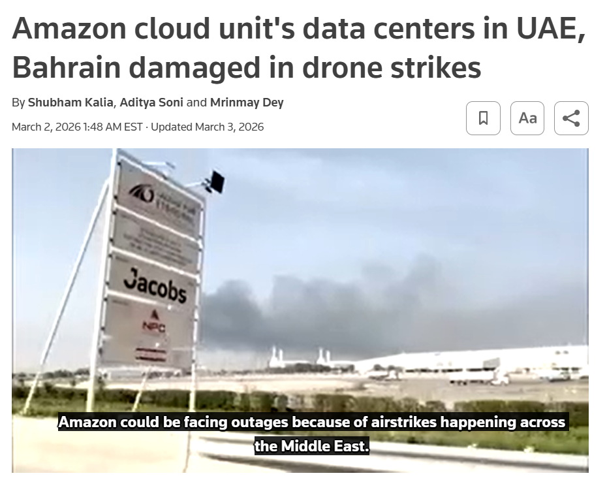
Protecting Physical Security
Protecting Data – Data Backup

Slide 28
Protecting Physical Security
Protecting Data – Data Backup
Types of Backup:
Full Backup
Back up all data from the hard disk or a directory or folder of the hard drive.
Incremental Backup
Only backs up data that changed since the last backup.
Restore: Full backup + every incremental backup since then.
Differential Backup
Backs up all changes since the last full backup.
Restore: Full backup + latest differential backup.

Slide 29
Protecting Physical Security
Protecting Equipment
Protect your equipment and the facilities that house it.
Physical concerns for equipment:
Extreme temperatures
Liquids
Living organisms (chew on wiring...)
Movement
Energy anomalies (loss of power, electrical surge...)
Smoke and fire (may introduce extreme temperatures)

