Slide 1
Cryptography
Security Concepts (Security Games)
CSC 481/681/781
Principles of Computer Security

Slide 2
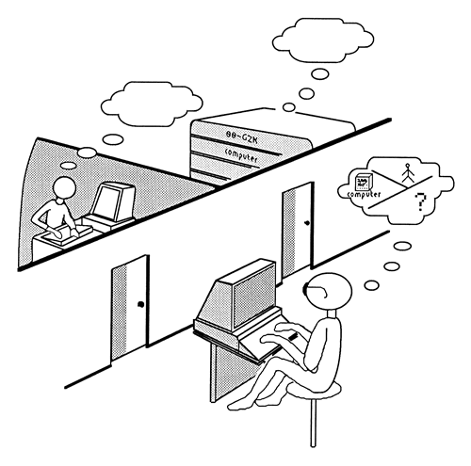
Models of Security
An “Imitation Game”
The Turing Test for Artificial Intelligence
Basic idea: An "interrogator" is communicating with either a person or a computer - can they tell the difference?
Some basic points:
If conversing with a computer is indistinguishable from conversing with a human, is the computer intelligent?
Oddly enough, computer might have to dumb-down some responses: "What is 1591356 times 672435?"
Is this different from a computer "understanding" a conversation?

Slide 3


Indistinguishability in Cryptography
Cryptographically-Secure Pseudorandom Number Generator
A PRNG is “cryptographically secure” if no polynomial-time attacker can tell the difference between a true RNG and the PRNG.
Formally, we define a game:
“Game master” picks a random bit b (0 or 1)
Adversary asks for a string of bits
If b=0 then
GM sends random {0,1}^{n}
else
GM picks x in {0,1}^{s} randomly and sends PRNG(x)
Adversary receives r and gives guess g=A(r) for b
Adversary “wins” if g=b
PRNG is secure if no polynomial-time adversary can win with probability significantly more than ½ (a wild guess).
Pseudo
RNG
True
RNG
??

Slide 4
Indistinguishability in Cryptography
Secure Encryption - A Chosen Plaintext Game
Game Master
Adversary
Pick random encryption key k and random bit b
Compute q₁ (“query 1”).
Ask: What is the encryption of q₁?
The answer is r₁
Compute response r₁ = E(k,q₁)
Compute q₂ (“query 2”).
Ask: What is the encryption of q₂?
The answer is r₂
Compute response r₂ = E(k,q₂)
Repeat polynomially many times, as needed...
Compute challenge plaintexts p₀ and p₁
(p₀,p₁)
The answer is c
Compute response c = E(k,p_{b})
Compute guess g (possibly asking more queries)

Slide 5
Indistinguishability in Cryptography
Secure Encryption - A Chosen Plaintext Game
Game Master
Adversary
Pick random encryption key k and random bit b
Compute q₁ (“query 1”).
Ask: What is the encryption of q₁?
Adversary wins if g=b
Scheme is secure if no polytime adversary can win with probability non-negligibly greater than ½
This is called IND-CPA security
Equivalent to semantic security!
Compute response r₁ = E(k,q₁)
The answer is r₁
Compute q₂ (“query 2”).
Ask: What is the encryption of q₂?
The answer is r₂
Compute response r₂ = E(k,q₂)
Repeat polynomially many times, as needed...
Compute challenge plaintexts p₀ and p₁
(p₀,p₁)
The answer is c
Compute response c = E(k,p_{b})
Compute guess g (possibly asking more queries)

Slide 6
Indistinguishability in Cryptography
Secure Encryption - A Chosen Plaintext Game
Consider this game when Encryption E is deterministic: (key, plaintext) pair always produces the same ciphertext
Game Master
Adversary
Pick random encryption key k and random bit b
Let q₁ = 0^{n} (string of n zero bits)
Ask: What is the encryption of q₁?
The answer is r₁
Compute response r₁ = E(k,q₁)
Compute challenges p₀=0^{n} and p₁=1^{n}
(p₀,p₁)
The answer is c
Compute response c = E(k,p_{b})
If c=r₁, then guess 0 - else guess 1
Bottom line: No deterministic encryption can have semantic security!
Bottom line 2: Random IVs and initial counter values are absolutely vital.

Slide 7
Indistinguishability in Cryptography
Secure Encryption - A Chosen Ciphertext Game
What if the adversary can ask the game master for decryptions?
Need to be a little more careful about how you design the game:
Adversary can choose arbitrary ciphertexts and ask for decryptions - can also still ask for encryptions
Adversary picks challenge pair of plaintexts: (p₀, p₁)
Game master encrypts a randomly-chosen p₀ or p₁ and sends back c
Adversary can ask more queries - but not for decryption of ciphertext c
Adversary guesses which plaintext was encrypted
If no polynomial-time adversary can win with non-negligible probability: IND-CCA2 secure
Equivalent to non-malleable security
Intuition: In step 4, can the adversary “tweak” challenge ciphertext c so that it is different (so decryption is allowed), but produces a recognizable change to decrypted plaintext?

Slide 8
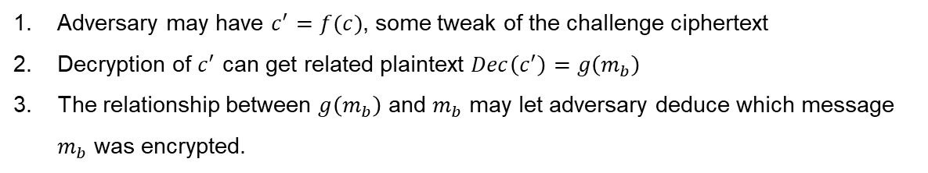
Indistinguishability in Cryptography
Secure Encryption - A Chosen Ciphertext Game
Intuition: In step 4, can the adversary “tweak” challenge ciphertext c so that it is different (so decryption is allowed), but produces a recognizable change to decrypted plaintext?
Adversary may have $c^{′}=f(c)$, some tweak of the challenge ciphertext
Decryption of $c^{′}$ can get related plaintext $Dec\left(c^{′}\right)=g\left(m_{b}\right)$
The relationship between $g\left(m_{b}\right)$ and $m_{b}$ may let adversary deduce which message $m_{b}$ was encrypted.
This is exactly why CPA security is insufficient.

Slide 9
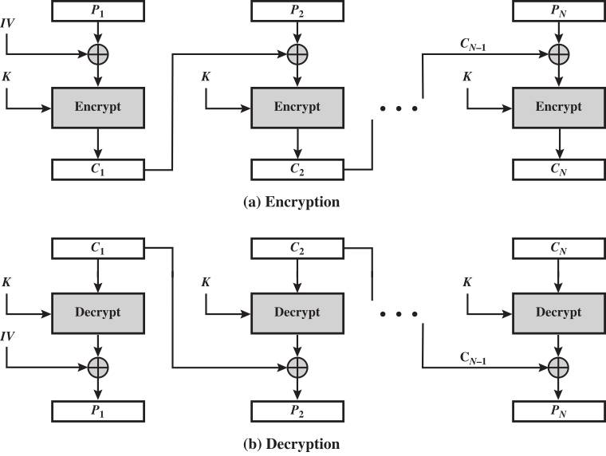
Let’s Review…
Cipher Block Chaining (CBC) Mode
IV must be random
Not sensitive
Transmit with ciphertext
Best not to repeat...
Randomizes next block
Breaks up pattern
Changing block affects all following blocks
But: Can’t parallelize
Not CCA-secure (malleable)
Padding oracle attack (2002)
Breaking assumptions
BEAST attack (2011)

Slide 10
Theory vs Practice
(Really: Misunderstand the theory in practice….)
Fact: If X is a block cipher that is a pseudorandom function, then X-CBC (using X in CBC mode) with random IVs is IND-CPA secure.
This does not mean that any way you can use of X in CBC mode is secure!
Two examples of misusing CBC mode:
Allowing cases in which the same IV can be reused (e.g., error retransmissions from the middle of a long plaintext)
Leads to the BEAST attack on SSL
Misinterpreting IND-CPA to mean simply “X-CBC is secure” and thinking it’s non-malleable (it’s not - winning IND-CCA2 adversaries exist)
Leads to padding oracle attacks

Slide 11
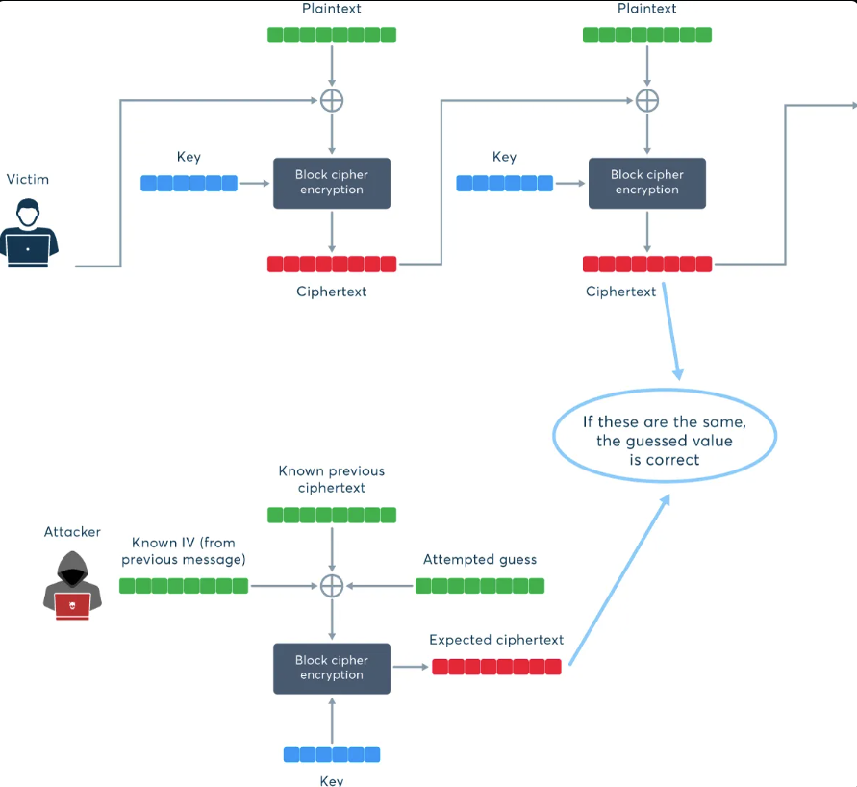
The BEAST Attack
Browser Exploit Against SSL/TLS - from 2011
Observe the encrypted traffic (passive attacker).
Inject chosen plaintext into the victim’s data stream.
Use the predictable/known CBC IV to get the expected ciphertext.

Slide 12
More Review…
Cipher Block Chaining (CBC) Mode - Padding
ECB and CBC modes must encrypt full blocks of plaintext!
What if you have 192 bits of plaintext with AES/CBC? 128+64 bits
Technique 1 (bit padding):
No matter how long the plaintext, always append a 1 bit, followed by as many 0’s as needed to fill out block.
Example: 8-bit blocks, 10111010 110 becomes 10111010 11010000
Advantage: plaintext can be any number of bits
Question: Why “always append 1”? What if plaintext is already a multiple of block size?
Technique 2 (byte count padding - or PKCS#7 / PKCS#5):
Count how many bytes of padding needed (at least 1), say c
Add c bytes each with value c
Ex (32-bit blocks, hex): 42 1a 49 c3 21 becomes 42 1a 49 c3 21 03 03 03
Only works for padding full bytes! (Note: Used by Java Crypto Architecture)

Slide 13
Cipher Block Chaining (CBC) Mode
Padding Oracle Attack
Important part: By changing bits in C_{N-1} before received, can change specific bits in the final block decrypted by the receiver!
PKCS #7 padding says what the final byte can be. Either 01 (if only byte of padding) or 02..10 if previous byte is the same.
“Oracle” tamper with ciphertext and see if it decrypted successfully (was there a retransmit)?
Tamper with the last two bytes of C_{N-1} to determine last byte of P_{N}
Then previous two bytes to determine next-to-last byte of P_{N} - repeat indefinitely!

Slide 14
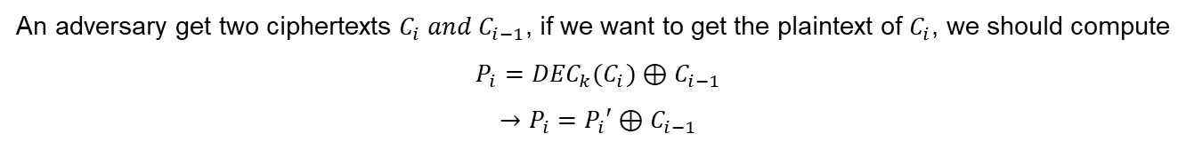
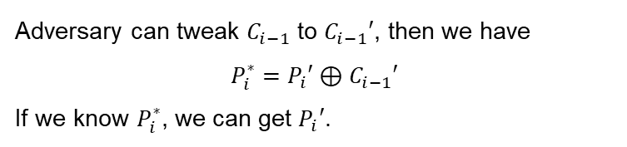

Cipher Block Chaining (CBC) Mode
Padding Oracle Attack
An adversary get two ciphertexts $C_{i} and C_{i−1}$, if we want to get the plaintext of $C_{i}$, we should compute
$$P_{i}={DEC}_{k}(C_{i})⊕C_{i−1}$$
$$→P_{i}=P_{i}′⊕C_{i−1}$$
It is impossible to infer $P_{i}′$ from $C_{i}$.
Adversary can tweak $C_{i−1}$ to $C_{i−1}′$, then we have
$$P_{i}^{∗}=P_{i}′⊕C_{i−1}′$$
If we know $P_{i}^{∗}$, we can get $P_{i}′$.

Slide 15
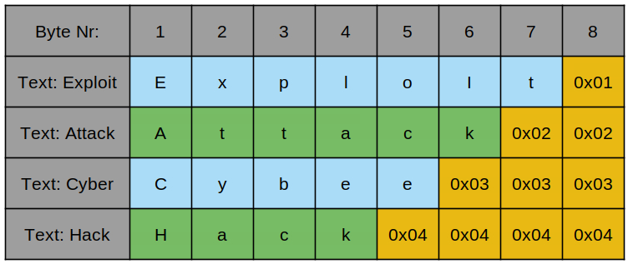
Cipher Block Chaining (CBC) Mode
Padding Oracle Attack
PKCS#7 Padding Scheme
What is a Padding Oracle?
System would response a response (e.g., error message, TLS error codes) if the decrypted plaintext has an invalid padding.

Slide 16
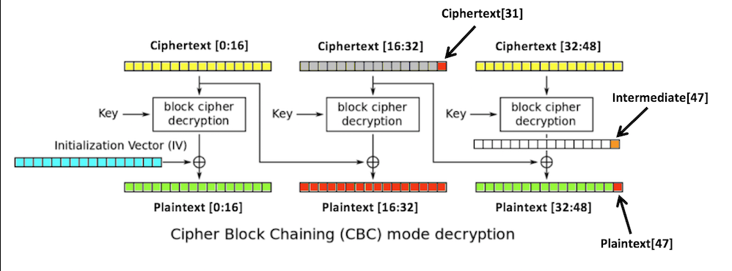
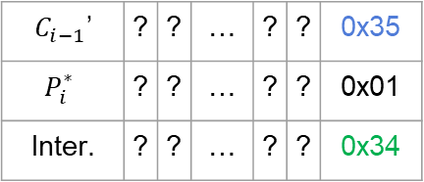
Cipher Block Chaining (CBC) Mode
Padding Oracle Attack
$$P_{i}^{∗}=P_{i}′⊕C_{i−1}′$$
Modify from the last byte of $C_{i−1}$ from 0x01 to 0xff, increasing by 1 per time.
Until there is no padding error from the system, it signifies correct padding.
$C_{i−1}$’ | ? | ? | … | ? | ? | 0x35
$$P_{i}^{∗}$$ | ? | ? | … | ? | ? | 0x01
Inter. | ? | ? | … | ? | ? | 0x34

Slide 17
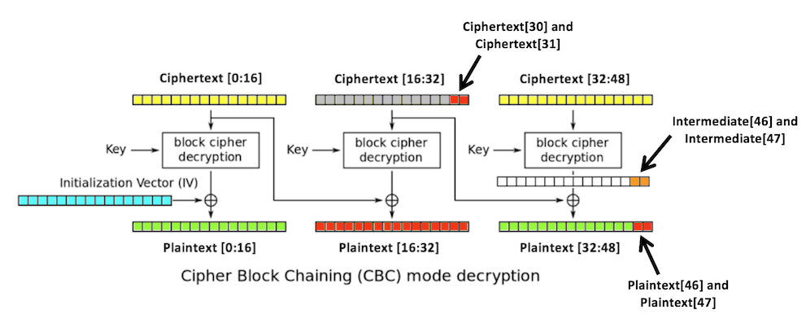
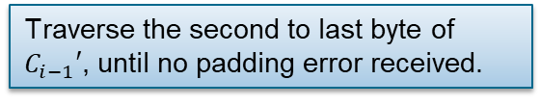
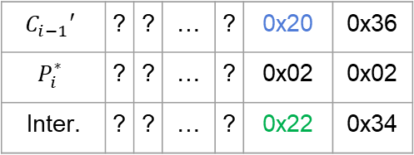
Cipher Block Chaining (CBC) Mode
Padding Oracle Attack
$$C_{i−1}′$$ | ? | ? | … | ? | 0x20 | 0x36
$$P_{i}^{∗}$$ | ? | ? | … | ? | 0x02 | 0x02
Inter. | ? | ? | … | ? | 0x22 | 0x34
Traverse the second to last byte of $C_{i−1}′$, until no padding error received.

Slide 18
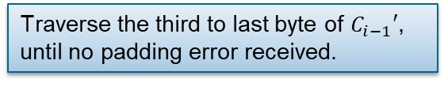
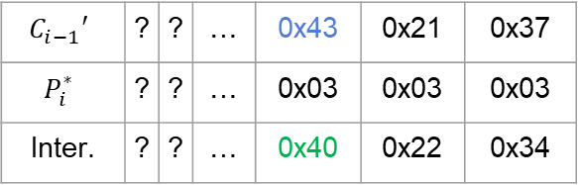
Cipher Block Chaining (CBC) Mode
Padding Oracle Attack
$$C_{i−1}′$$ | ? | ? | … | 0x43 | 0x21 | 0x37
$$P_{i}^{∗}$$ | ? | ? | … | 0x03 | 0x03 | 0x03
Inter. | ? | ? | … | 0x40 | 0x22 | 0x34
Traverse the third to last byte of $C_{i−1}′$, until no padding error received.

