Slide 1
Cryptography
Probability Basics
CSC 481/681
Principles of Computer Security

Slide 2
Randomness
The Importance for Security
Where do keys come from? Ideally: Random!
Randomness comes up a lot in security. Why?
Unpredictability: Values you don’t want an attacker to guess (security tokens, cryptographic keys, cut-and-choose, …)
High-Probability Uniqueness: Ensuring that a value used by a security protocol hasn’t been used before (duplicates in some protocols are disastrous!)
We need to be able to talk about random selection, “quality of randomness”, etc.
Next: Review of some probability theory

Slide 3
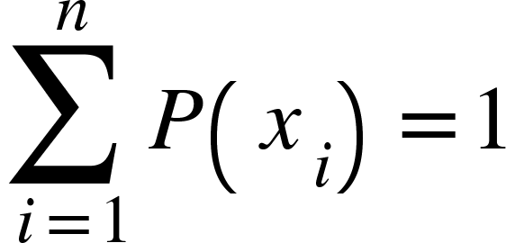
Probability Theory
A quick review of terms and concepts
A probability space is (slightly simplified definition):
A set of outcomes of an experiment (the sample space S)
A probability distribution maps outcomes to probabilities (P: S→[0,1])
We are interested in finite probability distributions
The sample space is finite: S = {x₁, x₂, ..., x_{n}}
Sum of probabilities is 1:
Example 1: A fair coin toss
S = {H, T }
For all x: P(x) = ½
Example 2: n (independent - will define later!) random bits (n-bit key)
S = { 00..00, 00..01, ... , 11..10, 11..11} (all possible n-bit values)
For all x∊S: P(x) = 1/2^{n}

Slide 4
Probability Theory
A quick review of terms and concepts - continued
Example 3: Win/loss outcomes in a 2-of-3 contest, win favored ¾
S = {WW, LWW, WLW, WLL, LWL, LL}
P(WW)=9/16, P(LWW)=9/64, P(WLW)=9/64, P(WLL)=3/64, P(LWL)=3/64, P(LL)=1/16
Example 4: General uniform distribution over m
S = {x₁, x₂, ..., x_{m}}
For all x∊S: P(x)=1/m (denote this U_{m} – so U_{m}(x)=1/m for all x)
An event in a probability space is a subset of events. Probability of the event is the sum of probabilities of outcomes in the event.
Event example: Event in “Example 3” could be “I win 2 of 3”
A = { WW, WLW, LWW }
P(A) = P(WW) + P(WLW) + P(LWW) = 9/16 + 9/64 + 9/64 = 54/64
Some possible events: “First bit of the key is 0”, “Roll a 7 or 11”, ...

Slide 5
Probability Theory
A quick review of terms and concepts - continued
Independent events: Good intuitive concept - formally, two events A and B are independent if and only if
P(A ∩ B) = P(A) ∙ P(B)
A random variable is really a function V that assigns a numerical value to each possible outcome of a random experiment: S → ℝ
Example 1: Number of heads in 3 coin tosses
Example 2: Sum of values on 2 dice
Example 3: Running time of randomized algorithm
The expected value of random variable V is
Typically sum over possible V values as events - H = # heads in 3 tosses:
E[H] = ⅛ ∙ 0 + ⅜ ∙ 1 + ⅜ ∙ 2 + ⅛ ∙ 3 = (3+6+3)/8 = 12/8 = 1½

Slide 6
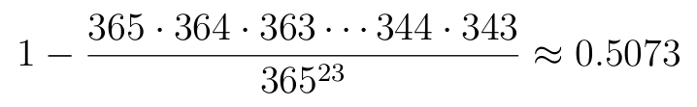
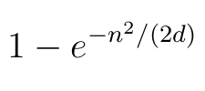
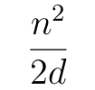
Probability Theory
The “Birthday Problem”
Birthday formulation: There are n=23 people in a room, with random birthdays. What is the probability that two have the same birthday? Surely with d=365 possibilities (ignoring leap years!) the odds are low, right?
Better than a 50/50 chance of a duplicate birthday!
General formula - estimated probability of duplicate in n items from U_{d}:
If exponent is small, this is approximately

Slide 7
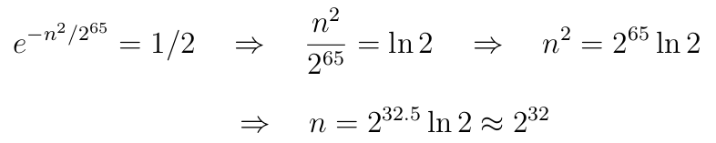
Probability Theory
The “Birthday Problem” - continued
General formula - estimated probability of duplicate in n items from U_{d}:
If exponent is small, this is approximately
Crypto Example 1: Prob of duplicate in a trillion 128-bit values?
Crypto Example 2: How many 64-bit samples before 50-50 chance of dup?
d=2⁶⁴, find n:
n ≈ 2⁴⁰, d=2¹²⁸ : n²/(2d) ≈ 2⁸⁰/2¹²⁹ = 1/2⁴⁹
This is definitely “small,” so prob of duplicate is approx 1/2⁴⁹ (one in 500 trillion)

Slide 8
Randomness
Computers don’t flip coins - where does randomness come from?
Dedicated random number generators:
Various hardware devices have been built
Included in security-conscious chips like TPMs
Now in modern (since 2012) Intel+AMD processors with RDRAND instruction
From gathering uncertain measures in system:
Many events have random uncertainty: typing, disk seek, net, …
Idea: Gather uncertain measures into a random pool
Unbiasing (getting rid of nonuniformity) is vital for this
Windows: Through crypto API; Linux: Through /dev/random
From pseudorandom number generators:
Use of computed values - hopefully seeded with true randomness
More later….

Slide 9
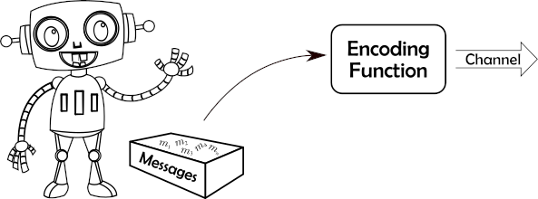
Entropy
Idea and Information Sources
Where does information come from?
Model as a probabilistic source S = (M,P) - messages are a sample space
Finite set of messages M = { m₁, m₂, ... , m_{n} }
Each message has a probability P(m_{i} )

Slide 10
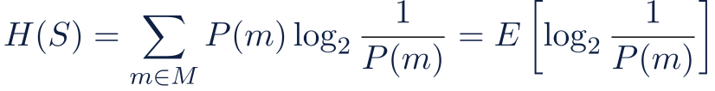
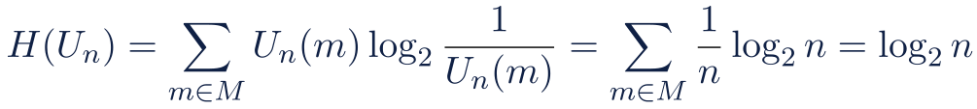
Entropy
Definition
For source S = (M,P), Shannon’s entropy H(S) is defined to be
Unit of measure is “bits”
Example: Entropy of uniform message source over n messages U_{n}
Specific instances:
Entropy of a coin flip: log₂ 2 = 1 bit
Entropy of a uniform 256-bit random key: log₂ 2²⁵⁶ = 256 bits
Entropy of a 6-sided dice roll: log₂ 6 ≈ 2.585 bits
It gives the average number of bits needed to encode one symbol if you know only its probability distribution.

Slide 11
Entropy
Entropy of English
Consider English writing as a source. If you only look at the frequency of individual letters in English (ignoring context):
There are 26 letters (A–Z), but their frequencies are unequal (e.g., “E” ≈ 13%, “Z” ≈ 0.1%). Using actual English letter frequencies, Shannon computed:
Entropy as independent single letters: ≈ 4.14 bits/letter
In real English text, letters are not independent, grammar and context make the next symbol highly predictable. For example, after “TH”, “E” is very likely.
Entropy as “guess” next letter in context ≈ 0.6-1.3 bits/letter
Perfectly random text:
log₂26 ≈ 4.7 bits/ letter

Slide 12
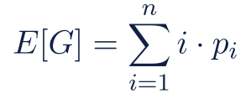
Entropy and Passwords
Modeling Brute-Force Attacks
Idea: Model password selection as a source (M,P)
Message space M is really set of possible passwords - say |M| = n possibilities
P(m) is the probability that a user selects password m
Put in decreasing order and abbreviate p_{i} as probability of ith password
p₁ ≥ p₂ ≥ … ≥ p_{n}
Optimal brute-force attacker: Tries passwords in decreasing probability
Random variable G for number of guesses to find a password
Expected number of guesses to crack:
This is sometimes called the “guessing entropy” of the distribution

Slide 13
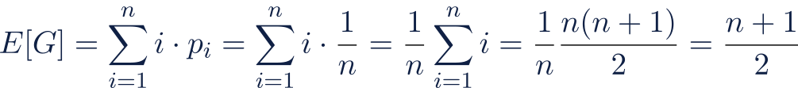
Entropy and Passwords
Example 1: Uniform distribution
Example 1: Passwords are uniformly-distributed set of n possibilities
Distribution is U_{n}, with p_{i} = 1/n for all i
Shannon entropy H(P) = n bits (go back 3 slides for entropy of U_{n})
Guessing entropy:
So if passwords are uniformly distributed 128-bit values:
n = 2¹²⁸ ⇒ E[G] = (2¹²⁸+1)/2 = 2¹²⁷ + 1/2
So “guessing entropy” is approximately ½ 2^{H(P)}

Slide 14
Entropy and Passwords
Example 2: English language
Example 2: Passwords are c character English language phrases
Distribution? Will return to later - for now, Shannon entropy ≈ 1.5c bits
Perhaps (just speculating!) guessing entropy is around ½ 2^{H(P)} ≈ 2^{1.5c-1} ?
  16 bytes (8*16=128 bits) uniformly distributed has guessing entropy 2¹²⁷+½ ≈ 128 million quadrillion guesses
  16 characters of English language would take ≈ 2²⁴⁻¹ ≈ 8 million guesses
Seems to show English is really, really bad for passwords
But: Based on an unjustified assumption about guessing entropy...

Slide 15
Entropy and Passwords
Relation between Shannon Entropy and Guessing Entropy
A lower bound on guessing entropy in terms of Shannon entropy allows a conclusion like this:
If we can guarantee password entropy of H(P) then we can guarantee brute force will take at least … tests on average
This would be good! Fortunately, this is possible:
Theorem [Massey, 1994]: For any probability distribution with Shannon entropy H(P) ≥ 2 bits, we have E[G] ≥ 2^{H(P)−2} + 1 ≈ ¼ 2^{H(P)}

Slide 16
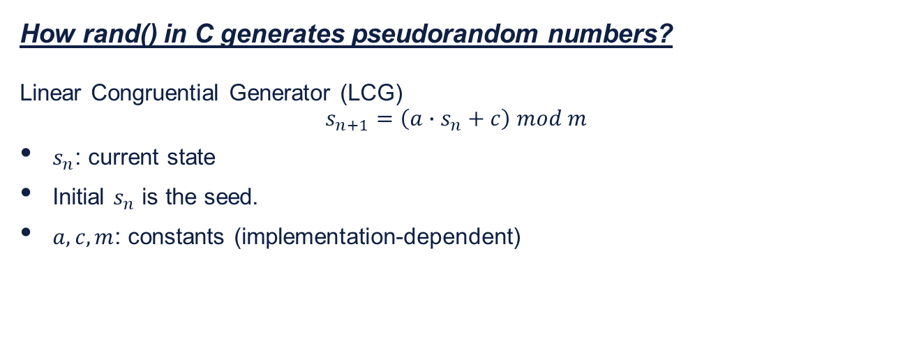
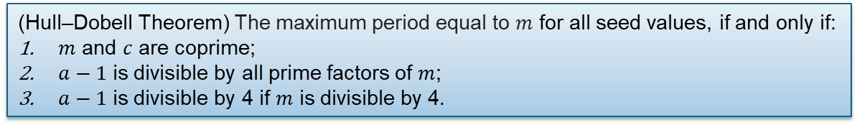
Pseudorandom Generation
Definition and Warning
How rand() in C generates pseudorandom numbers?
Linear Congruential Generator (LCG)
$$s_{n+1}=\left(a∙s_{n}+c\right) mod m$$
$s_{n}$: current state
Initial $s_{n}$ is the seed.
$a,c,m$: constants (implementation-dependent)
(Hull–Dobell Theorem) The maximum period equal to $m$ for all seed values, if and only if:
$m$ and $c$ are coprime;
$a−1$ is divisible by all prime factors of $m$;
$a−1$ is divisible by 4 if $m$ is divisible by 4.

Slide 17
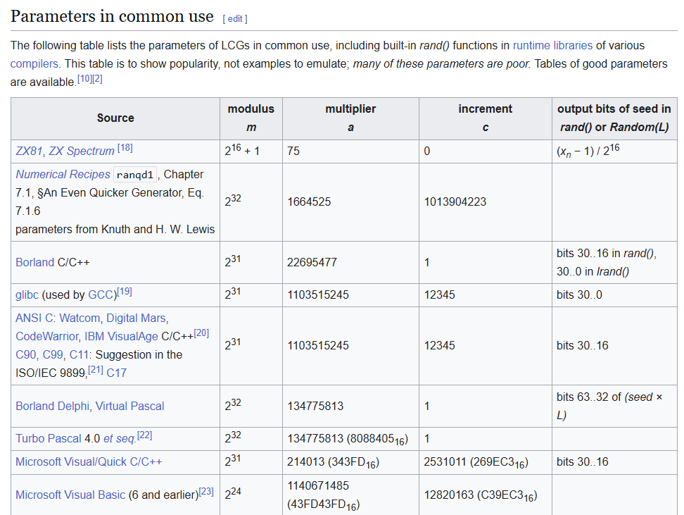

Pseudorandom Generation
Definition and Warning
How to set $a,c,m$?
- Wikipedia (https://en.wikipedia.org/wiki/Linear_congruential_generator)

Slide 18

Pseudorandom Generation
Definition and Warning
How to set $seed$?
Deterministic: Given the same seed, rand() always produces the same sequence.
Global internal seed: use srand(seed) initializes the seed:
srand(time(NULL)); // seed with current time

Slide 19
Pseudorandom Generation
Definition and Warning
A binary pseudorandom number generator (RPNG) f “stretches” an s-bit “seed” to n-bits
f: {0,1}^{s} → {0,1}^{n}
Some past/typical values for s:
Original C “rand()” function had 16-bit seed
Current C “rand()” function has 32-bit seed
Cryptographic PRNGs typically have seeds ≥ 128 bits
Consider generating 128 “random looking” bits with current C rand():
Each of the 2³² seeds gives a fixed 128-bit output
If no duplicates, probability of each 128-bit output is 1/2³²
Entropy is 32 bits, not matter how long it “looks like”!!!
Absolute law: Deterministic processes cannot increase entropy

