Slide 1
Security (Access Control) Models
CSC 481/681/781
Principles of Computer Security
Reference: Textbook Section 1.2 and 9.1-9.2

Slide 2
Basic Terminology
Security Policy
“Security policy is a definition of what it means to be secure for a system, organization or other entity. For an organization, it addresses the constraints on behavior of its members as well as constraints imposed on adversaries by mechanisms such as doors, locks, keys, and walls. For systems, the security policy addresses constraints on functions and flow among them, constraints on access by external systems and adversaries including programs and access to data by people.” -- Wikipedia
A high-level statement of what is allowed and what is forbidden. It reflects organizational goals such as confidentiality, integrity, and availability.

Slide 3
Basic Terminology
Security Model
“A computer security model is a scheme for specifying and enforcing security policies.”
-- Wikipedia
A security model provides a formal framework or mathematical abstraction of the policy. It describes the system in terms of states, subjects, objects, actions, and permissions, ensuring the policy rules are upheld.

Slide 4
Basic Terminology
Why use models?
  They give a concrete mental picture of policy
  Should be formal enough to allow analysis, proofs, and automated tools
    Ask questions like “Can Subject S obtain access to Object O?”
Interaction of implementation, model, policy:
  System policy defined in terms of language in model
  Policy on data takes priority over wishes of users
    Mandatory Access Control (MAC): Based on policy, overrides access control/permission decisions of users
    Discretionary Access Control (DAC): User-specified rights (as in Windows and Unix)

Slide 5
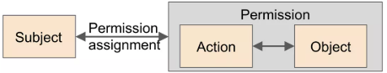
Basic Terminology
Components in Security Policies and Models:
  Subjects (or Users): Entities that perform actions
    Examples: Users (Alice, Bob, …), the system itself, processes
  Objects: Entities that actions are performed upon
    Examples: Memory, files, printers, I/O devices, network, programs, …
  Actions: What subjects can do with objects
    Examples: Read, Write, Execute
  Permissions: Mapping subject/object pairs to actions
    Can be specifically “allowed” or “disallowed” actions

Slide 6
Access-Control Models
Policy-based Access-Control Models
Model | Main Policy | Description
Bell–LaPadula (BLP) | Confidentiality Policy | No read up, no write down
Biba Model | Integrity Policy | No write up, no read down
Chinese Wall (Brewer–Nash) | Conflict-of-Interest Policy | Prevents a subject from accessing data of competing organizations.
These models explicitly define what the security policy is.

Slide 7
Access-Control Models
Non-Policy-based Access-Control Models
Model | Description
Access Control Matrix Model | Defines access rights of subjects over objects in a matrix.
Role-Based Access Control (RBAC) | Implements policies through user-role and role-permission assignments.
Capability-Based Model | Uses capabilities to control access to objects.
Non-policy-based models define how to enforce the rules, not what the rules are.

Slide 8
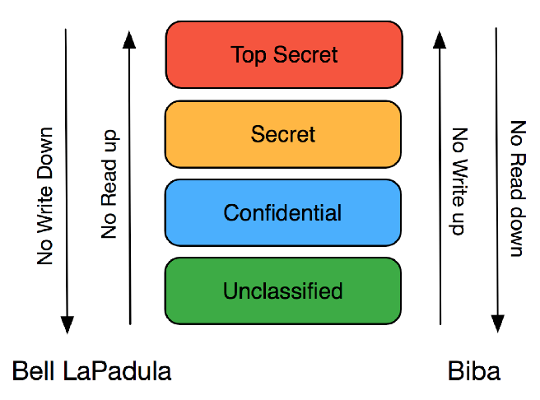
Bell-La Padula Confidentiality Model
No read up: A subject cannot read data at a higher classification.
No write down: A subject cannot write to a lower classification level.
Hierarchical Security Clearance

Slide 9
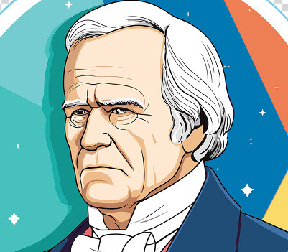


Bell-La Padula Confidentiality Model
Nuclear Assets Top Secret
Counter-attack Plans Top Secret
Appropriations Secret
Troop Strength Secret
Personnel List Confidential
Clearance: Top Secret
Clearance: Secret
Can write
(“write up”)
Can write
(“write up”)
Can read
(“read down”)
Can read
(“read down”)
Note restrictions on what President can write to. In a sense, he “knows too much” so shouldn’t be able to “leak” data into lower classification levels.

Slide 10
Bell-La Padula Confidentiality Model
Classification Level
Total Order: Unclassified < Confidential < Secret < Top Secret
Compartment
Partial Order: <Secret,{Appropriations}> <Secret,{Troop Strength}>
No Comparability

Slide 11
Bell-La Padula Confidentiality Model
Total Order on a universe set, U
  Reflexivity: x ≤ x, for all x ∈ U;
  Anti-symmetry: If x ≤ y and y ≤ x, then x=y;
  Transitivity: If x ≤ y and y ≤ z, then x ≤ z;
  Totality: If x, y ∈ U, then x ≤ y or y ≤ x.

Slide 12
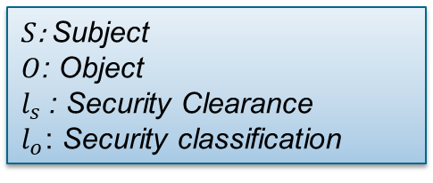


Bell-La Padula Confidentiality Model
$S$: Subject
$O$: Object
$l_{s}$: Security Clearance
$l_{o}$: Security classification
Nuclear Assets, Counter-attack Plans…
$$L\left(S\right)=l_{s}$$
$$L\left(O\right)=l_{o}$$

Slide 13
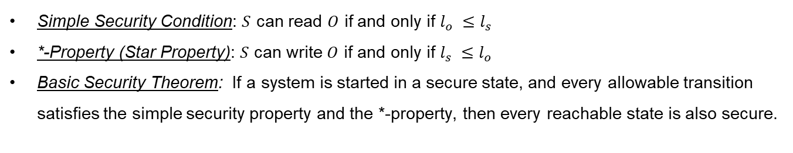
Bell-La Padula Confidentiality Model
Only consider the Total Order relation, we have
Simple Security Condition: $S$ can read $O$ if and only if $l_{o} ≤l_{s}$
*-Property (Star Property): $S$ can write $O$ if and only if $l_{s} ≤l_{o}$
Basic Security Theorem: If a system is started in a secure state, and every allowable transition satisfies the simple security property and the *-property, then every reachable state is also secure.

Slide 14
Bell-La Padula Confidentiality Model
Partial Order on a universe set, U
  Reflexivity: x ≤ x, for all x ∈ U;
  Anti-symmetry: If x ≤ y and y ≤ x, then x=y;
  Transitivity: If x ≤ y and y ≤ z, then x ≤ z;
  Totality: If x, y ∈ U, then x ≤ y or y ≤ x.

Slide 15
Bell-La Padula Confidentiality Model
Consider the compartment, all compartments can form a lattice
{NUC,EUR,US}
{NUC,EUR}
{NUC,US}
{EUR,US}
{NUC}
{EUR}
{US}
{ }

Slide 16
Bell-La Padula Confidentiality Model
Security level and compartment form a security level.
{NUC,EUR,US}
{NUC,EUR}
{NUC,US}
{EUR,US}
Examples:
William cleared into <Secret, {EUR}>
George cleared into <Top Secret, {NUC, US}>
A document classified as <Confidential, {EUR}>
{NUC}
{EUR}
{US}
{ }

Slide 17

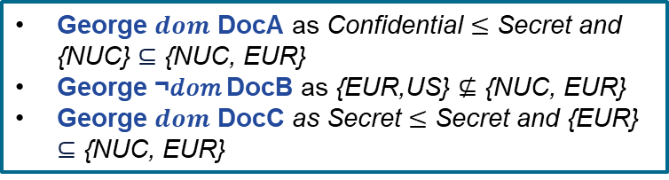
Bell-La Padula Confidentiality Model
Definition of Dominates: The security level ($L$, $C$) dominates the security level ($L′$,$C′$) if and only if $L^{′}≤L$ and $C′⊆C$.
($L$, $C$) $dom$ ($L′$,$C′$) ($L$, $C$) $¬dom$ ($L′$,$C′$)
Examples:
George cleared into <Secret, {NUC, EUR}>
DocA classified as <Confidential, {NUC}>
DocB classified as <Secret, {EUR,US}>
DocC classified as <Secret, {EUR}>
George $dom$ DocA as Confidential $≤$ Secret and {NUC} $⊆$ {NUC, EUR}
George ¬𝑑𝑜𝑚 DocB as {EUR,US} $⊈$ {NUC, EUR}
George $dom$ DocC as Secret $≤$ Secret and {EUR} $⊆$ {NUC, EUR}

Slide 18
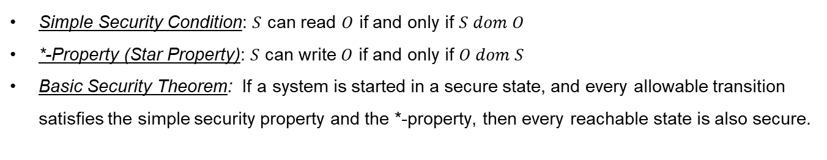
Bell-La Padula Confidentiality Model
Consider the Partial Order relation, we have
Simple Security Condition: $S$ can read $O$ if and only if $S dom O$
*-Property (Star Property): $S$ can write $O$ if and only if $O dom S$
Basic Security Theorem: If a system is started in a secure state, and every allowable transition satisfies the simple security property and the *-property, then every reachable state is also secure.

Slide 19

Bell-La Padula Confidentiality Model
Test Your Understanding
Given the security levels TOP SECRET, SECRET, CONFIDENTIAL, and UNCLASSIFIED (ordered from highest to lowest), and the compartment A, B, and C, specify what type of access (read, write, both, or neither) is allowed in each of the following situations. Assume that discretionary access controls allow anyone access unless otherwise specified.
Paul, cleared for (TOP SECRET, { A, C }), wants to access a document classified (SECRET, { B, C }).
Anna, cleared for (CONFIDENTIAL, { C }), wants to access a document classified (CONFIDENTIAL, { B }).
Jesse, cleared for (SECRET, { C }), wants to access a document classified (CONFIDENTIAL, { C }).
Sammi, cleared for (TOP SECRET, { A, C }), wants to access a document classified (CONFIDENTIAL, { A }).
Robin, who has no clearances (and so works at the UNCLASSIFIED level), wants to access a document classified (CONFIDENTIAL, { B }).

Slide 20
Bell-La Padula Confidentiality Model
Test Your Understanding
Given the security levels TOP SECRET, SECRET, CONFIDENTIAL, and UNCLASSIFIED (ordered from highest to lowest), and the compartment A, B, and C, specify what type of access (read, write, both, or neither) is allowed in each of the following situations. Assume that discretionary access controls allow anyone access unless otherwise specified.
Paul, cleared for (TOP SECRET, { A, C }), wants to access a document classified (SECRET, { B, C }). Neither (No read, no write)
Anna, cleared for (CONFIDENTIAL, { C }), wants to access a document classified (CONFIDENTIAL, { B }). Neither (No read, no write)
Jesse, cleared for (SECRET, { C }), wants to access a document classified (CONFIDENTIAL, { C }). Read Only
Sammi, cleared for (TOP SECRET, { A, C }), wants to access a document classified (CONFIDENTIAL, { A }). Read Only
Robin, who has no clearances (and so works at the UNCLASSIFIED level), wants to access a document classified (CONFIDENTIAL, { B }). Write Only

Slide 21
Biba Integrity Model
No read down: A subject cannot read data from a lower integrity level.
If a system administrator (high integrity) reads from a guest account’s log (low integrity), that would violate the Biba model. The admin could be misled by untrusted data.
High Integrity
Medium Integrity
Low Integrity
No write up: A subject cannot write to data at a higher integrity level.

Slide 22
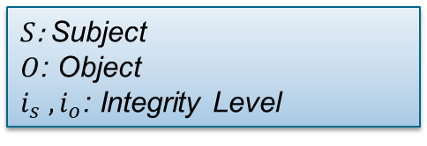
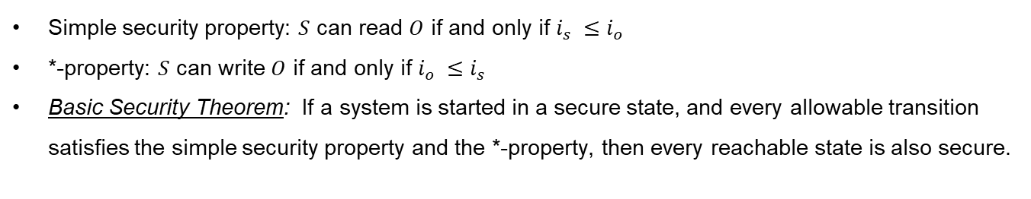
Biba Integrity Model
$S$: Subject
$O$: Object
$i_{s} ,i_{o}$: Integrity Level
Simple security property: $S$ can read $O$ if and only if $i_{s} ≤i_{o}$
*-property: $S$ can write $O$ if and only if $i_{o} ≤i_{s}$
Basic Security Theorem: If a system is started in a secure state, and every allowable transition satisfies the simple security property and the *-property, then every reachable state is also secure.

Slide 23
Group Discussion
Take a few minutes to think through and write out ideas for….
Scenario: A system enforces both Bell–LaPadula and Biba models. The security levels are: Top Secret, Secret, Confidential, and Unclassified. The integrity levels are: High, Medium, and Low.
Each User (Subject) and Documents (Object) has both a confidentiality level and an integrity level.
Entity | Confidentiality Level | Integrity Level
Alice (subject) | SECRET | LOW
Bob (subject) | CONFIDENTIAL | HIGH
File X | CONFIDENTIAL | MEDIUM
File Y | SECRET | HIGH
Access | Allowed or Denied?
1. Alice reads File X
2. Alice writes File X
3. Bob reads File Y
4. Bob writes File Y

Slide 24
Group Discussion
Take a few minutes to think through and write out ideas for….
Scenario: A system enforces both Bell–LaPadula and Biba models. The security levels are: Top Secret, Secret, Confidential, and Unclassified. The integrity levels are: High, Medium, and Low.
Each User (Subject) and Documents (Object) has both a confidentiality level and an integrity level.
Entity | Confidentiality Level | Integrity Level
Alice (subject) | SECRET | LOW
Bob (subject) | CONFIDENTIAL | HIGH
File X | CONFIDENTIAL | MEDIUM
File Y | SECRET | HIGH
Access | Allowed or Denied?
1. Alice reads File X | Allowed
2. Alice writes File X | Denied
3. Bob reads File Y | Denied
4. Bob writes File Y | Allowed

Slide 25

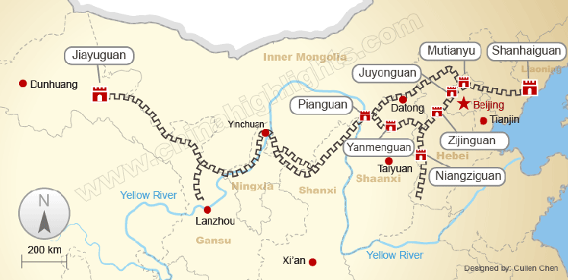
Chinese Wall Model (Brewer–Nash model)
The Great Wall was built during the Qin Dynasty to separate and protect territories within China.

Slide 26
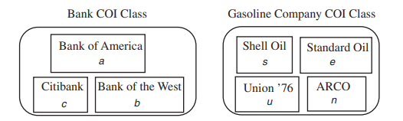



Chinese Wall Model (Brewer–Nash model)
Example: Suppose a lawyer counsels Bank of America in its investments. It could be a breach of confidentiality for her to consult also for Citibank. A simultaneous contract with McDonalds would not be a conflict.

Slide 27
Chinese Wall Model (Brewer–Nash model)
Definitions:
  Objects: Items of information related to a company
  Company datasets (CD): All objects related to a single company
  Conflict of interest (CoI) classes: Sets of companies which are in competition
  Sanitized data: companies have information that can release publicly

Slide 28
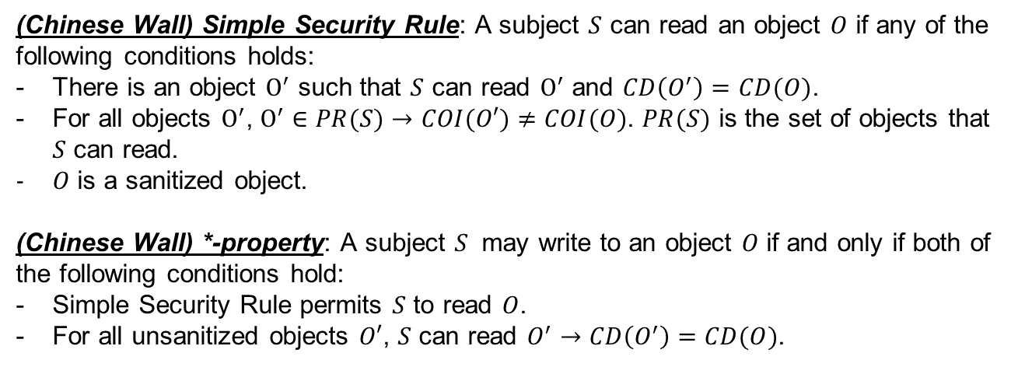
Chinese Wall Model (Brewer–Nash model)
(Chinese Wall) Simple Security Rule: A subject $S$ can read an object $O$ if any of the following conditions holds:
There is an object $O^{′}$ such that $S$ can read $O^{′}$ and $CD\left(O^{′}\right)=CD(O)$.
For all objects $O^{′}$, $O^{′}∈PR(S)→COI(O′)≠COI(O)$. $PR(S)$ is the set of objects that $S$ can read.
$O$ is a sanitized object.
(Chinese Wall) *-property: A subject $S$ may write to an object $O$ if and only if both of the following conditions hold:
Simple Security Rule permits $S$ to read $O$.
For all unsanitized objects $O′$, $S$ can read $O^{′}→CD\left(O^{′}\right)=CD(O)$.

Slide 29
Chinese Wall – Example
Advertising company with multiple clients:
Subject with access to Data 1 cannot access Data 2
  Different companies in CoIClass1
Accessing Data 3 doesn’t affect access to Data 1 or Data 2
  Different CoI classes
Conflict of Interest Classes
CoIClass₁ = {Enron, Exxon, Mobil}
CoIClass₂ = {Amazon, Barnes and Noble}
Companies
Enron
Exxon
Mobil
Amazon
Barnes and Noble
Objects:
Data 1 Label: <Enron> (CoIClass₁)
Data 2 Label: <Mobil> (CoIClass₁)
Data 3 Label: <Amazon> (CoIClass₂)

Slide 30



Access Control Matrix Model
Access control matrix: describes the rights of users over files in a matrix.
Objects $O$
 | Passwords | Src1.c | Src2.c | Program | AliceMail
Administrator | RW | RW | RW | RWX | RW
Alice | — | RW | R | RX | RW
Bob | — | RW | RW | RX | —
Carol | — | R | R | RX | —
Subjects $S$
Rights $a[s,o]$, $s∈S, o∈O$

Slide 31
Access Control Matrix Model
Problem: Huge matrix with sparse “information”
  Columns tend to be either all the same (public files) or mostly empty (private files)
  In reality: Store by row (capabilities) or by column (access control lists)
Complication: Polyinstantiation
  Multiple versions of the same object for different users
  Example: Multi-level secure database with different views
 | Passwords | Src1.c | Src2.c | Program | AliceMail
Administrator | RW | RW | RW | RWX | RW
Alice | — | RW | R | RX | RW
Bob | — | RW | RW | RX | —
Carol | — | R | R | RX | —

Slide 32
Access Control Matrix Model
Access control Lists (ACL):
Idea: Give columns of Access Control Matrix
  List attached to object giving subject rights
  Advantage: Can store rights with each object (easy to delete)
  Disadvantage: Hard to enumerate user rights
Each object has a list of subjects and corresponding rights
  Simplification 1: Default rights
    Apply if none of the specifics apply – public files easier
    “Others” rights in Unix, “Everyone” rights in Windows
  Simplification 2: Group rights
    Users grouped by role or project
    Supported by both Unix and Windows
    Unfortunately: only root/administrator can create groups

Slide 33
Access Control Matrix Model
Permission of Files in Linux
ls -l Test.txt
-rw-r--r-- 1 Alice Staff 46 Apr 14 16:37 Test.txt
Role | Rights | Description
Owner (Alice) | rw- | can read and write
Group (Staff) | r-- | can read only
Others | r-- | can read only

Slide 34
Access Control Matrix Model
Permission of Files in Linux
Note: The meanings of read (r), write (w), and execute (x) vary depending on the object being accessed.
For examples:
For a directory, read allows listing contents, write allows creating, renaming, or deleting entries, and execute allows entering or accessing files within it.
For a process, read means receiving signals, write means sending signals, and execute means running it as a subprocess.

Slide 35
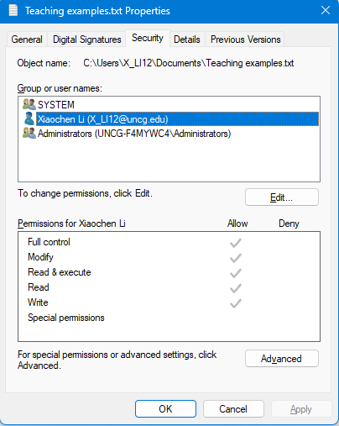
Access Control Matrix Model
Object
Windows 11 ACLs
Subjects
Actions
Permissions

Slide 36
Access Control Matrix Model
Application example – apache configuration:
  <Directory /mirror/ftp/pub>
  order deny,allow
  deny from all
  allow from 129.120.0.0/255.255.0.0
  allow from 10.1.0.0/255.255.0.0
  </Directory>
Server (system) example - /etc/hosts.deny:
  # DenyHosts: Fri Nov 10 07:13:10 2006 | sshd: 67.15.110.21
  sshd: 67.15.110.21
  # DenyHosts: Fri Nov 10 14:32:44 2006 | sshd: 82.208.158.241
  sshd: 82.208.158.241
Router example – Cisco router config:
  Router(config)# access-list 1 permit 172.16.0.0 0.0.255.255
  Router(config)# interface ethernet 0
  Router(config-if)# ip access-group 1 out
Network ACLs
Warning: IP addresses (down to an individual host) are not reliable. Subnets are a little better, but it’s still better to rely on other identifiers.

Slide 37
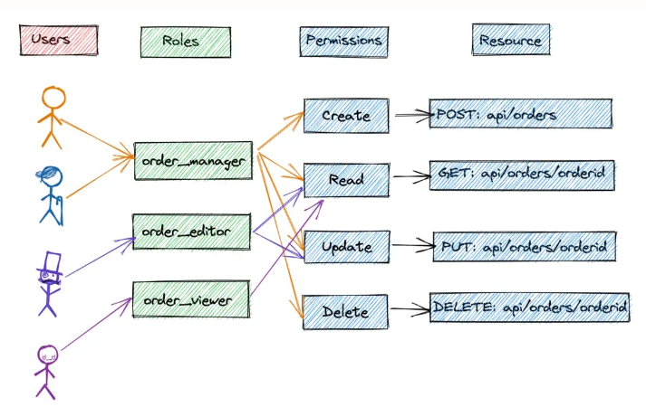
Role-Based Access Control (RBAC)
For Access Control Matrix Model: In large systems, managing permissions for each individual user becomes too complex.

Slide 38
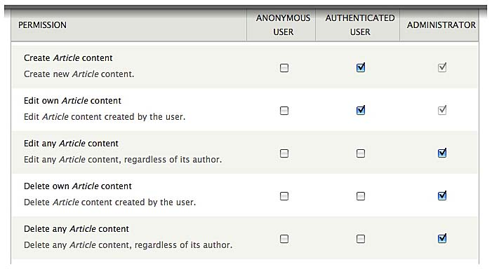
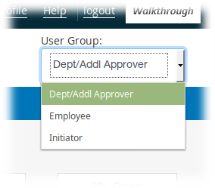
Role-Based Access Control (RBAC)
Recognizes that permissions are based on role, not identity
Permissions granted to groups (never users)
Users may be in one or more groups
  May change over time
  May follow from “status” in system (e.g., logged in or not)
For some tasks a user may need to select a specific role
Permissions Assignment by Role
Select “Active Role”

Slide 39
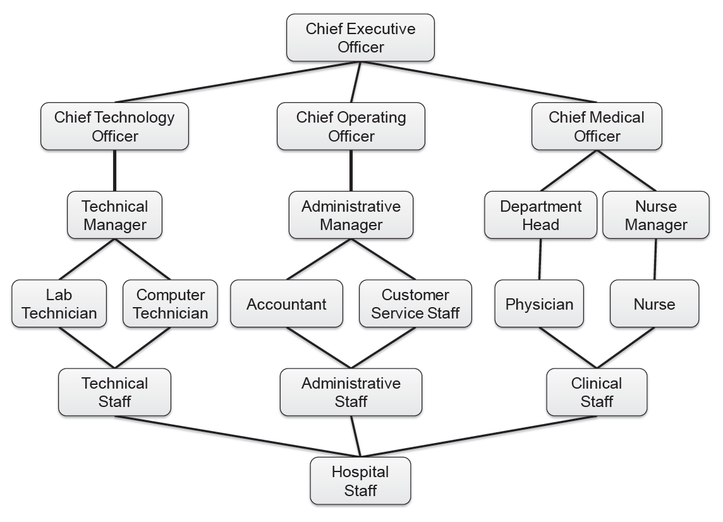
Hierarchical RBAC
Similar to object-oriented class hierarchies
Roles are often related and hierarchical:
Like OO relations:
A “Nurse Manager” IS-A “Nurse”
Inherits permissions (like methods)
Terminology reflects users/people:
“Dept Head” is senior to “Physician”

Slide 40


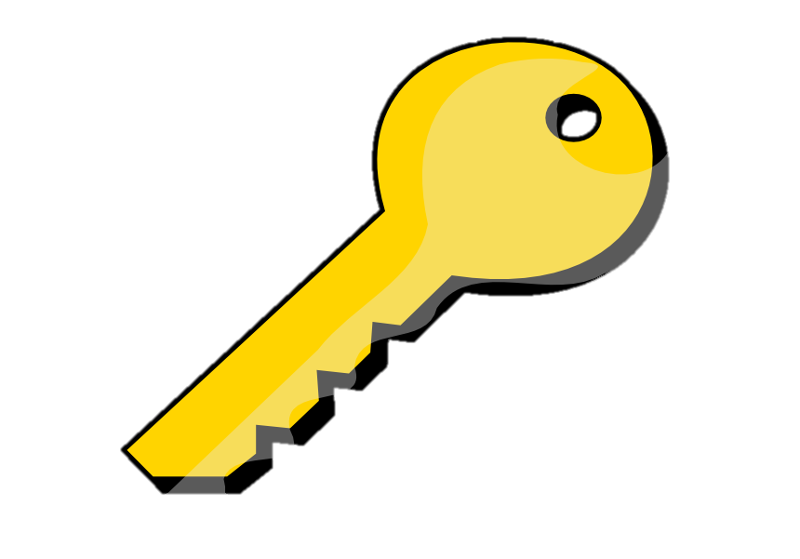
Capability-Based Model
Capability-Based Access Control assigns unforgeable capabilities to subjects, defining what operations they can perform on which objects.
ACL model: object keeps list of users
Capability-based model: user holds list of accessible objects

Slide 41
Capability-Based Model
Advantages:
  User-focused view allows for caching and efficient lookups
Disadvantages:
  Lots of shared (public) files cause lots of entries
  Deleting a file is difficult - must remove from all users’ lists

Slide 42
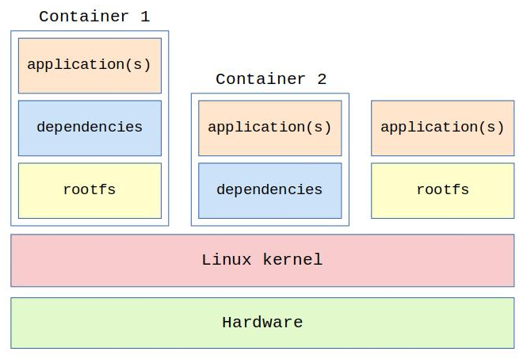
Capability-Based Model
Each container has its own filesystem, process space, and network stack, separated from the host and other containers.
Each process holds only the capabilities it truly needs. Process inside cannot perform privileged operations (e.g., modify kernel settings or access host files) unless explicitly granted.

Slide 43
Summary
Security Policy and Security Model
  A security policy defines what is allowed or forbidden.
  A security model defines how those policies/rules are enforced, providing a formal framework or mechanism.
Policy-based Access Control Model
  Bell-LaPadula Confidentiality model
  Biba Integrity Model
  Chinese Wall Model
Non-Policy-based Access-Control Models
  Access Control Matrix Model
  Role-Based Access Control (RBAC)
  Capability-Based Model

