Slide 1
Goals and Terminology
CSC 481/681/781
Principles of Computer Security

Slide 2
What is Computer Security
Goodrich and Tamassia: They didn’t provide a definition.
Wikipedia: Computer security (also cybersecurity, digital security, or information technology (IT) security) is a protection for computer software, systems, and networks from threats that can lead to unauthorized information disclosure, theft or damage to hardware, software, or data, as well as from the disruption or misdirection of the services.
Garfinkel and Spafford: A computer is secure if you can depend on it and its software to behave as you expect.
Olovsson: A secure system is a system on which enough trust can be put to use it together with sensitive information.
Ross: The ongoing and redundant implementation of protections for the confidentiality and integrity of information and system resources so that an unauthorized user has to spend an unacceptable amount of time or money or absorb too much risk in order to defeat it, with the ultimate goal that the system can be trusted with sensitive information.

Slide 3
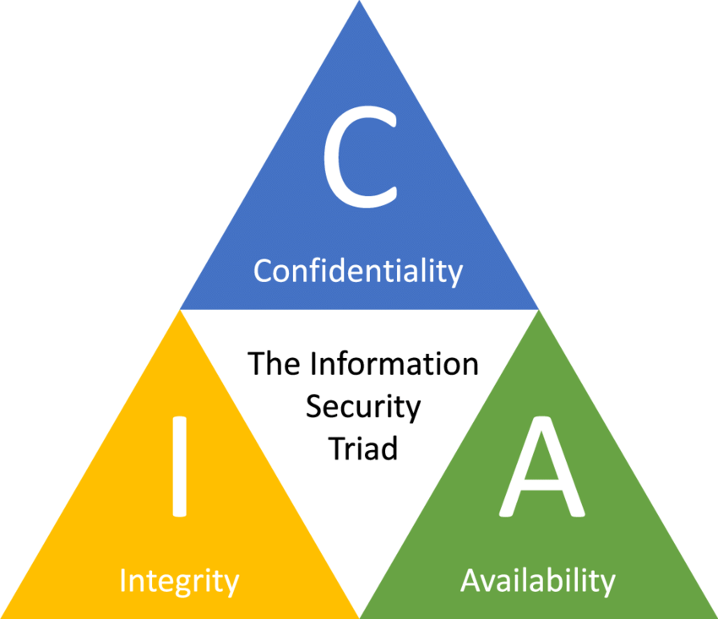
What is Computer Security
We can also concretize the concept of computer security by looking at its goals.
Avoiding unauthorized disclosure of information
Avoiding unauthorized modification of information
Ensuring information or systems are available in a timely fashion to those authorized to access them

Slide 4

What is Computer Security
We can also concretize the concept of computer security by looking at its goals.
Confidentiality : Keep secrets safe
“We don’t want the secrets inside the house to be spied on”
Integrity : Keep data correct
Ensures only authorized users can access data
“We don’t want the facilities inside the house to be moved, damaged, or stolen”
Protects data from unauthorized modification
Availability : Keep systems running
“We want to be able to use all the facilities in the house anytime.”
Ensures systems and data are accessible when needed

Slide 5
What is Computer Security
Other goals that can be important in some situations:
Non-repudiation: principals (subjects) can’t deny actions later;
Authenticity: ability to determine that statements, policies, and permissions issued by persons or systems are genuine;
Assurance: how trust is provided and managed in computer systems;
Accountability: (or Accounting or Audit): principals are responsible for actions;
Anonymity: certain records or transactions not to be attributable to any individual.

Slide 6
Test Your Understanding
Security Goals...
In the movie War Games, Matthew Broderick broke into his school’s computer and changed some grades.
Question: What is the primary security goal that was violated when the system allowed Matthew Broderick to change grades?
If you are thinking this is a good idea in real life, think again:
Story from Feb 12, 2019:
Michael Geddati, 20, was a freshman pre-med major when between December 2017 and May 2018, he accessed various systems without authorization to raise his grades.
. . .
As part of his plea, Geddati will pay more than $72,000 in restitution, including the repayment of his $30,000 scholarship to Rhodes. He also waived his right to appeal.
. . .
He could be sentenced to up to five years in federal prison and fined up to $250,000, although Ireland said probation would not be opposed.
I don’t know the end result, but I think studying is a safer way to get good grades…

Slide 7
Test Your Understanding
Security Goals...
A hospital employee accidentally sent patient medical records to the wrong email address.
Question: Which security goal was violated?
Confidentiality

Slide 8
Test Your Understanding
Security Goals...
An attacker steals a password to the CFO's account at a major company, and in the day before a financial report is to be released the attacker changes numbers to make it look like the company was far more successful than it really was. The next day the modified report gets released and the stock market price soars, making a big profit for the attacker.
Question: Which security goal was violated?
Integrity

Slide 9
Test Your Understanding
Security Goals...
A company’s website was taken offline for two days due to a DDoS attack.
Question: Which security goal was violated?
Availability

Slide 10
Test Your Understanding
Security Goals...
During a cyberattack, hackers stole customer credit card data and then encrypted the company’s files, demanding ransom.
Question: Which security goal was violated?
Confidentiality
Availability

Slide 11
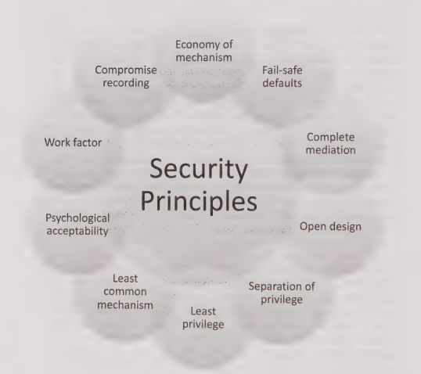
Secure Design Principles
Saltzer and Schroeder
Principles to guide design of secure systems (1975! Still the best...)
Economy of mechanism
Fail-safe defaults
Complete mediation
Open design
Separation of privilege
Least privilege
Least common mechanism
Psychological acceptability
Work factor
Compromise recording (i.e., logging or audit)

Slide 12
Test Your Understanding
Saltzer & Schroeder principle...
System designers encourage keeping designs minimal and streamlined to avoid unnecessary complexity, since complexity can introduce vulnerabilities.
Question: Which Saltzer & Schroeder principle does this reflect?
Economy of mechanism

Slide 13
Test Your Understanding
Saltzer & Schroeder principle...
A web application gives each component only the permissions it needs to do its job — nothing more.
Question: Which Saltzer & Schroeder principle does this reflect?
Least privilege

Slide 14
Test Your Understanding
Saltzer & Schroeder principle...
By default, a new user has no access to any files until explicit permission is granted.
Question: Which Saltzer & Schroeder principle does this reflect?
Fail-safe defaults

Slide 15
Test Your Understanding
Saltzer & Schroeder principle...
The security of a cryptographic system doesn’t depend on keeping the algorithm secret, only the key.
Question: Which Saltzer & Schroeder principle does this reflect?
Open design

Slide 16
Test Your Understanding
Saltzer & Schroeder principle...
Two users share a printer, but the system ensures they cannot access each other’s print jobs.
Question: Which Saltzer & Schroeder principle does this reflect?
Least common mechanism

Slide 17
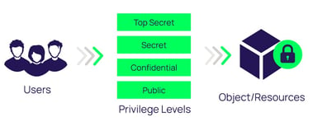
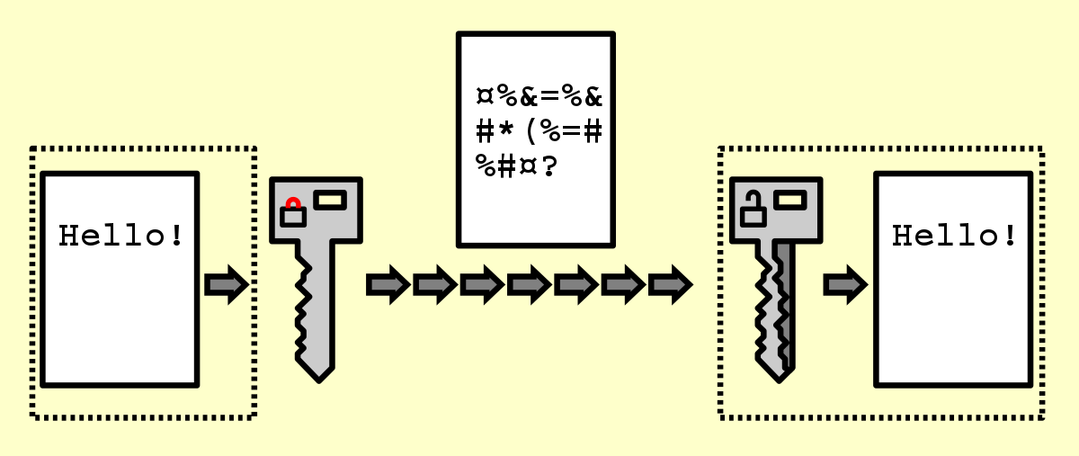
Challenges in Applying Security Principles in the Real World
Efficiency & Usability
For example, to achieve “Complete Mediation” and “Least Privilege ”
Access Control Checks:
A cloud storage system performs permission checks for every file access
In practice: developers may cache permissions, introducing potential bypasses.
Encryption Overhead:
Full-disk encryption in enterprise servers increases CPU load and latency
In practice: some admins disable it “temporarily” for speed.

Slide 18
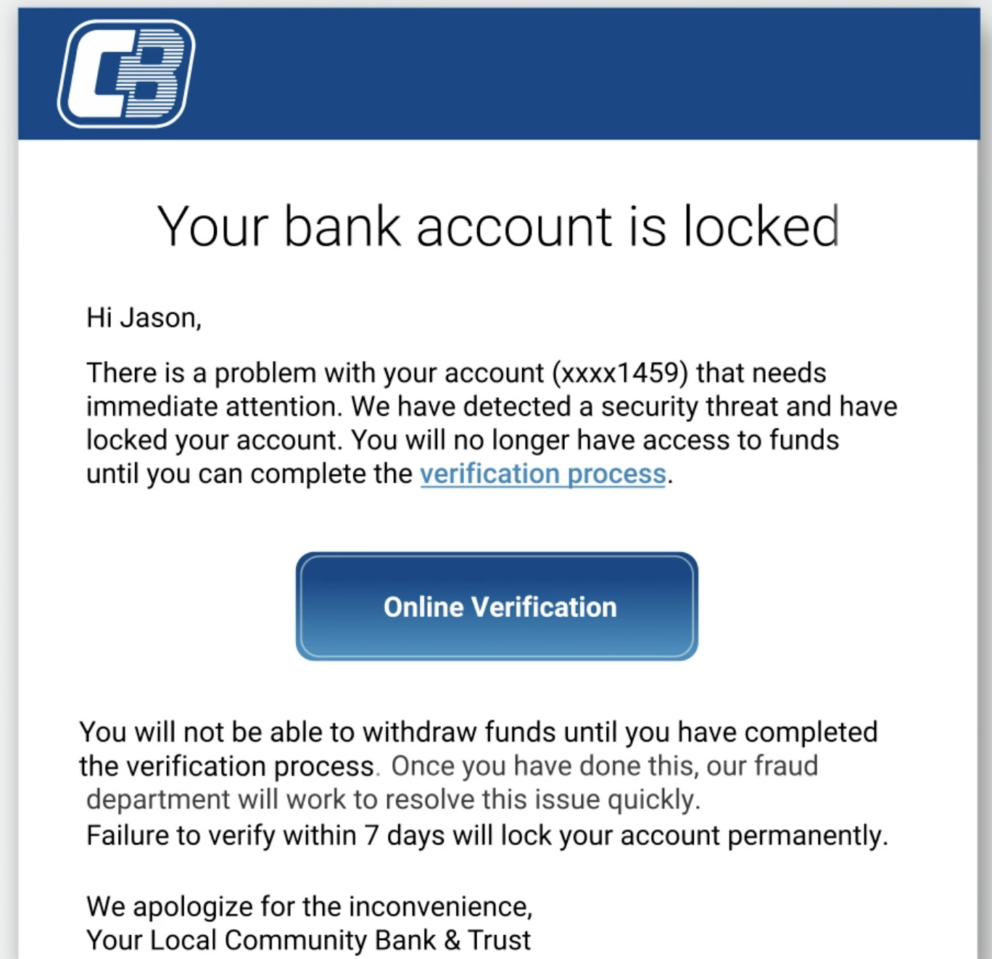
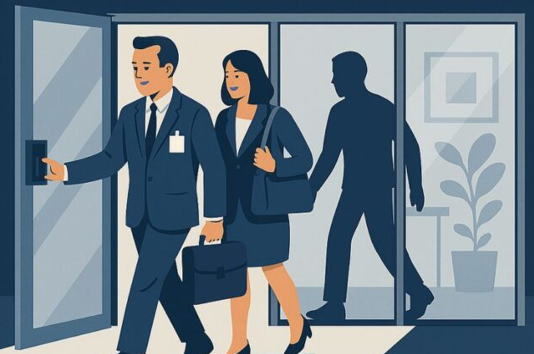
Challenges in Applying Security Principles in the Real World
Human Behavior & Social Engineering
Security mechanisms are strong, but humans are the weakest link. For example:
Weak Passwords:
- Simple passwords like “123456”, “password”, or their pet’s name;
- Same password for email, banking, and work accounts;
- Write password down on sticky notes
Phishing Emails:
- Attackers trick employees into revealing login credentials by posing as IT support.
Physical Tailgating:
- An unauthorized person follows an employee into a restricted area.
Good advice for any system designer: “Your users are not you”

Slide 19
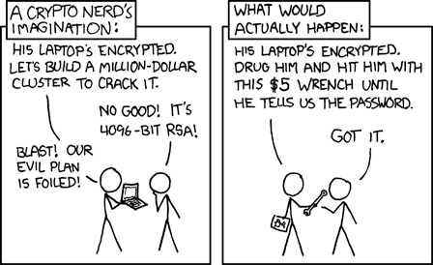
Blackmail or Physically Threaten?

Slide 20
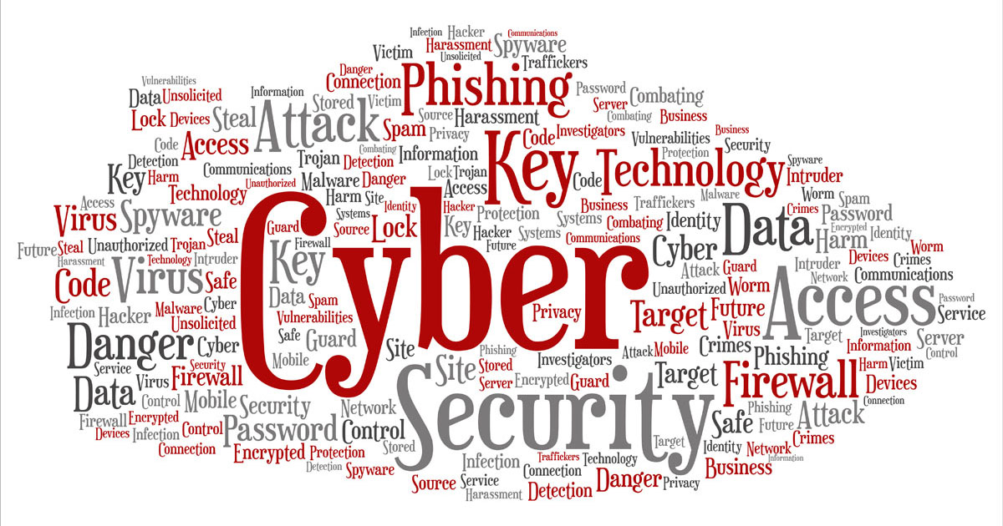
Basic Terminology in Computer Security
In computer security, precise terminology helps us describe how systems fail and how we defend them.
In this class, practice speaking the same language of security like an expert.
We’ll learn some basic terms:
🔹 Vulnerabilities 🔹 Threats 🔹 Attacks & Attackers 🔹 Security Model 🔹 Defenses

Slide 21
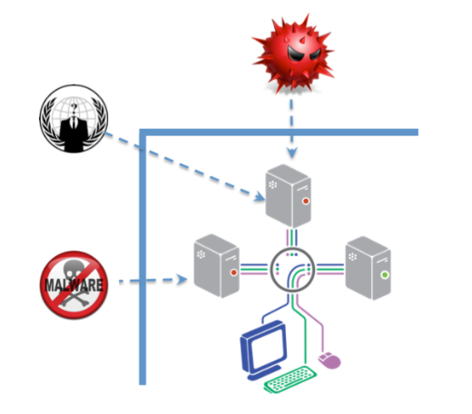
Basic Terminology in Computer Security
Vulnerabilities
A vulnerability is a weakness in a security system.
Can exist in software, hardware, configuration, or human behavior
For Examples:
Unpatched software bug (e.g., buffer overflow)
Default admin password
Poor input validation in a web form
Inadequate access controls
Poor coding practices
Attackers only need to find one vulnerability - you have to cover every possibility

Slide 22
Basic Terminology in Computer Security
Threats
A threat is a set of circumstances that has the potential to cause loss or harm (threats exploit vulnerabilities)
Threats can be
Accidental (natural disasters, human error, …)
Malicious (attackers, insider fraud, …)
NSA “major categories of threats”:
fraud, hostile intelligence service (HOIS), malicious logic, hackers, environmental and technological hazards, disgruntled employees, careless employees, and HUMINT
Human threats (as opposed to natural) are sometimes called threat actors
Note: Advanced Persistent Threat (APT) groups
Fancy Bear (APT 28 - Russian), Elfin Team (APT 33 - Iran), Numbered Panda (APT 12 - Chinese), Lazarus Group (APT 38 - N Korea), …

Slide 23
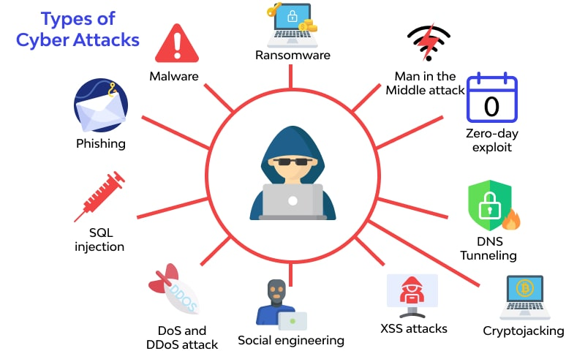
Basic Terminology in Computer Security
Attacks and Attackers
An attack is when a vulnerability is exploited to realize a threat
Passive attack (look but don’t touch) - eavesdropping, traffic analysis, ...
Active attack (go crazy) - masquerade, replay, tampering, denial of service, ...

Slide 24
Basic Terminology in Computer Security
Attacks and Attackers
An attacker is a person who exploits a vulnerability
Attackers must have Means (tools), Opportunity, and Motive (MOM)
Means: Often just an Internet connection!
Opportunity: Presence of vulnerabilities
Motive may be complex, or not what you think!

Slide 25
Attacker Motives
Intellectual challenge
Some people see it as a game (suggestion: try CTFs!)
Espionage (government or corporate)
Financial reward
Credit card numbers sold, spam-nets rented, fraud, ...
Revenge
Showing off
DDoS attacks on CNN, eBay, Yahoo, etc.
Civil disobedience
Basic vandalism
“Hacktivism”

Slide 26
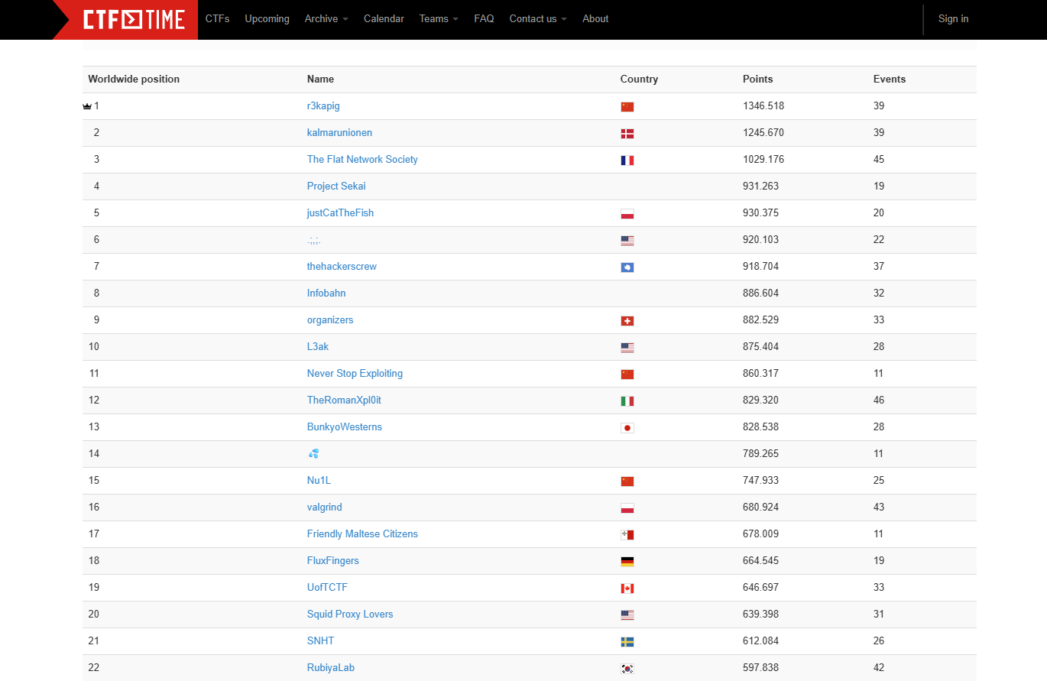
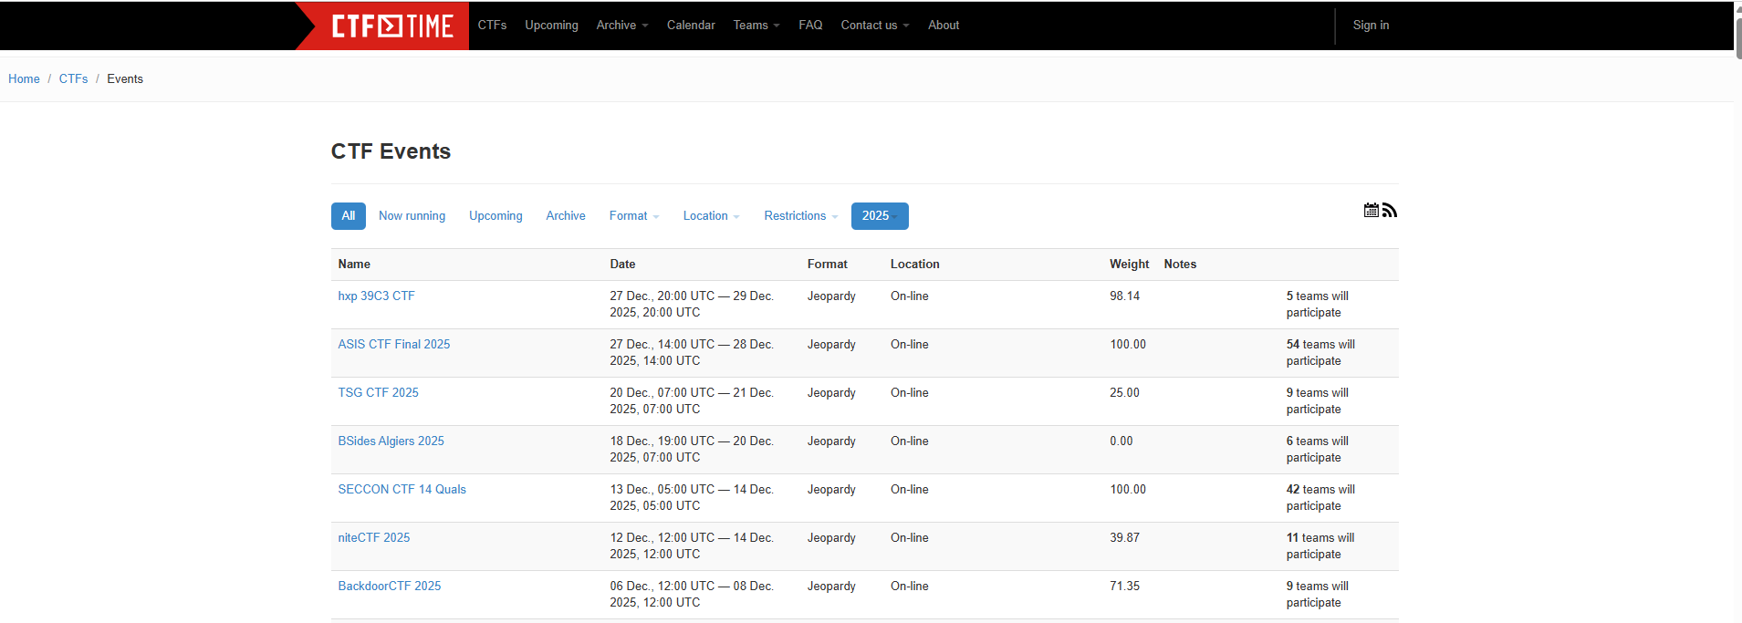
CTF
CTFs are cybersecurity competitions that simulate real-world hacking challenges.
Participants solve tasks to find "flags" (hidden pieces of data, like flag{you_found_me}) that prove they successfully exploited or analyzed something.
It’s a safe and legal way to learn hacking and defense skills.

Slide 27
CTF
Category | Description | Example
Crypto | Break or analyze encryption | Decode a Caesar cipher message
Web | Exploit insecure web apps | SQL injection on a login page
Pwn / Binary Exploitation | Find bugs in compiled programs | Buffer overflow
Reverse Engineering | Decompile and understand binaries | Crack a password algorithm
Forensics | Recover or analyze digital evidence | Find a flag in a memory dump
Misc / OSINT | Puzzle-style or open-source intelligence | Find data hidden in images

Slide 28
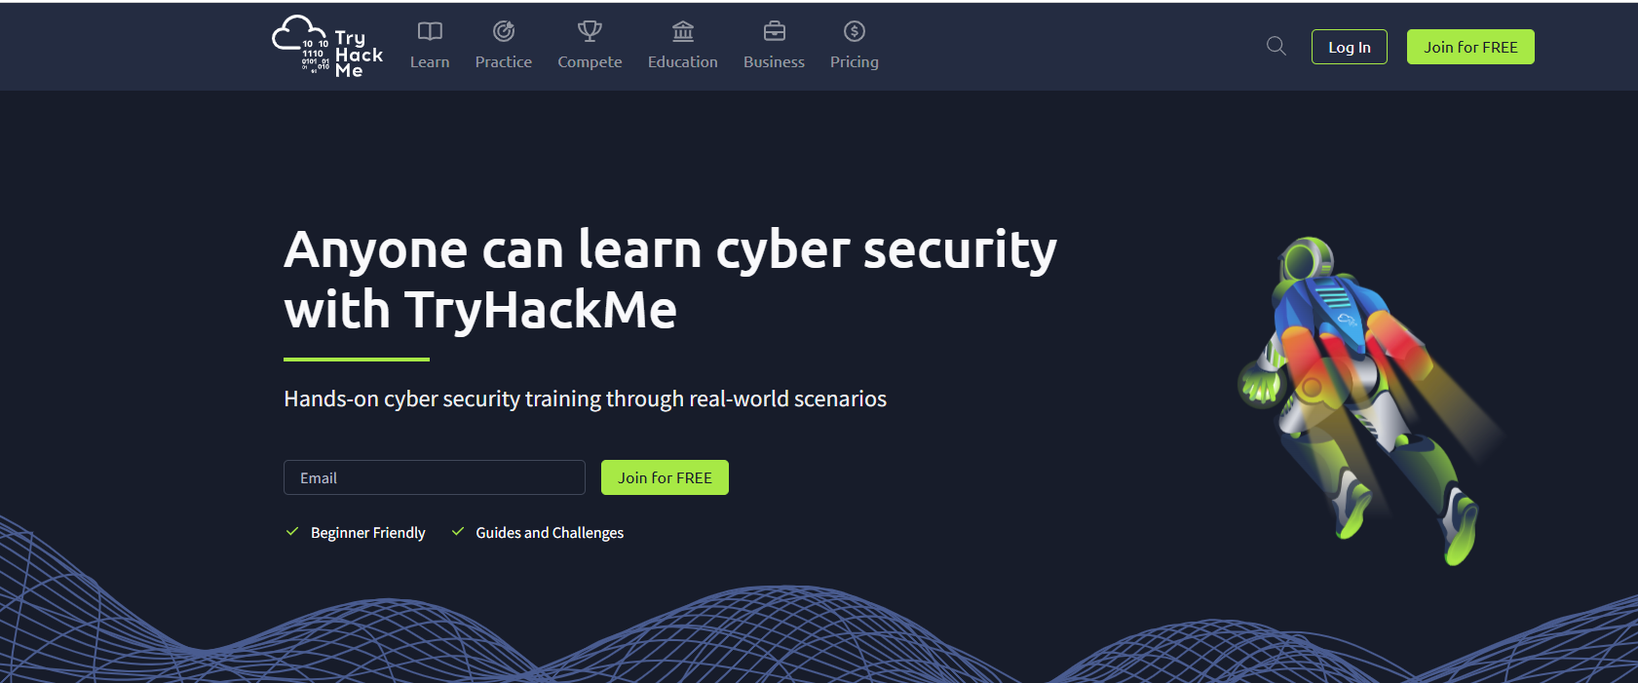
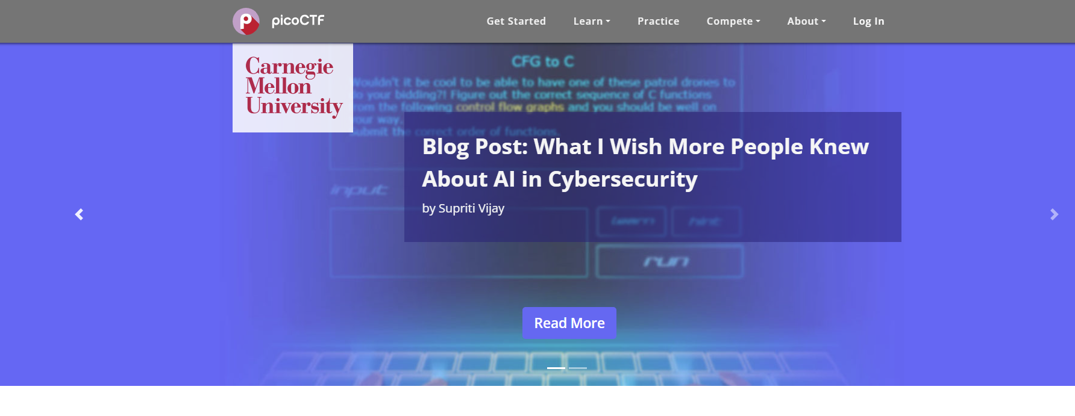
CTF
Start small, join your first CTF!
picoCTF: https://picoctf.org/index.html#picogym
TryHackMe: https://tryhackme.com/
Wargames: https://overthewire.org/wargames
CTFTime: https://ctftime.org/

Slide 29
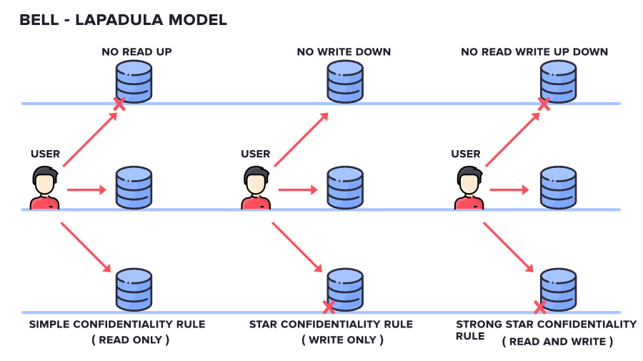
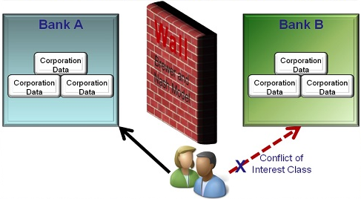
Basic Terminology in Computer Security
Security Models
A security model defines who can access what and under what conditions.
Bell-LaPadula Model:
- A military-oriented model that focuses on confidentiality.
Biba Model:
- Designed to maintain data integrity.
Brewer and Nash Model (Chinese Wall):
- Prevents conflicts of interest by creating a "wall“.

Slide 30
Basic Terminology in Computer Security
Defense and Protection
A defense (or control) is a mechanism (tool, technology, or policy) put in place to reduce risk
Remove a risk (remove or block a vulnerability)
Manage/mitigate risk
Transfer a risk (insurance, etc.)
Methods for defense:
Technical: encryption, access control, firewalls, intrusion detection.
Organizational: training, monitoring, policy enforcement
Human: awareness and safe behavior

Slide 31
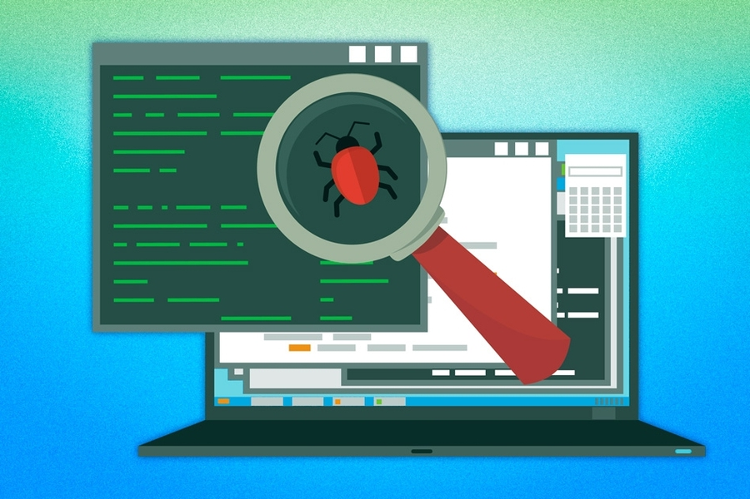
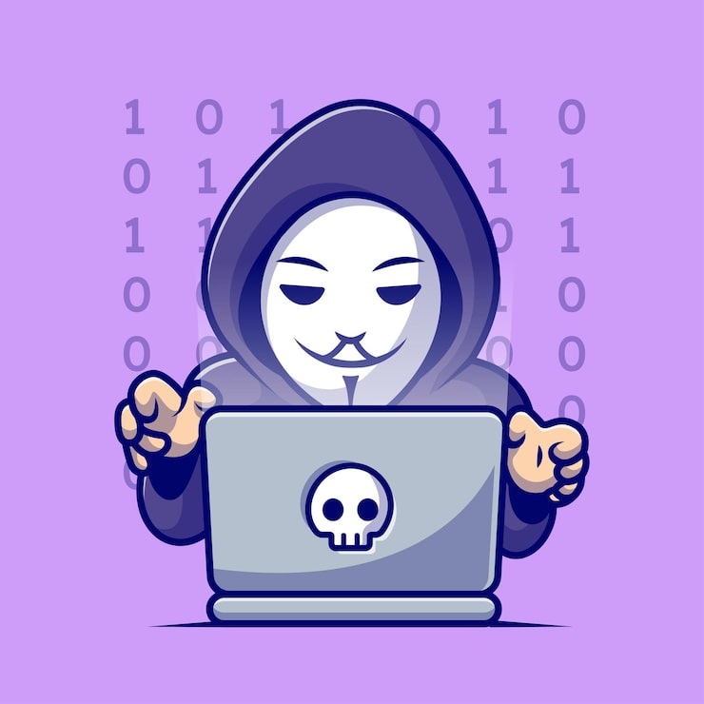
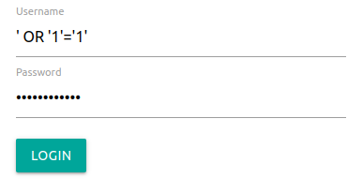
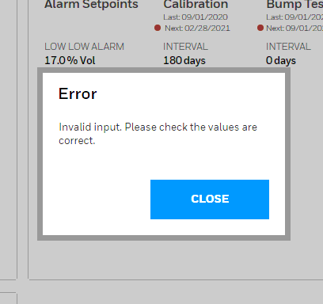
Basic Terminology in Computer Security
How Vulnerabilities, Threats, Attack, and Defenses Connect
Software bug in login form
Hacker discovers it
Sends malicious input
System validates input
Vulnerability
Threat
Attack
Defense
An Attack and Defense Chain

Slide 32
Group Discussion Take a few minutes to think through and write out ideas for….
Scenario: Your university’s Student Management System (SMS) stores grades, course enrollment, and student financial info. One day, a student (Bob) finds that by modifying the URL in his browser: https://university.edu/grades?student_id=12345 to https://university.edu/grades?student_id=54321 he can see another student’s grades. Later, he also discovers that he can upload a “custom script” into a course feedback form that changes how grades are displayed to professors. Meanwhile, the system goes down for several hours during final exams because a large number of students are trying to access it at the same time.
Step 1: Identify Violated Goals
Which CIA goals are violated?
Step 2: Analyze Threats & Vulnerabilities
What types of attacks occurred?
Step 2: Identify Security Principles
Which Security Principles Were Ignored?
Step 4: Design Better Defenses
What defenses can prevent each issue?

Slide 33
Which CIA goals are violated?
Fail-safe defaults
Viewing others’ grades: Confidentiality
Modifying displayed grades via script: Integrity
System outage during finals: Availability
Deny access by default; grant only when explicitly allowed.
What types of attacks occurred?
Every access to a resource must be checked for authorization.
Unauthorized access
Code injection
Denial of Service (DoS)
Complete mediation
Which Security Principles Were Ignored?
Least privilege
Users should have only the permissions needed for their role.
What defenses can prevent each issue?
Unauthorized grade access: Implement strong authentication and authorization checks;
Script injection: Input validation;
System crash under load: Load balancing, rate limiting.

Slide 34
Further Reading – Books and Stories
Cliff Stoll: The Cuckoo's Egg: Tracking a Spy Through the Maze of Computer Espionage (1989)
Fun “spy story” – true story, but reads like a novel
Steven Levy: Crypto: How the Code Rebels Beat the Government – Saving Privacy in the Digital Age (2002)
History of crypto revolution that started in the 1970’s
Bruce Schneier: Click Here to Kill Everybody: Security and Survival in a Hyper-connected World (2019)
Smart devices and security in physical devices (cars, etc.) - Schneier’s blog is good to follow
Ross Anderson: Security Engineering: A Guide to Building Dependable Distributed Systems (3rd edition - 2020)
Turning theory into secure practice
https://www.cl.cam.ac.uk/~rja14/book.html has videos and full 2nd edition for free

Slide 35
Some Other Sources of Information
General technical guides and information
NIST “800 series” : Wide range of topics
DoD/CNSS documents: Defense policies and procedures (e.g., the “Library” link at www.cnss.gov)
SANS Documents and Reading Room (www.sans.org)
News/Alert/Online Information
SecurityFocus: General security news site with lots of reliable information
BugTraq: Mailing list notifying people about vulnerabilities
US-CERT: US Computer Emergency Readiness Team
Clearinghouse for vulnerability and threat information/notices

