Slide 1
Course Information
CSC 481/681/781
Principles of Computer Security
Dr. Xiaochen Li

Slide 2

About Me
Assistant Professor, Department of Computer Science, University of North Carolina at Greensboro
Former Visiting Ph.D. Student and Postdoctoral Researcher, University of Virginia
Ph.D. in Cyberspace Security, Zhejiang University (China)
Research focus: Data Privacy in Cyberspace Security, with applications to statistical analysis and large language models (LLMs)
Email: x_li12@uncg.edu
Office: Petty 153
Office Hour: Monday Wednesday 10:00 am – 11:00 am

Slide 3


What Will You Learn in This Class?
Will I become as cool as Tank in The Matrix after taking this course?
No. This is an intro-level course, and computer security covers far more than system security alone.

Slide 4
What Will You Learn in This Class?
This is an intro-level course, so, the difficulty is low?
No, the difficulty is quite high.
This course is not as vivid or entertaining as you might expect. You will need to learn a large number of concepts, and some parts require strong logical and mathematical thinking. Topics such as cryptography can be especially challenging and may require additional self-study outside of class.

Slide 5
What Will You Learn in This Class?
Does this course require a lot of hands-on practice?
Yes, but only in the homework.
There will be practical components in assignments, but not in the midterm or final exams. The primary focus of the exams is on foundational theoretical concepts.

Slide 6
What Will You Learn in This Class?
How to Keep Up with This Course?
You must have completed basic computer science courses, e.g. computer system, computer network;
You should have background knowledge in probability and number theory;
You need to be able to use the Ubuntu (Linux) operating system;
You should have programming experience, able to read and write basic Python code;
⚠️ If you lack any of the above, you will need to make up the background knowledge on your own.

Slide 7
What Will You Learn in This Class?
Computer Security Topics Covered in This Course:
Basic security goals and terminology
Access control
Cryptography
Physical security
Operating system security
Software security
Hardware security
Web security
Network security

Slide 8
Course Information
All course-related information will be updated on the course website: https://xiaochenli-w.github.io/CSC-481-681-Principles-of-Computer-Security/
Textbook: The required textbook is
Michael T. Goodrich and Roberto Tamassia. Introduction to Computer Security, Pearson, 2011. ISBN-13 978-0-321-51294-9.
Those interested in learning more may also consider purchasing Professor Du’s book for additional insights.
Wenliang Du. Computer Security: A Hands-on Approach, CreateSpace Independent Publishing, 2017. ISBN-13: 978-1548367947.

Slide 9
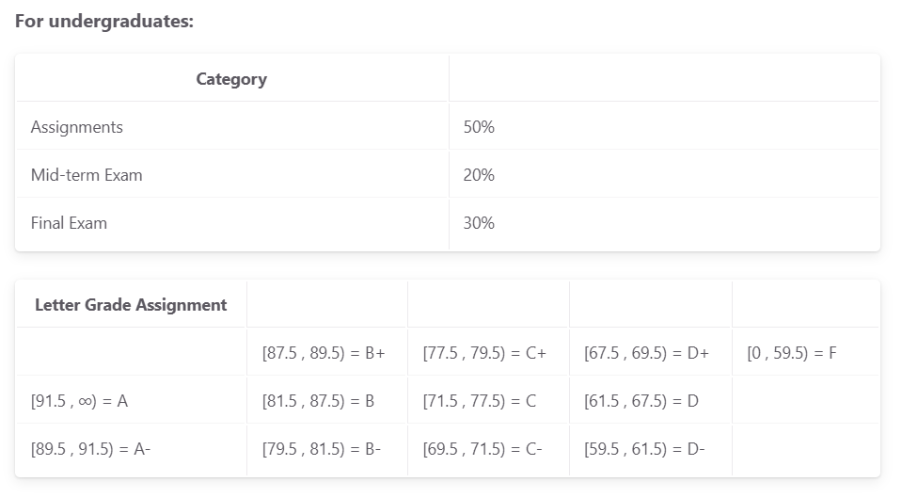
Course Information

Slide 10
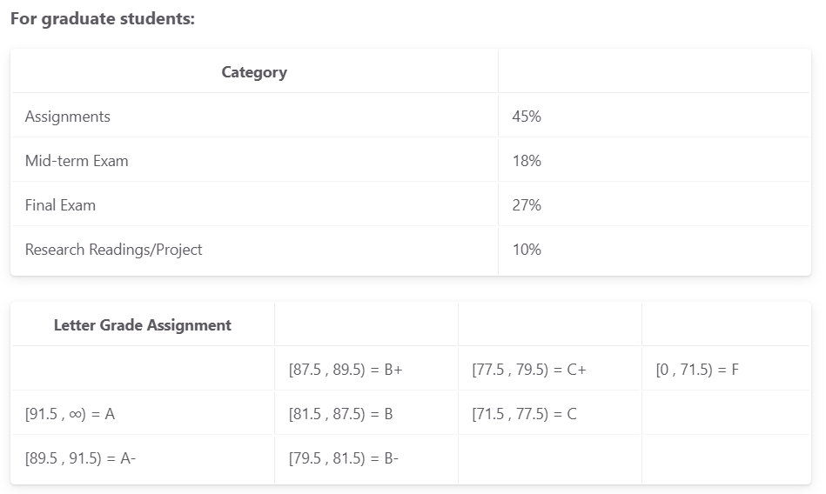
Course Information

Slide 11
Course Information
Attendance Policy: Attendance is mandatory, but no attendance check. All students are responsible for everything done or said in class (this can include changes in assignments, due dates, etc.). Note that this is a very dynamic class, with regular in-class activities, so it is highly unlikely that a student who regularly misses classes will be successful in the course. If attendance becomes a problem, then in-class exercises may be collected and included as part of the assignment portion of the grade.
The university allows for a limited number of excused absences for religious observances. Students who plan to take such an absence should notify the instructor at least two weeks in advance so that accommodations can be made. It is the student’s responsibility to obtain notes from another student if they miss class. Office hours are for answering questions about class material, and I will not re-teach a topic during office hours because you missed class.

Slide 12
Course Information
Assignments & Academic Integrity:
Assignments are individual work only, unless explicitly stated otherwise；
“Individual work” means your own work, in your own words — not generated by AI;
External references must be clearly cited if used;
Searching for solutions online is a violation of academic integrity;
Sharing or copying homework is a serious violation (both parties are penalized)

Slide 13
Course Information
SEED Lab:
Use the lab website (https://seedsecuritylabs.org/Labs_20.04/) to practice concepts learned in class;
Submit your lab report as a PDF on Canvas;
Do not share screenshots of experiment steps with other students; If discovered, both parties will lose points for that assignment;
Required: include unique identifiers (e.g., current timestamp) in screenshots as a “watermark”
Not completing some steps does not mean zero points; Include screenshots of your attempts and analysis of issues for partial credit;
Cheating (sharing or copying) will result in zero points.

