Slide 1
CS 405/605 Data Science

Slide 2
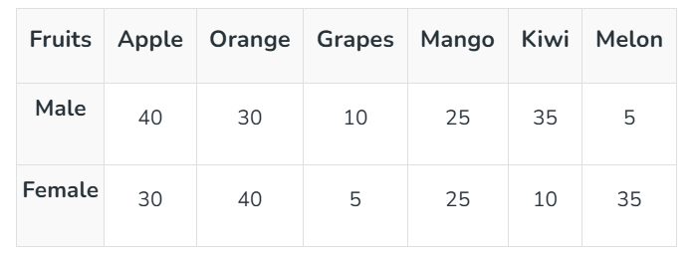
Visualization
Different Types of Basic Charts
1) Bar Chart
A bar chart (a horizontal column chart), should be used to avoid clutter when one data label is long or if you have more than 10 items to compare. This type of visualization can also be used to display negative numbers.
Practice: Imagine you surveyed 300 people to know which type of fruits are most liked by people.

Slide 3
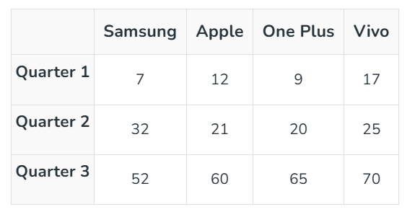
Visualization
Different Types of Basic Charts
2) Line Chart: is a graphical representation of the data that displays the relationship between two or more variables concerning time. It is made by connecting data points with straight-line segments.
A line chart reveals trends or progress over time and can be used to show many different categories of data.
You should use it when you chart a continuous data set.
Practice: Draw a compound line graph for the given data.

Slide 4
Visualization
Classroom Exercise: Titanic Data Visualization
Objective: Visualize the relationship between age, sex, and survival using titanic.csv.
Instructions:
Load the Titanic dataset into a pandas DataFrame.
Select the columns: Age, Sex, and Survived.
Bin Age into groups (e.g., 0–12, 13–20, 21–40, 41–60, 61–80).
Calculate the number of survivors for each AgeGroup and Sex.
Visualize the data:
Grouped Column Chart: AgeGroup on x-axis, Male/Female side-by-side, Survived on y-axis.
Line Chart: AgeGroup on x-axis, two lines for Male and Female, Survived on y-axis.
Add titles, labels, and legends for clarity.
Answer the following questions:
Which AgeGroup has the most survivors?
Are females consistently surviving more than males?
How does survival trend with age for each gender?

