Slide 1
CS 405/605 Data Science

Slide 2
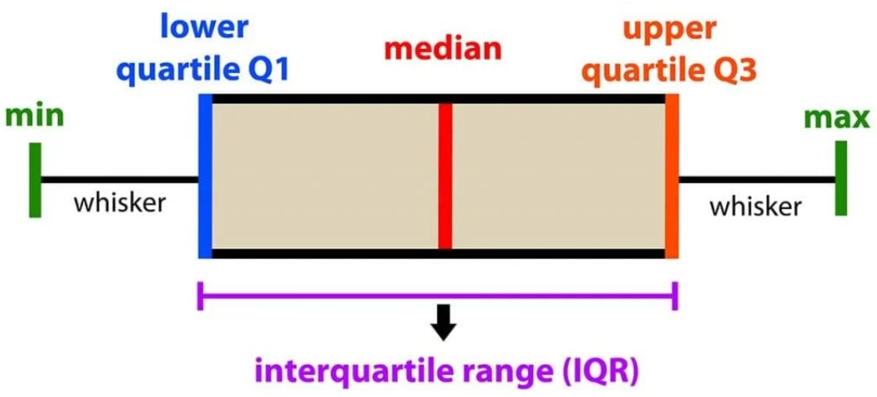
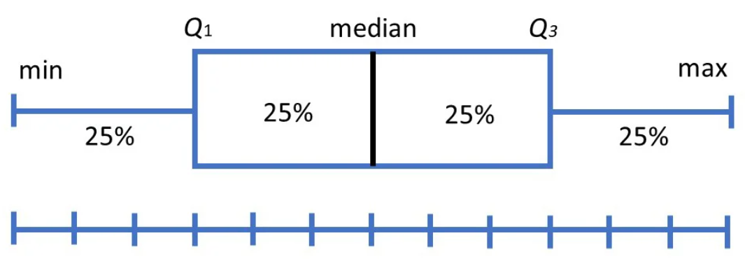
Visualization
Visualizations of Distribution
Box and Whisker Plot
Box plots visually show the distribution of numerical data and skewness by displaying the data quartiles (or percentiles) and averages.
Box plots divide the data into sections containing approximately 25% of the data in that set.

Slide 3
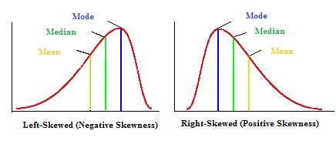
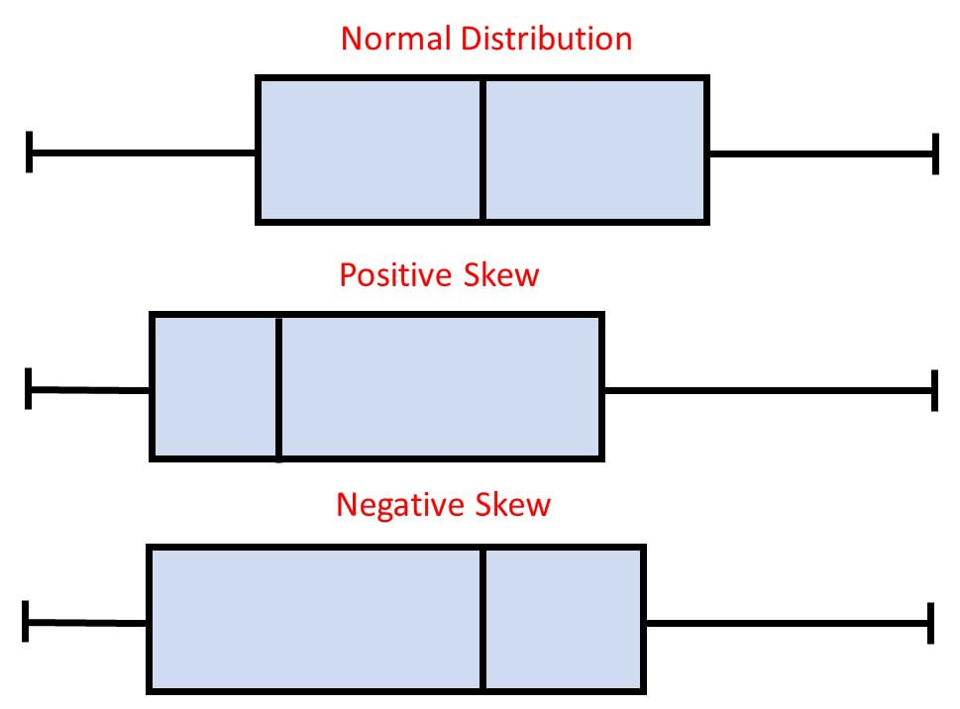
Visualization
Visualizations of Distribution
Box and Whisker Plot
Box plots visually show the distribution of numerical data and skewness by displaying the data quartiles (or percentiles) and averages.
distribution is symmetric
distribution is positively skewed
distribution is negatively skewed

Slide 4
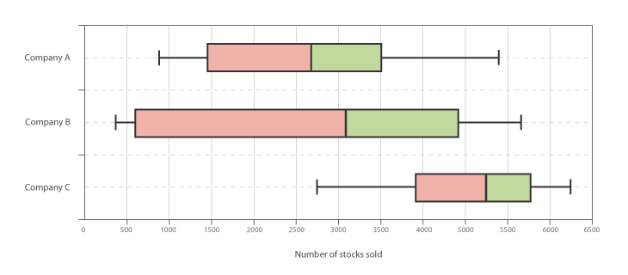
Visualization
Visualizations of Distribution
Box and Whisker Plot
Box plots visually show the distribution of numerical data and skewness by displaying the data quartiles (or percentiles) and averages.

Slide 5
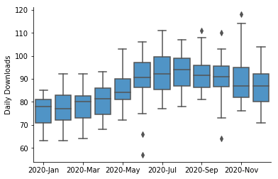
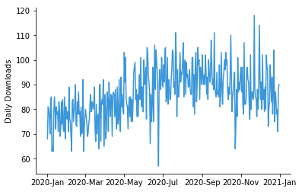
Visualization
Visualizations of Distribution
Box and Whisker Plot
Box plots visually show the distribution of numerical data and skewness by displaying the data quartiles (or percentiles) and averages.

Slide 6
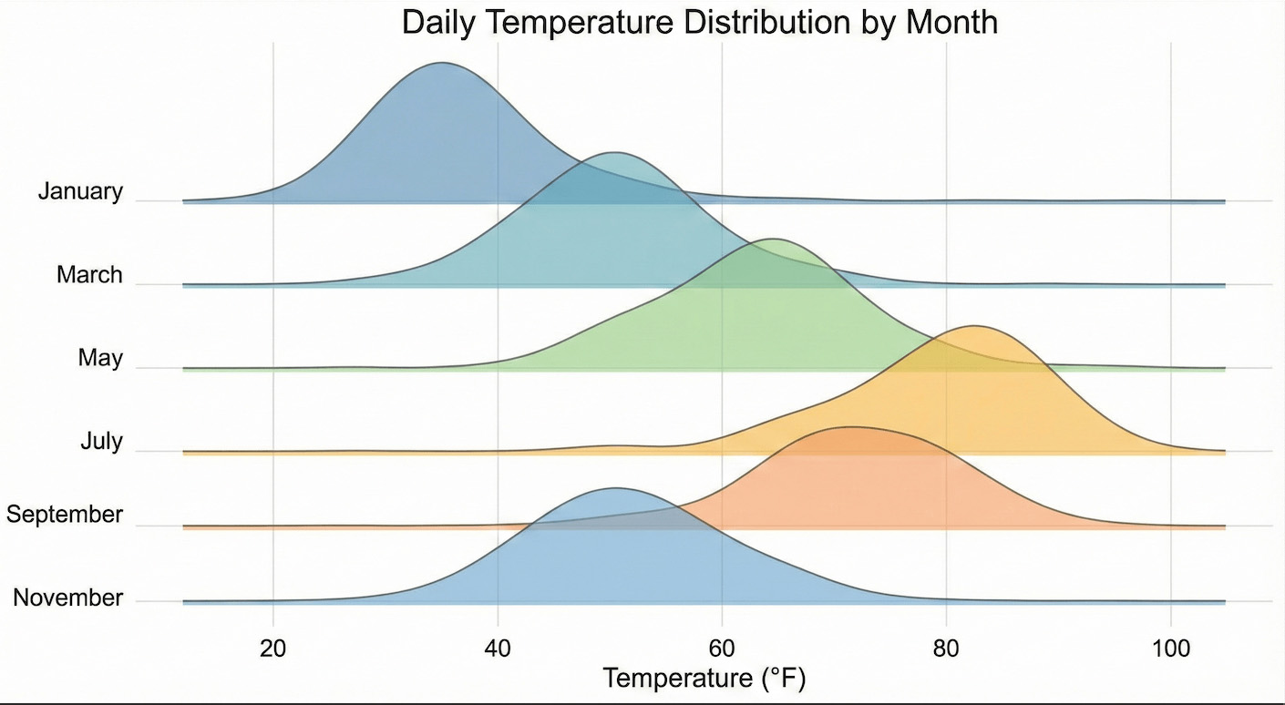
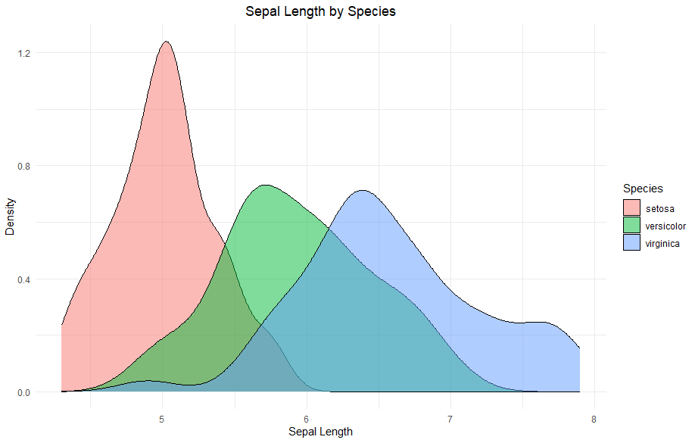
Visualization
Visualizations of Distribution
2) Density Plot
Density plots are used to visualize the distribution of continuous data, and are good for showing distribution characteristics, such as shape, central tendency, and spread, making them valuable for understanding data patterns and comparing distributions.

Slide 7
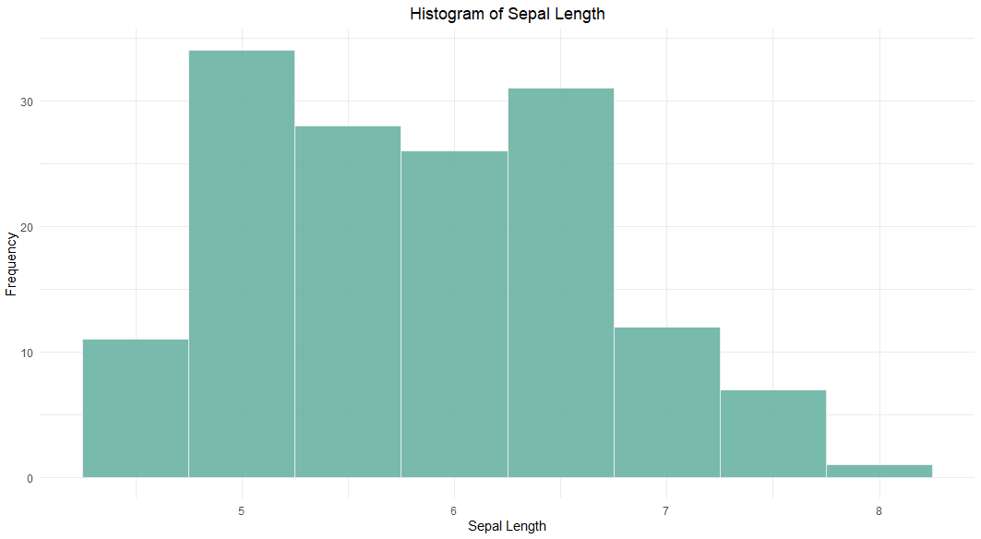
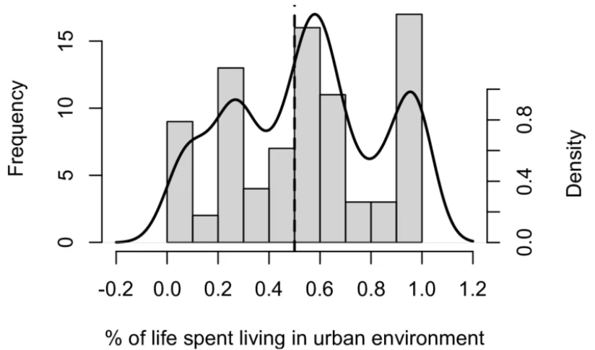
Visualization
Visualizations of Distribution
3) Histogram
Histograms are used to visualize the distribution of continuous data by grouping it into intervals (bins) and representing the frequency or density of data points within each bin. They are effective for revealing data patterns, central tendencies, and variations.

Slide 8
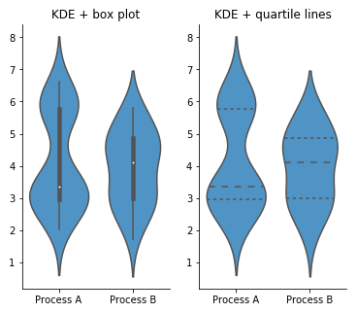
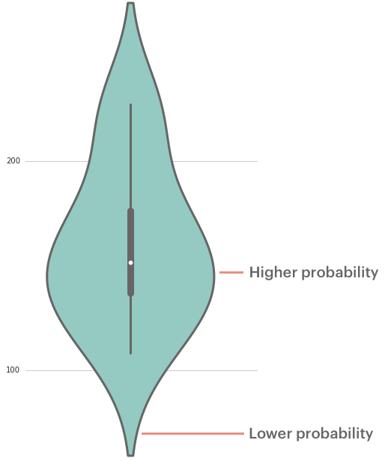
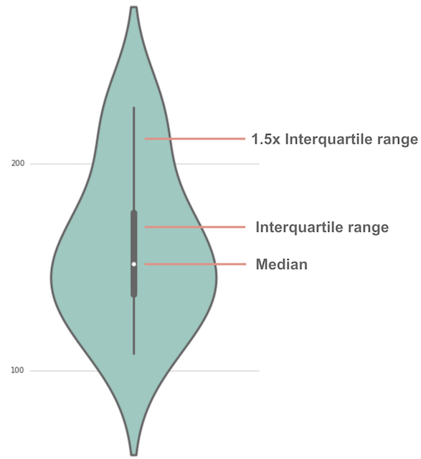
Visualization
Visualizations of Distribution
4) violin plot
A violin plot depicts distributions of numeric data for one or more groups using density curves. The width of each curve corresponds with the approximate frequency of data points in each region.

Slide 9
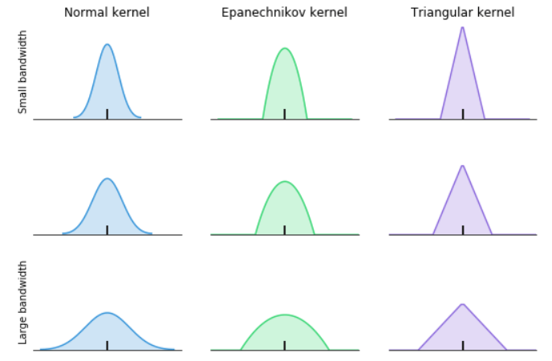
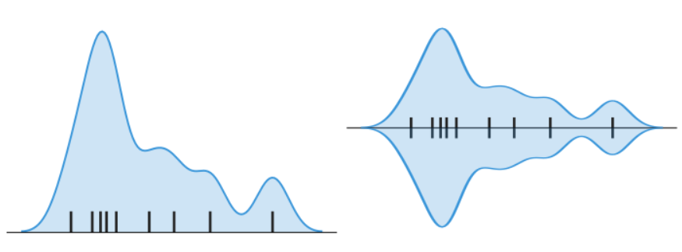
Visualization
Visualizations of Distribution
4) violin plot
A violin plot depicts distributions of numeric data for one or more groups using density curves. The width of each curve corresponds with the approximate frequency of data points in each region.

Slide 10
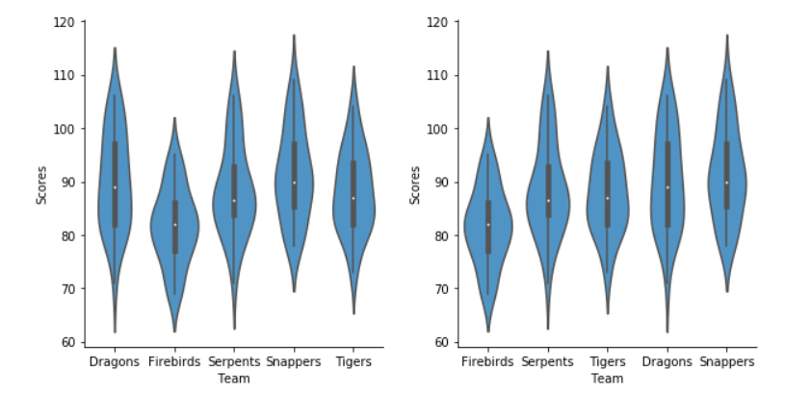
Visualization
Visualizations of Distribution
4) violin plot
A violin plot depicts distributions of numeric data for one or more groups using density curves. The width of each curve corresponds with the approximate frequency of data points in each region.
Consider the order of groups

Slide 11
Visualization
Visualizations of Correlation
5) Correlation Heatmap
A correlation heatmap is a 2D graphical representation of a correlation matrix between multiple variables.
The color intensity of each cell represents the strength of the correlation:
1 (or close to 1): Strong positive correlation (dark colors)
0: No correlation (neutral colors)
-1 (or close to -1): Strong negative correlation (light colors)

Slide 12
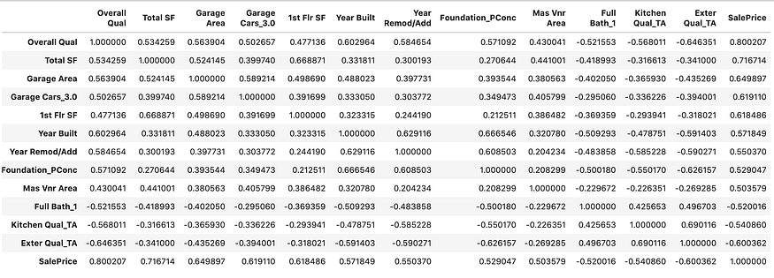
Visualization
Visualizations of Correlation
5) Correlation Heatmap
A correlation heatmap is a 2D graphical representation of a correlation matrix between multiple variables.
correlation matrix
dataframe.corr()

Slide 13
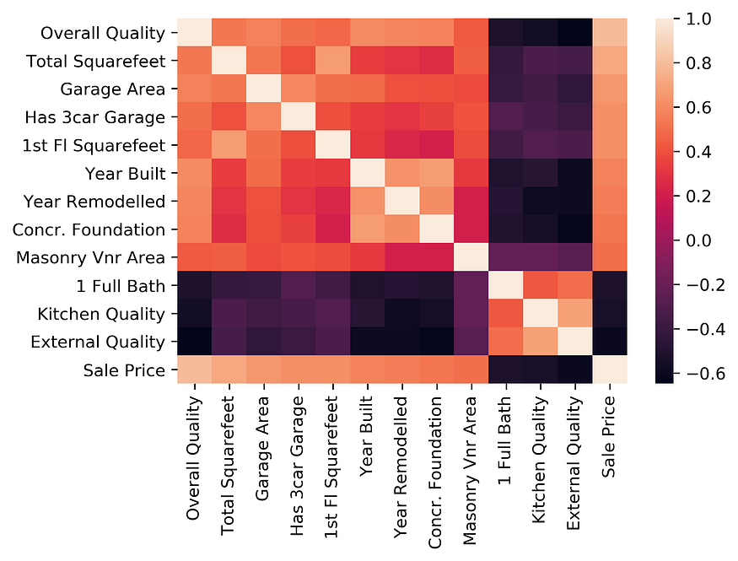
Visualization
Visualizations of Correlation
5) Correlation Heatmap
A correlation heatmap is a 2D graphical representation of a correlation matrix between multiple variables.

Slide 14
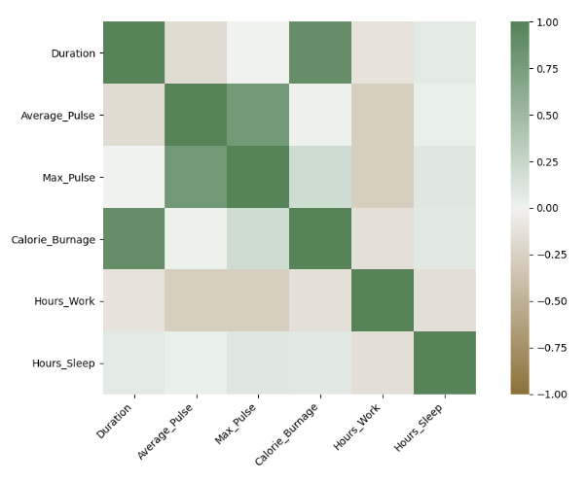
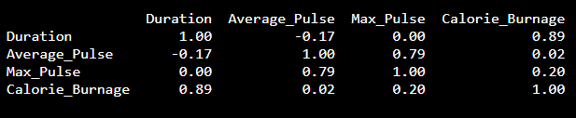
Visualization
Visualizations of Correlation
5) Correlation Heatmap
A correlation heatmap is a 2D graphical representation of a correlation matrix between multiple variables.

