Slide 1
CSC 405/605 Data Science

Slide 2
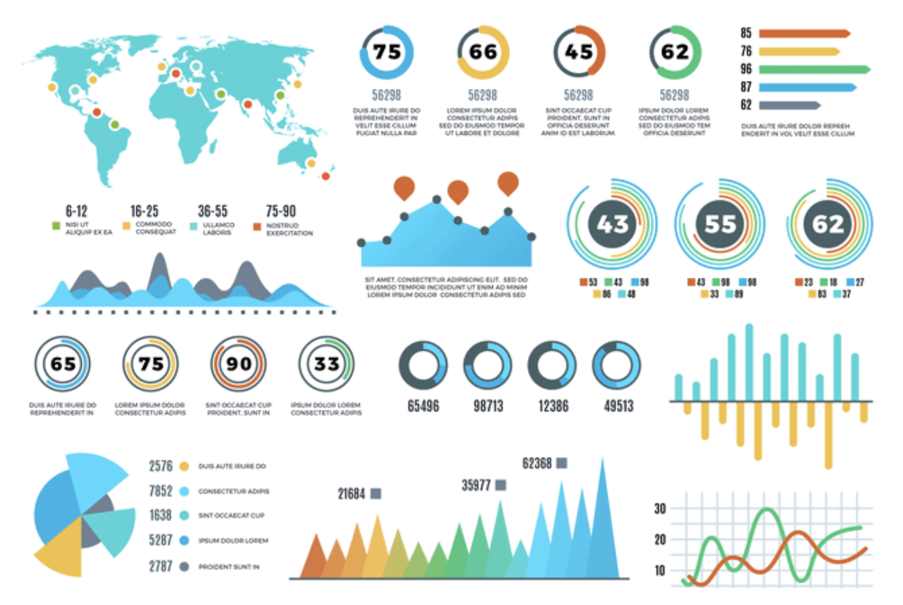
Visualization
What is data visualization?
Example. Consider a case where you are asked to illustrate crucial sales aspects (like sales performance, target, revenue, acquisition cost, etc.) from huge amounts of sales data, which one would you prefer:
Exploring the data using Excel (or spreadsheets)
and keeping track of each sales aspect manually.
2. Exploring the data using different types of sales
graphs and charts.
Obviously, you would prefer graphs and charts.
So, data visualization plays a key role in
data exploration and data analysis.

Slide 3
Visualization
What is data visualization?
“A picture is worth a thousand words.”
In data science, visual presentation of the data is a first-class citizen.
We combine together various charts to better understand the data and the relationships it hides.
Data Visualization is the technique to represent the
data/information in a pictorial or graphical format that
enables stakeholders and decision-makers to analyze
and explore data visually and uncover deep insights.

Slide 4
Visualization
What is the benefit of data visualization?
Helps in data analysis, data exploration and makes the data more understandable.
Summaries the complex quantitative information in a small space.
Helps in discovering the latest trends, hidden patterns in the data.
Identifies the relationships/correlations between the variables.
Helps in examining the areas that need attention or improvement

Slide 5
Visualization
Common Types of Data Visualization
Charts and Graphs: They are used to visualize data, with charts comparing data points across categories or showing trends over time and graphs analyzing relationships between variables to identify correlations, trends and outliers. Examples: Bar Charts, Line Charts, Pie Charts, Scatter Plots, Histograms, Box Plots.
Maps: They are used to display geographical data which provides spatial context to trends and patterns.
Examples: Geographic Maps, Heat Maps
Dashboards: They combine multiple visualizations into a single interface which provides real-time insights and interactive features for users to explore data.

Slide 6
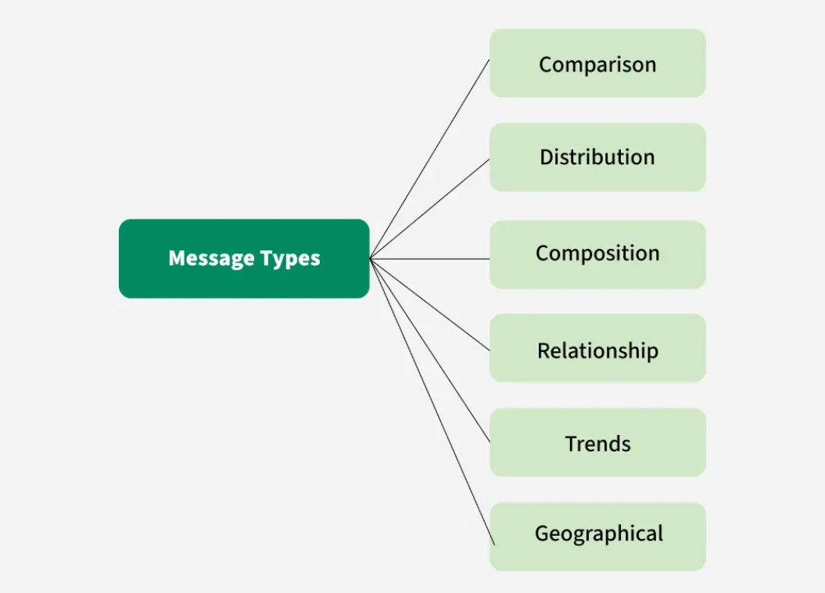
Visualization
Basic Charts for Data Visualization

Slide 7
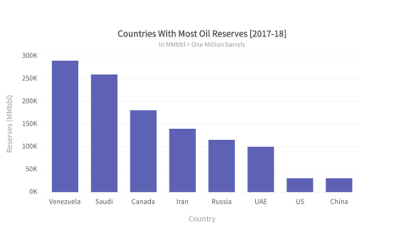
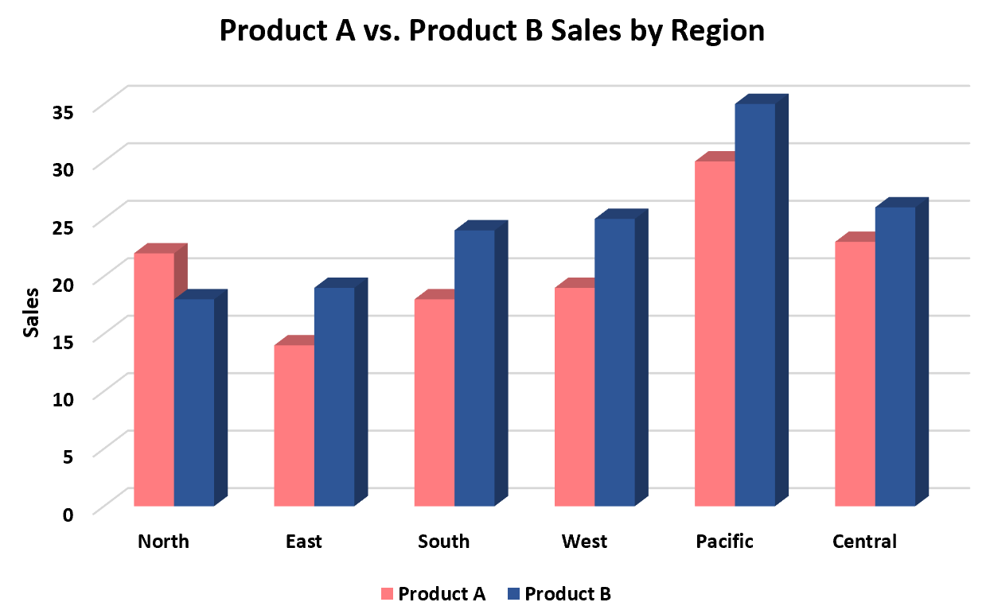
Visualization
Different Types of Basic Charts
Column Chart
A column chart is a vertical bar graph used to compare discrete categories or show data changes over time, with categories on the horizontal axis and values on the vertical axis.

Slide 8
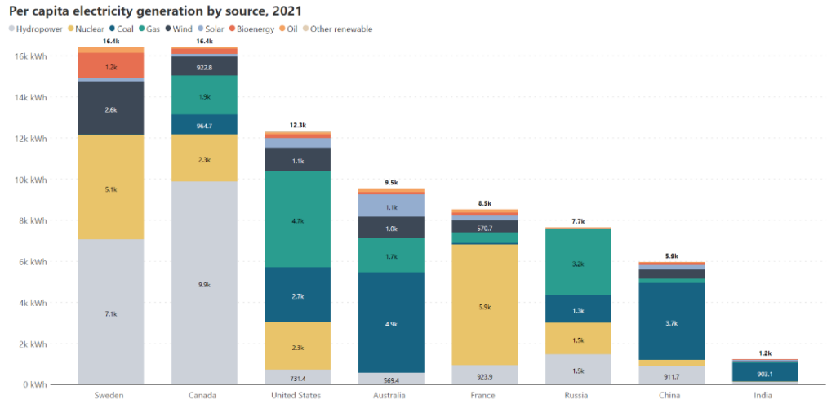
Visualization
Different Types of Basic Charts
Column Chart
A column chart is a vertical bar graph used to compare discrete categories or show data changes over time, with categories on the horizontal axis and values on the vertical axis.
Stacked column charts

Slide 9
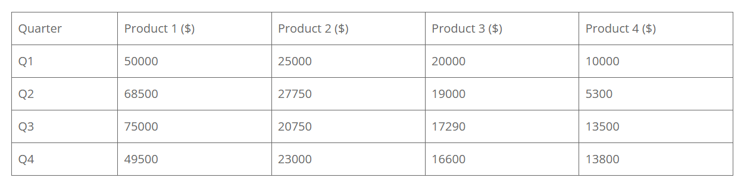
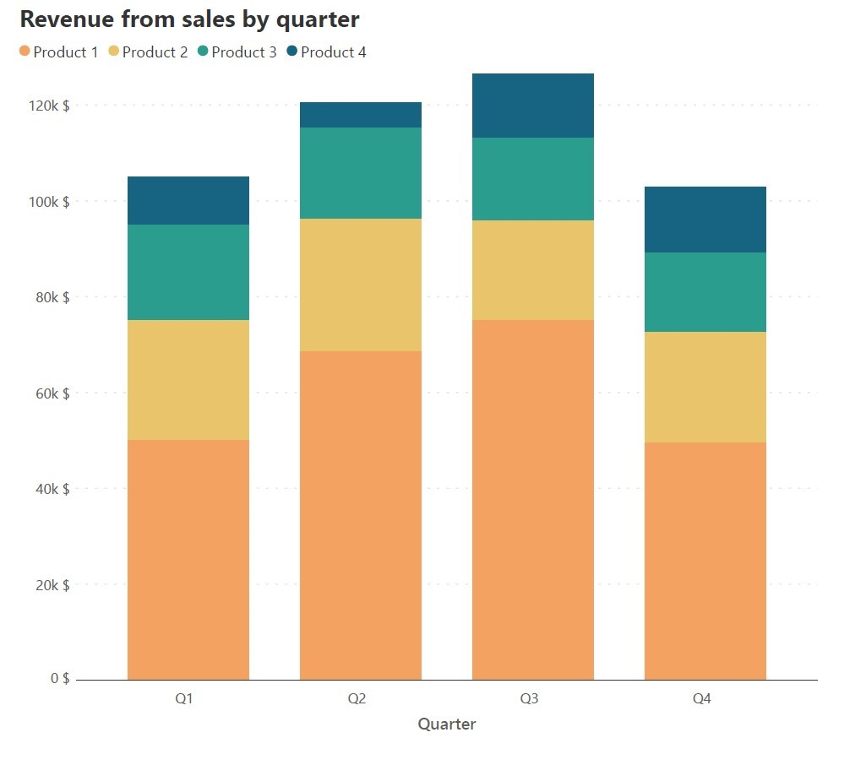
Visualization
Different Types of Basic Charts
Column Chart: Stacked column charts: the primary use for stacked column charts is in representing data where values are divided into contributing categories that sum to the total. This means that the data naturally has two categorical variables, one of which we designate as the primary variable to plot as columns, and the second which we use to divide the columns into segments.

Slide 10
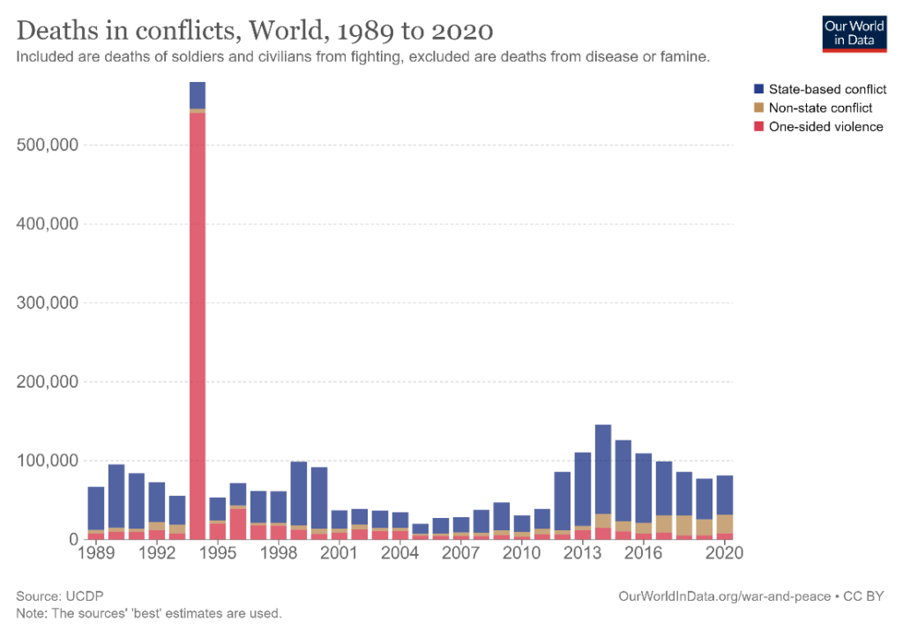
Visualization
Different Types of Basic Charts
Column Chart: Stacked column charts: the primary use for stacked column charts is in representing data where values are divided into contributing categories that sum to the total. This means that the data naturally has two categorical variables, one of which we designate as the primary variable to plot as columns, and the second which we use to divide the columns into segments.
The year 1994 jumps out as being one with a disproportionately high number of deaths, and it is apparent that the escalation in one-sided violence is the main cause for this tremendous increase.

Slide 11
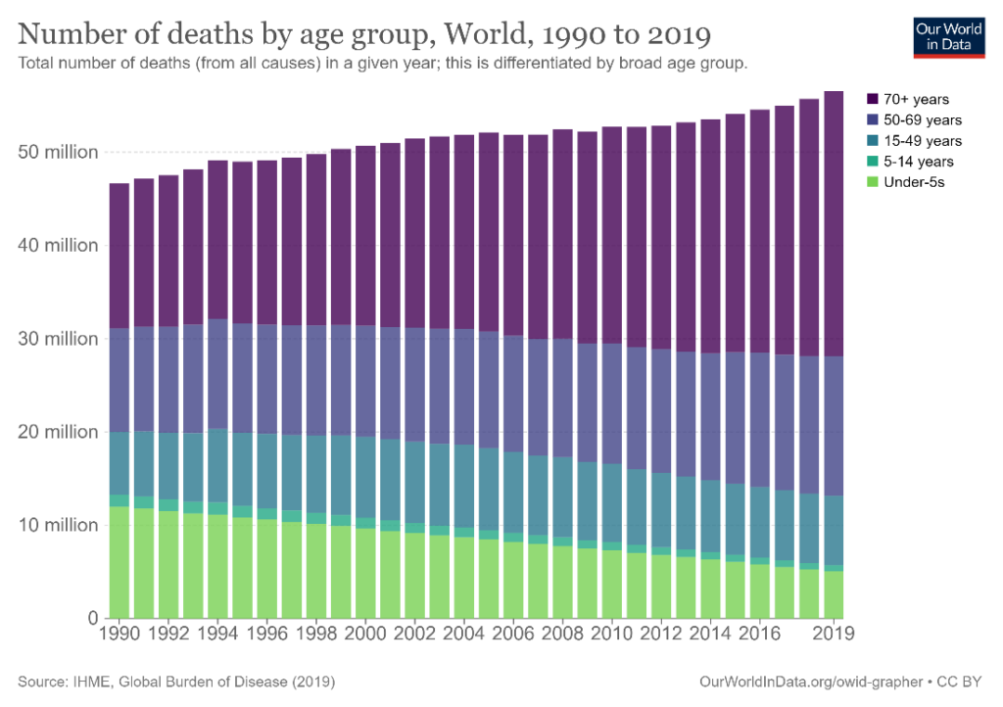
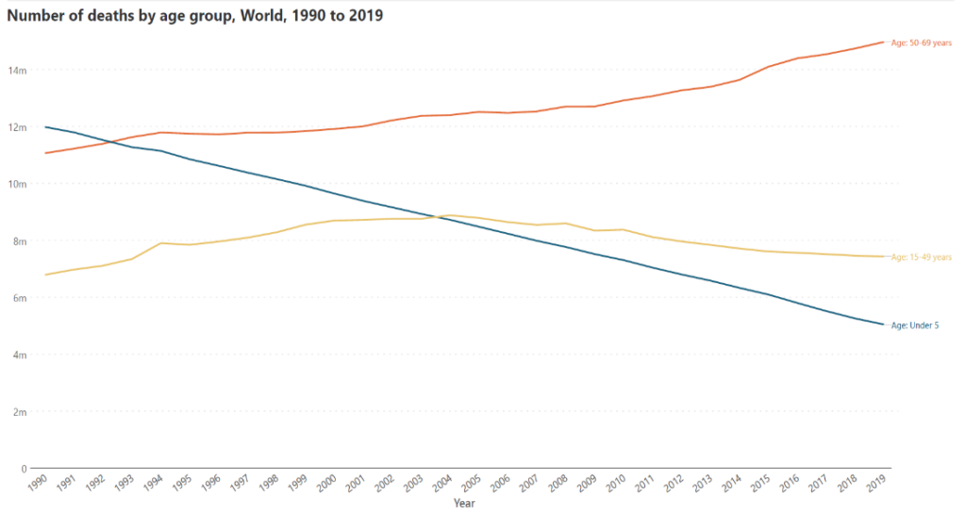
Visualization
Different Types of Basic Charts
Column Chart: Stacked column charts: the primary use for stacked column charts is in representing data where values are divided into contributing categories that sum to the total. This means that the data naturally has two categorical variables, one of which we designate as the primary variable to plot as columns, and the second which we use to divide the columns into segments.
Stacked column charts are not always a good option

Slide 12
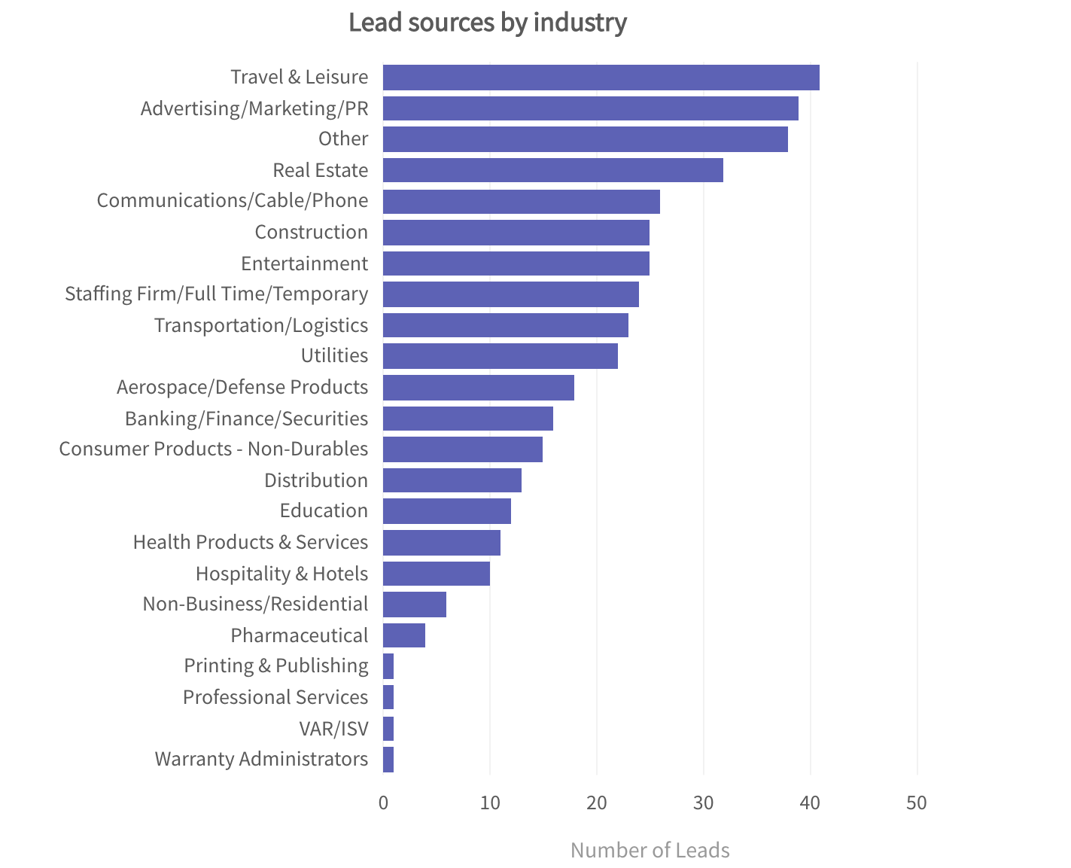
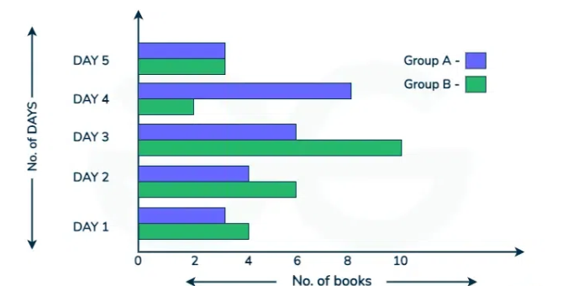
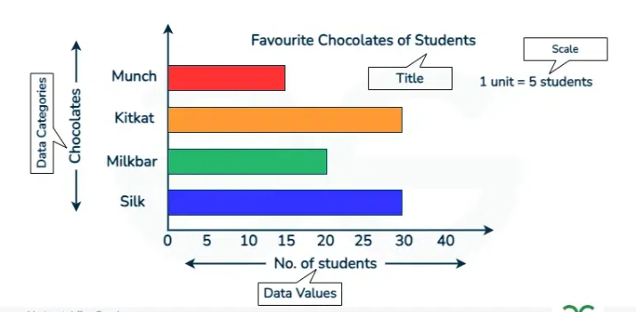
Visualization
Different Types of Basic Charts
2) Bar Chart
A bar chart (a horizontal column chart), should be used to avoid clutter when one data label is long or if you have more than 10 items to compare. This type of visualization can also be used to display negative numbers.

Slide 13
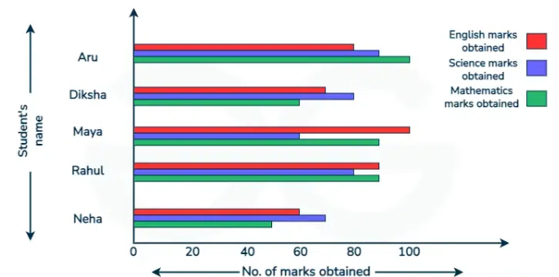
Visualization
Different Types of Basic Charts
2) Bar Chart
A bar chart (a horizontal column chart), should be used to avoid clutter when one data label is long or if you have more than 10 items to compare. This type of visualization can also be used to display negative numbers.
How many marks were obtained out of 100 by Neha in English?
Who scored the highest marks in Mathematics?
Name the students who obtained less than 80 in Science.

Slide 14
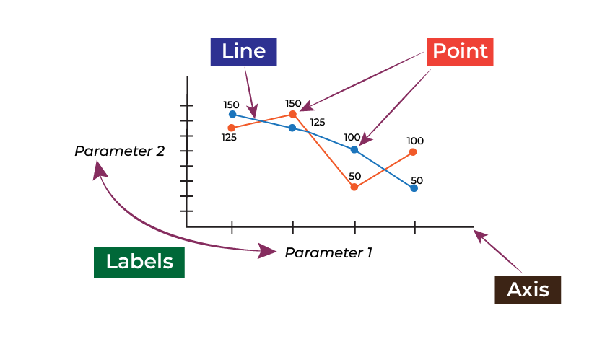
Visualization
Different Types of Basic Charts
3) Line Chart: is a graphical representation of the data that displays the relationship between two or more variables concerning time. It is made by connecting data points with straight-line segments.
A line chart reveals trends or progress over time and can be used to show many different categories of data.
You should use it when you chart a continuous data set.

Slide 15
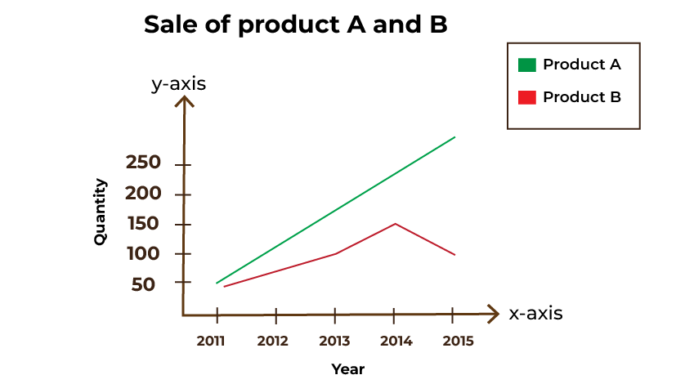
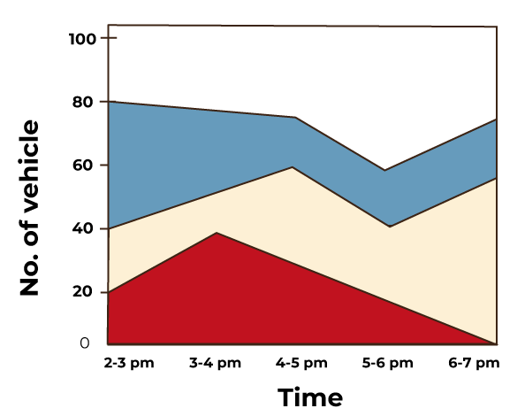
Visualization
Different Types of Basic Charts
3) Line Chart: is a graphical representation of the data that displays the relationship between two or more variables concerning time. It is made by connecting data points with straight-line segments.
A line chart reveals trends or progress over time and can be used to show many different categories of data.
You should use it when you chart a continuous data set.

Slide 16
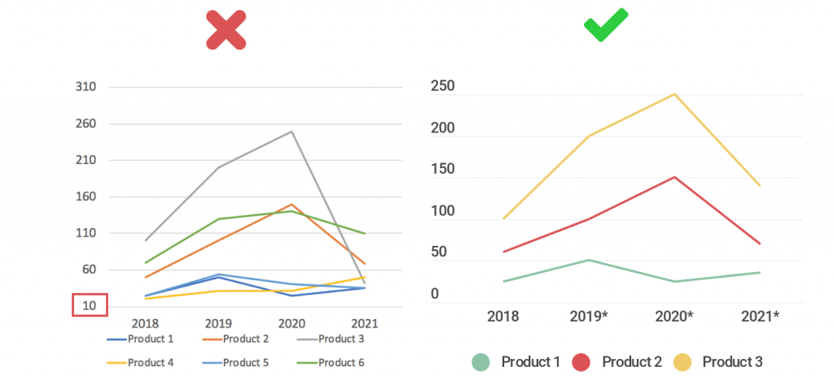
Visualization
Different Types of Basic Charts
3) Line Chart
Some tips:
Multiple-line charts with more than 5 lines can become cluttered and very difficult to read.

Slide 17
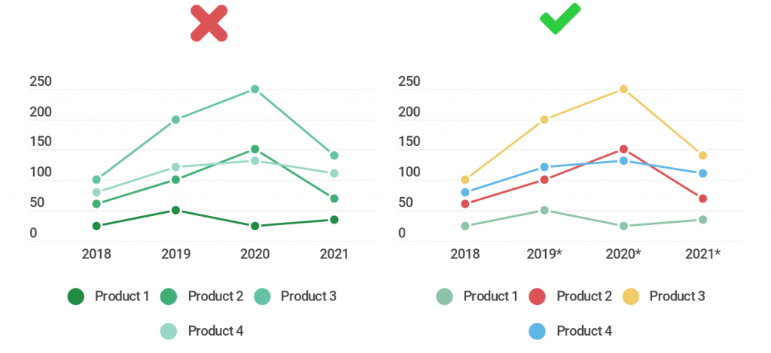
Visualization
Different Types of Basic Charts
3) Line Chart
Some tips:
Don’t make your lines all the same color, or variations of the same shade.

Slide 18
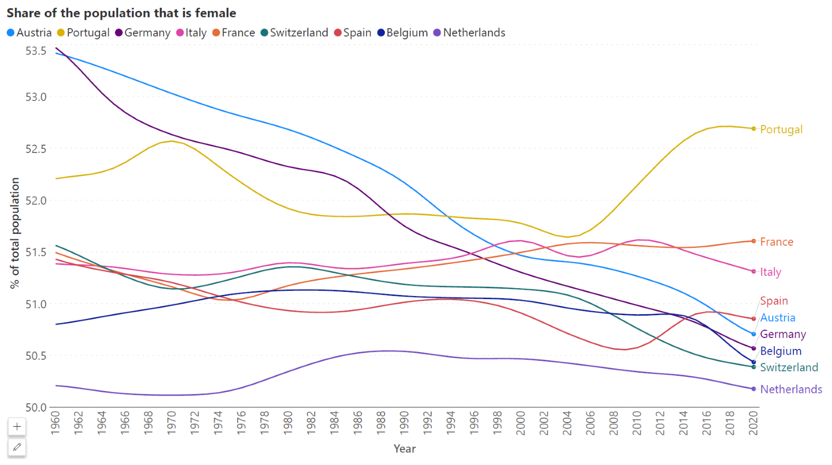
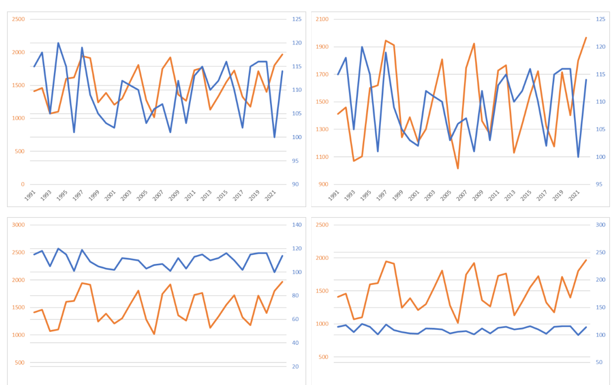
Visualization
Different Types of Basic Charts
3) Line Chart
Some tips:

Slide 19
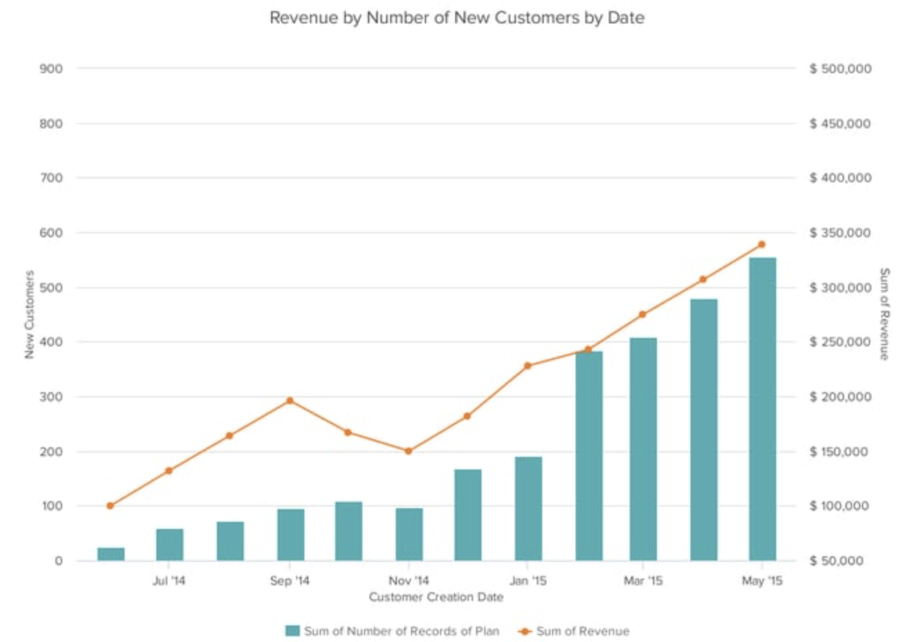
Visualization
Different Types of Basic Charts
4) Dual Axis Chart
A dual axis chart allows you to plot data using two y-axes and a shared x-axis. It's used with three data sets,
one of which is based on a continuous set of data and another which is better suited to being grouped by category. This should be used to visualize a correlation or the lack thereof between these three data sets.
Use the y-axis on the left side for the primary variable because brains are naturally inclined to look left first.
Use different graphing styles to illustrate the two data sets, as illustrated above.
Choose contrasting colors for the two data sets.

Slide 20
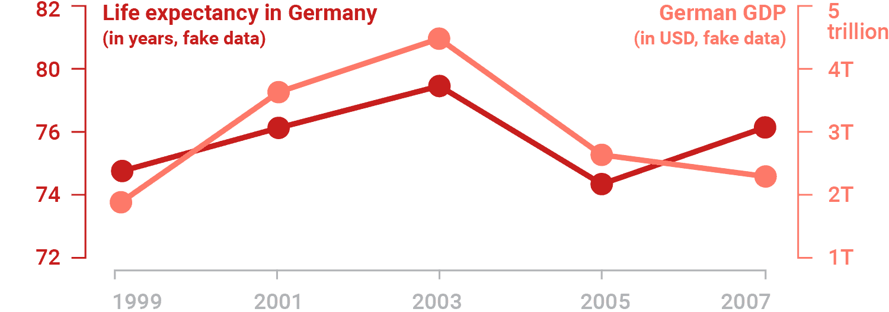
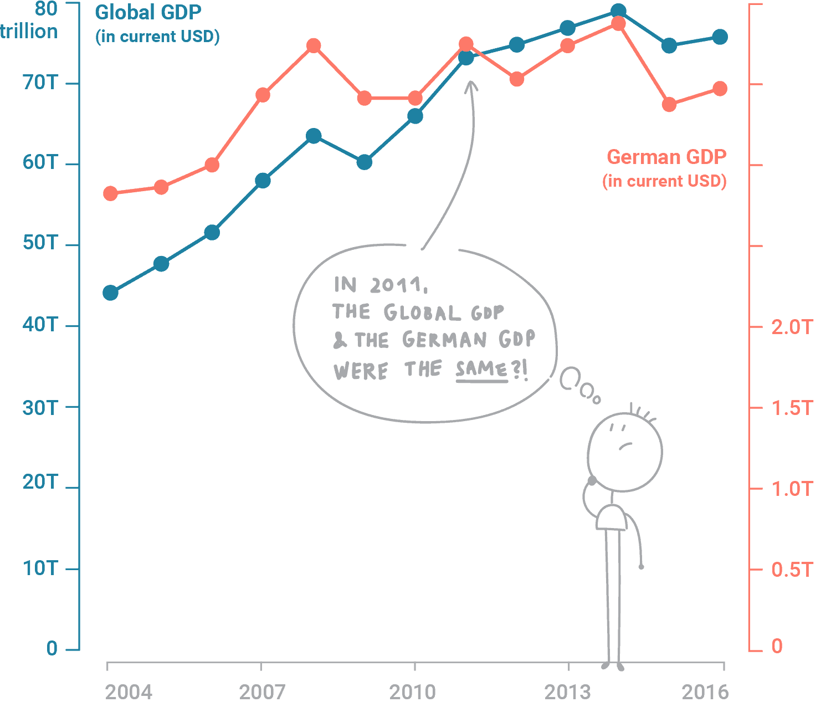
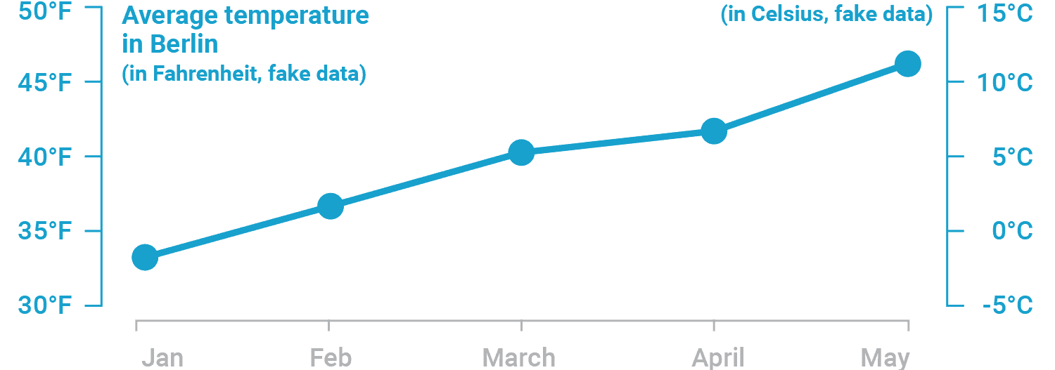
Visualization
Different Types of Basic Charts
4) Dual Axis Chart

Slide 21
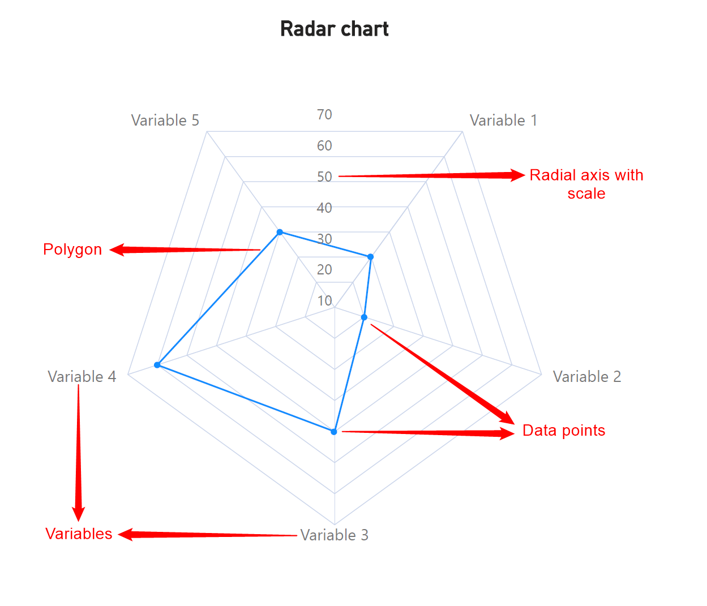
Visualization
Different Types of Basic Charts
5) Radar Chart
A radar chart, sometimes called a spider chart or a star chart, is a powerful tool to examine multivariate data in a novel and engaging form.

Slide 22
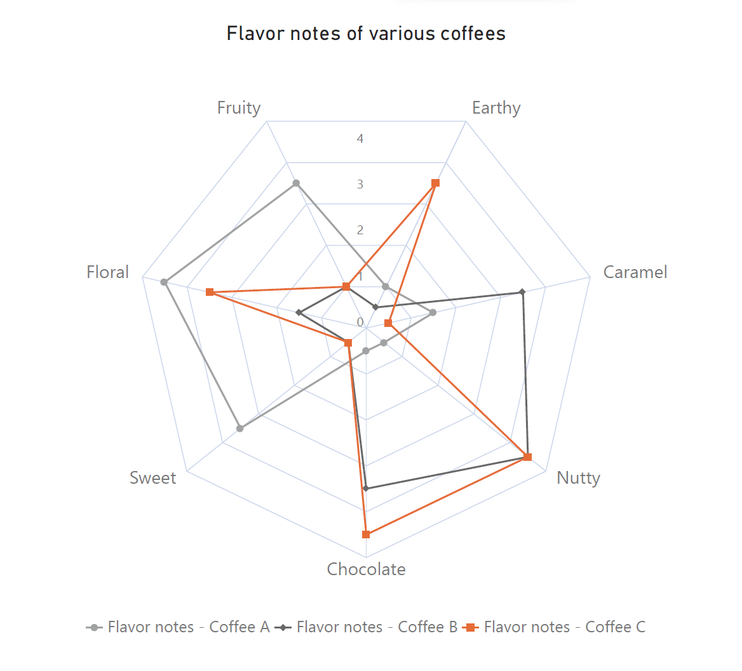
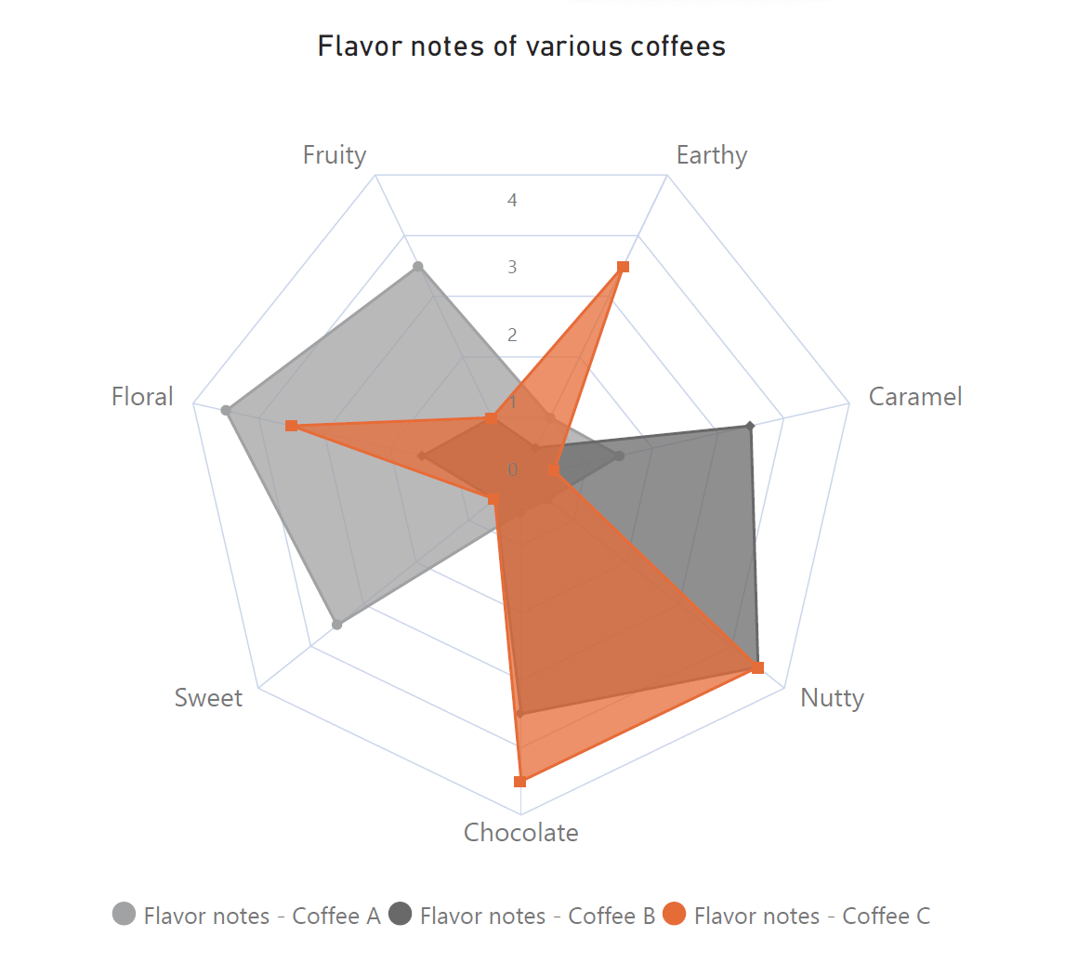
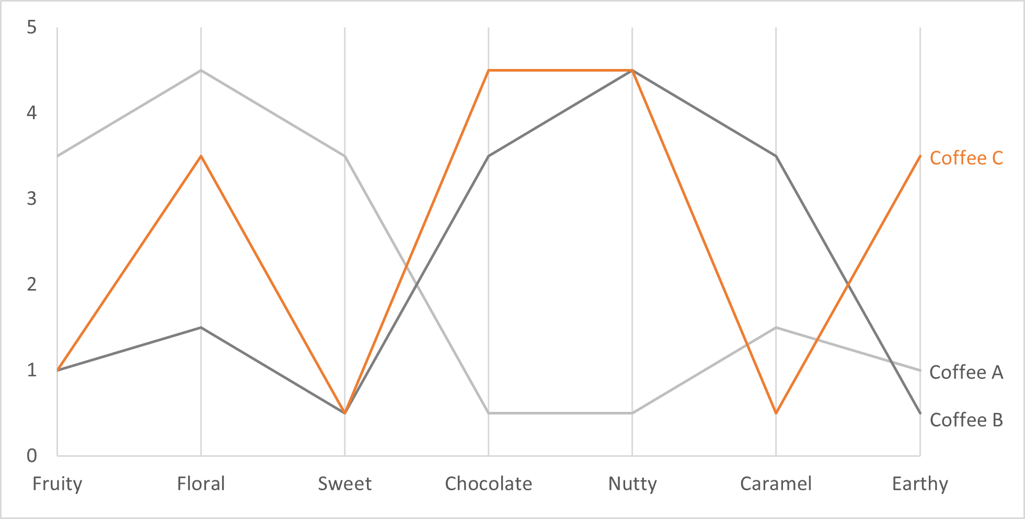
Visualization
Different Types of Basic Charts
5) Radar Chart
A radar chart, sometimes called a spider chart or a star chart, is a powerful tool to examine multivariate data in a novel and engaging form.

Slide 23
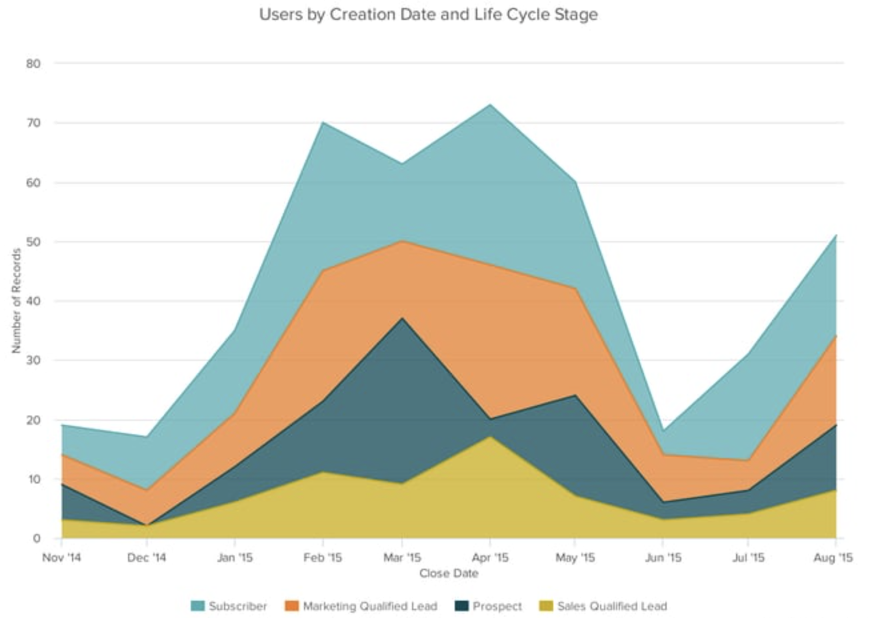
Visualization
Different Types of Basic Charts
6) Area Chart
Basically, a line chart, but the space between the x-axis and the line is filled with a color or pattern. It is useful
for showing part-to-whole relations, such as showing individual sales contribution to total sales for a year.
It helps you analyze both overall and individual trend information.
Use transparent colors so information isn't obscured in the background.
Don't display more than four categories to avoid clutter.
Organize highly variable data at the top of the chart to make it easy to read

Slide 24
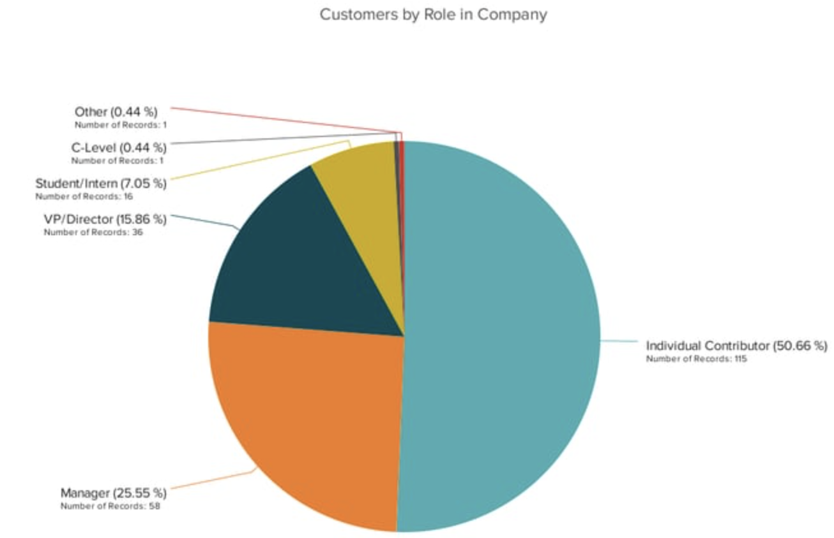
Visualization
Different Types of Basic Charts
7) Pie Chart
A pie chart shows a static number and how categories represent part of a whole -- the composition of something. A pie chart represents numbers in percentages, and the total sum of all segments needs to equal 100%.
Don't illustrate too many categories to ensure
differentiation between slices.
Ensure that the slice values add up to 100%.
Order slices according to their size.

Slide 25
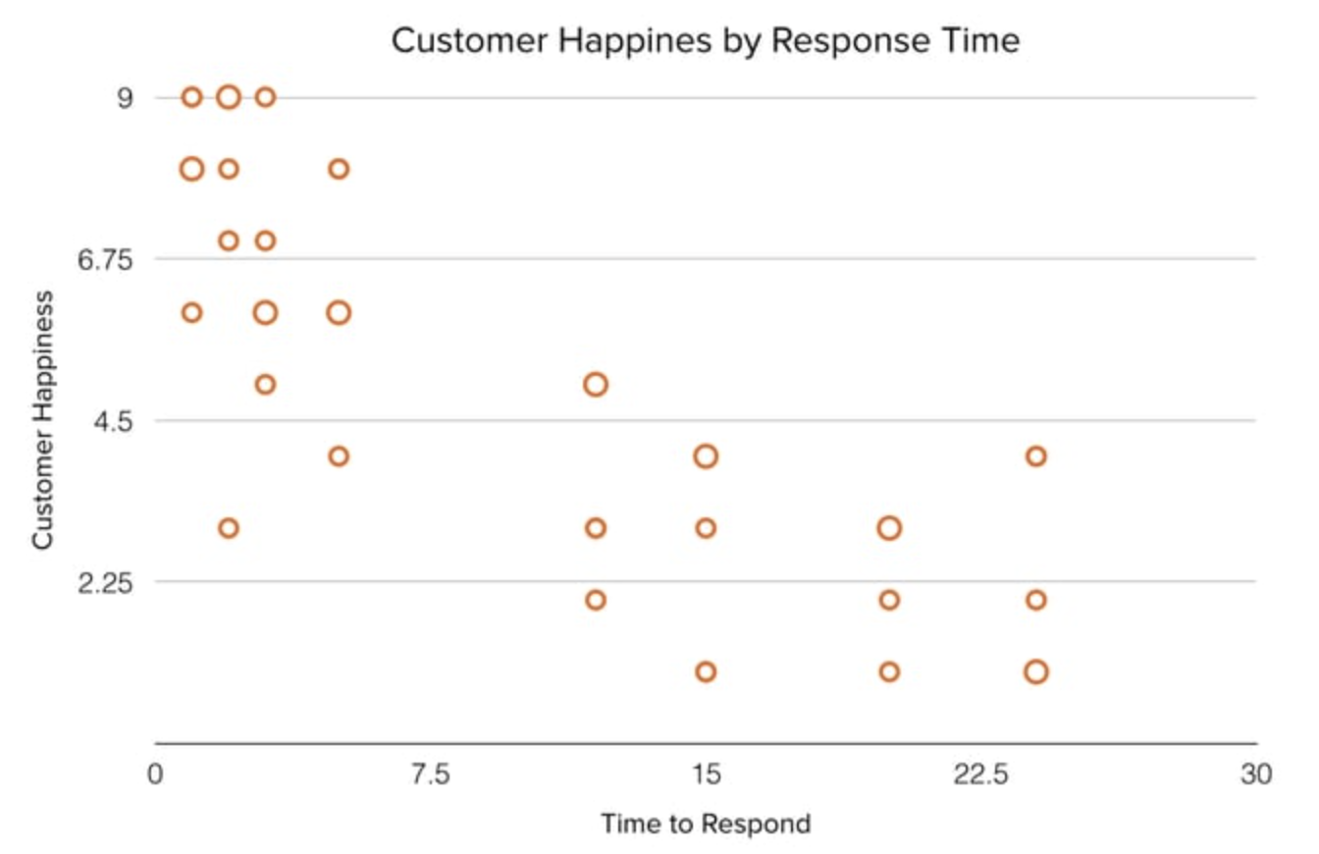
Visualization
Different Types of Basic Charts
8) Scatter Plot
A scatter plot is a type of data visualization that displays individual data points on a two-dimensional graph.
Scatter plots are particularly useful for visualizing the relationship between two continuous variables and identifying patterns, trends, correlations, and outliers in the data.
Limited to Two or Three Variables: Scatter plots are not well-suited for visualizing relationships involving more than three variables.
Overplotting: High-density data can lead to overplotting, where points overlap excessively, obscuring patterns.

Slide 26
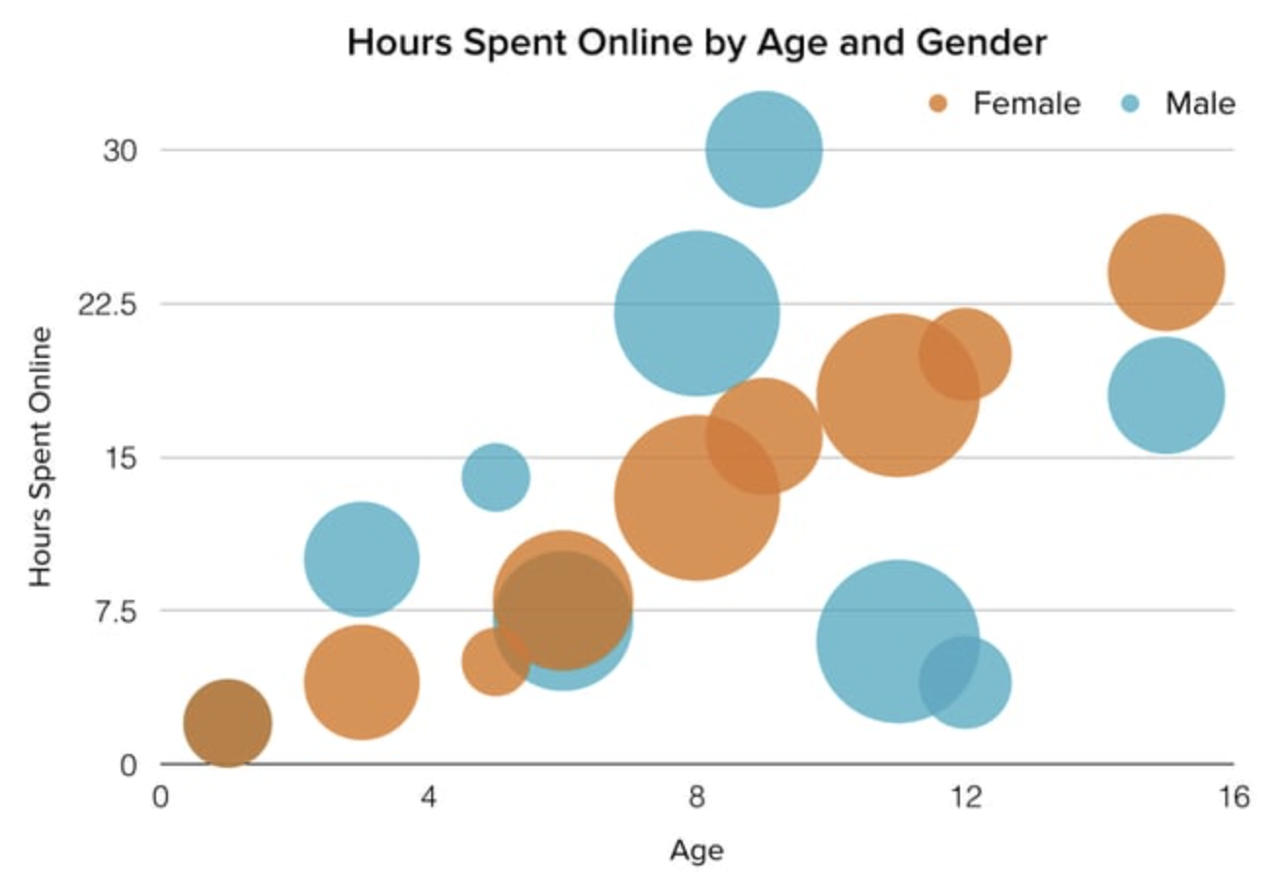
Visualization
Different Types of Basic Charts
9) Bubble Chart
A bubble chart is similar to a scatter plot in that it can show distribution or relationship. There is a third data set, which is indicated by the size of the bubble or circle.
A bubble chart is a type of graph that represents three variables using bubble sizes, colors, and positions.
The bubble chart has an x-axis and y-axis to represent two variables, and the size of the bubbles represents the third variable. The larger the bubble, the higher the value of the third variable.

Slide 27
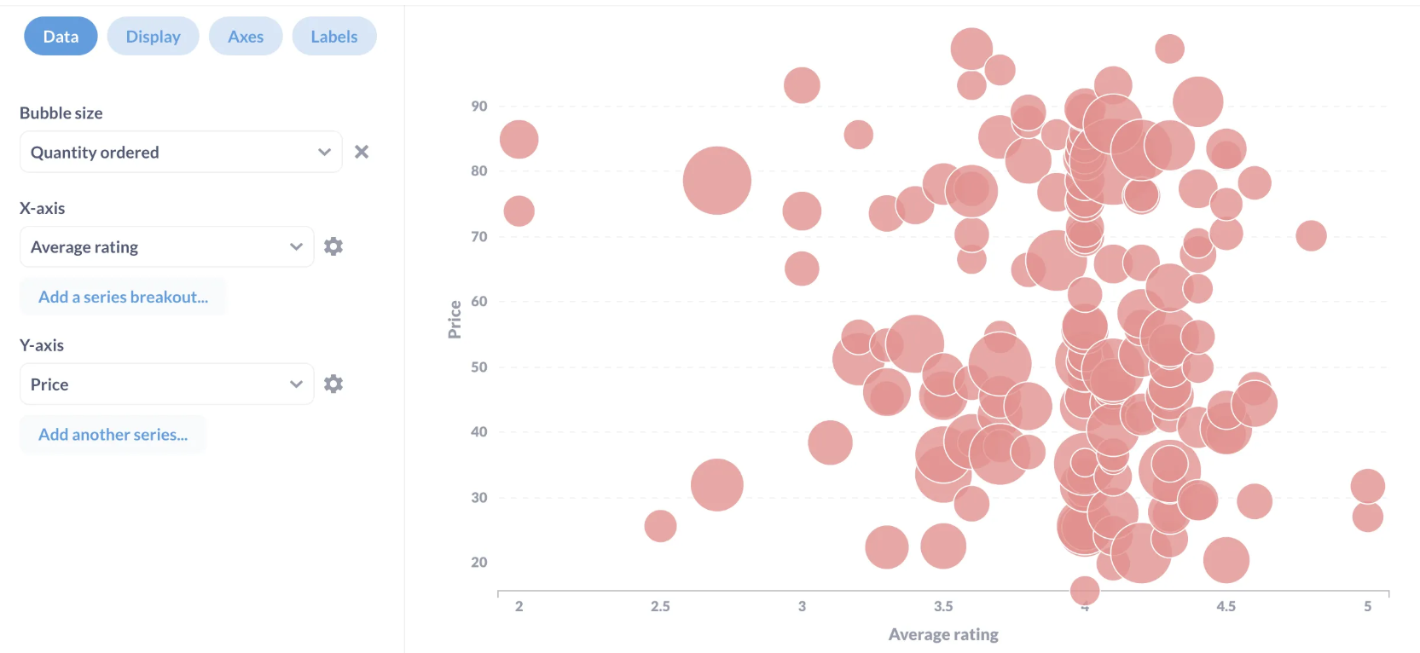
Visualization
Different Types of Basic Charts
9) Bubble Chart
A bubble chart is similar to a scatter plot in that it can show distribution or relationship. There is a third data set, which is indicated by the size of the bubble or circle.

Slide 28
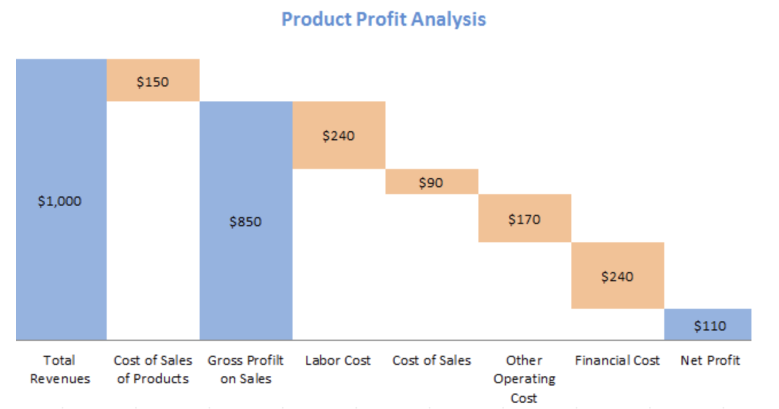
Visualization
Different Types of Basic Charts
10) Waterfall Chart
also known as bridge charts, are a type of data visualization that helps in understanding the incremental changes in the value of a variable. They are commonly used in financial analysis to show how a starting value (such as net income) is affected by a series of positive and negative changes (such as revenue, expenses, taxes) to reach an ending value.
Use contrasting colors to highlight differences
Choose warm colors to indicate increases and
cool colors to indicate decreases.

Slide 29
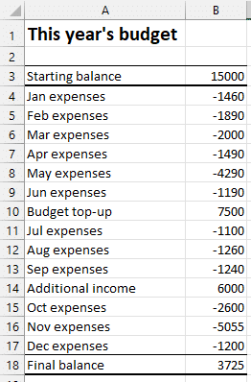
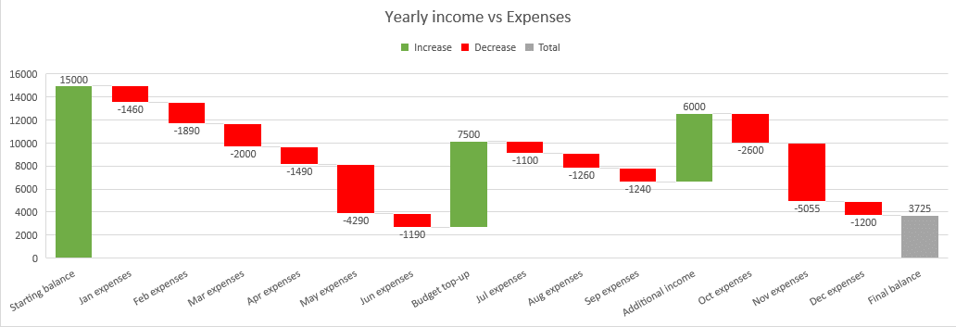
Visualization
Different Types of Basic Charts
10) Waterfall Chart

Slide 30
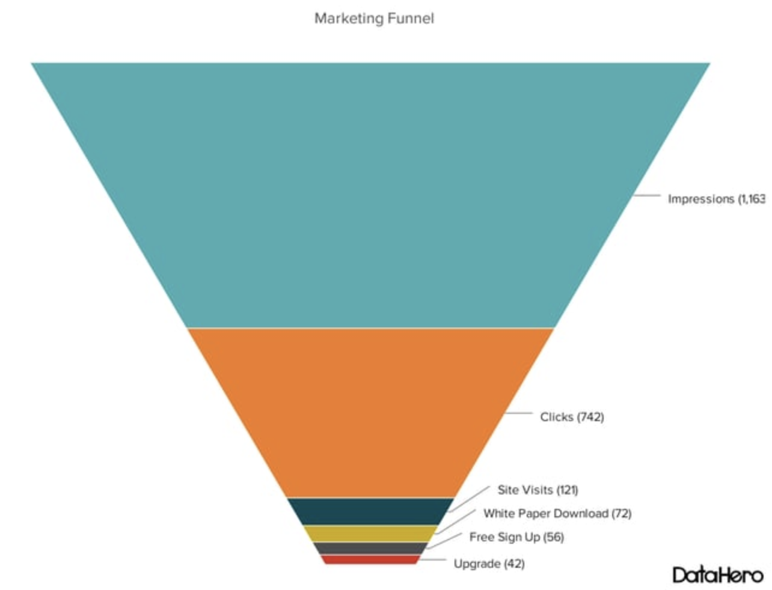
Visualization
Different Types of Basic Charts
11) Funnel Chart
A funnel chart shows a series of steps and the completion rate for each step. This can be used to track the sales process or the conversion rate across a series of pages or steps.
Area-width ambiguity: In a funnel chart, people visually judge the area, but the data is usually encoded using width only.
Use contrasting colors or one color in gradating hues, from
darkest to lightest as the size of the funnel decreases.

Slide 31
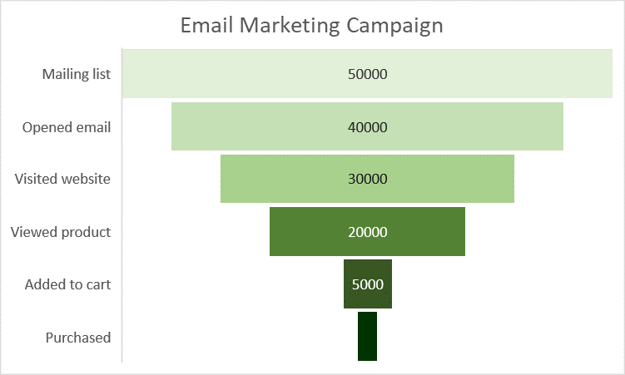
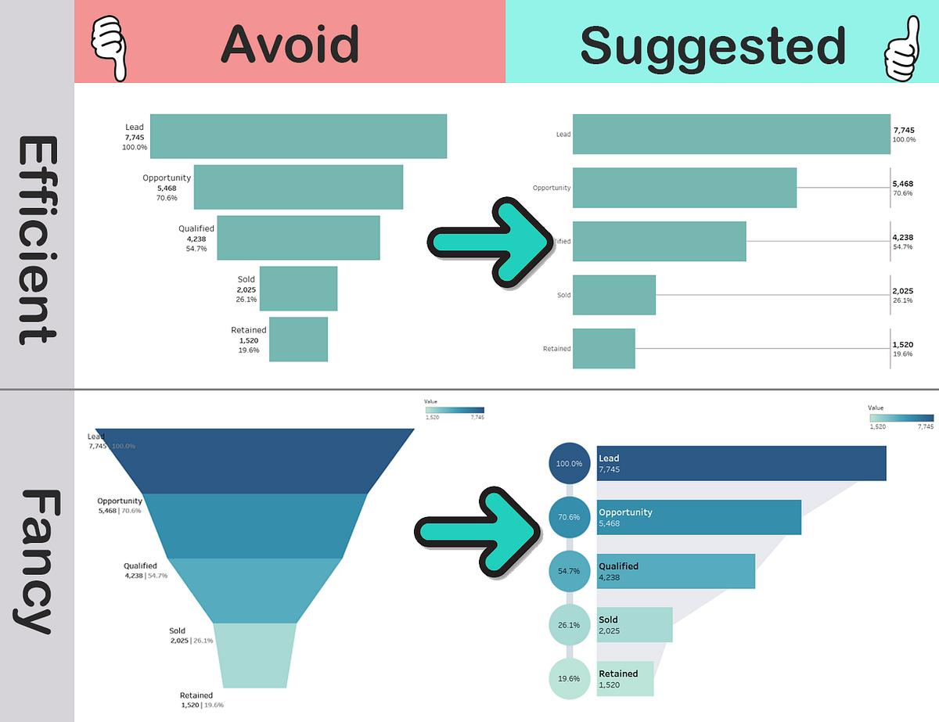
Visualization
Different Types of Basic Charts
11) Funnel Chart
A funnel chart shows a series of steps and the completion rate for each step. This can be used to track the sales process or the conversion rate across a series of pages or steps.

Slide 32
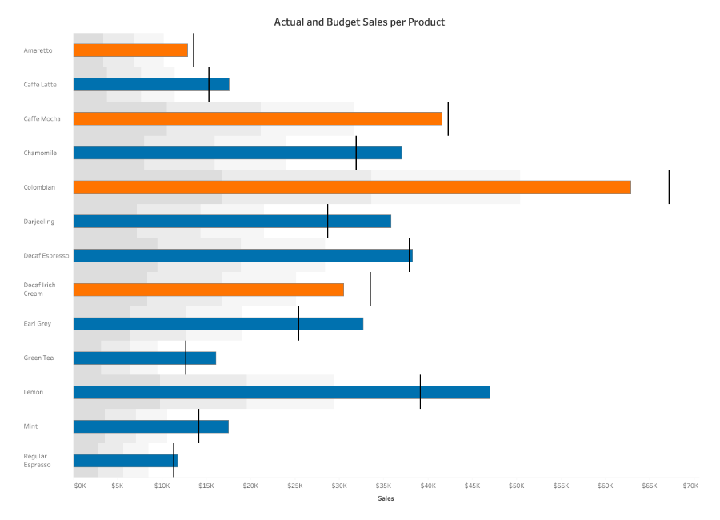
Visualization
Different Types of Basic Charts
Bullet Chart
A bullet graph reveals progress toward a goal, compares this to another measure, and provides context in the
form of a rating or performance.
Uses a vertical bar to show the target for each Product
Uses colors (yellow and green) to distinguish which product met its sales goals
Uses gray to mark the goal bar around the product bar
Starts at a base of zero

Slide 33
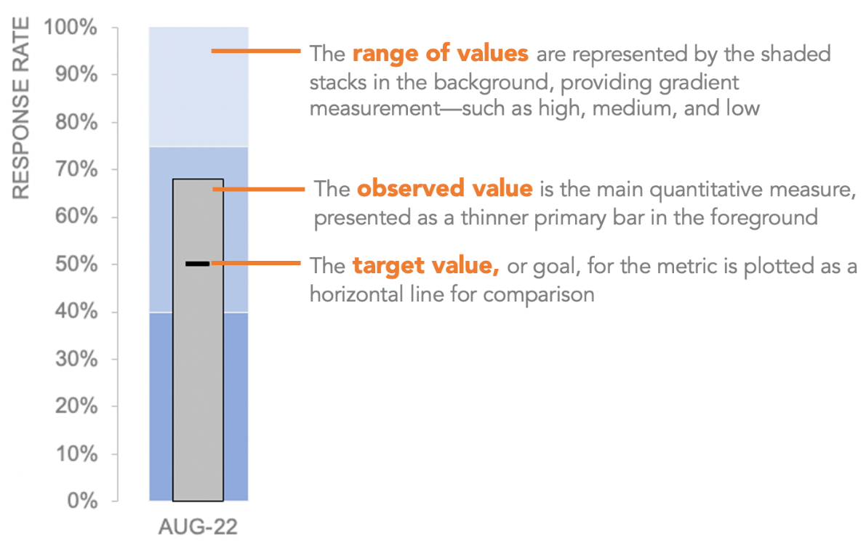
Visualization
Different Types of Basic Charts
Bullet Chart
A bullet graph reveals progress toward a goal, compares this to another measure, and provides context in the
form of a rating or performance.

Slide 34
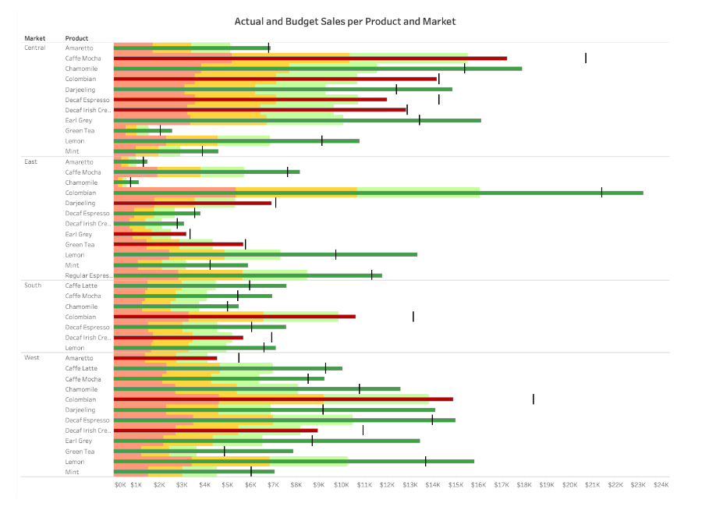
Visualization
Different Types of Basic Charts
Bullet Chart
Tips:

Slide 35
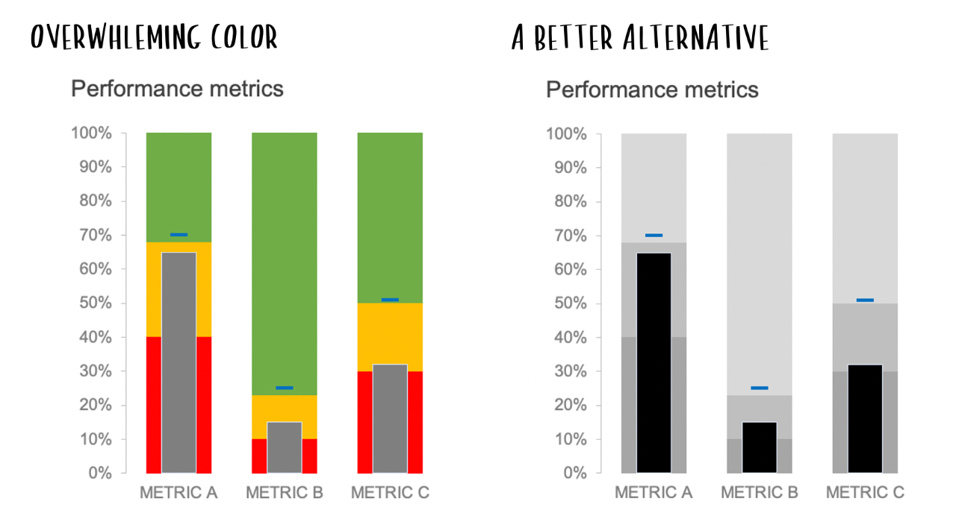
Visualization
Different Types of Basic Charts
Bullet Chart
Tips:
Using too much color can overwhelm and confuse your audience.

Slide 36
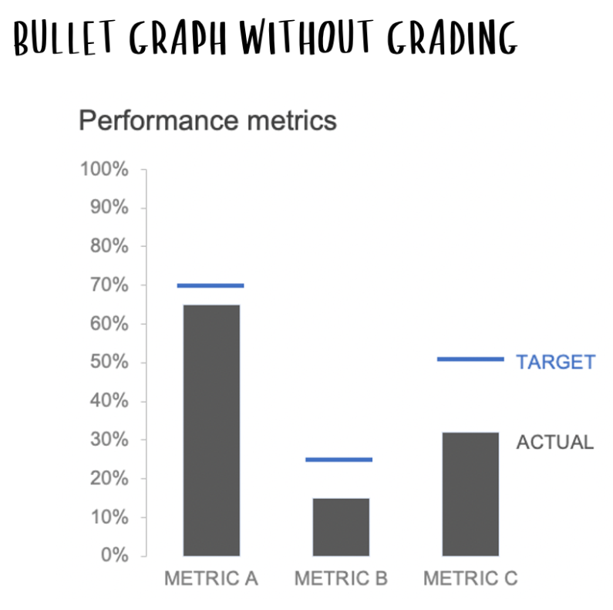
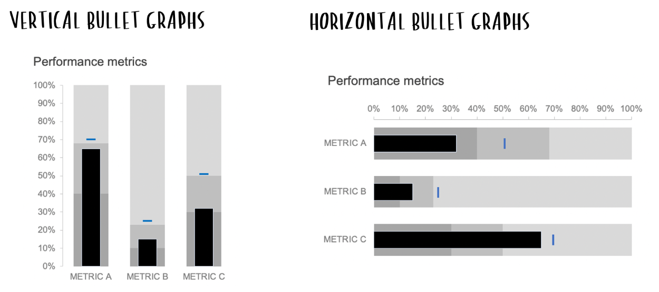
Visualization
Different Types of Basic Charts
Bullet Chart
Tips:

Slide 37
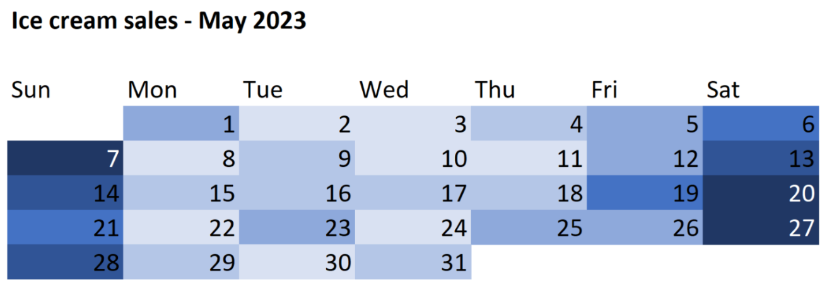
Visualization
Different Types of Basic Charts
13) Heat Map
A heat map is a two-dimensional representation of data in which various values are represented by colors.

Slide 38
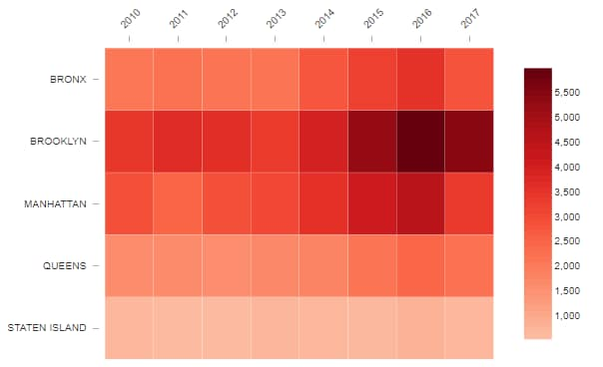
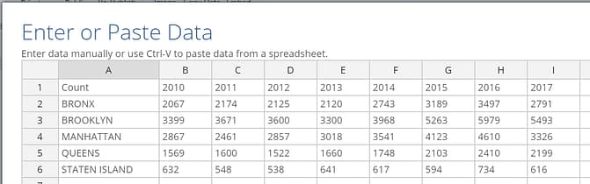
Visualization
Different Types of Basic Charts
13) Heat Map
This table contains the number of rats sighted in each borough of New York, from 2010 to 2017. It’s not too difficult to find the biggest concentration of rats was in Brooklyn in 2016, but the heatmap makes it easy.

Slide 39
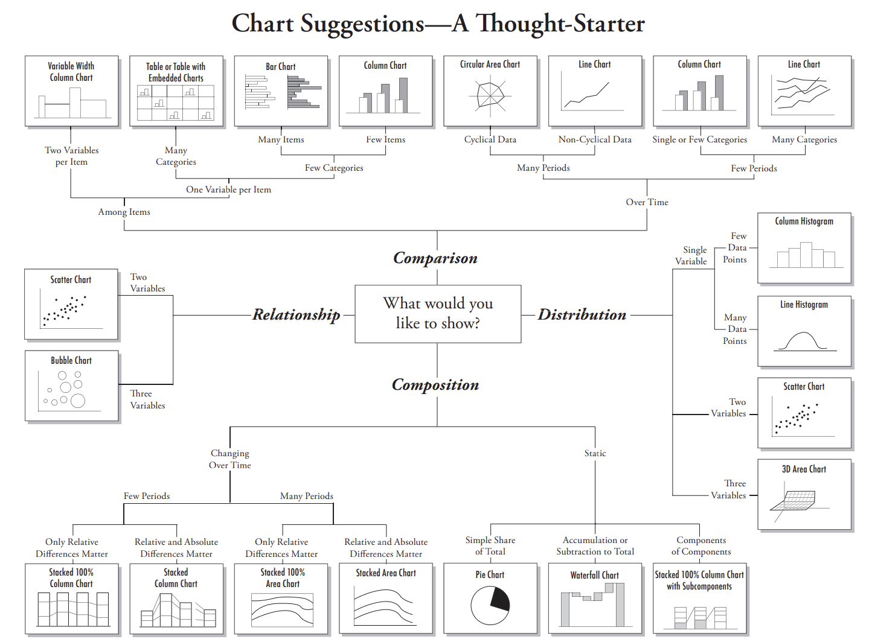
Visualization

