Slide 1
Introduction to NumPy
CSC 405/605

Slide 2
What is NumPy?
NumPy Stands For Numerical Python.
NumPy is a Python library used for working with array.
NumPy is the fundamental package for scientific computing.
It also has functions for working in domain of linear algebra, Fourier transform, and matrices.
NumPy was created in 2005 by Travis Oliphant. It is an open-source project, and you can use it freely.

Slide 3
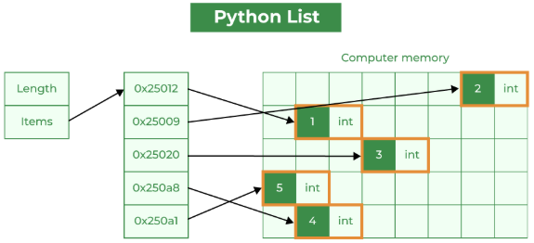
Why use NumPy?
Python list vs NumPy array
  Lists in Python store additional information about each element, such as its type and reference count.
  Lists can hold different data types, but this can decrease memory efficiency and slow numerical operations.
  Lists may not store elements in contiguous memory locations, causing memory fragmentation and inefficiency.

Slide 4
Why use NumPy?
Python list vs NumPy array
  Lists are not optimized for numerical computations and may have slower mathematical operations due to Python's interpretation overhead. They are generally used as general-purpose data structures.

Slide 5
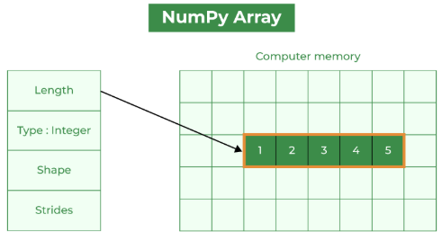
Why use NumPy?
Python list vs NumPy array
  NumPy arrays store elements of the same data type, making them more compact and memory-efficient than lists.
  NumPy arrays store elements in adjacent memory locations, reducing fragmentation and allowing for efficient access
  NumPy arrays have extra metadata like shape, strides, and data type. However, this overhead is usually smaller than the per-element overhead in lists.

Slide 6
Why use NumPy?
Python list vs NumPy array
  NumPy arrays are optimized for numerical computations, with efficient element-wise operations and mathematical functions. These operations are implemented in C, resulting in faster performance than equivalent operations on lists.

Slide 7
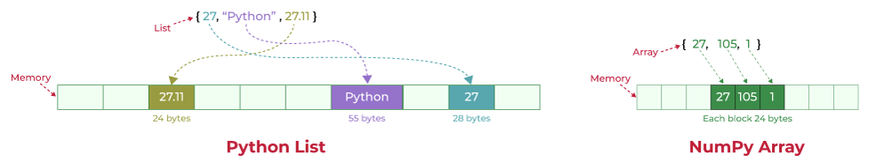
Why use NumPy?

Slide 8
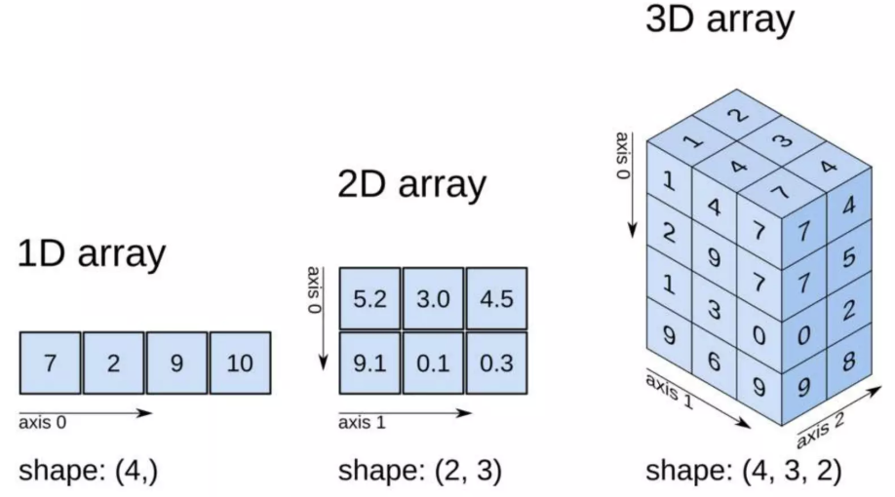
Create NumPy Array

Slide 9
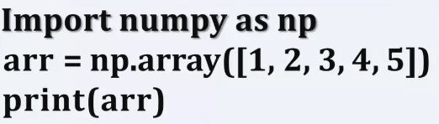
Create NumPy Array
1-D Array
  An array that has 0-D arrays as its elements is called uni-dimensional or 1-D array. These are the most common and basic arrays.

Slide 10
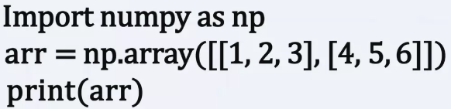
Create NumPy Array
2-D Array
  An array that has 1-D arrays as its elements is called a 2-D array.

Slide 11
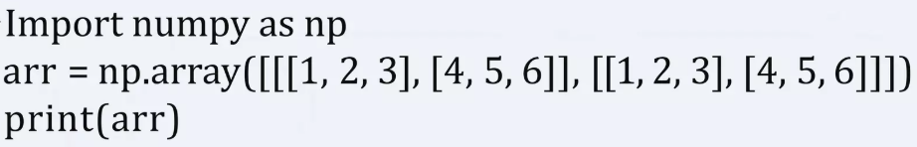
Create NumPy Array
3-D Array
  An array that has 2-D arrays (matrices) as its elements is called 3-D array.

Slide 12
Create NumPy Array
numpy.empty
  The numpy.empty() function is used to create a new array of a specified shape and data type, without initializing its elements.
numpy.empty(shape, dtype=float, order='C')
Parameter | Description
shape | Shape (dimensions) of the array
dtype | Data type of the array (optional)
order | Memory layout of the array: "C" = row-major order "F" = column-major order

Slide 13
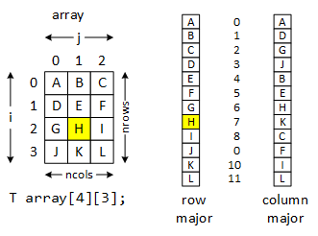
Create NumPy Array
numpy.empty
  The numpy.empty() function is used to create a new array of a specified shape and data type, without initializing its elements.
numpy.empty(shape, dtype=float, order='C')

Slide 14
Create NumPy Array
numpy.zeros
  The numpy.zeros() function creates a new array of a specified shape, where all elements are initialized to 0.
numpy.zeros(shape, dtype=float, order='C')
Parameter | Description
shape | Shape (dimensions) of the array
dtype | Data type of the array (optional)
order | Memory layout of the array: "C" = row-major order (C-style) "F" = column-major order (Fortran-style)

Slide 15
Create NumPy Array
numpy.ones
  The numpy.ones() function creates a new array of a specified shape, where all elements are initialized to 1.
numpy.ones(shape, dtype=None, order='C')
Parameter | Description
shape | Shape (dimensions) of the array
dtype | Data type of the array (optional)
order | Memory layout of the array: "C" = row-major order (C-style) "F" = column-major order (Fortran-style)

Slide 16
Create NumPy Array
numpy.linspace
  The numpy.linspace() function creates a one-dimensional array of evenly spaced numbers over a specified interval.
  np.linspace(start, stop, num=50, endpoint=True, retstep=False, dtype=None)
Parameter | Description
start | The starting value of the sequence
stop | The ending value of the sequence. Included if endpoint=True
num | Number of evenly spaced samples to generate (default is 50)
endpoint | If True, the stop value is included in the sequence; otherwise, it is excluded (default is True)
retstep | If True, also returns the spacing between values
dtype | Data type of the resulting array

Slide 17
Create NumPy Array
Debug Challenge: Fix the Code
  Download ‘exercise.ipynb’ from course website
  Try to fix all bugs in the code

