Slide 1
Git & GitHub
CSC 405/605

Slide 2
What are Git & GitHub?
Tools to enable version control and collaboration.
Manage and track changes to files over time.
Share, discuss, edit, and review code more easily.
Know who made what changes, why, and when.
Revert changes to previous versions.
Git is a software like Word’s “tracked changes.”
GitHub is a collaboration tool like Dropbox or Google Drive.

Slide 3
Why are Git & GitHub useful?
Internal management
Code is safely stored in one central location
All staff have access to the same version of code
External collaboration
Share code developed for your city for use in others
Work together on cross-city projects
Reproducibility over time
Efficiently produce results on a schedule

Slide 4
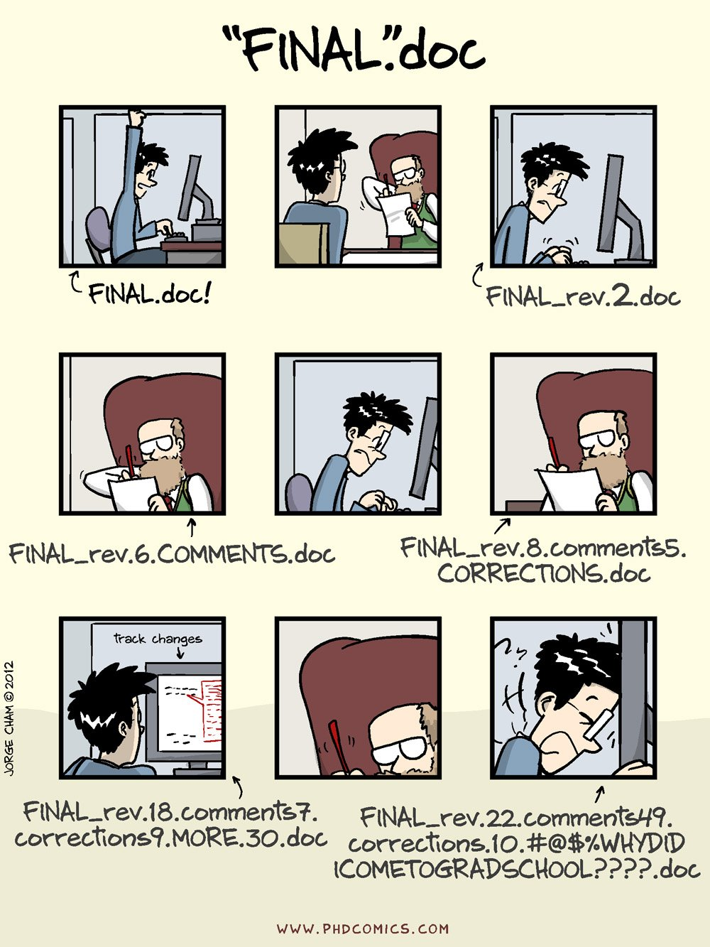
Why are Git & GitHub useful?
Git & GitHub help avoid this →

Slide 5
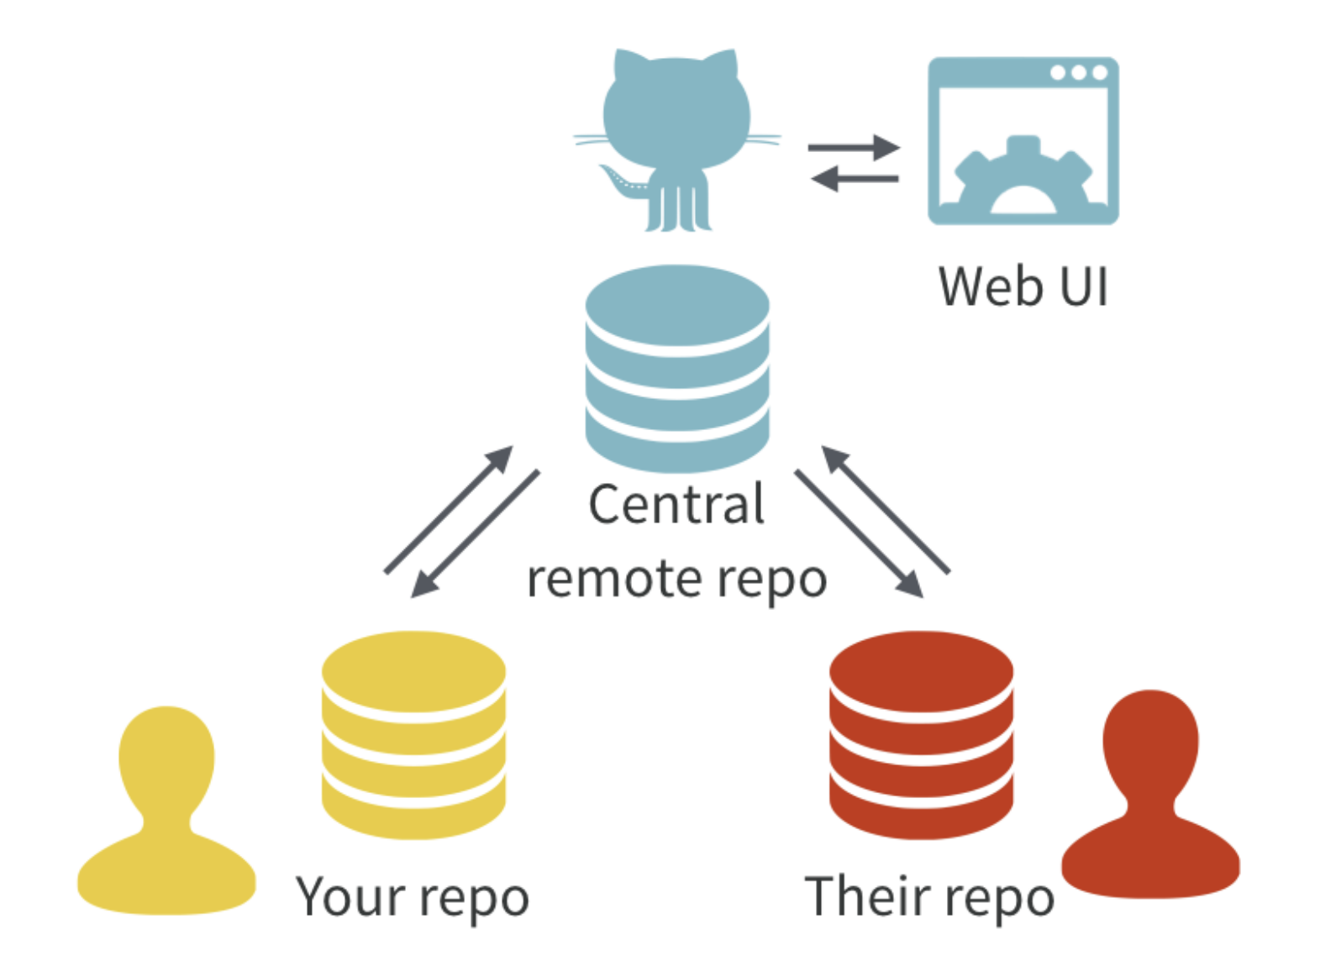
Key Terms & Concepts
All contributors have a local copy of the Git repository. These stay in sync through a central remote repository hosted on GitHub.

Slide 6
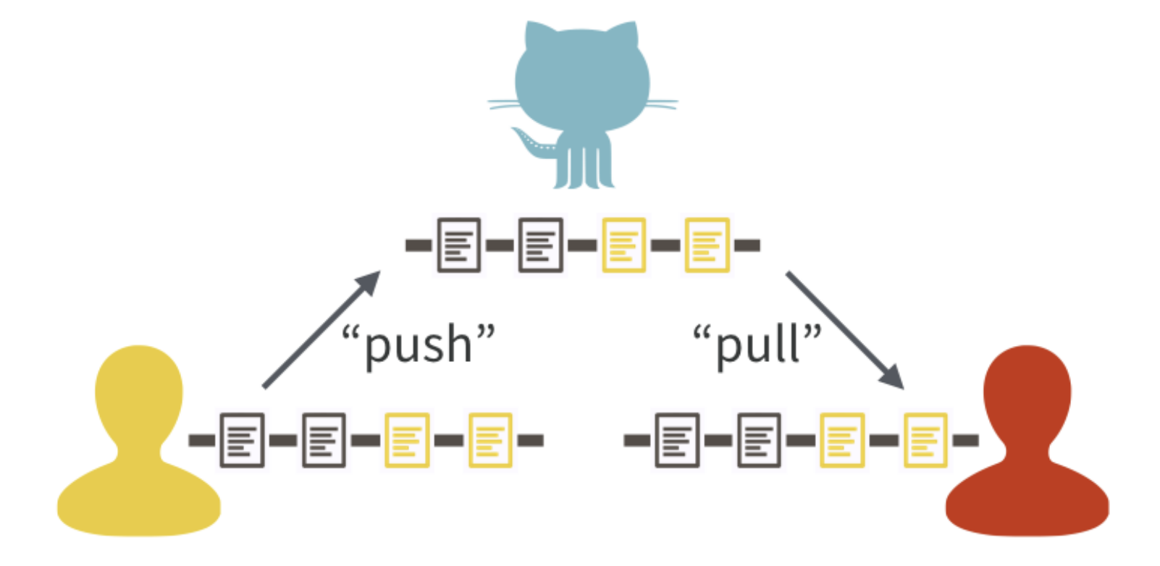
Key Terms & Concepts
One contributor makes commits and pushes their updates to the central version on GitHub. The other contributor pulls from GitHub to stay up-to-date.

Slide 7
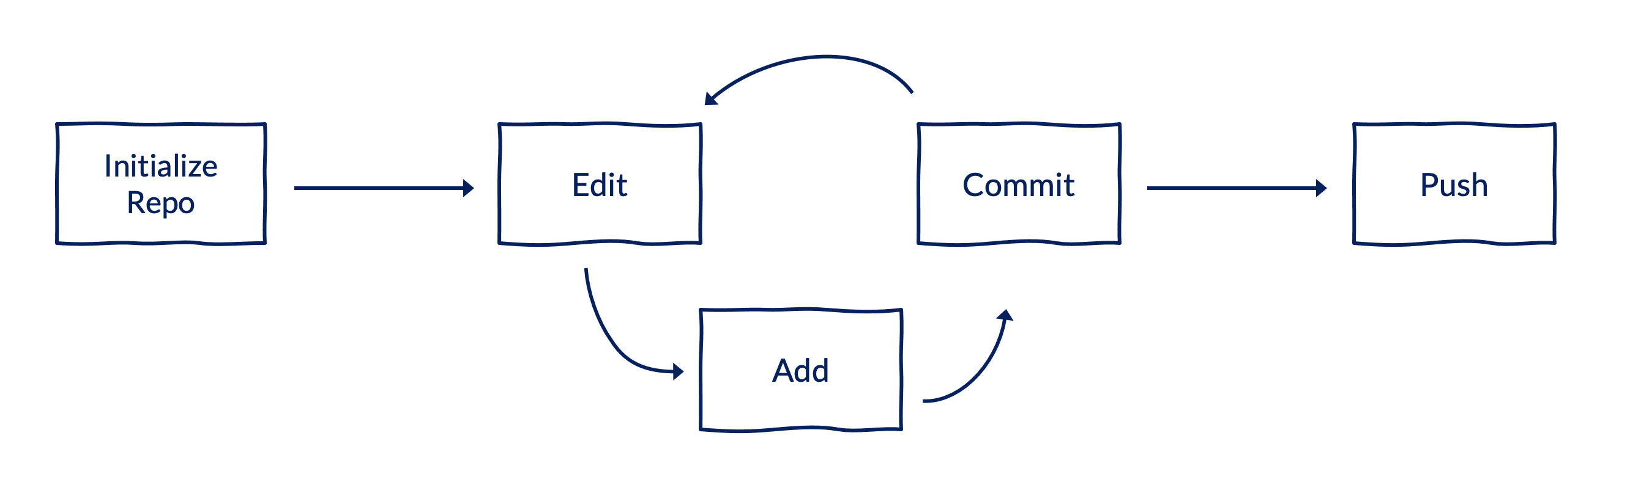
Basic Workflow
Initialize a repository (create or clone), edit files, tell Git which files to track (add), take a snapshot of those files (commit), send those snapshots to GitHub (push), and repeat.

Slide 8
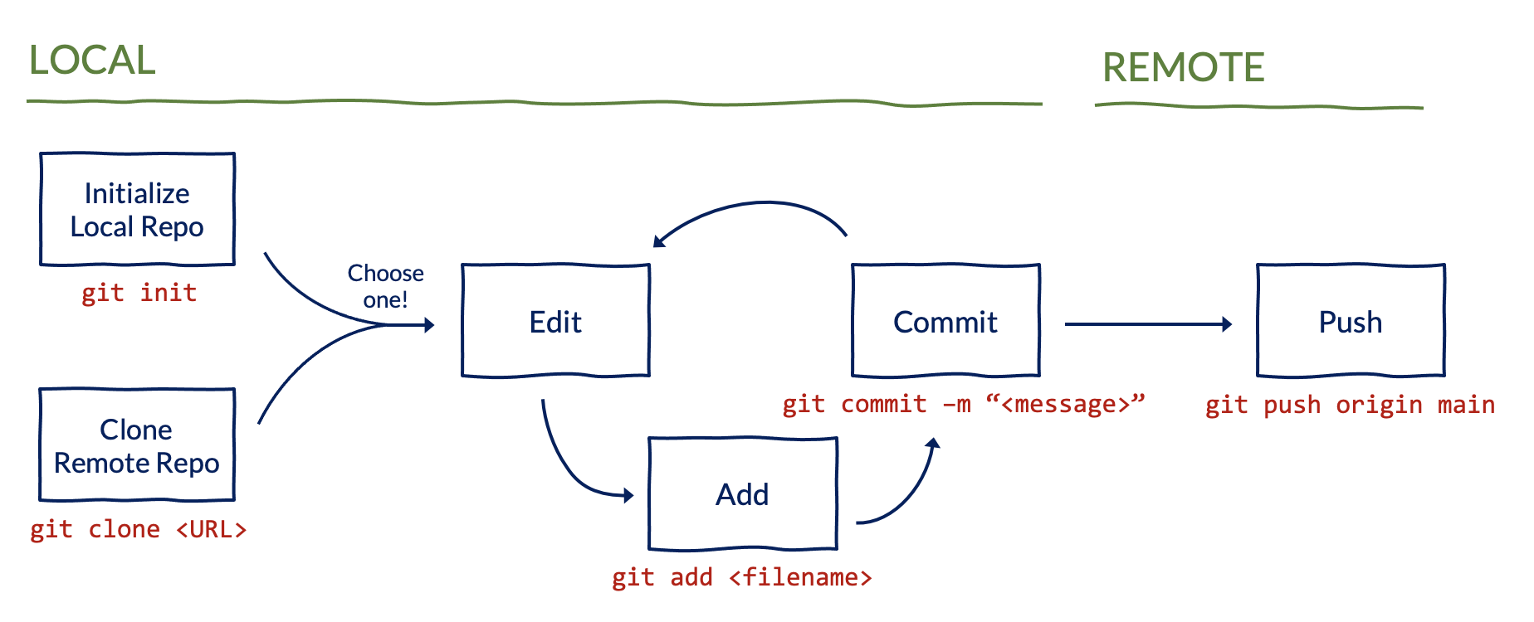
Basic Workflow
If starting from scratch, you will need to create a new repository. If not, you can clone an existing repository.

Slide 9
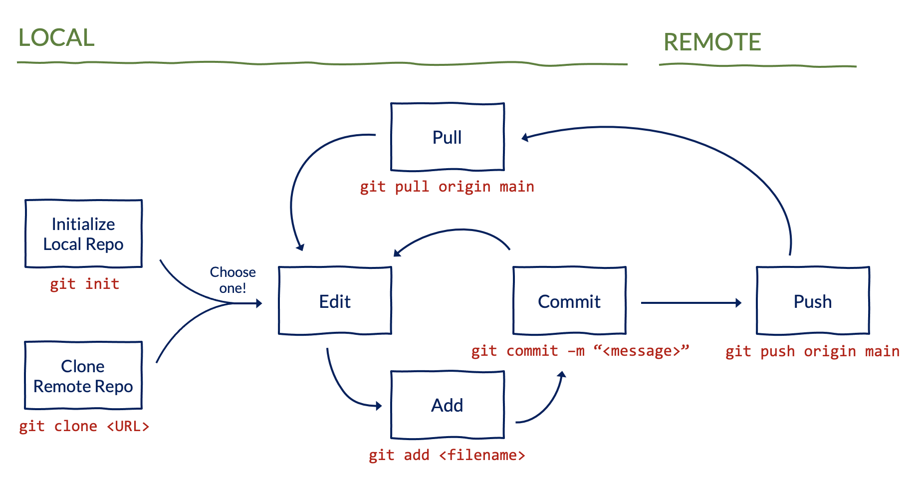
Collaborative Workflow
A collaborative workflow includes an extra step to pull updates from GitHub.

Slide 10
Collaborative Workflow
Your Partner (or you on another computer)
You
You
sync
sync
sync
edit
edit
edit
commit
commit
commit
edit
server
edit
server
edit
commit
commit
commit
edit
edit
edit
commit
commit
commit
sync
sync
sync
Your partner gets your work from the server
You get your partner’s work from the server

Slide 11
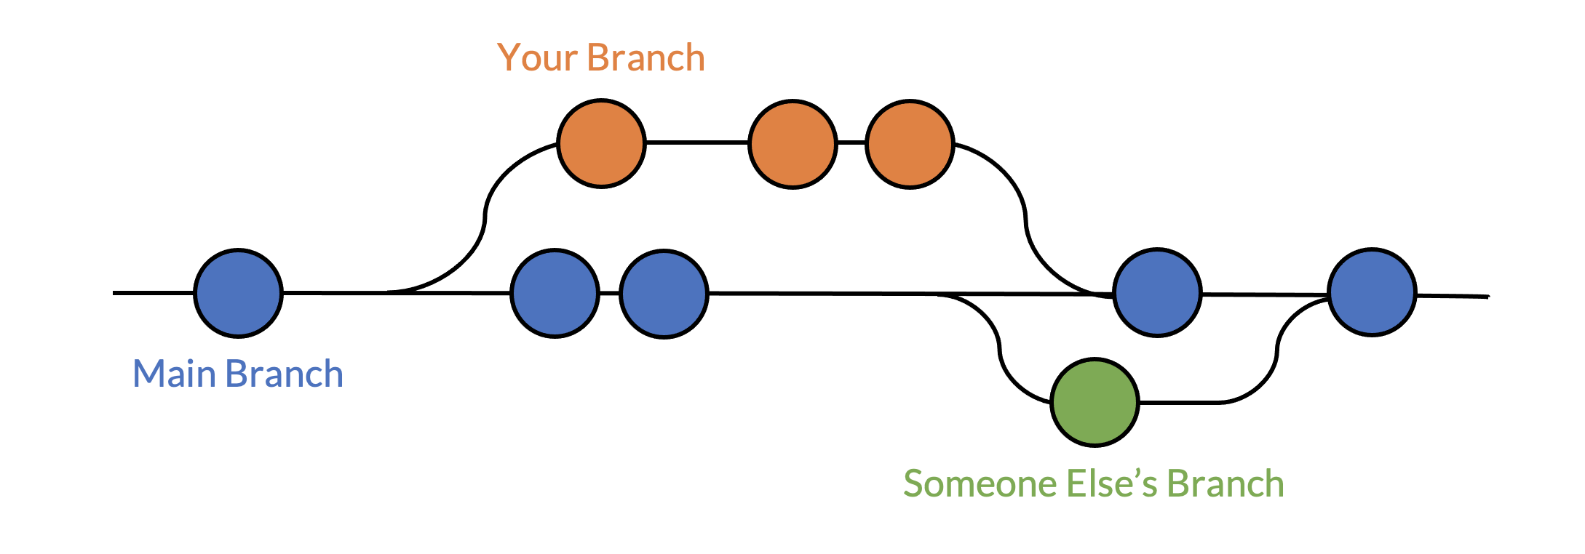
More Terms & Concepts
Branches let you and your collaborators update existing code or add new code without fear of overwriting each others’ files.
All commits live on a branch. The default branch in a repository is called the main branch.
Pull requests let you merge changes from one branch into another.
GitHub provides a helpful interface to review pull requests.

Slide 12
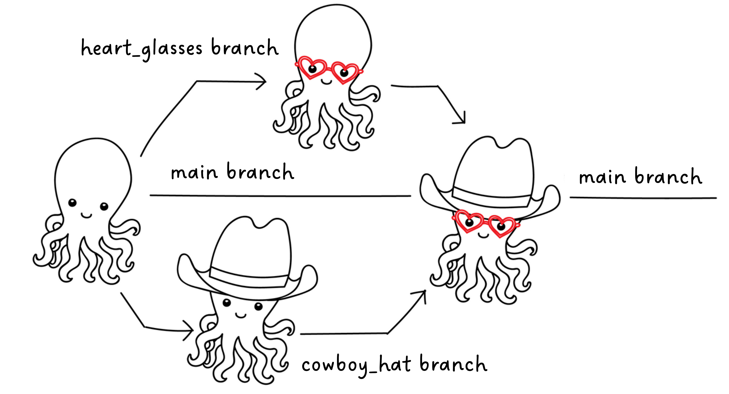
More Terms & Concepts
Branches let multiple collaborators make updates at the same time to later merge into the main branch.

Slide 13
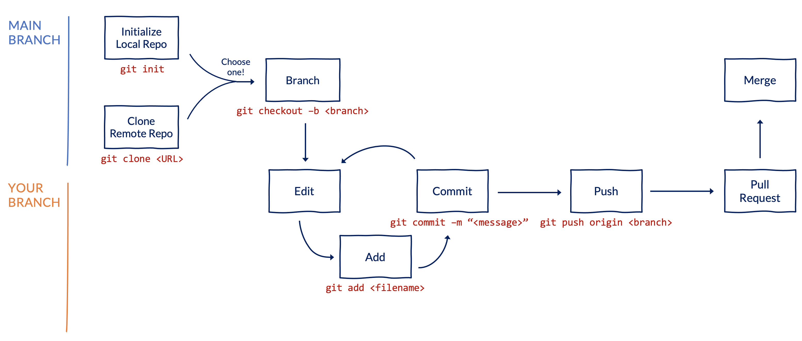
Collaborative Workflow
A more robust collaborative workflow involves using branches and pull requests.

Slide 14
Key Commands
git clone <url>: “Copy this remote project to my local computer.”
git add <filename>: “Look at this file.”
git commit -m <message>: “Take a snapshot of the files I’ve added.”
git status: “Tell me what you’re looking at.”
git push: “Send my snapshots to GitHub so others can see them.”
git pull: “Replace my local version of this project with the remote version.”
git checkout –b <new_branch>: “Create a new branch and switch to it.”
git checkout <existing_branch>: “Switch to a different branch.”

Slide 15
Initial Setup
Create a GitHub account.
Install Git and GitHub Desktop on your computer.
Configure Git and GitHub.
Configure your GitHub username and email address.
See GitHub’s Getting Started guide for detailed instructions.

Slide 16
Demo: Part 1
Create a new repository
Clone an existing repository
Edit a file on your local computer
Add and commit the changes
Push the updates to GitHub

Slide 17
Demo: Part 2
Pull updates from GitHub to your local computer
Create a new branch
Edit a file on your local computer
Add, commit, and push the updates to GitHub
Open a pull request
Merge the pull request into the main branch

Slide 18
Best Practices & Tips
Always follow your organization’s policies and avoid pushing potentially confidential information to GitHub.
In general, you should only track code on GitHub.
Consider whether a repository should be private or public.
Use README files to document your repositories.
Write descriptive commit messages to help your collaborators and future self.
Work with your collaborators to develop workflows to meet your needs.

Slide 19
More Readings
These are some of our favorite resources to learn more:
GitHub’s Getting Started Guide
Happy Git and GitHub for the UseR
Getting Git Right
This is a great interactive exercise to practice what you learned today:
GitHub Skills – Introduction to GitHub

