Slide 1
Introduction to Data Science
CSC 405/605

Slide 2
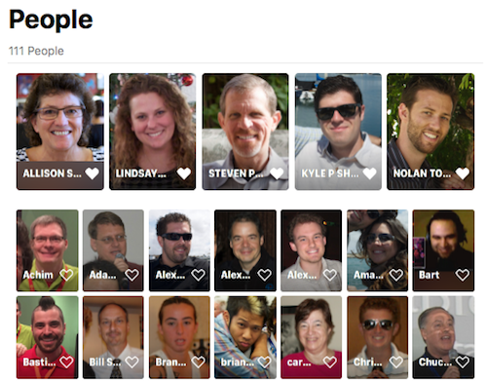
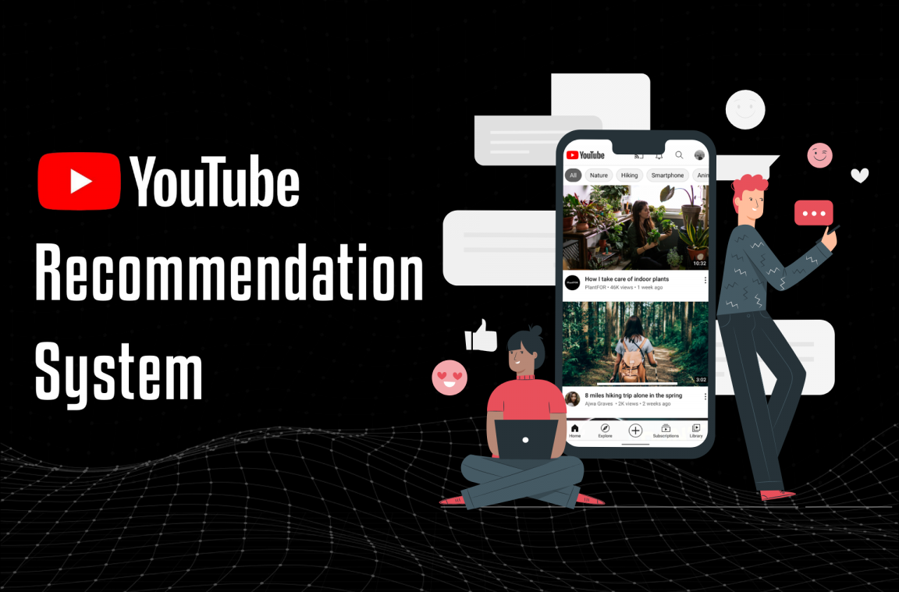
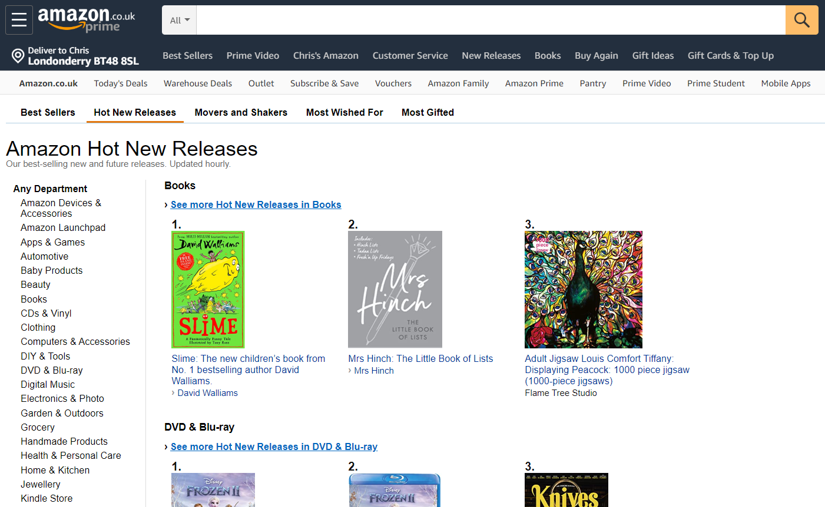
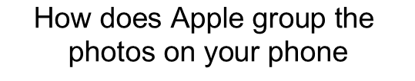
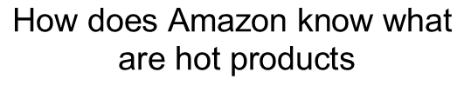
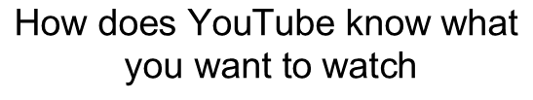
Why Do We Learn Data Science?
$$\text{How} \text{does} \text{YouTube} \text{know} \text{what} \text{you} \text{want} \text{to} \text{watch}$$
$$\text{How} \text{does} \text{Amazon} \text{know} \text{what} \text{are} \text{hot} \text{products}$$
$$\text{How} \text{does} \text{Apple} \text{group} \text{the} \text{photos} \text{on} \text{your} \text{phone}$$

Slide 3

Why Do We Learn Data Science?
$\text{How} \text{does} \text{ChatGpt} \text{understand} \text{and} \text{answer} \text{your} \text{question}$?

Slide 4
Definition of Data Science
What is Data Science?
Data science is an interdisciplinary field that uses algorithms, procedures, and processes to examine large amounts of data to uncover hidden patterns, generate insights, and direct decision making.
Big data is a broad term for data-sets that are large and/or complex.
Challenges include analysis, capture, data-curation, search, machine learning, statistics, sharing, storage, transfer, visualization, and information privacy.
How is it different from Data Analytics?
Data Analytics is a sub-set of Data Science
Data Analytics is mostly about using statistical and enterprise software to gain insights in the data
Does not solve all components of data problems

Slide 5
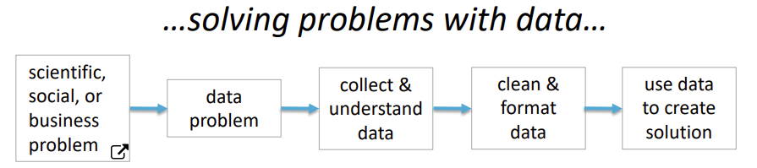
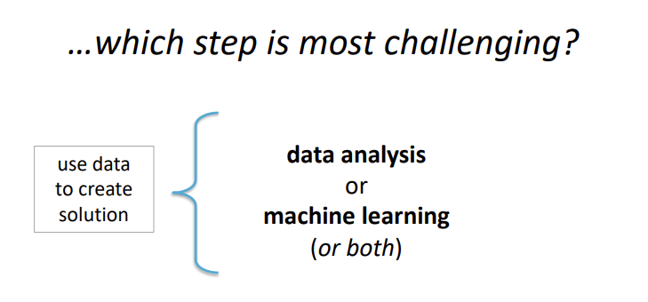
Definition of Data Science

Slide 6
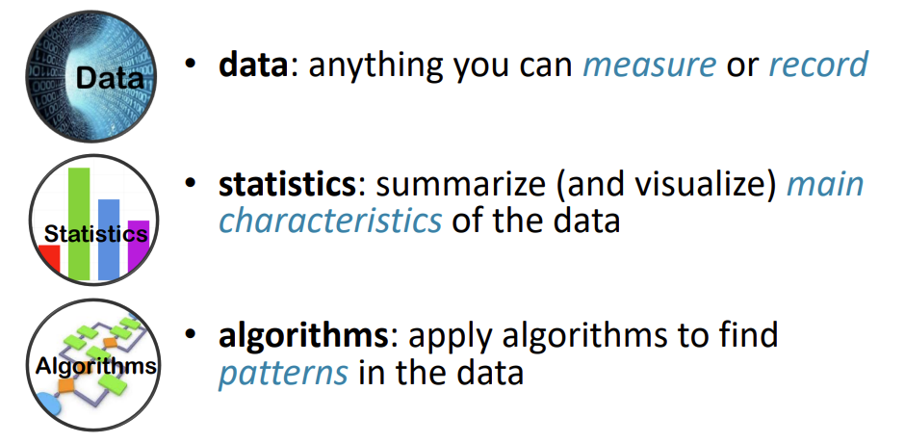
Definition of Data Science
Data Analysis: …using data to discover useful information…

Slide 7
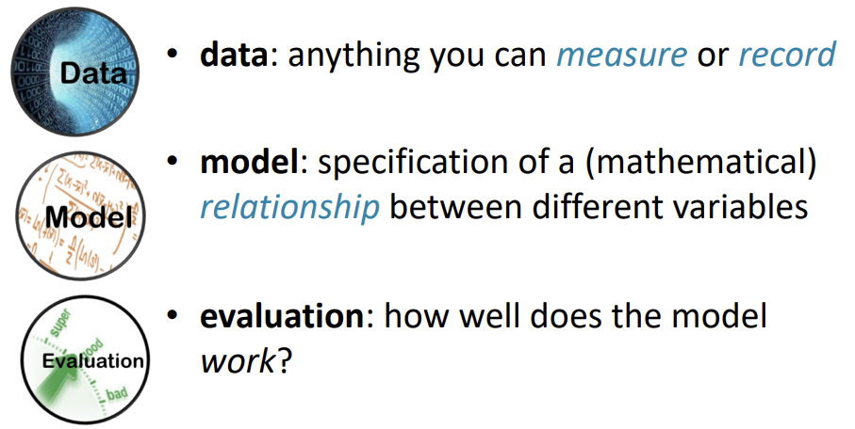
Definition of Data Science
Machine Learning: …creating and using models that learn from data…

Slide 8
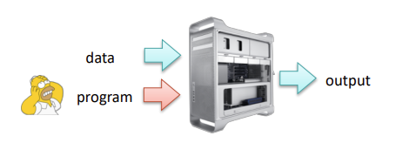
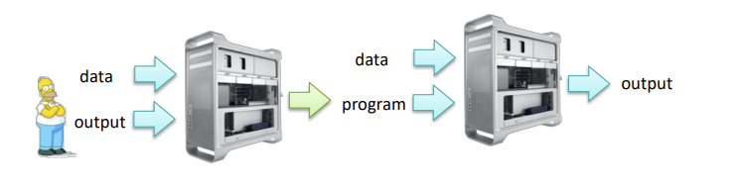
Definition of Data Science
Machine Learning: …creating and using models that learn from data…
Traditional CS
Machine Learning

Slide 9
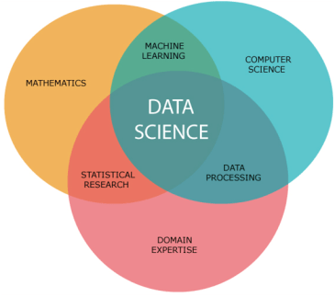
Definition of Data Science
Goal of Data Science: “Turn Data into Data Products”

Slide 10
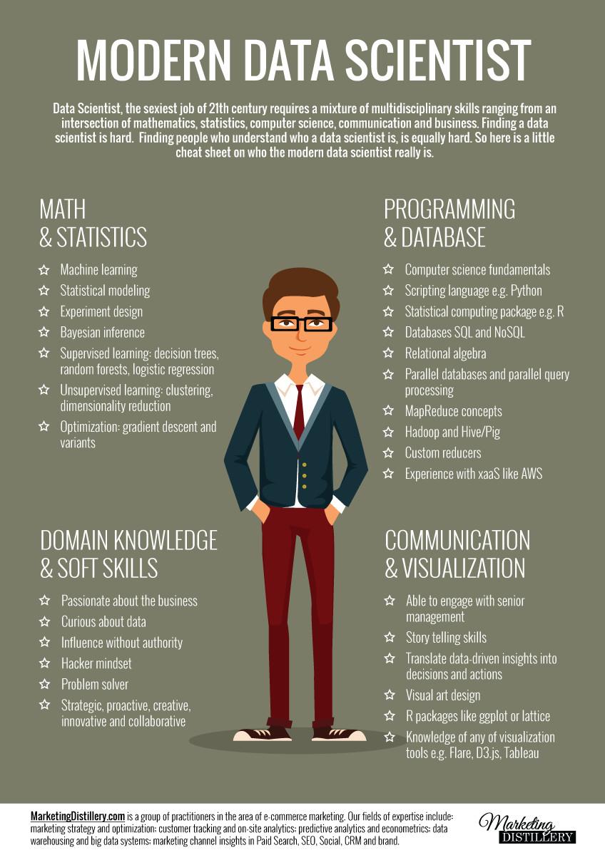
Career Opportunities

Slide 11
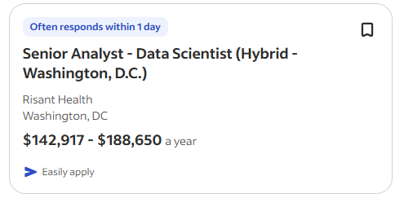
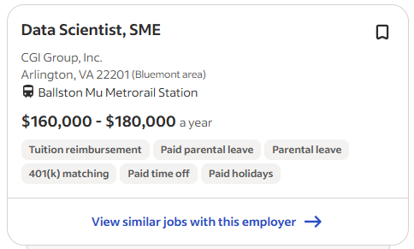
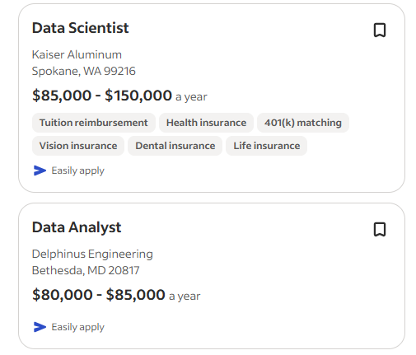
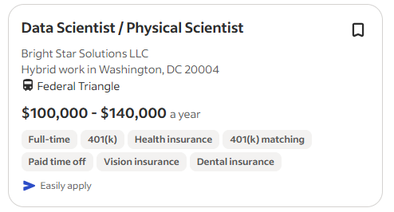
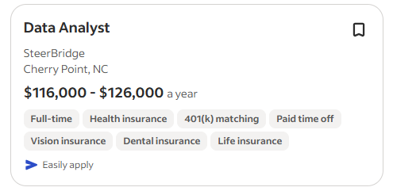
Career Opportunities
Indeed.com

Slide 12
Career Opportunities
"The rise of Data Science needs will create roughly 11.5 million job openings by 2026"
- US Bureau of Labor Statistics
"By 2026, Data Scientists and Analysts will become the number one emerging role in the world."
- World Economic Forum
Data Science and Artificial Intelligence are amongst the hottest fields of the 21st century that will impact all segments of daily life by 2026, from transport and logistics to healthcare and customer service.

Slide 13
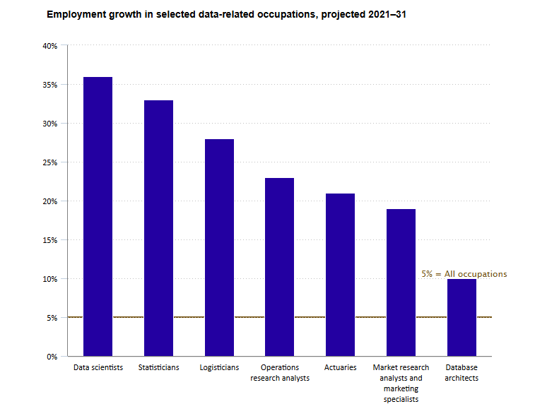

Career Opportunities
The occupation of data scientists is projected to have the fastest employment growth (grow 36% between 2021 and 2031) over the decade.
https://www.bls.gov/careeroutlook/2023/data-on-display/data-occupations.htm

Slide 14
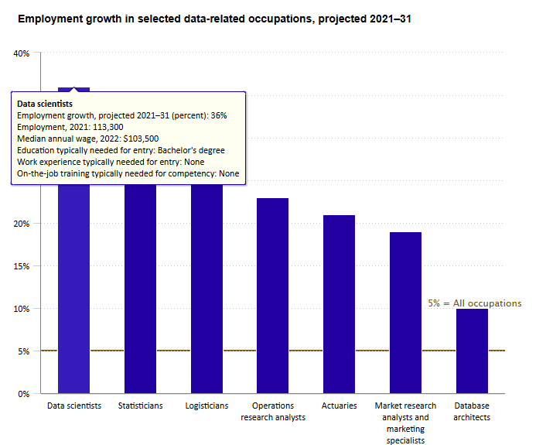
Career Opportunities
The occupation of data scientists is projected to have the fastest employment growth (grow 36% between 2021 and 2031) over the decade.
https://www.bls.gov/careeroutlook/2023/data-on-display/data-occupations.htm

Slide 15
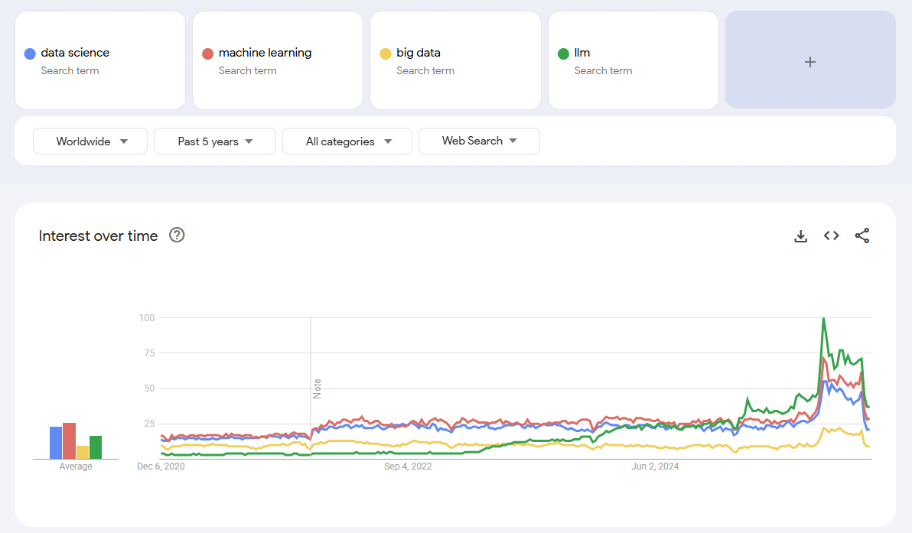
Career Opportunities
Google trends

Slide 16
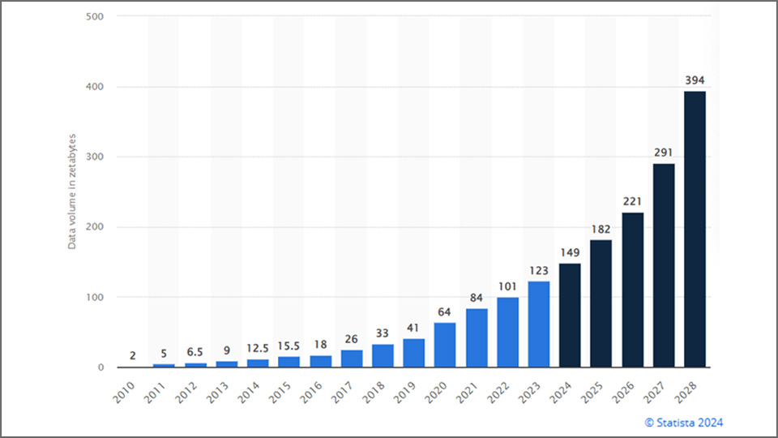
Career Opportunities
Global data volume is doubling every few years—and there’s no indication that trend is slowing
https://www.studionetworksolutions.com/how-much-data-is-used-and-stored-in-the-world/

Slide 17
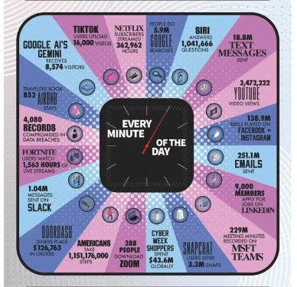
Career Opportunities
Every Minute on the Internet in 2025
https://www.dks.com.pk/every-minute-on-the-internet-in-2025-mind-blowing-stats-you-cant-ignore/

Slide 18
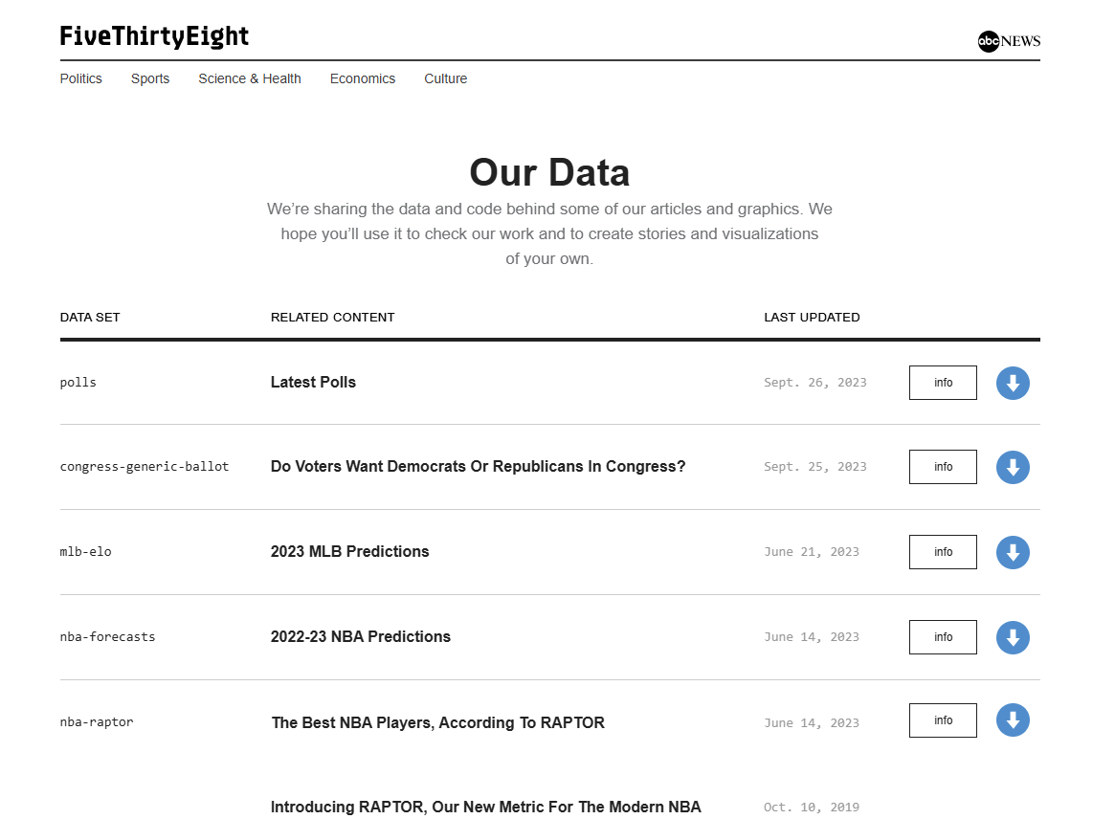

Examples
FiveThirtyEight: FiveThirtyEight, also rendered as 538, was an American website that focused on opinion poll analysis, politics, economics, and sports blogging in the United States.
- Wikipedia
Nate Silver
https://data.fivethirtyeight.com/

Slide 19
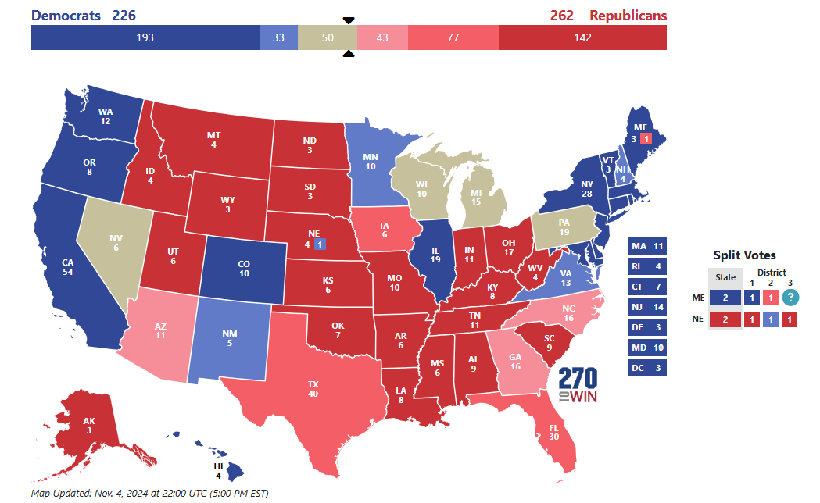
Examples
FiveThirtyEight published a dynamic Presidential Forecast starting before Election Day, updating regularly until Election Day
Recommend reading: “How 538's 2024 presidential election forecast work” (https://abcnews.go.com/538/538s-2024-presidential-election-forecast-works/story?id=113068753)
2024 Election Forecast from 538
https://www.270towin.com/maps/538-forecast-2024-presidential-election

Slide 20
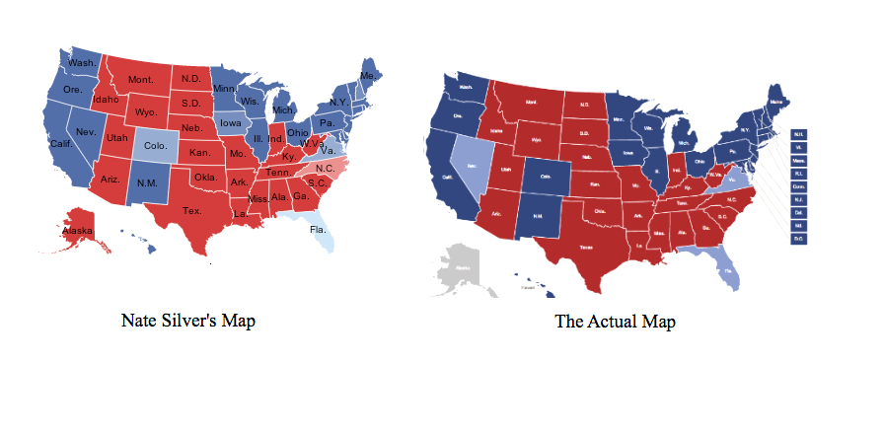
Examples
2012 Nate Silver’s prediction of election

Slide 21
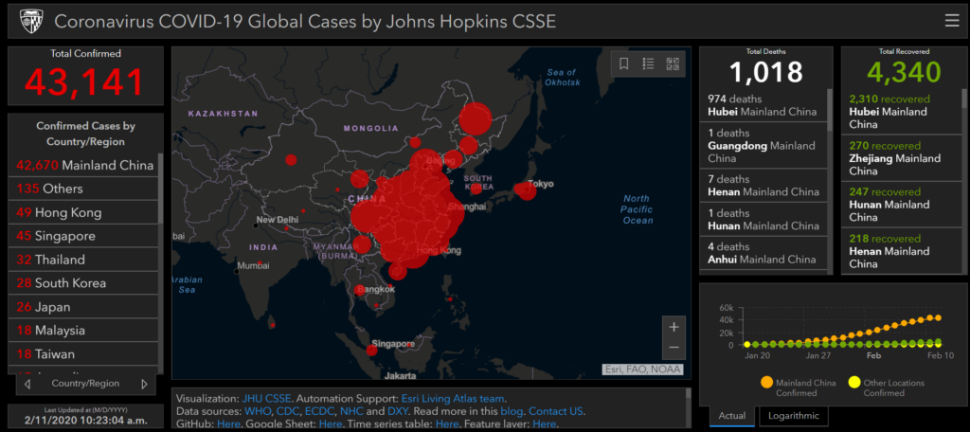
Examples
John Hopkins University’s Center for Systems Science and Engineering provides a real-time update on the new COVID-19 confirmed cases, deaths, and recoveries by country, province, and city.
Used by governments (CDC, WHO), airlines, and media, Helped scientists track spread and forecast hospital demand

Slide 22
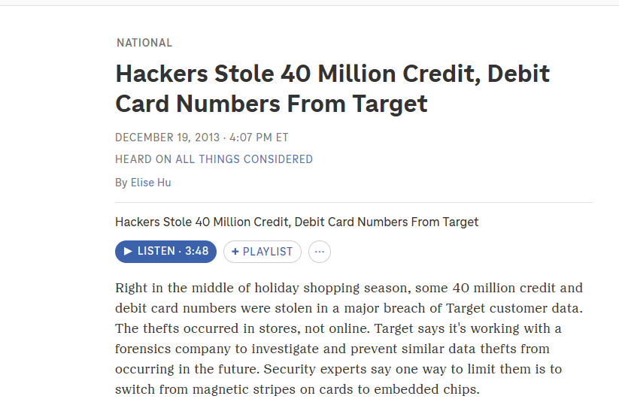
Examples
Cyber-Security - 2013 Target Data
Data science models learn the “normal pattern” of network traffic or user actions, then they can flag anything unusual automatically in real time.
login time & location
number of failed login attempts
file access patterns
network packet characteristics
Target actually had an AI-powered anomaly detection system, but alerts were ignored.

Slide 23
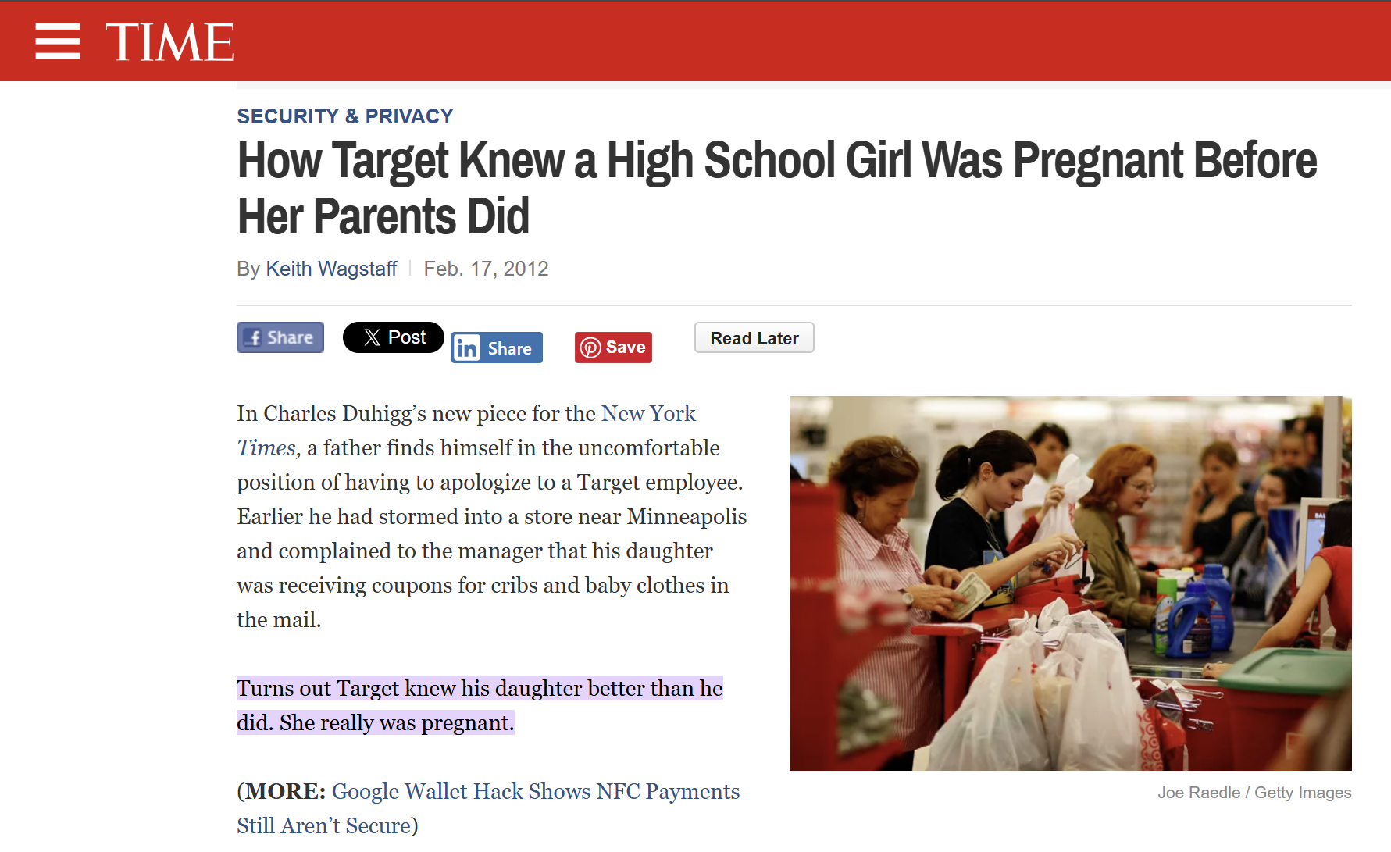
Examples
Cyber-Security – Data Privacy Leakage
To train data science models, companies often collect:
Healthcare records
Location data
Financial data
Browsing and communication logs
…
These datasets always contain sensitive information.
https://techland.time.com/2012/02/17/how-target-knew-a-high-school-girl-was-pregnant-before-her-parents/

Slide 24
Datasets
Academic Datasets
UC Irvine Machine Learning Repository (http://archive.ics.uci.edu/ml/)
Stanford Large Network Dataset Collection (http://snap.stanford.edu/data/)
Inter-university Consortium for Political and Social Research (http://www.icpsr.umich.edu/)
Pittsburgh Science of Learning Center's DataShop (https://pslcdatashop.web.cmu.edu/)
Academic Torrents (http://academictorrents.com/)
Private Companies
Data.World (https://data.world/)
Quandl Financial Data (https://www.quandl.com/)
Amazon Web Services Public Data Sets (http://aws.amazon.com/datasets/)
Kaggle (http://www.kaggle.com/)
Nytimes (http://developer.nytimes.com/docs)

Slide 25
Datasets
Gov. and NGO’s
Data.gov (https://www.data.gov/)
NYC Open Data (https://nycopendata.socrata.com/)
DC Open Data Catalog (http://data.dc.gov/)
OpenDataDC (http://www.opendatadc.org/)
DataLA (https://data.lacity.org/)
Project Open Data Dashboard (http://data.civicagency.org/))
data.gov.uk (http://data.gov.uk/)
US Census Bureau (http://www.census.gov/)
World Bank Open Data (http://data.worldbank.org/)
Humanitarian Data Exchange (http://docs.hdx.rwlabs.org/)
Sunlight Foundation (http://sunlightfoundation.com/api/)
ProPublica Data Store (https://projects.propublica.org/data-store/)

Slide 26
Datasets
Other resources
20 Big Data Sources (http://www.smartdatacollective.com/bernardmarr/235366/big-data-20-free-big-data-sources-everyone-should-know )
Center for Data Innovation (http://www.datainnovation.org/category/publications/dataset-blog/)
Data Science Central (http://www.datasciencecentral.com/)
Python API’s (http://www.pythonforbeginners.com/api/listof-python-apis)
PyCoders Weekly (http://pycoders.com/)

