Slide 1
CSC 405/605/705: Data Science
Dr. Xiaochen Li

Slide 2

About Me
Assistant Professor, Department of Computer Science, University of North Carolina at Greensboro
Former Visiting Ph.D. Student and Postdoctoral Researcher, University of Virginia
Ph.D. in Cyberspace Security, Zhejiang University (China)
Research focus: Data Privacy in Cyberspace Security, with applications to statistical analysis and large language models (LLMs)
Email: x_li12@uncg.edu
Office: Petty 153
Office Hour: Monday Wednesday 10:00 am – 11:00 am

Slide 3
What is the course about?
Programming your way into Data Science
It is not a Statistics or an AI or a Visualization course
The course contains parts of everything
Learn about lot of tools and how to use them in innovative ways
We will work with real-world data
Hopefully develop some cool projects

Slide 4
Course Information
You can find all course-related information on this course website, including lecture slides, assignments, and other resources. You can also find this link on Canvas.
https://xiaochenli-w.github.io/CSC-405-605-705-Data-Science/

Slide 5
Course Information
Prerequisites
A grade of C or better in CSC 330 and (STA271 or STA290), or permission of instructor (prior programming and statistics experience is required).
Experience in:
Programming skills Python
We will go through Introduction to Python
You would have to work hard in the early weeks to get comfortable with Python
Linux, Terminal, Command-Line

Slide 6
Course Information
Textbooks
There is no required textbook for the course. Class slides will be available for download. Suggested textbooks are:
1) Building Machine Learning Systems with Python (Richert and Coelho)
2) Data Science from Scratch (Joel Grus)

Slide 7
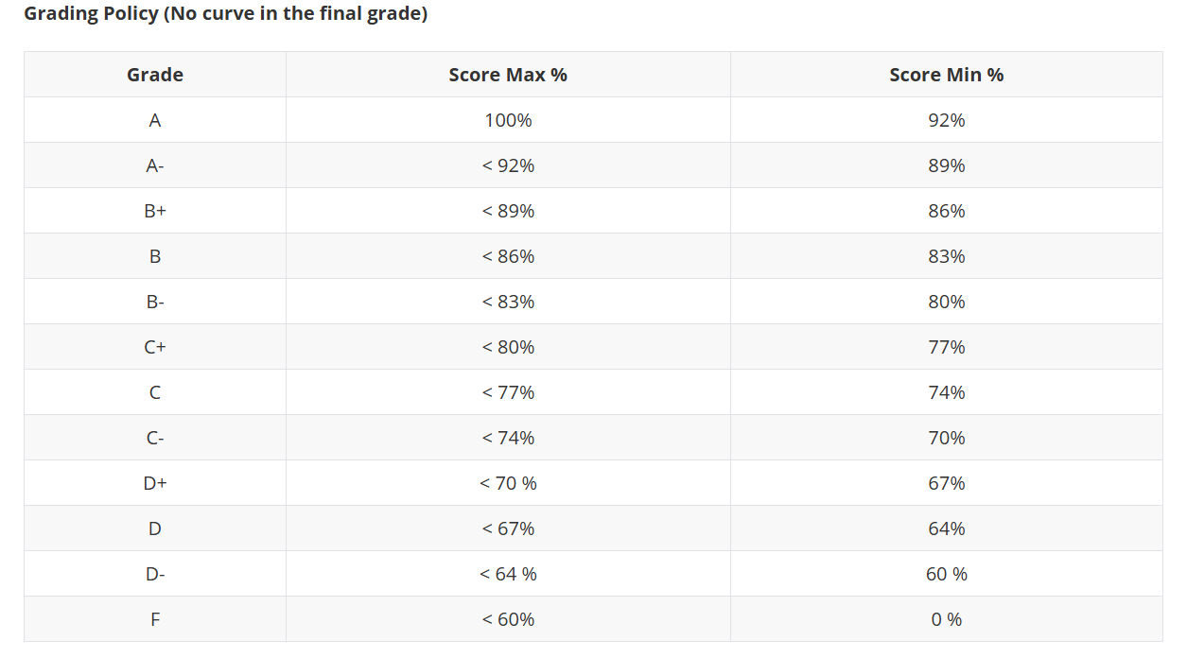
Course Information
Class Participation: 10%
In Class Quizzes (2): 20%
Assignments (3): 30%
Project: 40% (30% for Graduate Students)
Research Report: 10% ( Graduate Students Only)
No final exam! No curve!

Slide 8
Course Information
[Class Participation: 10%]
Regular attendance is required for all class meetings. Students who are unable to attend an in-person class must notify the instructor in advance via email with a valid reason; otherwise, the absence will not be credited. Attendance may be recorded at any time during the class session, and the total number and timing of attendance checks are at the instructor’s discretion. Final participation grades will be based on the overall attendance record.

Slide 9
Course Information
[In class quizzes (2): 20%]
Two in-class quizzes will be conducted during the semester, each contributing 10% to the final grade. Quizzes must be completed in class as scheduled; failure to attend or complete a quiz during class will result in no credit.

Slide 10
Course Information
[Assignments (3): 30%]
Three programming-based assignments will be given covering the utilization of the tools learned in class. Each assignment accounts for 10 points. Absolutely no collaboration on assignments. Students must upload individual assignments to canvas before deadline. Later submission (per day) will have a 50% deduction, late for more than 2 days will directly have zero grade.

Slide 11
Course Information
**[Project: 40% (30% for Graduate Students)]**
This course includes a group project focused on the complete end-to-end development of an analytical model. The project will be conducted in teams of 2-4 students and organized into the following stages:
- Stage I: Dataset Selection and Project Setup
- Stage II: Data Analysis, Distributions, and Hypothesis Testing
- Stage III: Machine Learning and Deep Learning Model Development
- Stage IV: Visualization, Final Report, and Presentation
The project will progress alongside the course schedule, and the instructor will provide reminders and guidance on project milestones during relevant class sessions. Each group is required to submit a final written report and deliver an in-class presentation of approximately 15–20 minutes.

Slide 12
Course Information
[Research Report: 10% ( Graduate Students Only)]
Graduate students are required to submit a project report using the IEEE Conference double-column format. Please use the official IEEE template ( https://www.overleaf.com/latex/templates/ieee-conference-template/grfzhhncsfqn).
Students should choose a project topic relevant to the course and conduct a brief literature review by reading 2–4 related research papers, including at least one paper published after January 2025. The report should clearly reference and discuss these papers.
The report should be at least 3 pages for a single author and 5 pages for two or more authors, inclusive of figures and references. The final report must be submitted before the final week of the course.

Slide 13
Course Information
Independent project Option:
Undergraduate and master’s students are encouraged to pursue independent projects within the Data Science course. If you have a project idea you're passionate about, you are welcome to develop it as part of this course. Projects aimed at publication are particularly encouraged.
Your project should align with the course content, covering topics such as data cleaning, statistical analysis, machine learning models, advanced deep learning networks, and visualization. The project should be both challenging and innovative, offering something new or building upon previous work.
Given that this project constitutes a significant portion of your course grade, a high standard of quality is expected.
Note: If you choose this option, please inform the lecturer during the first week of the course.

Slide 14
Course Information
1. Introduction to Data Science: (Week 1-3)
Data Science Introduction
Class Project discussion and team formed
Programming prepare
1). Re/Introduction to Python
2). IPython, IPython-Notebook
Data Science Reproducibility
1). Setting up your Repository – Data, Code, and Doc
2). Using Version Control with Git
2. Data Munging, Wrangling, Cleaning (Week 4-5)
Data Structures
Data Manipulation
1). Selection - Indexing
2). Handling Missing Data
3). Aggregation
4). Descriptive Statistics
5). Merging / Join
6). Working with Date-Time
Assignment 1 due

Slide 15
Course Information
3. Data and Statistics (Week 6-8)
Distributions
Estimates
Statistical Hypothesis Testing
Correlation
Distribution Estimators: MoM, MLE, KDE
4. Introduction to Applied Data Modeling: (Weeks 9-12)
Applied Machine Learning
Regression and Feature Selection
Bias versus Variance
Clustering and Dimensionality Reduction
Validation and Model Performance
Mathematical optimization (if time allowed)
Stochastic thinking (if time allowed)
Invited talk (if time allowed)
Assignment 2 due

Slide 16
Course Information
5. Data Visualization (Week 13-14)
Graph Generation
1). Types of Graphs
2). Customizing Plots
3). Visualizing Errors
4). Interactive / Dynamic Graphs
Visualization Best Practices
6. Project Presentations: (Week 15–16)
Project Report Due and Final presentation
Graduate Students report submission

Slide 17
Course Information
Midterm Grades:
A midterm grade (https://spartancentral.uncg.edu/student-records/grades/) will be assigned to all undergraduate students and made available in UNCGenie. This grade reflects your current performance based on completed coursework and is intended for feedback purposes only; it will not be used in calculating the final course grade. The midterm grade is meant to help you assess whether you are on track or need to make adjustments. Students receiving a D or F at midterm are encouraged to contact the instructor to discuss possible strategies and options for continuing in the course. Final grades will be determined based on all required work completed throughout the semester.

Slide 18
Course Information
Suggestions
Please pay close attention to the course website (https://xiaochenli-w.github.io/CSC-405-605-705-Data-Science/). As the course progresses, lecture slides and assignments will be continuously posted there. In particular, make sure to check the Schedule module, where I will post reminders about when assignments are released and due, the timing of upcoming quizzes, and progress updates for different project stages.
Participation and interaction are strongly encouraged in class.
Start working on the project early. Emails with questions about assignments or projects sent within two days of the submission deadline may not receive a response.

Slide 19
Course Information
The course is going to be tough, especially for people with limited programming experience
Work hard, be rewarded with a good data science experience;
Will talk about the benefits later in course intro;
Do not cheat in the course – Result will be an ‘F’ grade.
Assignment solutions are unique, differs from student to student.
No collaboration on Assignments;

Slide 20
Course Information
In team project
Do not think that you can get away without contributing - I will be monitoring repositories for work done;
Any work done should be reported on the repository – worked locally on your own computer will not count;
Utilization of resources found on the Internet is allowed for project accomplishment, with caveats
Any code/library used should be referenced/cited and thoroughly understood
If you use code without understanding, that counts as plagiarism

Slide 21
Course Information
Use of AI Tools
The use of AI tools is allowed when used responsibly for learning purposes such as understanding concepts, debugging code or understanding error messages. However, all submitted work must reflect the students’ own understanding. Students are expected to write and modify code by hand, make independent analytical decisions, and fully understand the methods and results they present. During project presentations, students may be asked to explain any part of their report, code, or analysis; inability to clearly explain submitted work will result in grade penalties, including partial credit loss or individual score adjustments.

Slide 22
Team Creation
The team creation can be random or self-assigned;
Task for today – Get in touch with class participants and setup groups of 2-4 students. Mix of graduate and undergraduate;
Email me the group list (student names and emails) before next week. (Each group designates one person to email me);
Project presentation, all members should present. If someone does not, they will not be graded.

