Slide 1
Statistics in Data Science
CSC 405/605

Slide 2
Correlation
Explanatory Variable and Response Variable
  Correlation describes linear relationships between quantitative variables.
  Correlations tell us to the degree that two variables are similar or associated with each other. It is a measure of association.
  Correlations are bivariate or multivariate in nature, i.e., relational between variables.
  Correlations measure association by measuring how when one variable changes another changes with it, which means it is measuring dynamic relationships (change).

Slide 3
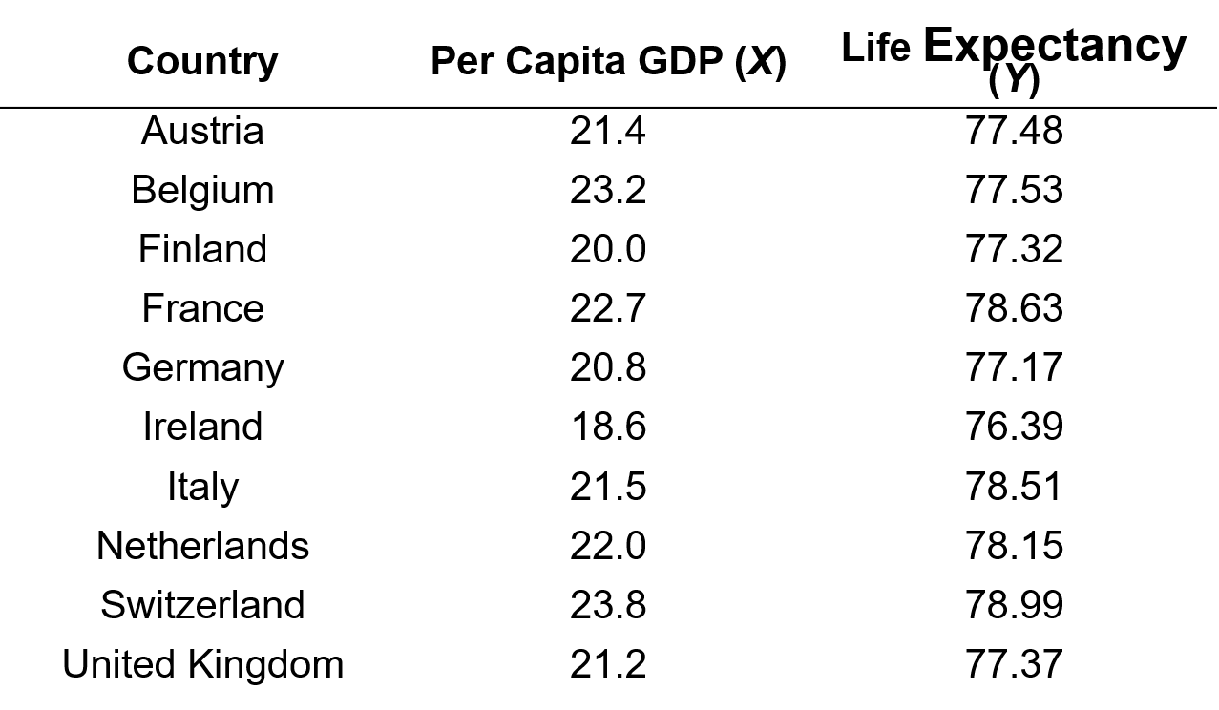
Correlation
Example: The correlation between per capita gross domestic product (X) and life expectancy (Y) will be explored. X is the quantitative explanatory variable, Y is the quantitative response variable.

Slide 4

Correlation
Scatterplot: A scatterplot visualizes the relationship between two numerical variables.
Bivariate points ($x_{i}$, $y_{i}$)

Slide 5
Correlation
Interpreting Scatterplots
  Form: Can relationship be described by straight line (linear)? ..by a curved line? etc.
  Outliers?: Any deviations from overall pattern?
  Direction of the relationship either:
    Positive association (upward slope)
    Negative association (downward slope)
    No association (flat)
  Strength: Extent to which points adhere to imaginary trend line

Slide 6
Correlation
Interpreting Scatterplots
Interpretation:
Form: linear (straight)
Outliers: none
Direction: positive
Strength: difficult to judge by eye

Slide 7
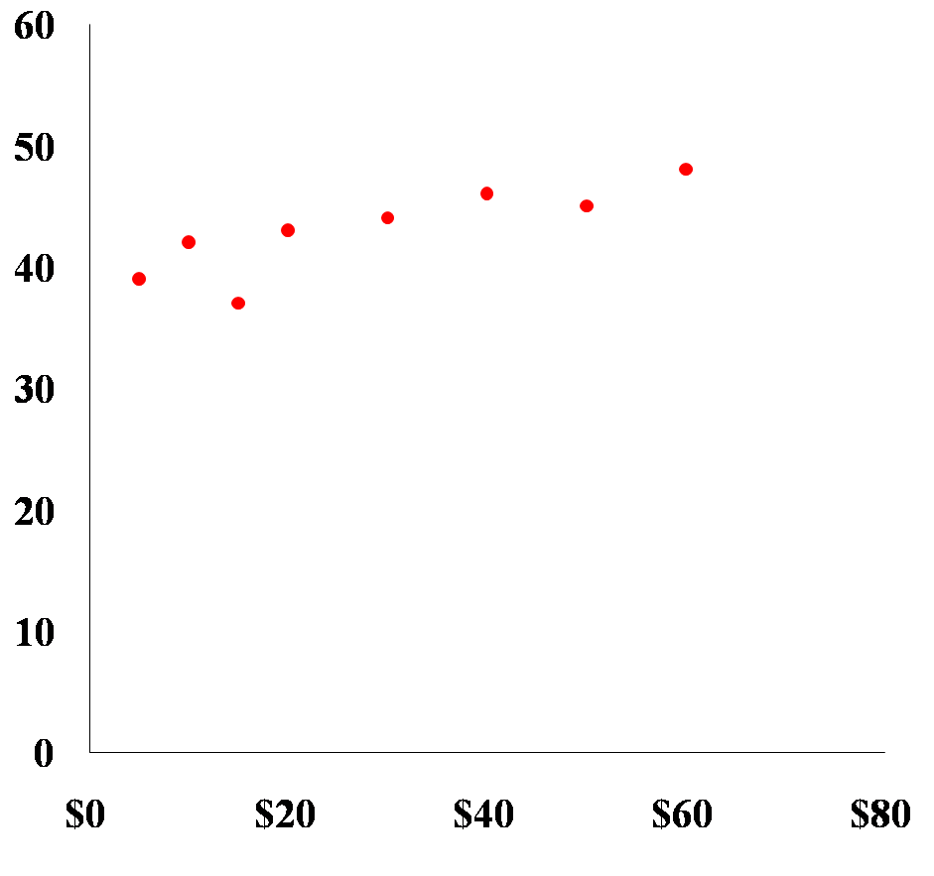
Correlation
Interpreting Scatterplots
Interpretation:
Form: linear
Outliers: none
Direction: positive
Strength: difficult to judge by eye (looks strong)

Slide 8
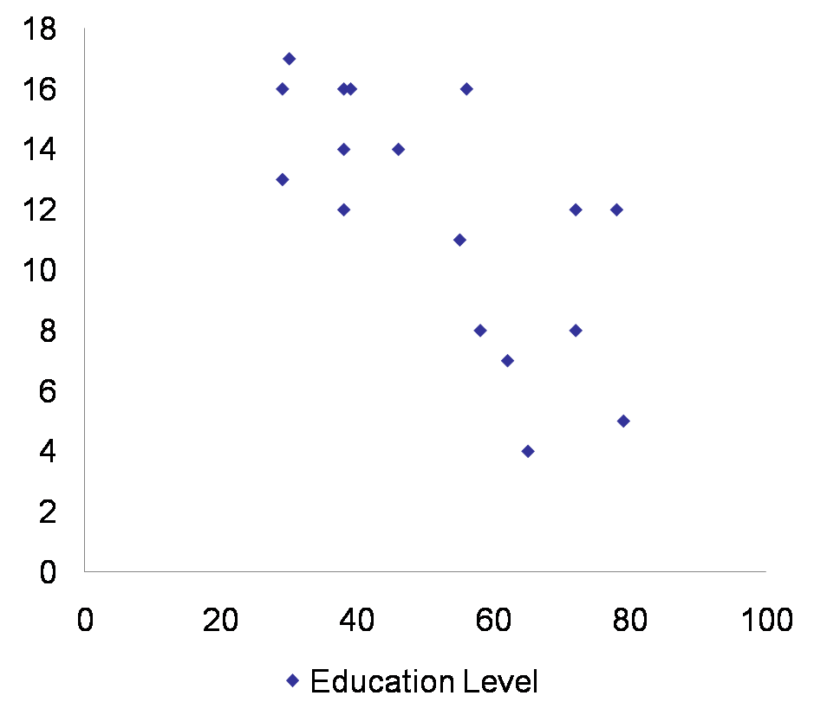
Correlation
Interpreting Scatterplots
Interpretation:
Form: linear
Outliers: none
Direction: negative
Strength: difficult to judge by eye (looks moderate)

Slide 9
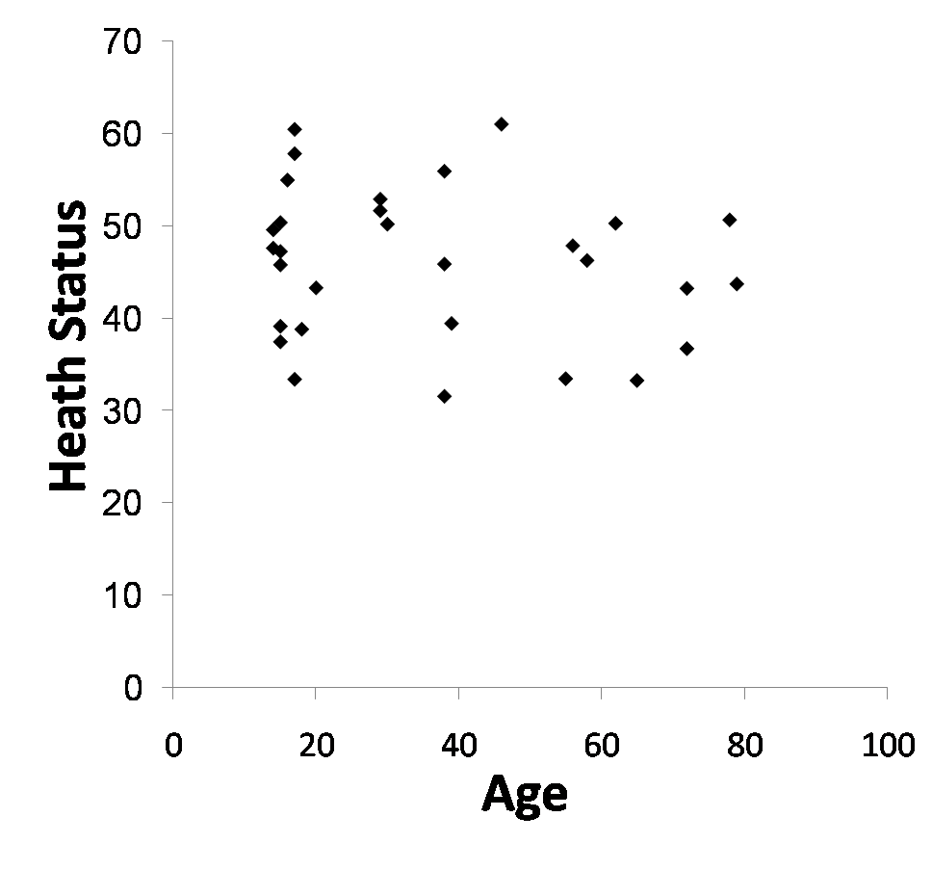
Correlation
Interpreting Scatterplots
Interpretation:
Form: linear(?)
Outliers: none
Direction: negative
Strength: difficult to judge by eye (looks weak)

Slide 10
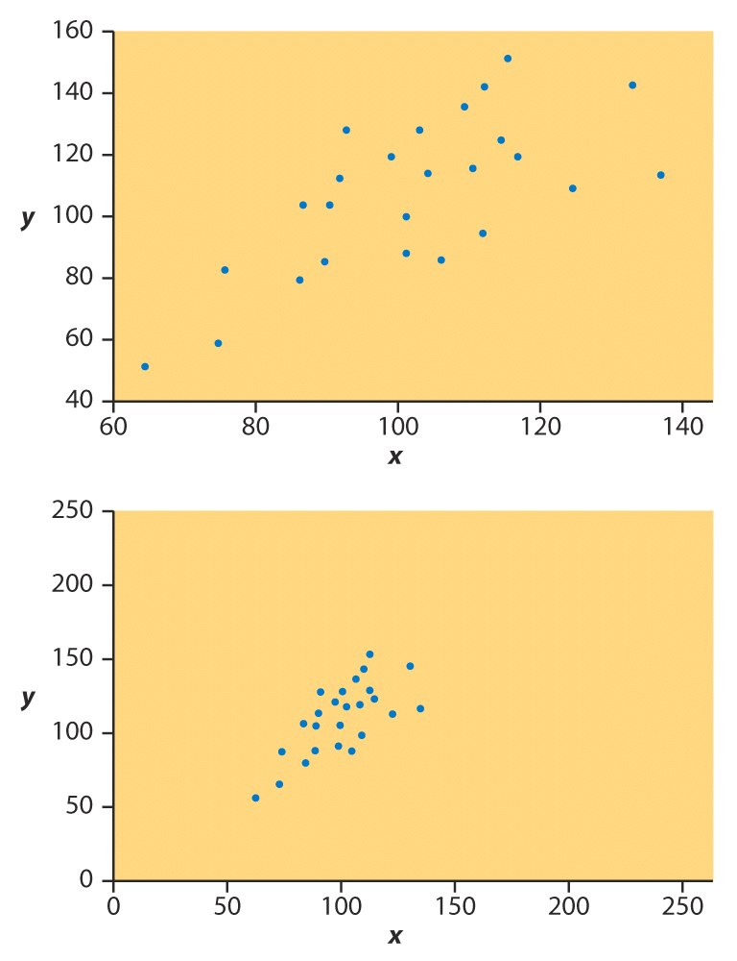
Correlation
Interpreting Scatterplots
It is difficult to judge correlational strength by eye alone;
Here are identical data plotted on differently axes;
First relationship seems weaker than second;
This is an artifact of the axis scaling;
We use a statistical called the correlation coefficient to judge strength objectively

Slide 11

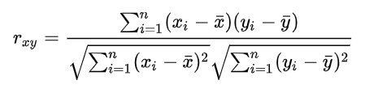
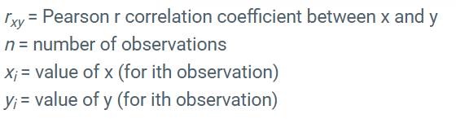
Correlation
Correlation coefficient:
  Pearson r Correlation is the most commonly used statistic to measure the degree of the relationship between linearly related variables.
=

Slide 12
Correlation
Correlation coefficient:
  Pearson r Correlation is the most commonly used statistic to measure the degree of the relationship between linearly related variables.
  r is always between −1 and +1
    r = 1: perfect positive
    r = -1: perfect negative
    r = 0: no linear relationship
  The closer r is to +1 or –1, the stronger the correlation.
0.0 < |r| < 0.3 weak correlation
0.3 < |r| < 0.7 moderate correlation
0.7 < |r| < 1.0 strong correlation
|r| = 1.0 perfect correlation

Slide 13
Correlation
Correlation coefficient:
  Pearson r Correlation is the most commonly used statistic to measure the degree of the relationship between linearly related variables.
  r is always between −1 and +1
    r = 1: perfect positive
    r = -1: perfect negative
    r = 0: no linear relationship
  The closer r is to +1 or –1, the stronger the correlation.
Husband’s age / Wife’s age
r = .94 (strong positive correlation)
Husband’s height / Wife’s height
r = .36 (weak positive correlation)
Distance of golf putt / percent success
r = -.94 (strong negative correlation)

Slide 14
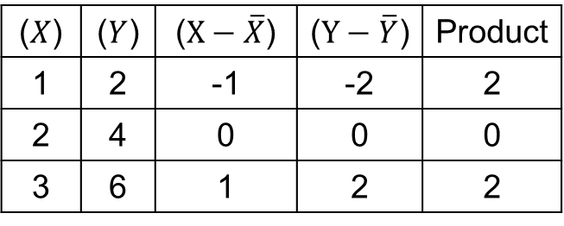


Correlation
Pearson r Correlation: Example
X=[1,2,3], Y=[2,4,6]
$$\overline{X}=2, \overline{Y}=4$$
($X$) | ($Y$) | ($X−\overline{X}$) | ($Y−\overline{Y}$) | Product
1 | 2 | -1 | -2 | 2
2 | 4 | 0 | 0 | 0
3 | 6 | 1 | 2 | 2
$$r=\frac{4}{\sqrt{2}×\sqrt{8}}=1$$

Slide 15
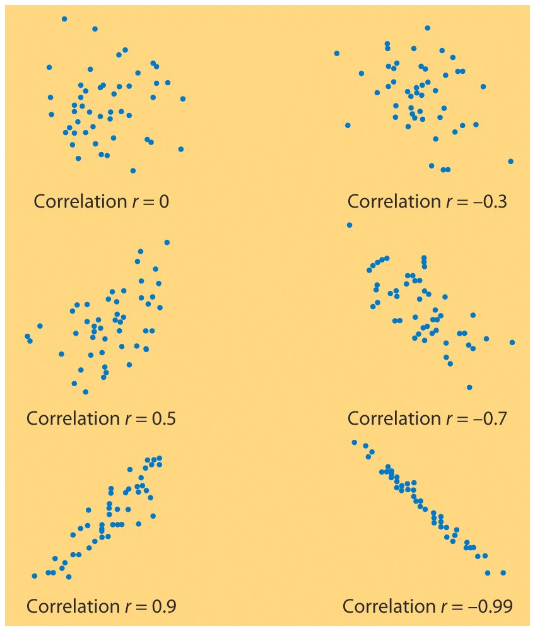
Correlation

Slide 16

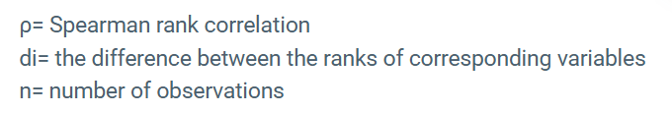
Correlation
Correlation coefficient:
  Spearman ρ Correlation: Apply Pearson to ranks instead of raw values.
The assumptions of the Spearman correlation are that data must be at least ordinal and the scores on one variable must be monotonically related to the other variable.

Slide 17
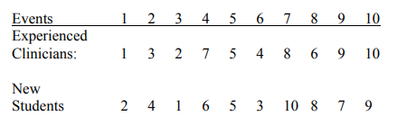
Correlation
Spearman ρ Correlation: Example
In a study of diagnostic processes, entering clinical graduate students are shown a 20-minute
videotape of children’s behavior and asked to rank-order 10 behavioral events on the tape in the order of
the importance each has for a behavioral assessment. (1 = most important.) The data are then averaged to
produce an average rank ordering for the entire class. The same thing was then done using experienced
clinicians. The data follow:
Use Spearman correlation to measure the agreement between experienced and novice clinicians.

Slide 18

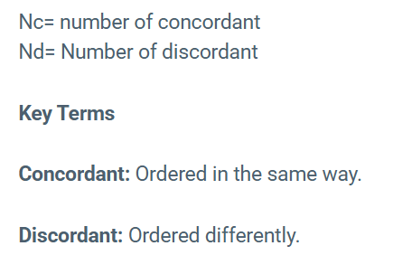
Correlation
Correlation coefficient:
  Kendall rank τ correlation: Measure how often pairs agree in order.
Total pairs
X=[1,2,3], Y=[3,2,1]
Pair | X order | Y order | Result
(1,2) | ↑ | ↓ | discordant
(1,3) | ↑ | ↓ | discordant
(2,3) | ↑ | ↓ | discordant

Slide 19
Correlation
Kendall rank τ correlation: Example
In a study of diagnostic processes, entering clinical graduate students are shown a 20-minute
videotape of children’s behavior and asked to rank-order 10 behavioral events on the tape in the order of
the importance each has for a behavioral assessment. (1 = most important.) The data are then averaged to
produce an average rank ordering for the entire class. The same thing was then done using experienced
clinicians. The data follow:
Use Spearman correlation to measure the agreement between experienced and novice clinicians.

Slide 20
Now we can measure correlation—but is it statistically significant?
Statistical significance tells us whether an observed effect is unlikely to have happened by chance.

Slide 21

Hypothesis Testing
We don’t just describe data, we make decisions.
  Is a new teaching method better?
  Do two groups behave differently?
  Are two variables related?

Slide 22
Hypothesis Testing
I assume the average weight of this class is 58 kg!
Core Idea: Hypothesis Testing Framework
  Making an assumption, called hypothesis, about a population parameter.
  Collecting sample data.
  Calculating a sample statistic.
  Using the sample statistic to evaluate the hypothesis.
© 1984-1994 T/Maker Co.

Slide 23
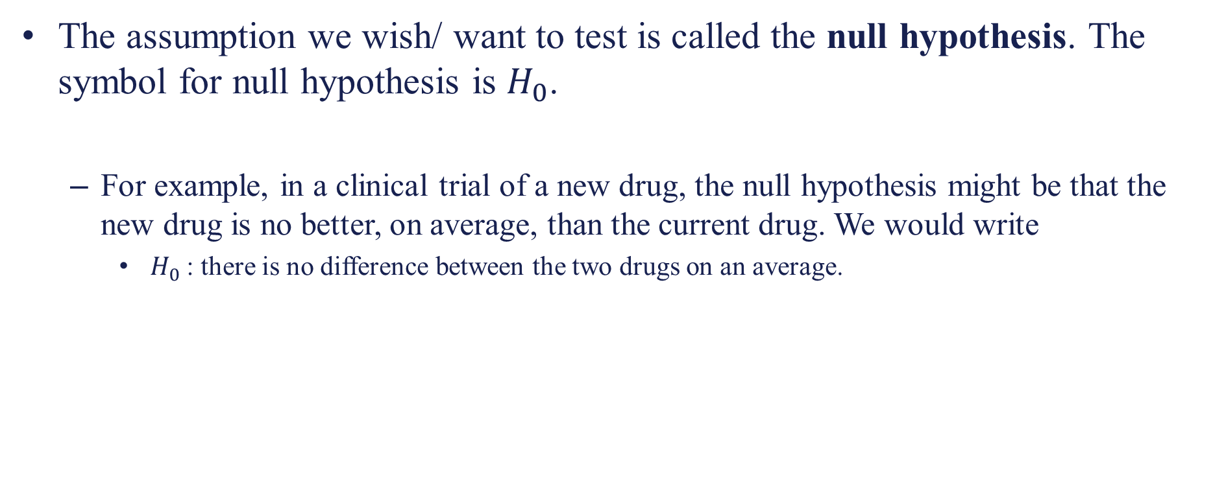
Hypothesis Testing
The assumption we wish/ want to test is called the null hypothesis. The symbol for null hypothesis is $H_{0}$.
  For example, in a clinical trial of a new drug, the null hypothesis might be that the new drug is no better, on average, than the current drug. We would write
    $H_{0}$: there is no difference between the two drugs on an average.
Begin with the assumption that the null hypothesis is TRUE.
(Similar to the notion of innocent until proven guilty)

Slide 24
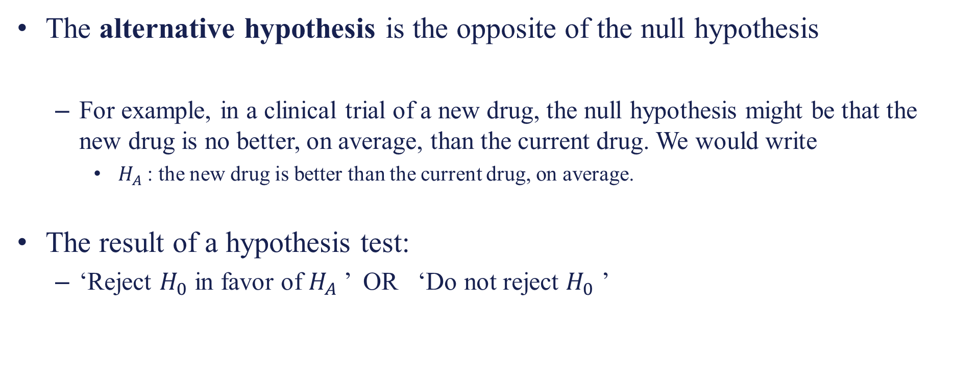
Hypothesis Testing
The alternative hypothesis is the opposite of the null hypothesis
  For example, in a clinical trial of a new drug, the null hypothesis might be that the new drug is no better, on average, than the current drug. We would write
    $H_{A}$: the new drug is better than the current drug, on average.
The result of a hypothesis test:
  ‘Reject $H_{0}$ in favor of $H_{A}$’ OR ‘Do not reject $H_{0}$ ’

Slide 25
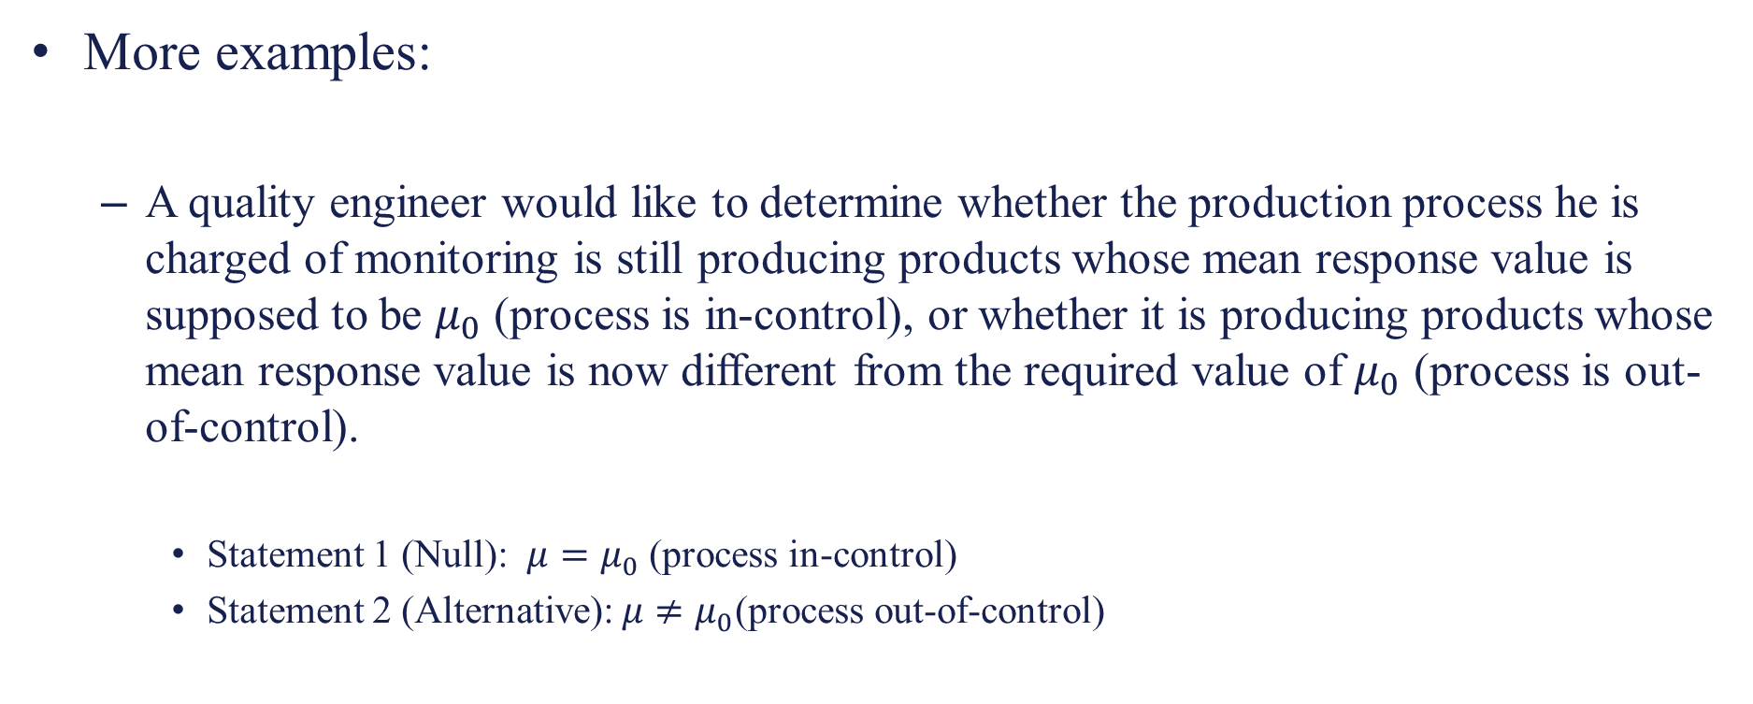
Hypothesis Testing
More examples:
  A quality engineer would like to determine whether the production process he is charged of monitoring is still producing products whose mean response value is supposed to be $μ_{0}$ (process is in-control), or whether it is producing products whose mean response value is now different from the required value of $μ_{0}$ (process is out-of-control).
    Statement 1 (Null): $μ=μ_{0}$ (process in-control)
    Statement 2 (Alternative): $μ≠μ_{0}$(process out-of-control)

Slide 26
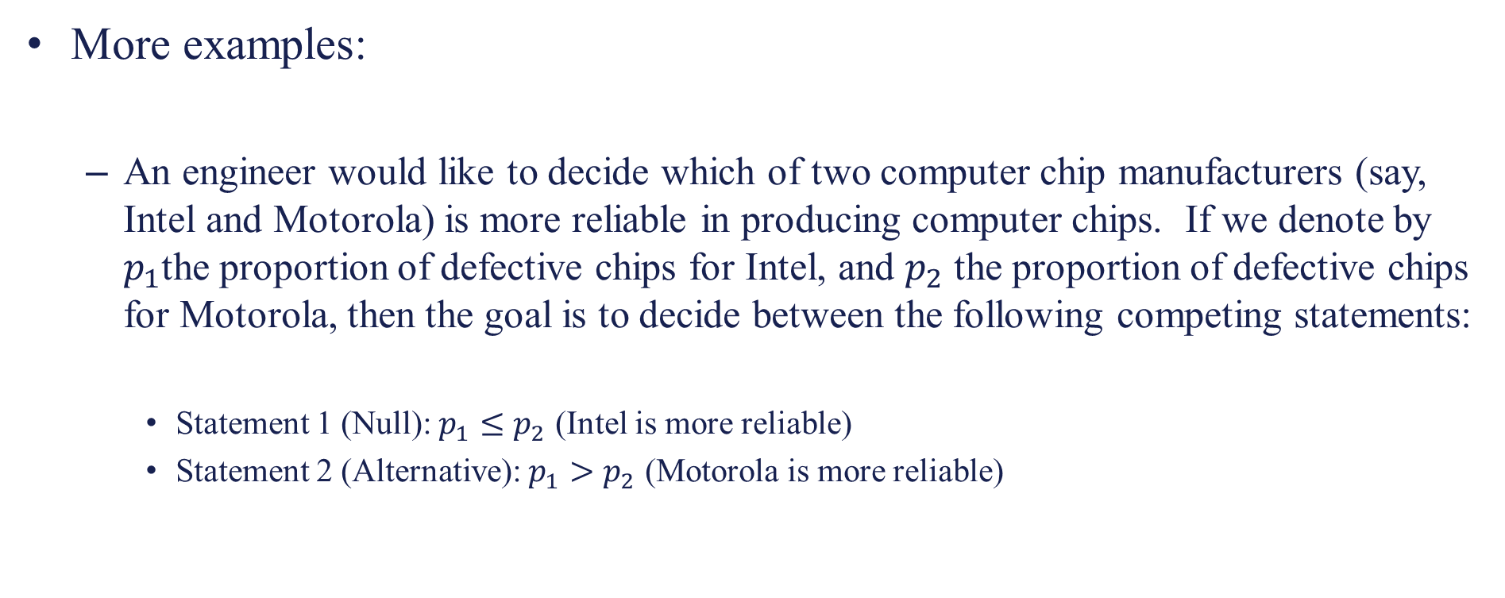
Hypothesis Testing
More examples:
  An engineer would like to decide which of two computer chip manufacturers (say, Intel and Motorola) is more reliable in producing computer chips. If we denote by $p_{1}$the proportion of defective chips for Intel, and $p_{2}$ the proportion of defective chips for Motorola, then the goal is to decide between the following competing statements:
    Statement 1 (Null): $p_{1}≤p_{2}$ (Intel is more reliable)
    Statement 2 (Alternative): $p_{1}>p_{2}$ (Motorola is more reliable)

Slide 27
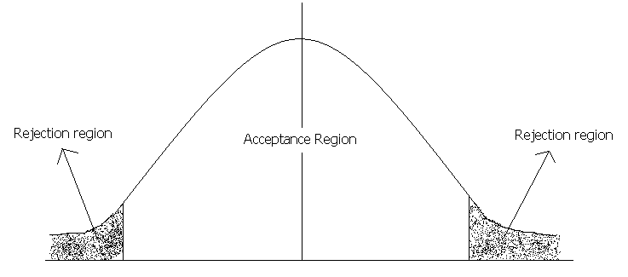
Hypothesis Testing
Significance level: refers to the percentage of sample means that is outside certain prescribed limits. E.g. testing a hypothesis at 5% level of significance means
  We reject the null hypothesis if it falls in the two regions of area 0.025.
  Do not reject the null hypothesis if it falls within the region of area 0.95.
If our sample statistic(calculated value) fall in the non-
shaded region( acceptance region), then it simply means
that there is no evidence to reject the null hypothesis.
Critical value
Critical value

Slide 28
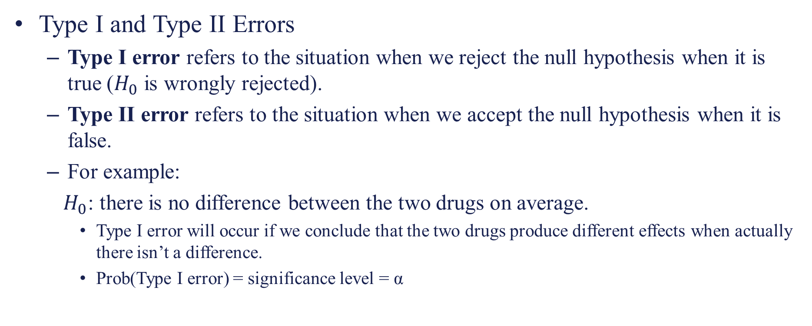
Hypothesis Testing
Type I and Type II Errors
  Type I error refers to the situation when we reject the null hypothesis when it is true ($H_{0}$ is wrongly rejected).
  Type II error refers to the situation when we accept the null hypothesis when it is false.
  For example:
  $H_{0}$: there is no difference between the two drugs on average.
    Type I error will occur if we conclude that the two drugs produce different effects when actually there isn’t a difference.
    Prob(Type I error) = significance level = α

Slide 29
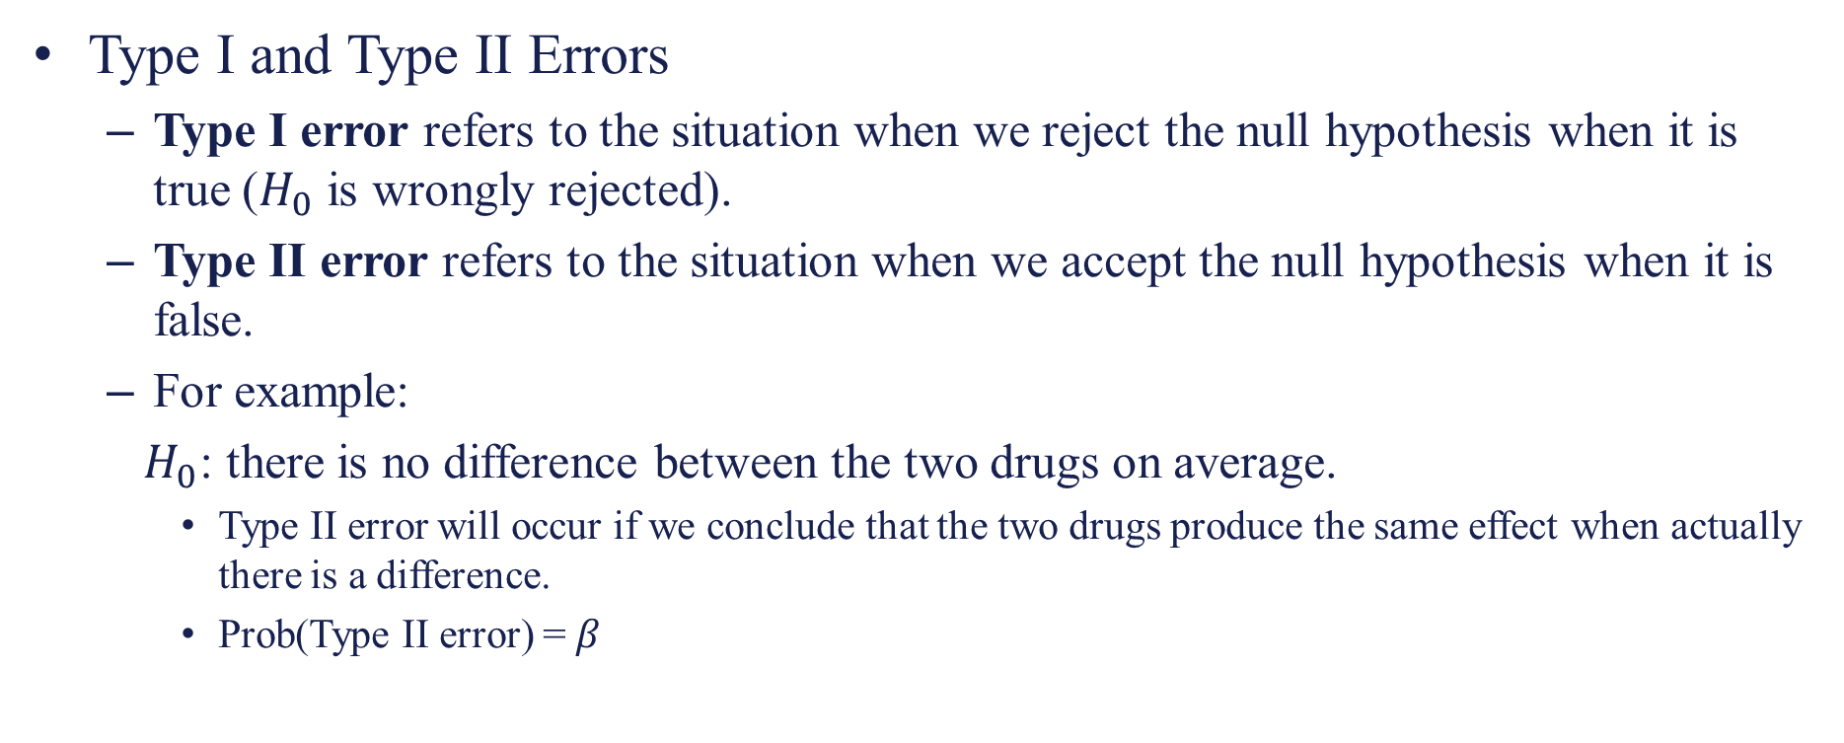
Hypothesis Testing
Type I and Type II Errors
  Type I error refers to the situation when we reject the null hypothesis when it is true ($H_{0}$ is wrongly rejected).
  Type II error refers to the situation when we accept the null hypothesis when it is false.
  For example:
  $H_{0}$: there is no difference between the two drugs on average.
    Type II error will occur if we conclude that the two drugs produce the same effect when actually there is a difference.
    Prob(Type II error) = $β$

Slide 30
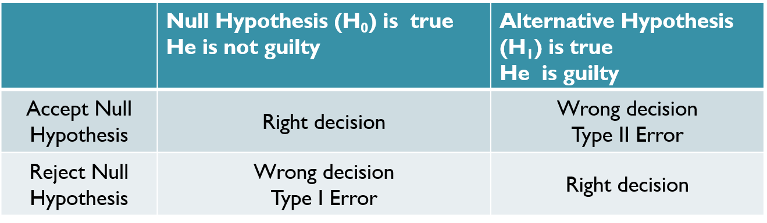
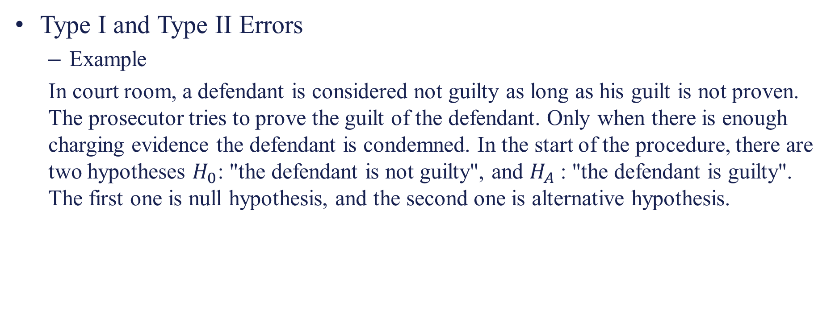
Hypothesis Testing
Type I and Type II Errors
  Example
  In court room, a defendant is considered not guilty as long as his guilt is not proven. The prosecutor tries to prove the guilt of the defendant. Only when there is enough charging evidence the defendant is condemned. In the start of the procedure, there are two hypotheses $H_{0}$: "the defendant is not guilty", and $H_{A}$: "the defendant is guilty". The first one is null hypothesis, and the second one is alternative hypothesis.

Slide 31
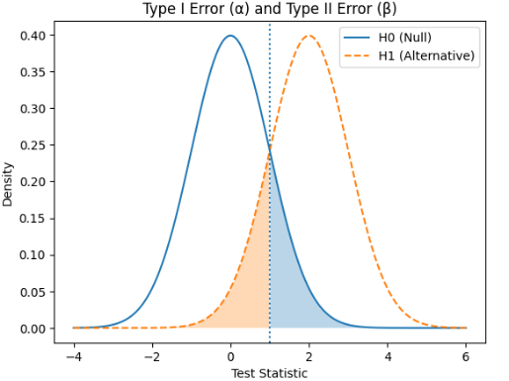
Hypothesis Testing
Type I and Type II Errors

Slide 32
Hypothesis Testing
Two-Tailed Test is that where the hypothesis about the population parameter is rejected for the value of sample statistic failing into either tail of the distribution.
When the hypothesis about the population parameter is rejected for the value of sample statistic failing into one side tail of the distribution, then it is known as one-tailed test.
If the rejection area falls on the right side, then it is called right-tailed test. On the other hand, if the rejection area falls on the right side, then it is called left-tailed test.

Slide 33
Hypothesis Testing
Critical Value(s)
α
H₀: μ ≥ 3 H₁: μ < 3
Rejection Regions
0
Fig 1 One-tail Test
α
H₀: μ ≤ 3 H₁: μ > 3
Fig 2 One-tail Test
0
α/2
H₀: μ = 3 H₁: μ ≠ 3
0
Fig-3 two-tail test

Slide 34
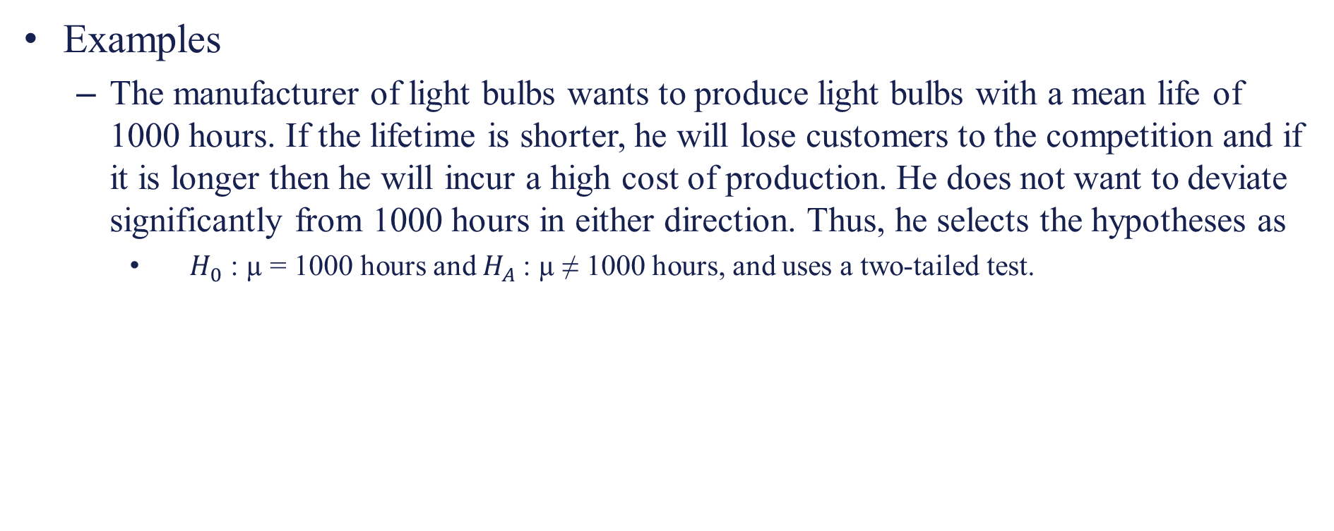
Hypothesis Testing
Examples
  The manufacturer of light bulbs wants to produce light bulbs with a mean life of 1000 hours. If the lifetime is shorter, he will lose customers to the competition and if it is longer then he will incur a high cost of production. He does not want to deviate significantly from 1000 hours in either direction. Thus, he selects the hypotheses as
    $H_{0}$ : µ = 1000 hours and $H_{A}$: µ ≠ 1000 hours, and uses a two-tailed test.

Slide 35
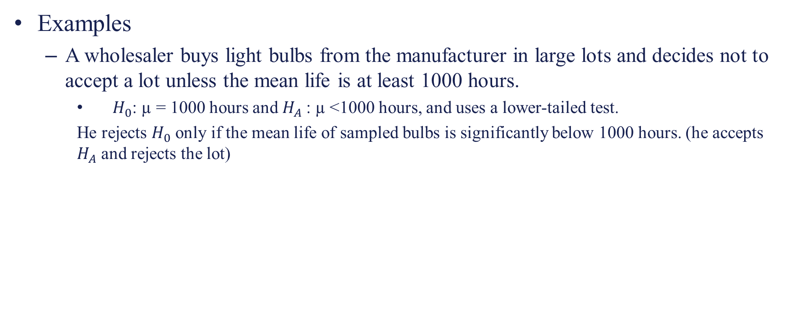
Hypothesis Testing
Examples
  A wholesaler buys light bulbs from the manufacturer in large lots and decides not to accept a lot unless the mean life is at least 1000 hours.
    $H_{0}$: µ = 1000 hours and $H_{A}$: µ <1000 hours, and uses a lower-tailed test.
    He rejects $H_{0}$ only if the mean life of sampled bulbs is significantly below 1000 hours. (he accepts $H_{A}$ and rejects the lot)

Slide 36
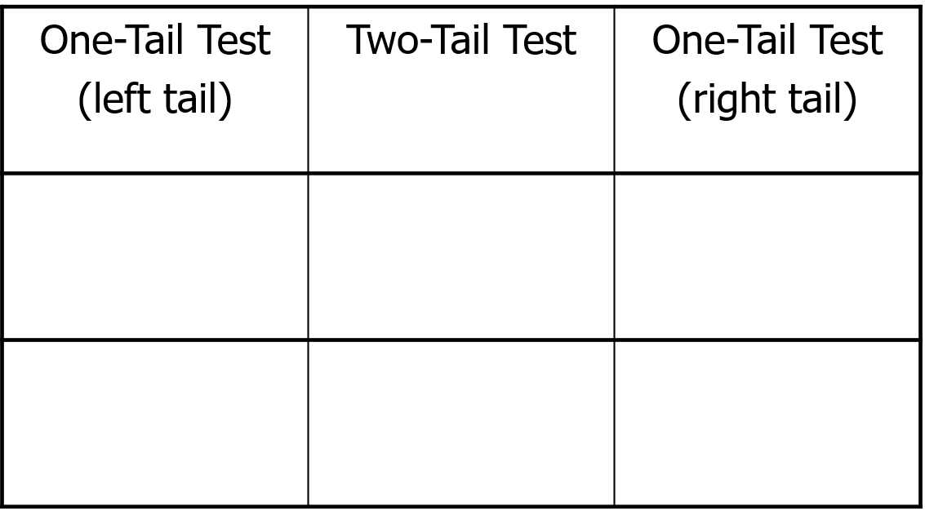



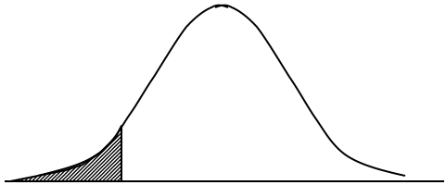
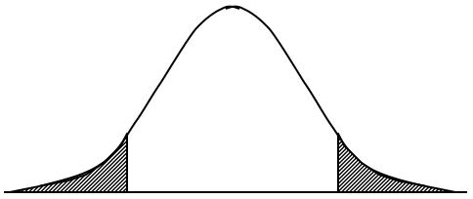
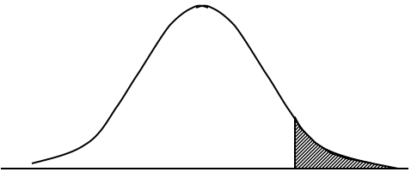
Hypothesis Testing
Summary of One- and Two-Tail Tests

Slide 37
Hypothesis Testing
Process of significance testing:
  In the process of testing for statistical significance, there are the following steps:
  Stating a hypothesis for research
  Starting a null hypothesis
  Selecting a probability of error level
  Selecting and computing a statistical significance test
  Interpreting the results

Slide 38
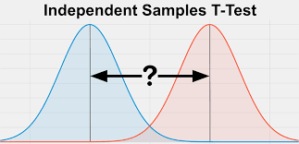
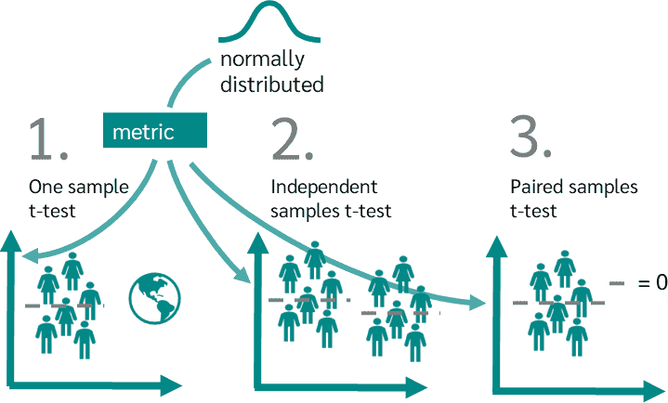
Hypothesis Testing
T-Test: determine if there is a significant difference between the means of two groups and how they are related. There are :
  One sample T- Test
  Independent T- Test
  Paired T- Test

Slide 39
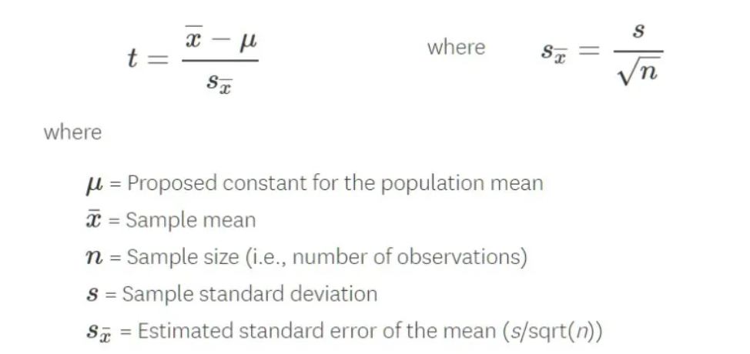
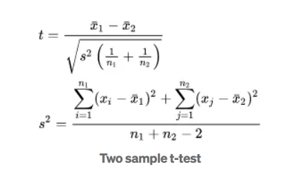
Hypothesis Testing
T-Test

Slide 40

Hypothesis Testing
T-Test: Independent Two-Sample t-test Example
  Compare average exam scores of two groups:
  Group A: 78, 82, 85, 90, 88
  Group B: 72, 75, 78, 70, 74

Slide 41
Hypothesis Testing
ANOVA Test: It is also called an analysis of variance and is used to compare multiple (three or more) samples with a single test.
The hypothesis being tested in ANOVA is
  Null: All pairs of samples are same i.e. all sample means are equal
  Alternate: At least one pair of samples is significantly different

Slide 42
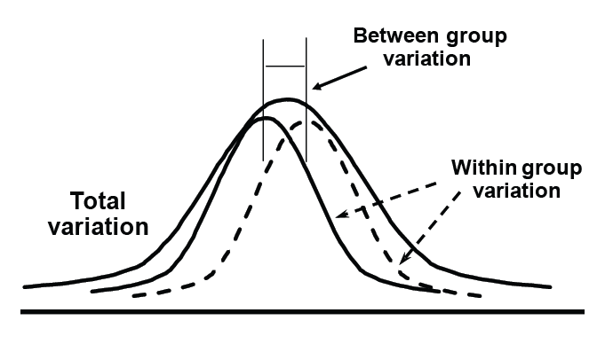

Hypothesis Testing
ANOVA Test

Slide 43

Hypothesis Testing
ANOVA Test: Example
  Compare 3 teaching methods:
  Group 1: 85, 88, 90
  Group 2: 78, 82, 80
  Group 3: 92, 94, 96

Slide 44
Hypothesis Testing
Chi-Square Test: Chi-Square test is used when we perform hypothesis testing on two categorical variables from a single population.
The hypothesis being tested for chi-square is
  Null: Variable A and Variable B are independent.
  Alternate: Variable A and Variable B are not independent.

Slide 45
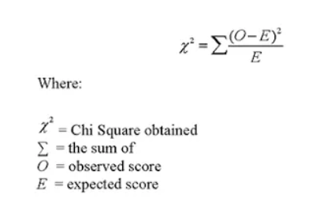
Hypothesis Testing
Chi-Square Test

Slide 46


Hypothesis Testing
Chi-Square Test: Example
Test if gender and preference are independent:
 | Like | Dislike | Total
Male | 30 | 20 | 50
Female | 20 | 30 | 50
Total | 50 | 50 | 100

Slide 47
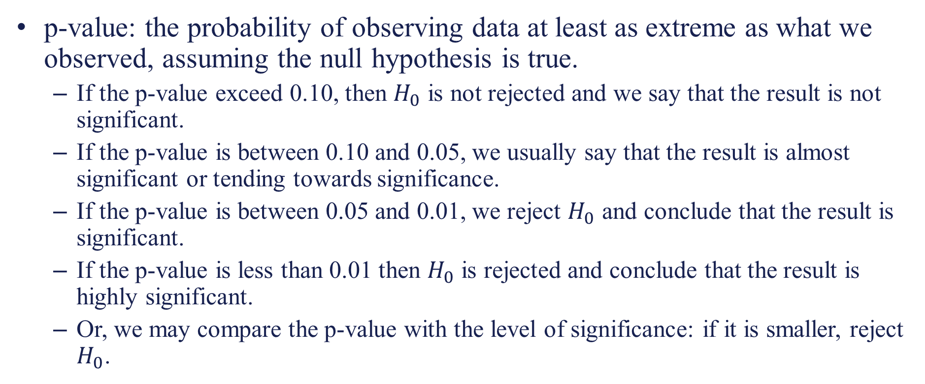
Hypothesis Testing
p-value: the probability of observing data at least as extreme as what we observed, assuming the null hypothesis is true.
  If the p-value exceed 0.10, then $H_{0}$ is not rejected and we say that the result is not significant.
  If the p-value is between 0.10 and 0.05, we usually say that the result is almost significant or tending towards significance.
  If the p-value is between 0.05 and 0.01, we reject $H_{0}$ and conclude that the result is significant.
  If the p-value is less than 0.01 then $H_{0}$ is rejected and conclude that the result is highly significant.
  Or, we may compare the p-value with the level of significance: if it is smaller, reject $H_{0}$.

Slide 48
Hypothesis Testing
p-value: the probability of observing data at least as extreme as what we observed, assuming the null hypothesis is true.
Example:
  Suppose you test whether a new drug provides more pain relief than a placebo.
    If the drug has no real effect, your test statistic will be close to what’s expected under the null hypothesis, and the p-value will be high (close to 1).
    If the drug truly works, your test statistic will differ more from the null expectation, and the p-value will drop.
The smaller the p-value, the less likely the results occurred by random chance, and the stronger the evidence that you should reject the null hypothesis.

