Slide 1
Statistics in Data Science
CSC 405/605

Slide 2
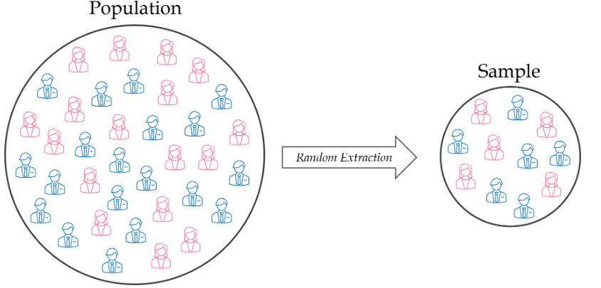
Continuous Distribution
Central Limit Theorem (CLT)

Slide 3
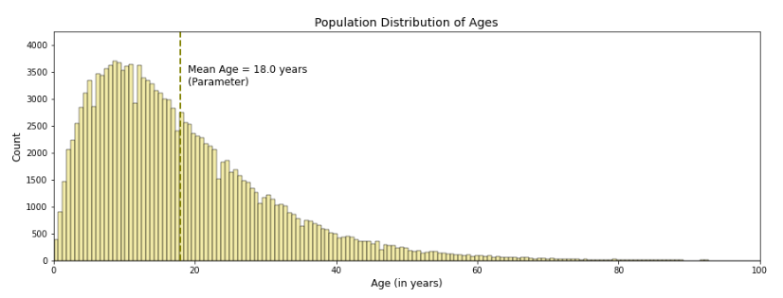
Continuous Distribution
Central Limit Theorem (CLT)
Suppose we repeatedly draw random and independent samples from a population.
Each sample has size 𝑛=100
For each sample, we calculate the sample mean age
Example samples:
Sample 1 → mean age = 17.8
Sample 2 → mean age = 18.4
Sample 3 → mean age = 18.1
…
If we repeat this thousands of times, we obtain thousands of sample means.

Slide 4
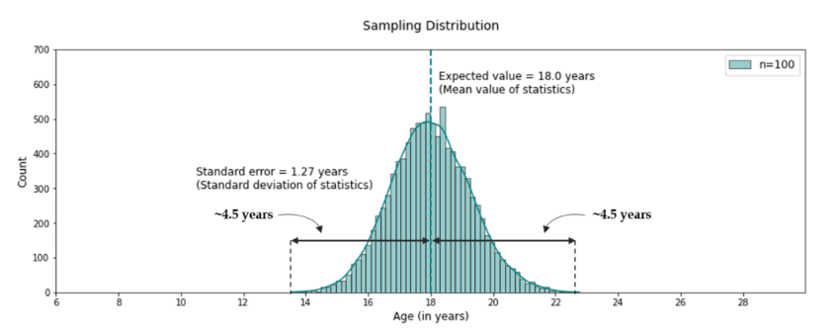
Continuous Distribution
Central Limit Theorem (CLT)
We can plot these values in a histogram. This histogram is called the sampling distribution.
The sampling distribution is very close to a normal distribution.

Slide 5
Continuous Distribution
Central Limit Theorem (CLT)
We can plot these values in a histogram. This histogram is called the sampling distribution.
The sample mean is an unbiased estimator of the population mean.

Slide 6
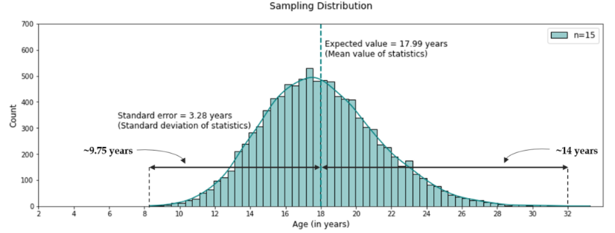
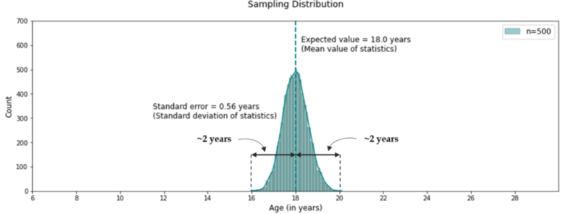
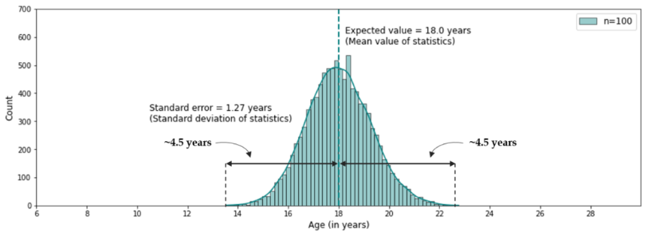
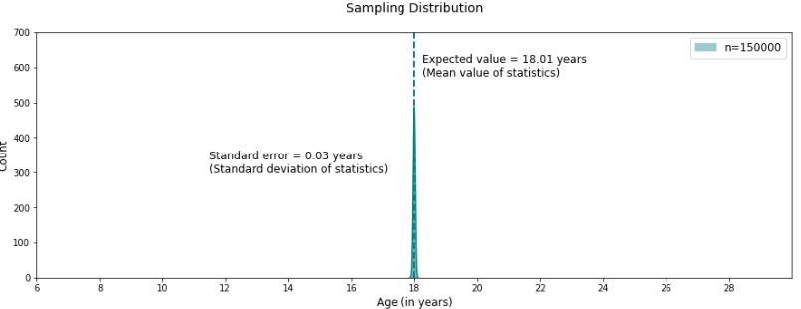
Continuous Distribution
Central Limit Theorem (CLT)
As the sample size n increases, the standard error decreases, meaning the sample mean becomes more stable.

Slide 7
Probability Density Estimation
Construct an estimate of the underlying probability distribution function from sample (observed data).
Choose a model that can estimate the underlying probability density function;
Fit the model to the sample data.

Slide 8
Probability Density Estimation
Why Is Knowing the Distribution Important?
Compute key statistics
Mean
Variance
Understand data behavior
Shape of the distribution
Skewness and variability
Detect unusual observations
Identify outliers or anomalies
Determine whether an observation is unlikely or very unlikely
Support downstream tasks
Decision making
Modeling and inference
Treat your project dataset as a sample, and your goal is to learn something about the underlying population and distribution.

Slide 9
Probability Density Estimation
Parametric Vs Non-parametric Estimation
Parametric probability density estimation involves selecting a common distribution and estimating the parameters for the density function from a data sample.
Non-parametric probability density estimation involves using a technique to fit a model to the arbitrary distribution of the data, like kernel density estimation

Slide 10
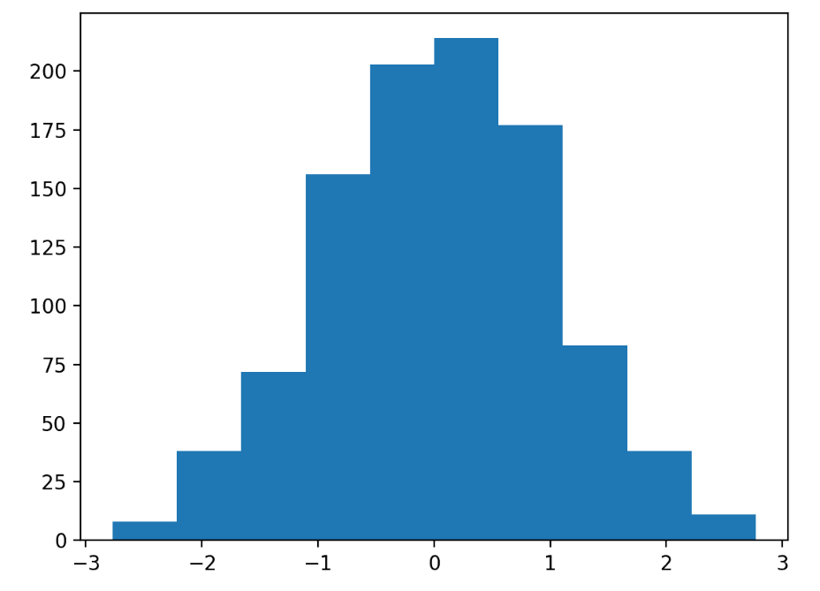
Probability Density Estimation
The first step in density estimation is to create a histogram of the observations in the random sample.

Slide 11
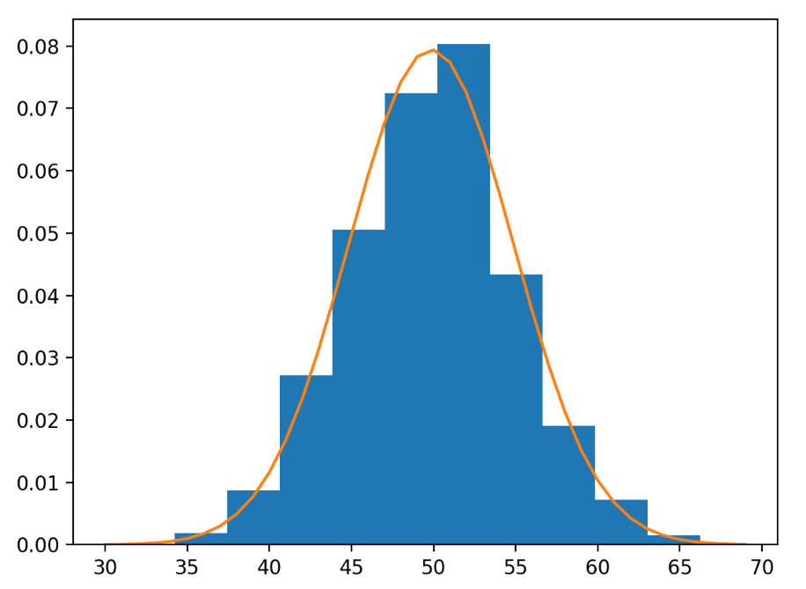
Probability Density Estimation
Parametric Density Estimation
The shape of a histogram of most random samples will match a well-known probability distribution.
Normal Distribution: parameters can be estimated from data by calculating the sample mean and sample standard deviation.
Check if it is a good fit:
Plotting the density function and comparing the shape to the histogram.
Sampling the density function and comparing the generated sample to the real sample.
Using a statistical test to confirm the data fits the distribution.

Slide 12


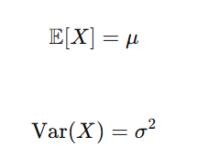
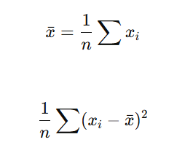


Probability Density Estimation
Parametric Density Estimation
Method of Moments (MoM): match theory with data.
Gaussian Distribution
Exponential Distribution
Theoretical Moments
Theoretical Moments
Mean:
Mean:
Variance:

Slide 13
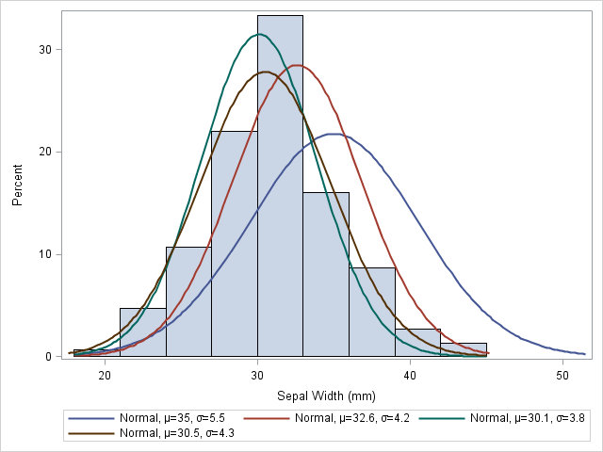
Probability Density Estimation
Parametric Density Estimation
For example, we assume the data is Gaussian distribution, but key question is: Why are these the “right” parameters?
We need a general method to estimate parameters from data.

Slide 14
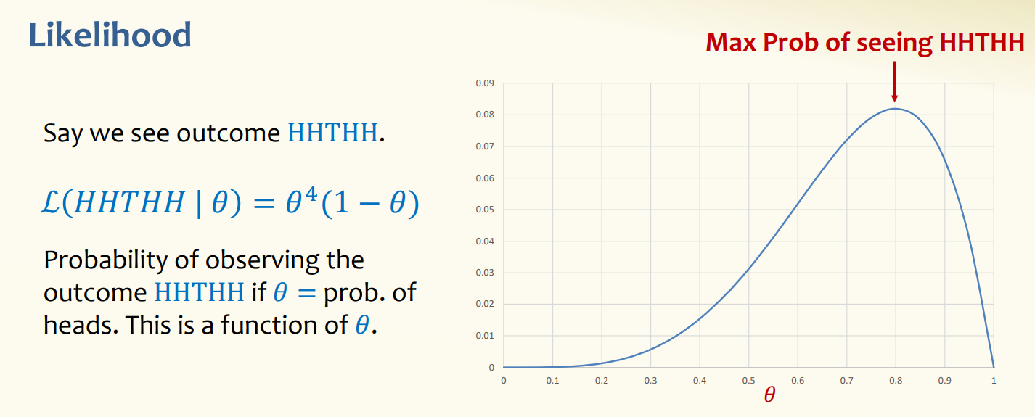
Probability Density Estimation
Parametric Density Estimation
Maximum Likelihood Estimation (MLE): Adjust parameters to maximize the probability of observed data.
Suppose we have a mystery coin with some probability 𝑝 of coming up heads. We
flip the coin 5 times, independent of other flips.

Slide 15
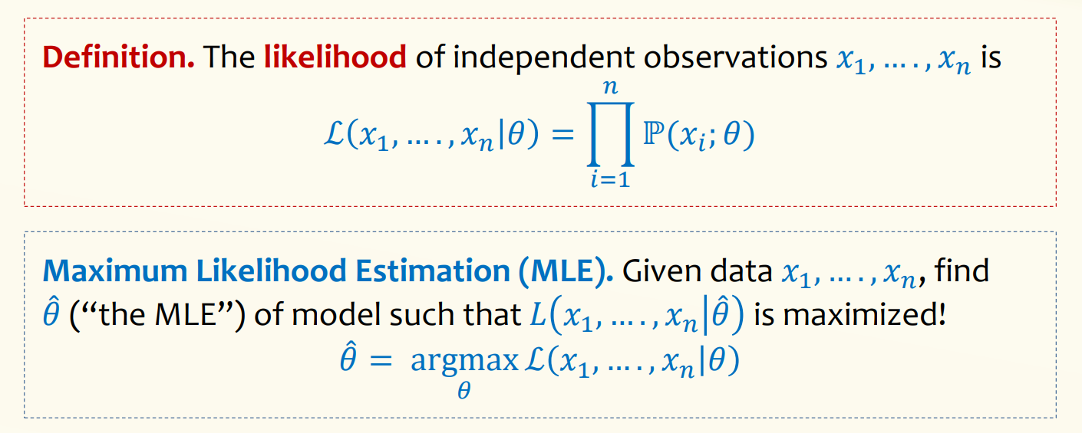

Probability Density Estimation
Parametric Density Estimation
Maximum Likelihood Estimation (MLE): Adjust parameters to maximize the probability of observed data.

Slide 16
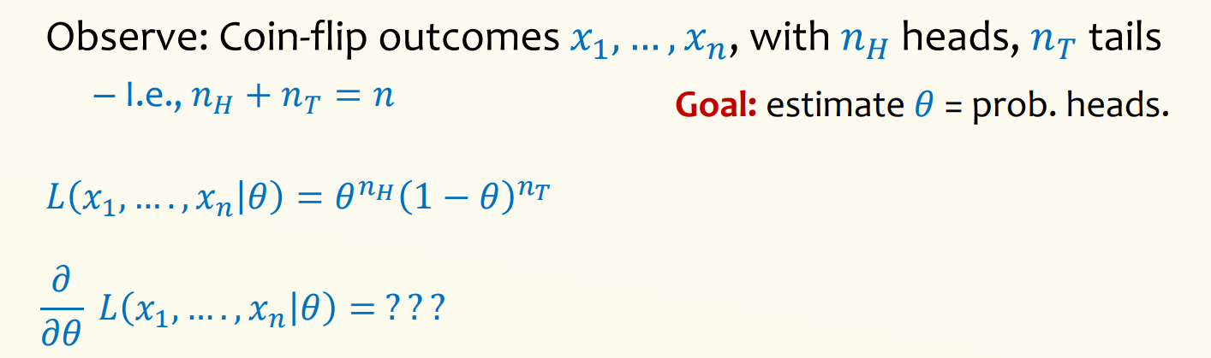
Probability Density Estimation
Parametric Density Estimation
Maximum Likelihood Estimation (MLE): Adjust parameters to maximize the probability of observed data.
While it is possible to compute this derivative, it’s not always nice since we are working with products.

Slide 17
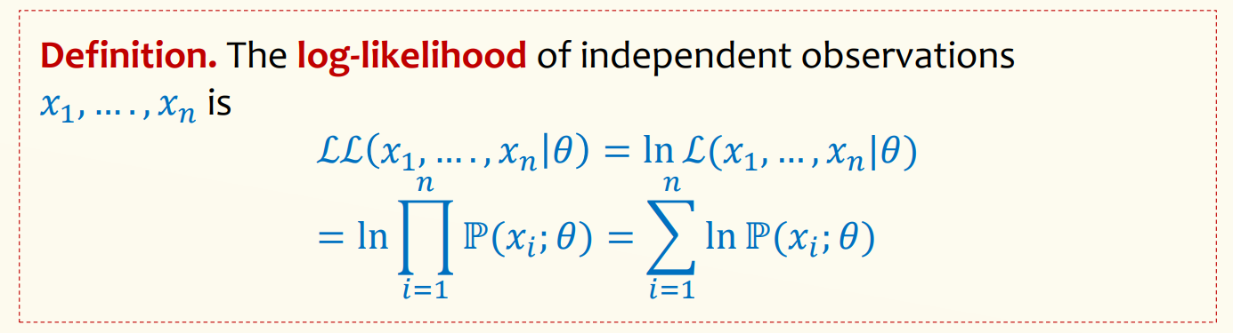
Probability Density Estimation
Parametric Density Estimation
Maximum Likelihood Estimation (MLE): Adjust parameters to maximize the probability of observed data.

Slide 18
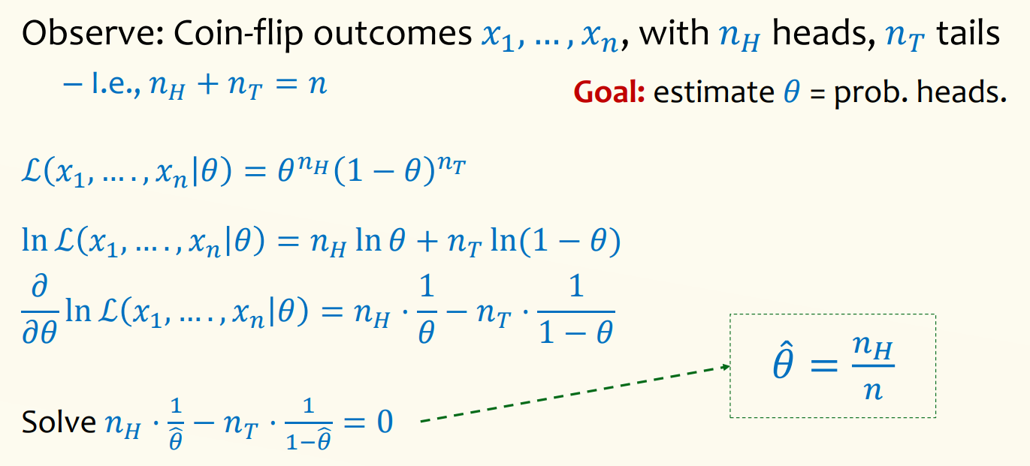
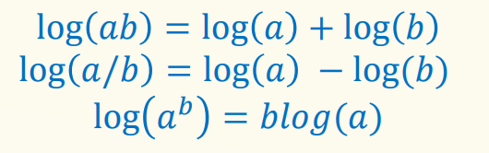
Probability Density Estimation
Parametric Density Estimation
Maximum Likelihood Estimation (MLE): Adjust parameters to maximize the probability of observed data.
Useful log properties:

Slide 19
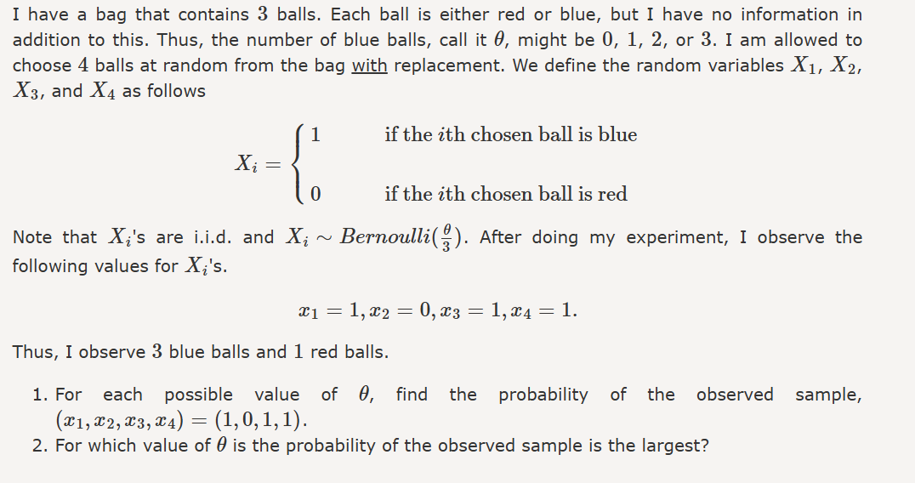
Probability Density Estimation
Test your understanding…

Slide 20
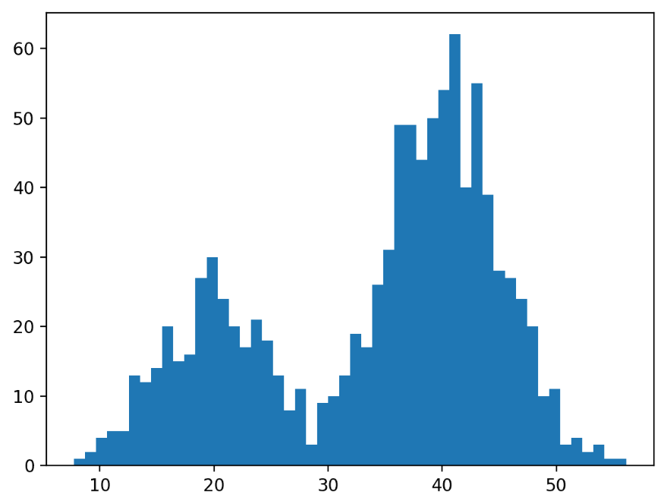
Probability Density Estimation
Non-Parametric Density Estimation
In some cases, a data sample may not resemble a common probability distribution or cannot be easily made to fit the distribution.
This is often the case when the data has two peaks (bimodal distribution) or many peaks (multimodal distribution)

Slide 21
Probability Density Estimation
Non-Parametric Density Estimation
Kernel Density Estimation
weights the contribution of observations from a data sample based on their relationship.
Smoothing Parameter (bandwidth): Parameter that controls the number of samples or window of samples used to estimate the probability distribution.

Slide 22
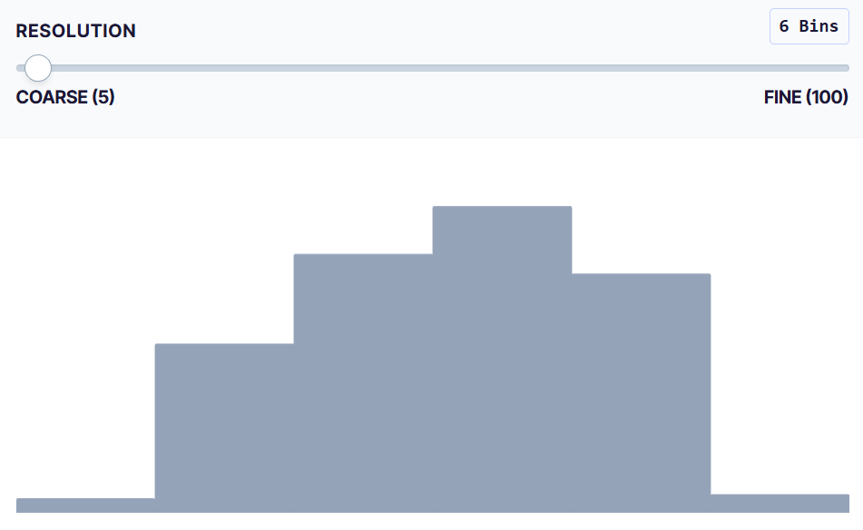
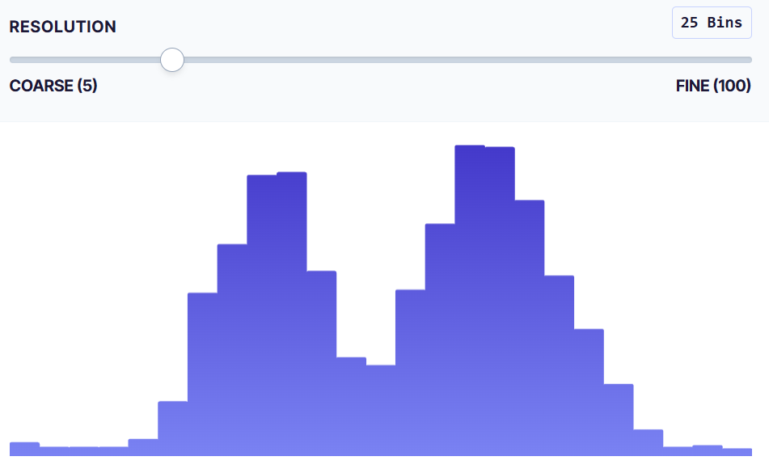
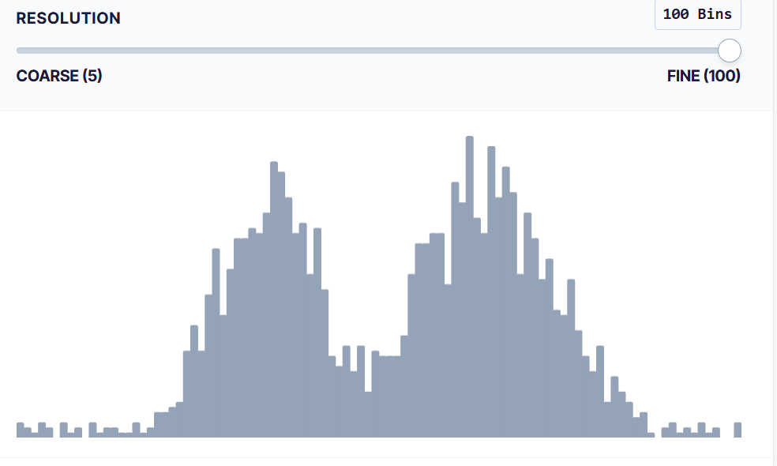
Probability Density Estimation
Non-Parametric Density Estimation
The Binning Trap: Histograms seem simple, but they can be misleading.
Visual Bias
Visual Bias
looks unimodal
looks bimodal
looks noisy
Bin Width:
Too small → noisy, overfitting
Too large → oversmoothed, lose structure
So how can we avoid these arbitrary bins?
https://www.nveil.com/histogram-history-binning-bias-kde/

Slide 23
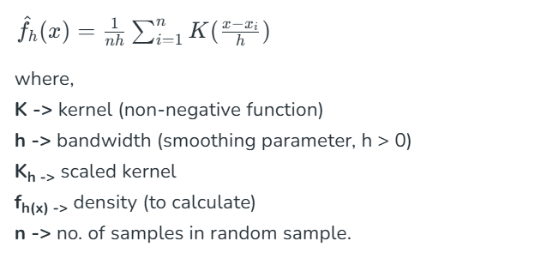
Probability Density Estimation
Non-Parametric Density Estimation
Kernel Density Estimation (KDE)
Instead of grouping data into bins: We estimate a smooth density, each data point contributes continuously.

Slide 24

Probability Density Estimation
Non-Parametric Density Estimation
Kernel Density Estimation (KDE)
Kernel Function 𝐾
Common choice: Gaussian kernel

Slide 25
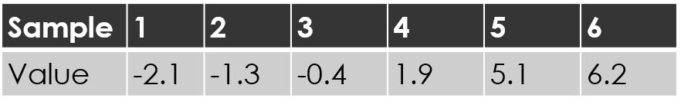
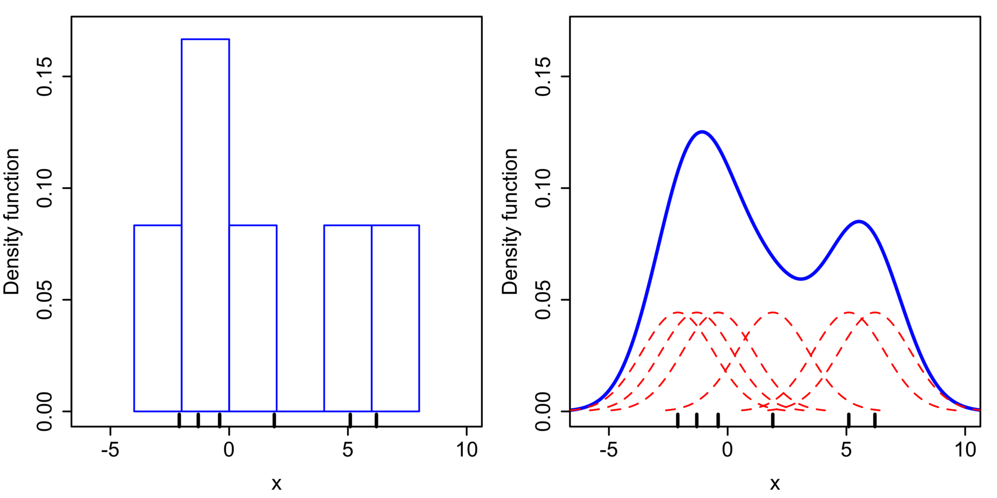
Probability Density Estimation
Non-Parametric Density Estimation
Kernel Density Estimation (KDE)

Slide 26
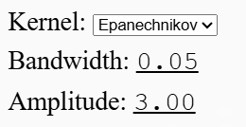
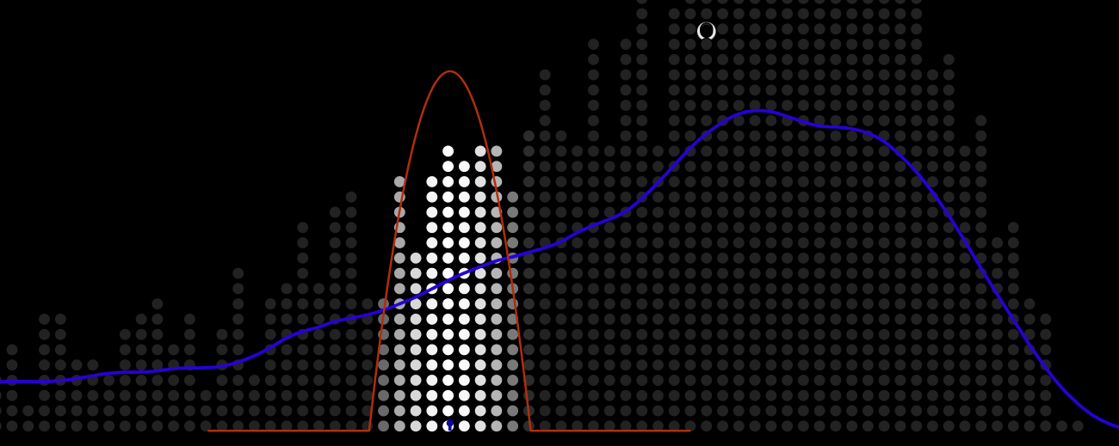
Probability Density Estimation
Non-Parametric Density Estimation
Kernel Density Estimation (KDE)
https://mathisonian.github.io/kde/

Slide 27
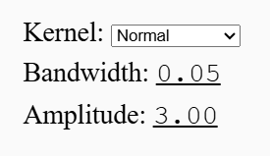
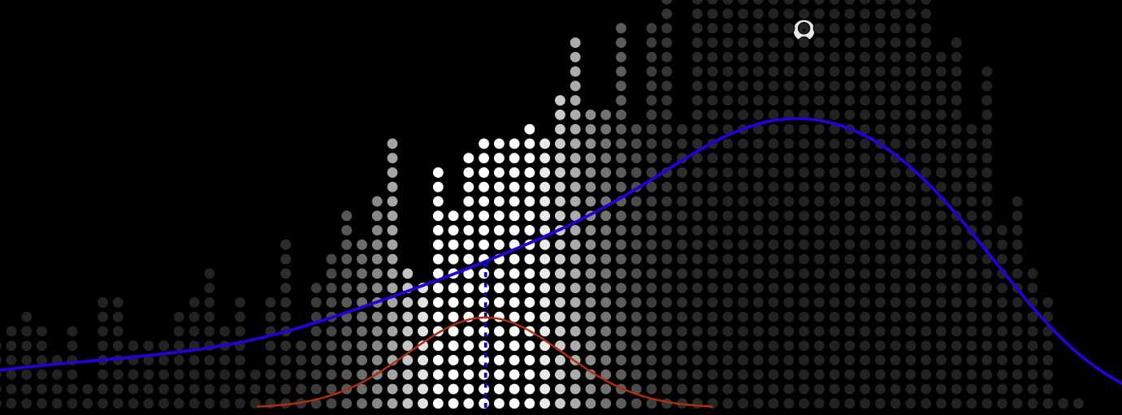
Probability Density Estimation
Non-Parametric Density Estimation
Kernel Density Estimation (KDE)
https://mathisonian.github.io/kde/

Slide 28
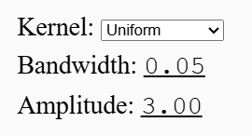
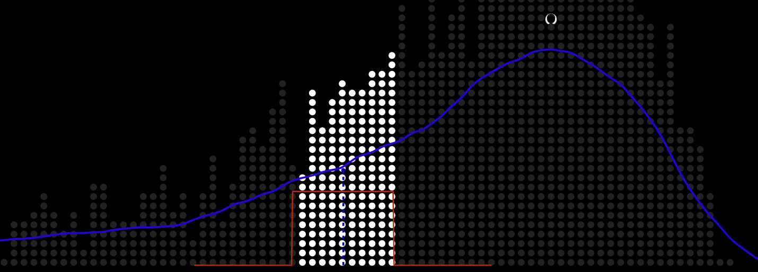
Probability Density Estimation
Non-Parametric Density Estimation
Kernel Density Estimation (KDE)
https://mathisonian.github.io/kde/

Slide 29
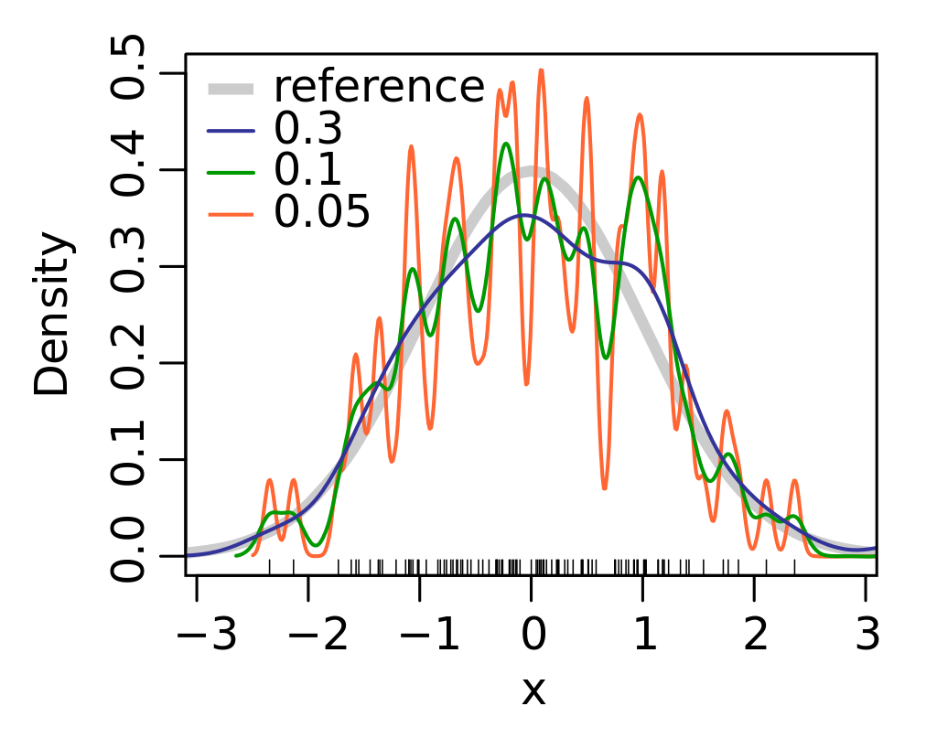
Probability Density Estimation
Non-Parametric Density Estimation
Kernel Density Estimation (KDE)
https://mathisonian.github.io/kde/

