Slide 1
Statistics in Data Science
CSC 405/605

Slide 2

Random Variable

Slide 3
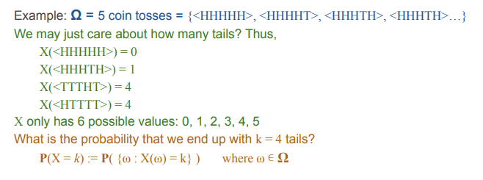

Random Variable
A random variable is a numerical value that summarizes the outcome of a random experiment.

Slide 4
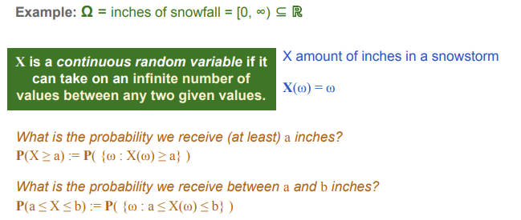
Random Variable

Slide 5
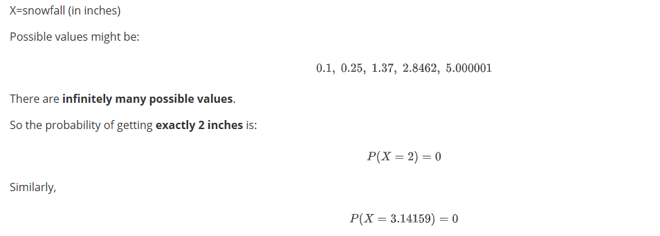
Random Variable
For continuous variables, the probability of any exact value is zero because there are infinitely many possible values.
Instead, probability is defined over intervals, not individual points.

Slide 6

Discrete Distribution
For discrete random variables, we use a Probability Mass Function (PMF).
Example: Number of heads in 3 coin tosses
Each specific value has a probability.

Slide 7
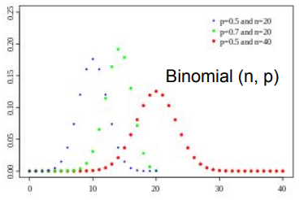
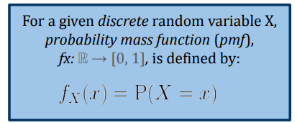
Discrete Distribution
Probability Mass Function (PMF)
A PMF describes the probability distribution of a discrete random variable.
The PMF gives the probability that the random variable takes a specific value.

Slide 8


Discrete Distribution
Probability Mass Function (PMF)
A PMF describes the probability distribution of a discrete random variable.
Properties of a PMF
Probabilities are non-negative
The total probability equals 1

Slide 9
Discrete Distribution
Probability Mass Function (PMF) - Binomial Distribution
A random variable 𝑋 follows a binomial distribution if:
There are n independent trials
Each trial has two outcomes (success or failure)
The probability of success is p
The probability is the same for every trial

Slide 10
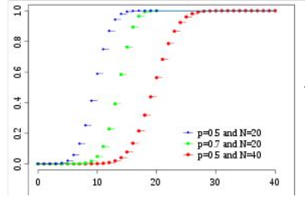
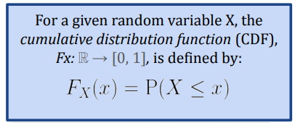
Discrete Distribution
Cumulative distribution function (CDF)- Binomial Distribution

Slide 11

Discrete Distribution
Cumulative distribution function (CDF)- Binomial Distribution

Slide 12
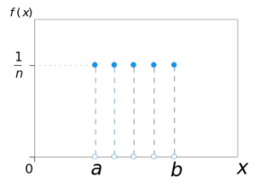
Discrete Distribution
Probability Mass Function (PMF) - Discrete Uniform

Slide 13
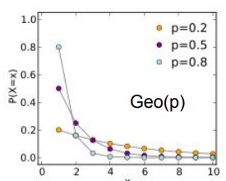
Discrete Distribution
Probability Mass Function (PMF) - Geometric(p)

Slide 14
Discrete Distribution
Probability Mass Function (PMF)
Binomial(n, p)
Example: number of heads after n coin flips (p, probability of heads)
Bernoulli(p) = Binomial(1, p)
Example: one trial of success or failure
Discrete Uniform(a, b)
Example: one trial of coin flips/dice roll
Geometric(p)
Example: coin flips until first head

Slide 15

Continuous Distribution
Example: Number of heads in 3 coin tosses
But for continuous random variables, we learned:
Each specific value has a probability.
How to model?

Slide 16

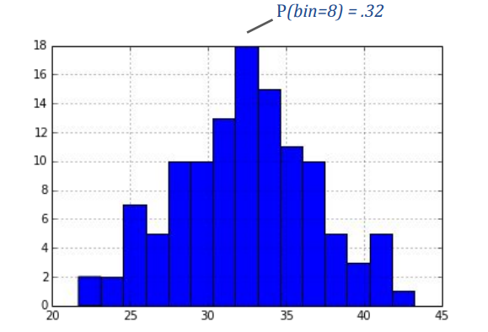
Continuous Distribution

Slide 17
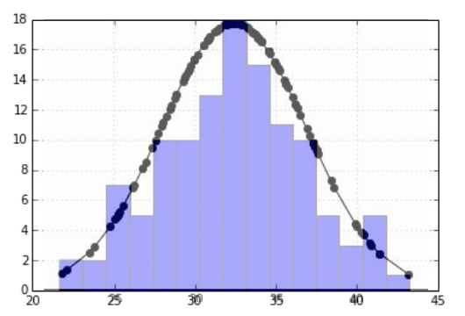
Continuous Distribution

Slide 18
Continuous Distribution
For discrete random variables, we use a Probability Mass Function (PMF).
For continuous variables, we use a Probability Density Function (PDF).

Slide 19


Continuous Distribution
Probability Density Function (PDF).
A PDF describes how probability is distributed over possible values of a continuous variable.
We denote it as
Total area under the curve equals 1

Slide 20

Continuous Distribution
Probability Density Function (PDF).
For continuous variables, probability is computed over intervals:
Probability equals the area under the density curve between 𝑎 and 𝑏.

Slide 21
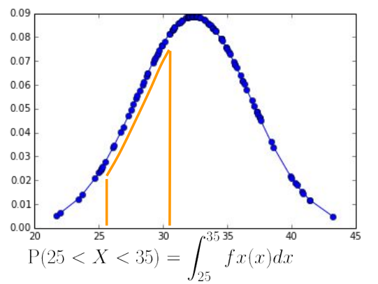
Continuous Distribution

Slide 22
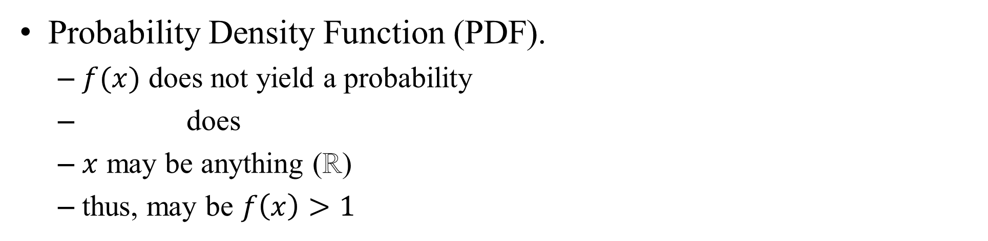
Continuous Distribution
Probability Density Function (PDF).
$f(x)$ does not yield a probability
does
$x$ may be anything (ℝ)
thus, may be $f\left(x\right)>1$

Slide 23
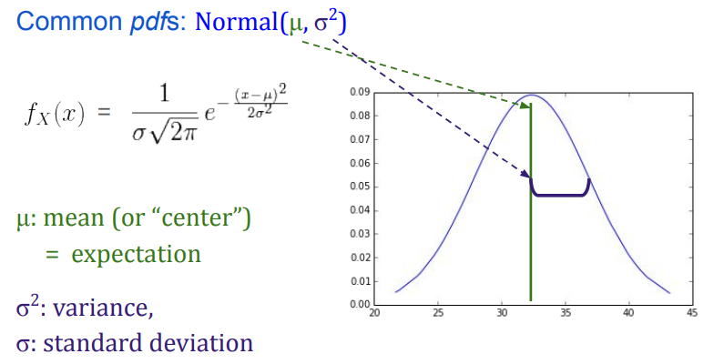
Continuous Distribution
Probability Density Function (PDF).

Slide 24
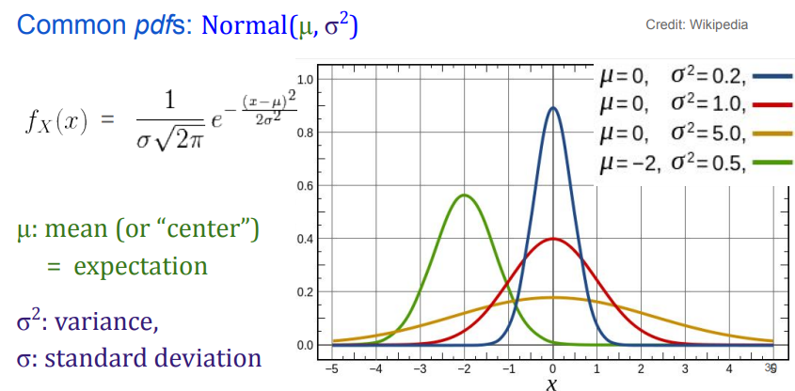
Continuous Distribution
Probability Density Function (PDF).

Slide 25
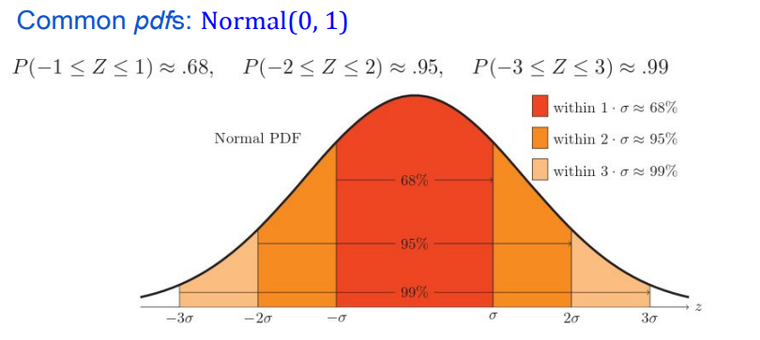
Continuous Distribution
Probability Density Function (PDF).

Slide 26

Continuous Distribution
Probability Density Function (PDF).
We can convert any normal variable x into the standard normal variable z using two steps:
Step 1: subtract the mean (mean centering)
This moves the center of the distribution to 0.
Step 2: divide by the standard deviation
This rescales the data so the spread becomes 1.

Slide 27
Continuous Distribution
Probability Density Function (PDF).
Suppose a student, Bob, receives the following scores:
English: 90
Math: 60
Question: In which subject did Bob perform better?

Slide 28
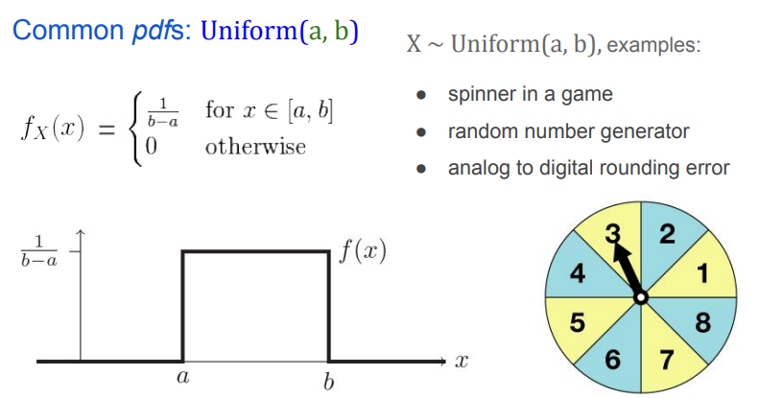
Continuous Distribution
Probability Density Function (PDF)

Slide 29
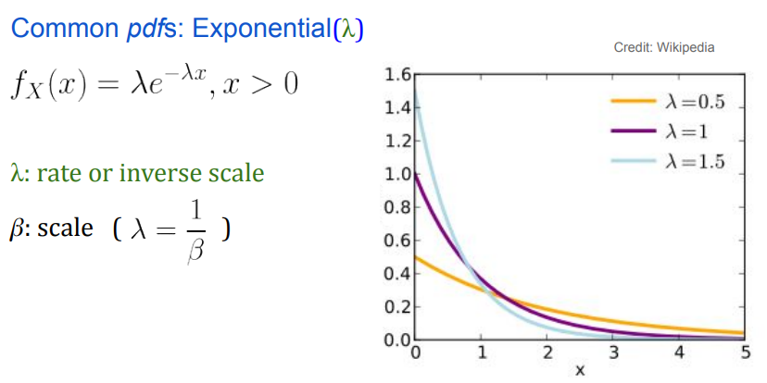
Continuous Distribution
Probability Density Function (PDF)
For example, if buses arrive at a bus stop every 15 minutes on average, the time you wait for the next bus can be modelled using an exponential distribution.

Slide 30
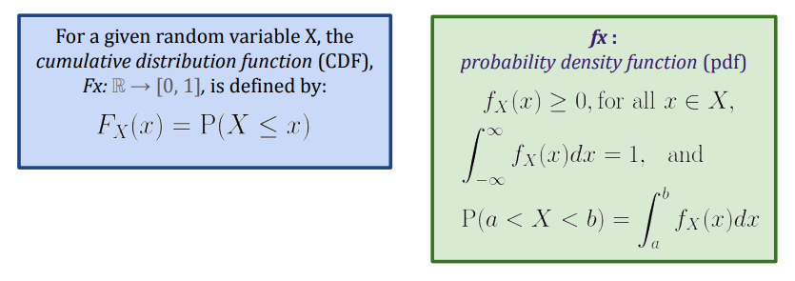
Continuous Distribution

Slide 31
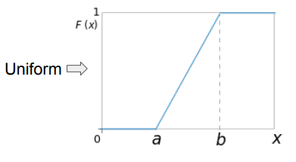
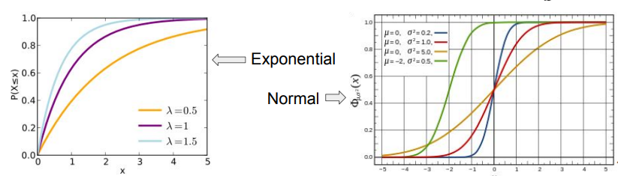
Continuous Distribution
Cumulative Distribution Function (CDF)

Slide 32
Exercise 1
For each variable below, determine whether it is Discrete or Continuous.
Number of emails you receive today;
Height of a student in centimeters;
Number of bugs in a software program;
Time required to train a machine learning model;
Number of customers visiting a website in one hour

Slide 33
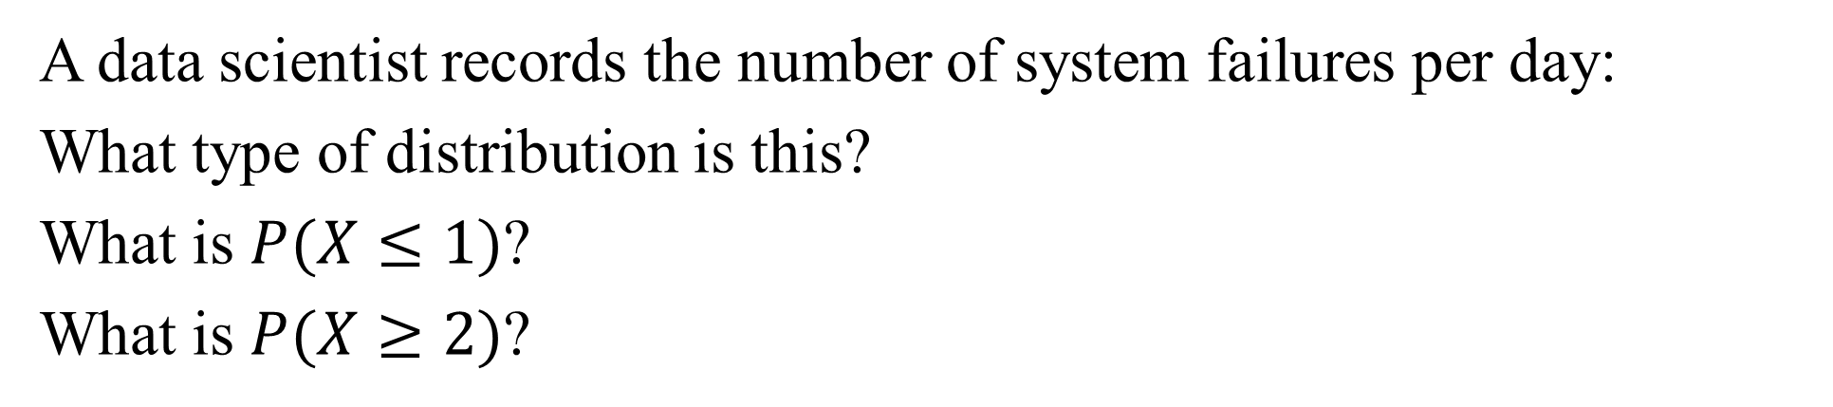
Exercise 2
A data scientist records the number of system failures per day:
What type of distribution is this?
What is $P(X≤1)$?
What is $P(X≥2)$?
Failures (X) | Probability
0 | 0.50
1 | 0.30
2 | 0.15
3 | 0.05

Slide 34
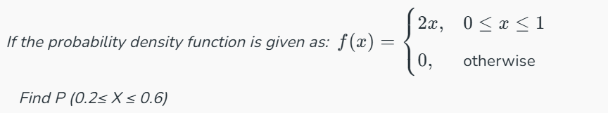
Exercise 3

Slide 35
Exercise 4
The exam scores in a statistics class follow a normal distribution with: Mean μ=70, Standard deviation σ=10. A student scored 85.
Compute the z-score.
Is the score above or below average?

Slide 36
Exercise 5
In a sample of size 7 with values 6, 8, 10, 12, 14, 16, 18 calculate the Z-score for x = 16.

