Slide 1
Statistics in Data Science
CSC 405/605

Slide 2

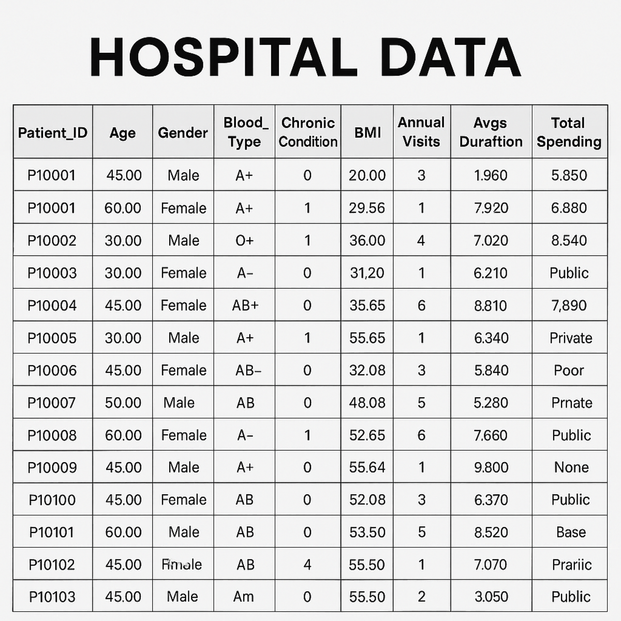

Probability Foundation
Probability in Data Science

Slide 3

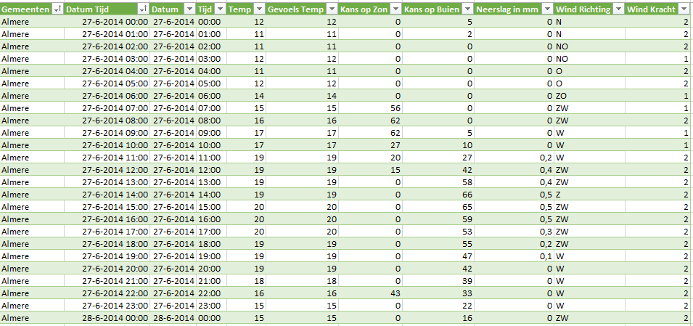
Probability Foundation
Probability in Data Science

Slide 4
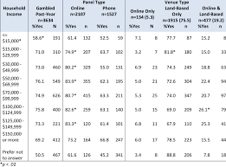

Probability Foundation
Probability in Data Science

Slide 5


Probability Foundation

Slide 6
Probability Foundation
Why Do We Need Probability in Statistics?
Statistics helps us learn about a population using only a sample of data.
But this introduces uncertainty:
Different samples may give different results.
Our estimate may not perfectly represent the population.
Probability helps us quantify and manage this uncertainty.
Estimate population parameters
Build confidence intervals
Perform hypothesis testing
Understand sampling distributions

Slide 7
Event
An event is a set of outcomes of an experiment to which a probability is assigned.
E represents event
P(E) is the probability that the event E occur.
A situation where E might happen (success) or might not happen (failure) is called a trial.

Slide 8




Event
Rolling dice
Tossing a coin
Pulling colored ball out of the bag
play the lottery

Slide 9
Event
Dependent and Independent Events are the types of events that occur in probability.
Suppose we have two events say Event A and Event B;
If Event A and Event B are dependent events, then the occurrence of one event is dependent on the occurrence of other events;
If they are independent events, then the occurrence of one event does not affect the probability of other events.

Slide 10
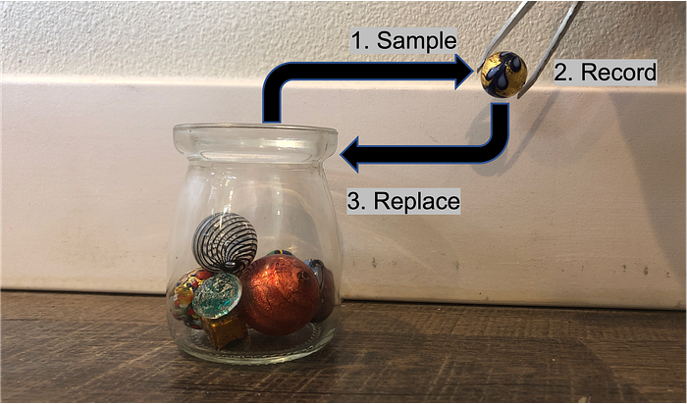
Event
Each sampling is an independent event

Slide 11
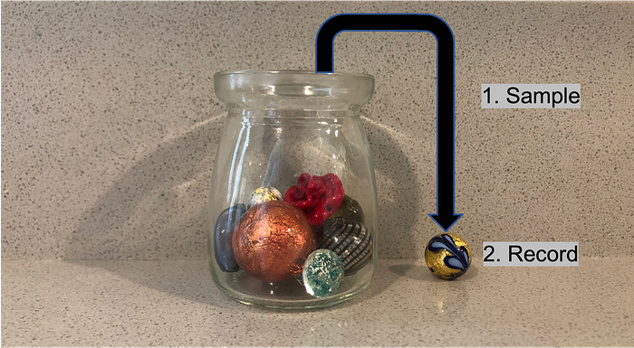

Event
Each sampling is a dependent event

Slide 12
Definitions of Probability
There are two types of probability. They are Mathematical probability and Statistical probability.
Mathematical/Theoretical Probability (or a priori probability):
“If the probability of an event can be calculated even before the actual happening of the event, that is, even before conducting the experiment, it is called Mathematical probability (or a priori probability).”
Example:
“If we keep using the examples of tossing of fair coin, dice etc., we can state the answer in advance (prior), without tossing of coins or without rolling the dice etc.,”

Slide 13
Definitions of Probability
Statistical/Empirical Probability (or a posteriori probability):
“If the probability of an event can be determined only after the actual happening of the event, it is called Statistical probability(or a posteriori probability).”
If a coin is tossed 10 times we may get 6 heads and 4 tails or 4 heads and 6 tails or any other result. In these cases, the probability of getting a head is not 0.5 as we consider in Mathematical probability.
However, if the experiment is carried out a large number of times we should expect approximately equal number of heads and tails and we can see that the probability of getting head approaches 0.5.

Slide 14
Definitions of Probability
Conditional probability:
Let A be any event with p(A) >0.
The probability that an event B occurs subject to the condition that A has already occurred is known as the conditional probability of occurrence of the event B on the assumption that the event A has already occurred.
It is denoted by the symbol P(B|A) and is read as the probability of B given A.

Slide 15
Definitions of Probability
Bayes Theorem:
Often in statistics we want to answer questions like:
If a medical test is positive, what is the probability the patient actually has the disease?
If an email contains certain words, what is the probability it is spam?
If a customer clicked an ad, what is the probability they are interested in the product?
These questions have the structure:
P(A∣B)

Slide 16
Definitions of Probability
Bayes Theorem:
However, sometimes we only know the reverse probability:
P(B∣A)
Example:
Probability a test is positive if someone has a disease

Slide 17
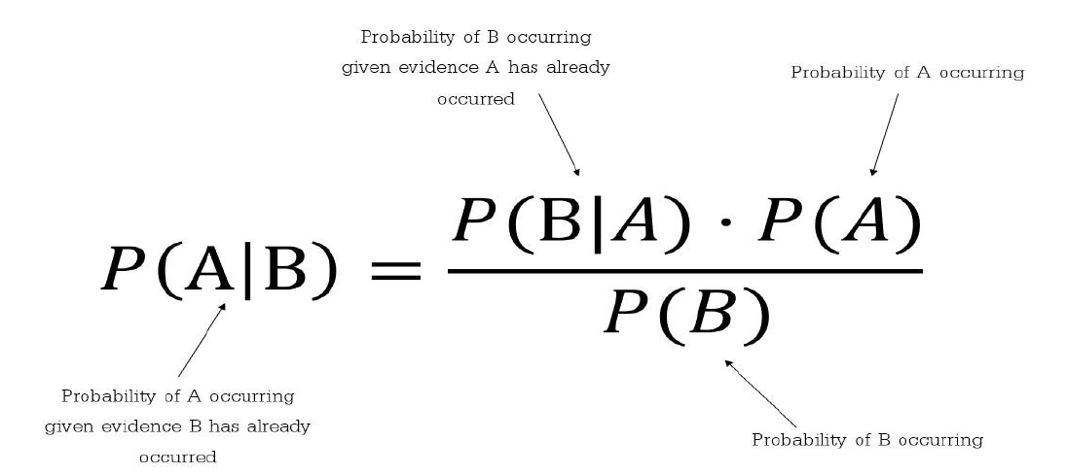
Definitions of Probability
Bayes Theorem:

Slide 18
Definitions of Probability
Bayes Theorem:
Example: Medical Test
Suppose:
1% of people have a disease
Test accuracy:
99% positive if the person has the disease
5% false positive if the person does not have the disease
We want:
P(Disease | Positive)

Slide 19
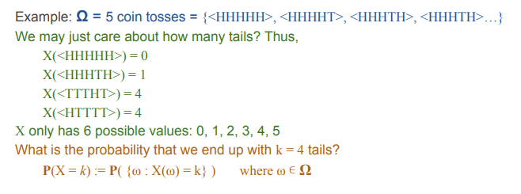
Random Variable
A random variable is a numerical value that summarizes the outcome of a random experiment.
X = the number of tails in 5 coin tosses
Possible values of X:
X∈{0,1,2,3,4,5}

Slide 20
Random Variable
A random variable is a numerical value that summarizes the outcome of a random experiment.
Event : getting exactly 4 tails
Random variable: number of tails
A random variable converts an outcome into a number, while an event describes a situation we are interested in.

Slide 21
Exercise 1
Throw a dice, find the probability that an even number is obtained.

Slide 22
Exercise 2
Two coins are tossed, find the probability that two heads are obtained. Note: Each coin has two possible outcomes H (heads) and T (Tails).

Slide 23
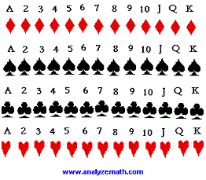

Exercise 3
Two cards are drawn without replacement from a standard deck. What is the probability that: The first card is a diamond and the second card is the 3 of diamonds?

