Slide 1
Statistics in Data Science
CSC 405/605

Slide 2


What is Statistics?
Why?
Data Analysis
Science of learning from data.
Methodical data collection.
Employ correct data analysis.
Presenting analysis effectively.
Opposite to statistics is “Anecdotal Evidence”.
Decision- Making

Slide 3
What is Statistics?
Data gathered are all raw data, and raw data do not provide meaningful information. That's why we need statistics to collect, organize and analyze data. With statistics,
Which observation is the most occurring?
Is there a difference between the two experiments?
Is the collected sample a representation of the population?
Is the result obtained significant enough to make a difference?
……
These questions can be answered by statistics and transform the raw data into meaningful information.

Slide 4
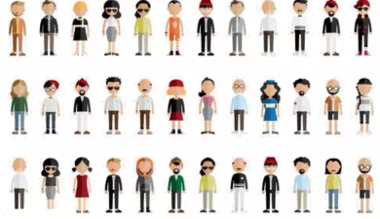
Basic Terminology
There are a few statistical terms one should be aware of while dealing with statistics.
Population
Population is the set of sources from which data has to be collected.

Slide 5
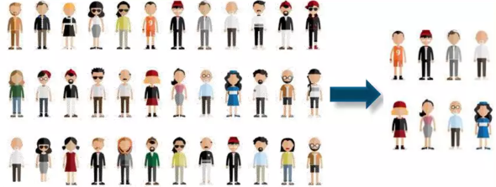
Basic Terminology
There are a few statistical terms one should be aware of while dealing with statistics.
Sample
A Sample is a subset of the Population.

Slide 6
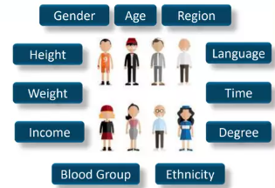
Basic Terminology
There are a few statistical terms one should be aware of while dealing with statistics.
Variable
A variable is any characteristics, number, or quantity that can be measured or counted.

Slide 7
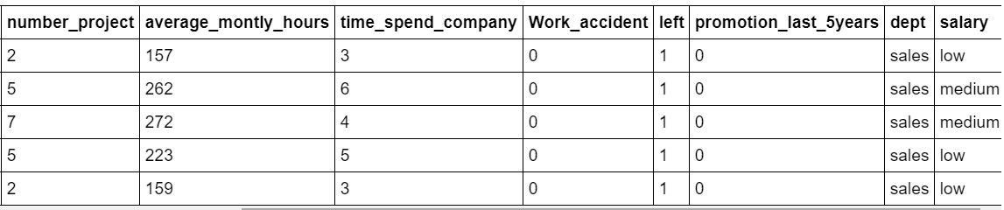
Basic Terminology
Variable
Explanatory (predictor or independent)
Response (outcome or dependent)
A variable can serve as independent in one study and dependent in another

Slide 8
Basic Terminology
Data Types of Variables
Types of Data
Quantitative
Qualitative
Data
Data
Numerical in nature
Categorical in nature

Slide 9
Basic Terminology
Data Types of Variables
Quantitative
Qualitative

Slide 10
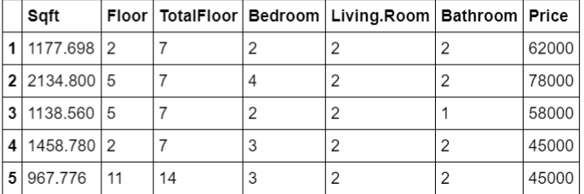
Basic Terminology
Data Types of Quantitative Variables
Continues Variables
Discrete Variables

Slide 11
Basic Terminology
Data Types of Quantitative Variables
Aspect | Discrete | Continuous
Definition | Countable, finite or countably infinite values | Measurable, infinite possible values in an interval
Examples | Number of purchases, number of children, dice rolls | Height, weight, time, temperature, price
Values | Whole numbers only | Can take fractional/decimal values
Visualization | Bar plots, probability mass functions (PMF) | Histograms, density curves, probability density functions (PDF)

Slide 12
Basic Terminology
Data Types of Qualitative Variables
Ordinal Variables
Binary Variables
Categorical Variables

Slide 13
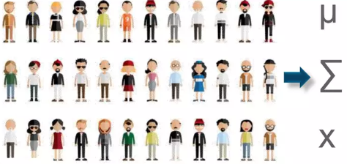
Basic Terminology
There are a few statistical terms one should be aware of while dealing with statistics.
Parameter
Also known as a statistical model, a statistical Parameter or population parameter is a quantity that indexes a family of probability distributions.

Slide 14
Statistical Methods
Statistical
Methods
Descriptive
Inferential
Statistics
Statistics
Descriptive statistics uses the data to provide descriptions of the population, either through numerical calculations or graphs or tables.
Inferential statistics makes inferences and predictions about a population based on a sample of data taken from the population in question.

Slide 15
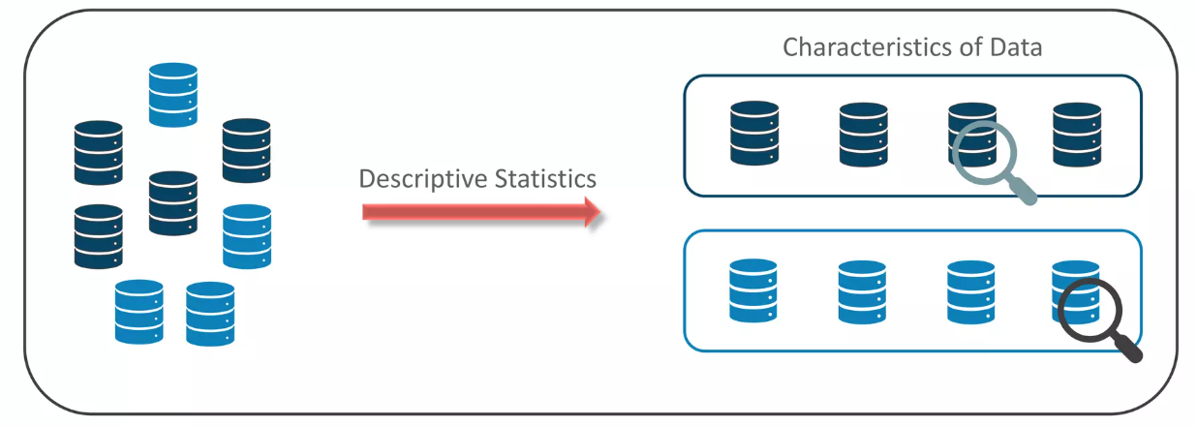
Descriptive Statistics
This method, is mainly focused upon the main characteristics of data. It provides graphical summary of the data.

Slide 16
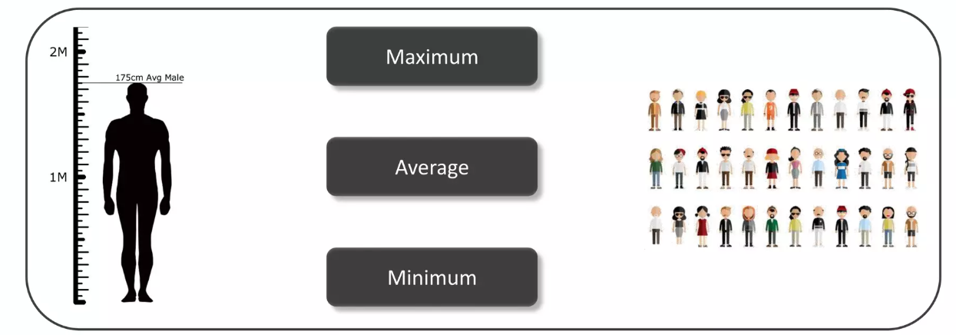
Descriptive Statistics
This method, is mainly focused upon the main characteristics of data. It provides graphical summary of the data.

Slide 17
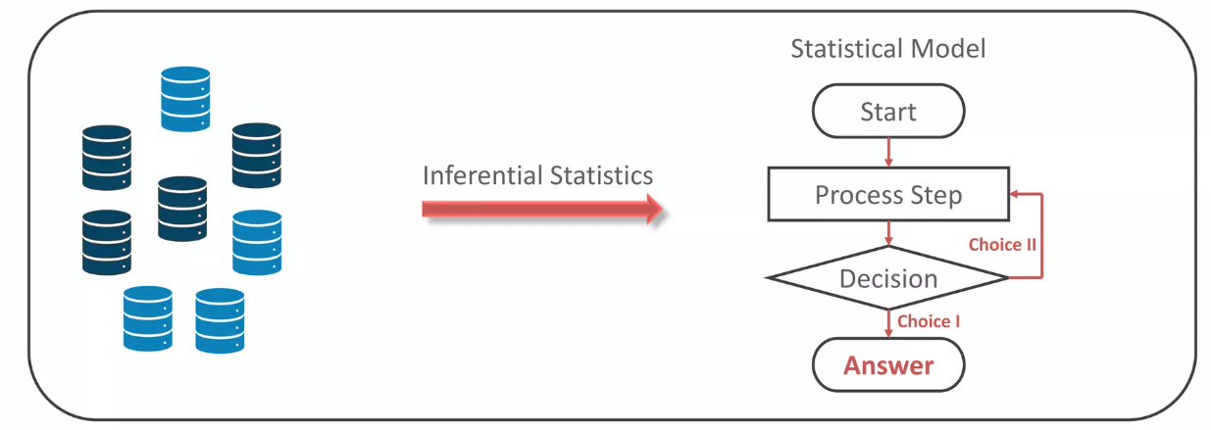
Inferential Statistics
This method, generalizes a large dataset and applies probability to draw a conclusion. It allows us to infer data parameters based on a statistical model using a sample data.

Slide 18
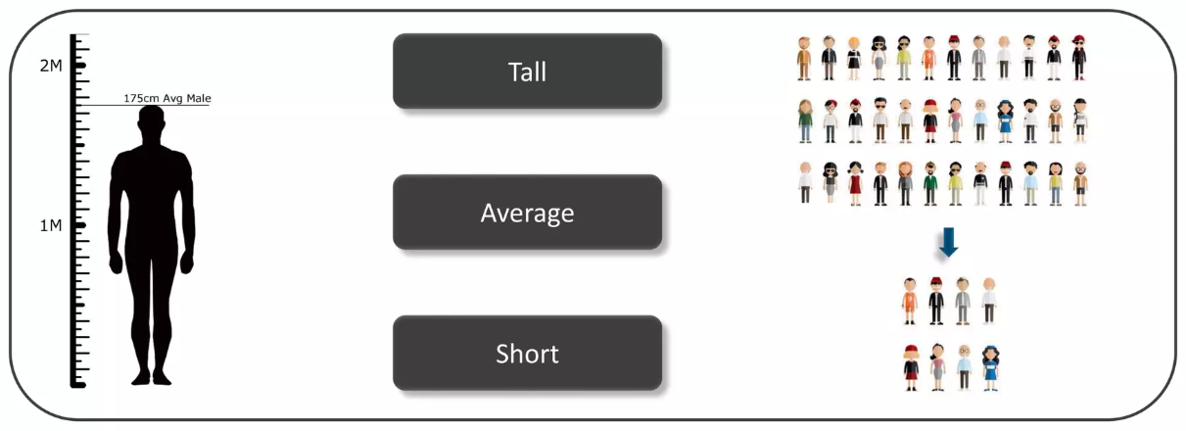
Inferential Statistics
This method, generalizes a large dataset and applies probability to draw a conclusion. It allows us to infer data parameters based on a statistical model using a sample data.

Slide 19
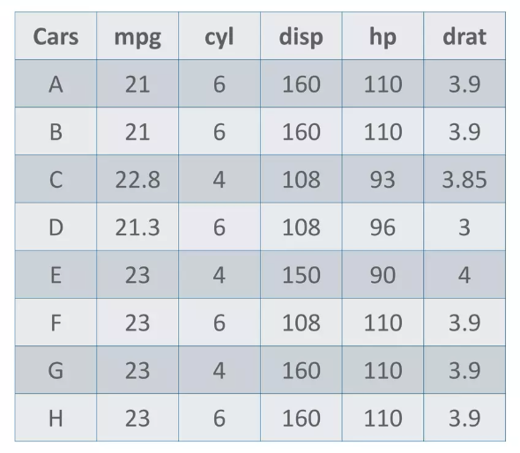
Statistical Measures for Descriptive Statistics
Here is a sample dataset of cars containing the variables: Cars, Mileage per Gallon (mpg), Cylinder Type (cyl),
Displacement (disp), HorsePower (hp) &
Real Axle Ratio (drat).
Using descriptive Analysis, you can analyze each of the variables in the dataset for mean, standard deviation, minimum and maximum.

Slide 20

Statistical Measures for Descriptive Statistics
Measures of the Central Tendency
Mean: measure of average of all the values in a sample is called Mean.
If we want to find out the average horsepower of the cars among the population of cars, we will check and calculate the average of all values. In this case,

Slide 21

Statistical Measures for Descriptive Statistics
Measures of the Central Tendency
Median: measure of the central value of the sample set is called Median.
If we want to find out the center value of
mpg among the population of cars, we will
arrange the mpg values in ascending order
to choose the middle value. In this case,
21, 21, 21.3, 22.8, 23, 23, 23, 23
But in case of even entries, we take
average of the two middle values. In this
case,

Slide 22
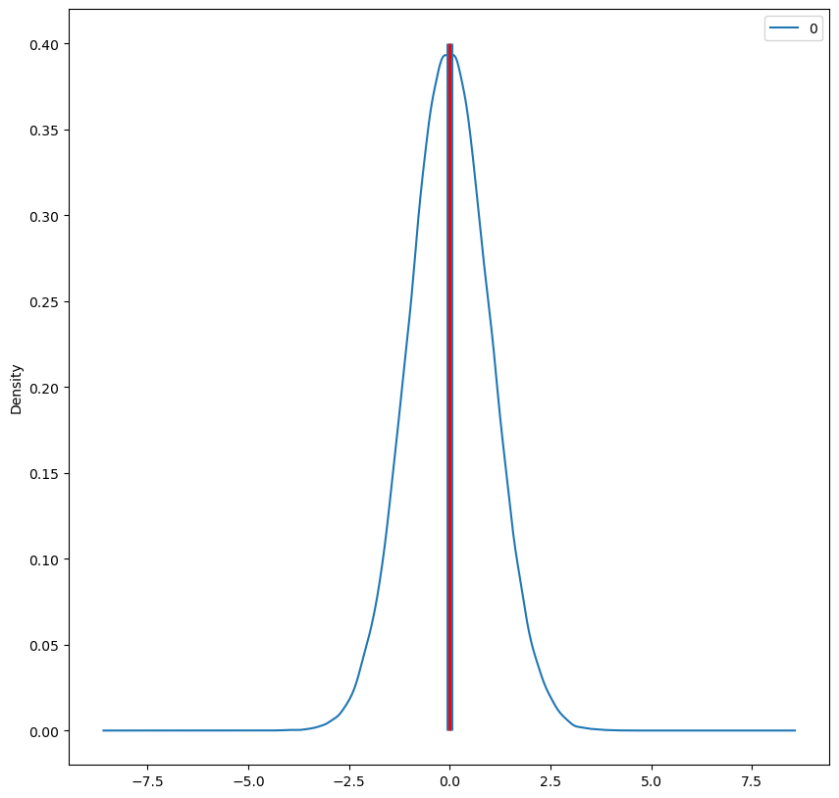
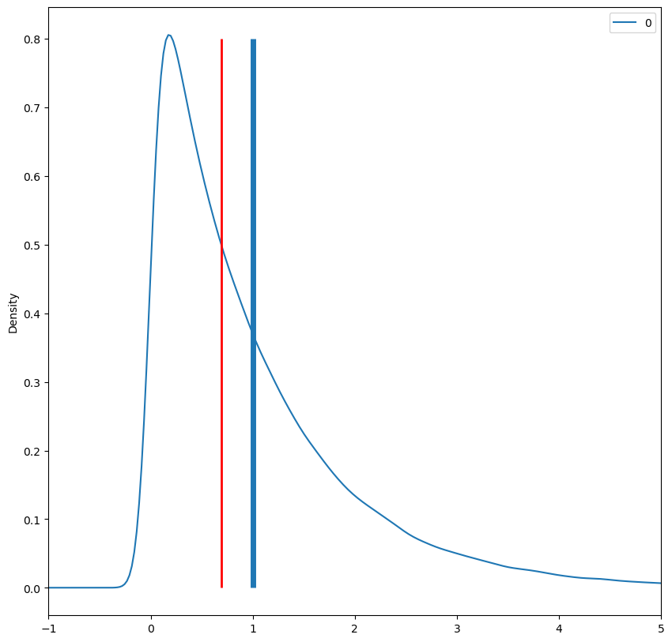
Statistical Measures for Descriptive Statistics
Measures of the Central Tendency
Since the median tends to resist the effects of skewness and outliers, it is known a "robust" statistic. The median generally gives a better sense of the typical value in a distribution with significant skew or outliers.
Blue: mean
Red: median

Slide 23
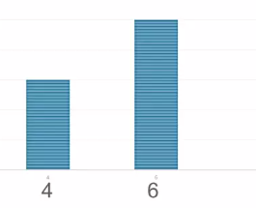
Statistical Measures for Descriptive Statistics
Measures of the Central Tendency
Mode: the value most recurrent in the sample set is known as Mode.
If we want to find out the most common type of cylinder among the population of cars, we will check the value which is repeated most number of times.

Slide 24
Statistical Measures for Descriptive Statistics
Measures of the Central Tendency
The mean is commonly used with continuous numerical data. It represents a typical or "average" value in the dataset. Sensitive to outliers.
The median is the middle value when the data is sorted in ascending or descending order. The median is robust to outliers and is often preferred when dealing with skewed data. Like the mean, it is used with numerical data.
The mode of a variable is simply the value that appears most frequently. Unlike mean and median, you can take the mode of a categorical variable and numerical data and it is possible to have multiple modes.
Use as df.mean(); df.median(); df.mode().

Slide 25
Statistical Measures for Descriptive Statistics
Measures of the Spread
Spread in statistics refers to the degree of variability or dispersion in a dataset. It measures how data points are scattered or spread out from the central tendency.
Measures of spread (dispersion) are statistics that describe how data varies.
While measures of center give us an idea of the typical value, measures of spread give us a sense of how much the data tends to diverge from the typical value.
quartiles, variance, standard deviation, skewness, and kurtosis as measures of spread.

Slide 26

Statistical Measures for Descriptive Statistics
Measures of the Spread
Range: is the given measure of how spread apart the values in a dataset are.

Slide 27
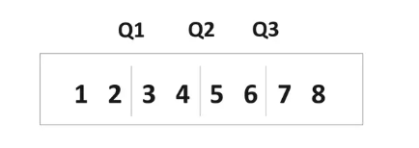

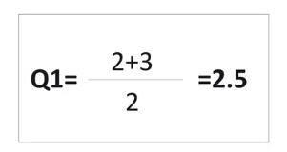
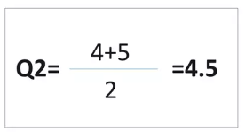
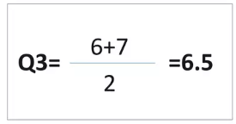
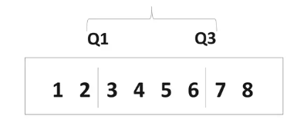
Statistical Measures for Descriptive Statistics
Measures of the Spread
Inter Quartile Range(IQR): is the measure of variability, based on dividing a dataset into quartiles.

Slide 28

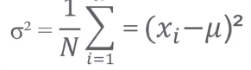
Statistical Measures for Descriptive Statistics
Measures of the Spread
Variance: describes how much a random variable differs from its expected value. It entails computing squares of deviations.
Deviation: is the difference between each element from the mean.
Population Variance: is the average of squared deviations.

Slide 29
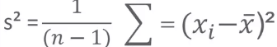
Statistical Measures for Descriptive Statistics
Measures of the Spread
Variance: describes how much a random variable differs from its expected value. It entails computing squares of deviations.
Deviation: is the difference between each element from the mean.
Sample Variance: is the average of squared differences from the mean.

Slide 30
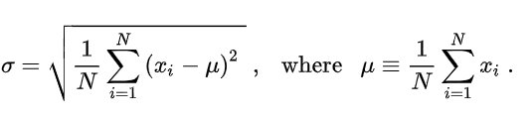
Statistical Measures for Descriptive Statistics
Measures of the Spread
Standard Deviation: is the measure of the dispersion of a set of data from its mean.

Slide 31
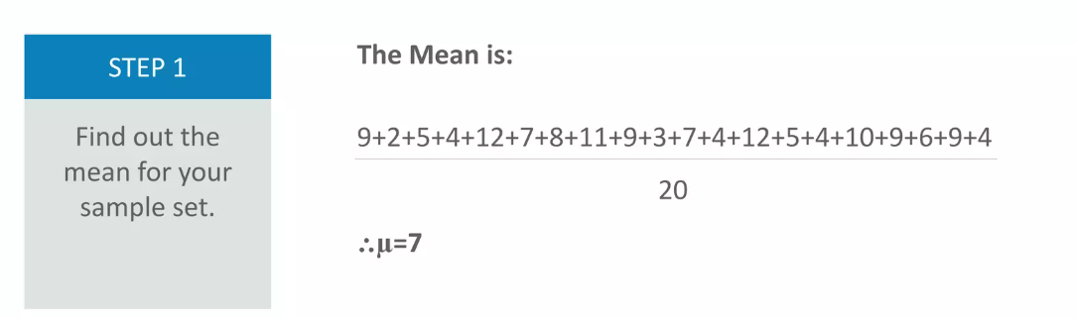
Statistical Measures for Descriptive Statistics
Measures of the Spread
Standard Deviation: is the measure of the dispersion of a set of data from its mean.
Ross has 20 Dinosaur figures. They have the numbers 9, 2, 5, 4, 12, 7, 8, 11, 9, 3, 7, 4, 12, 5, 4, 10, 9, 6, 9, 4. Work out the Standard Deviation.

Slide 32
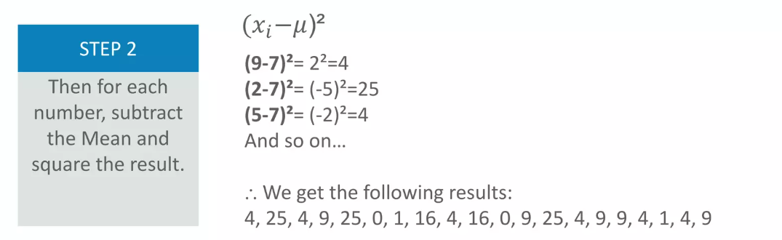
Statistical Measures for Descriptive Statistics
Measures of the Spread
Standard Deviation: is the measure of the dispersion of a set of data from its mean.
Ross has 20 Dinosaur figures. They have the numbers 9, 2, 5, 4, 12, 7, 8, 11, 9, 3, 7, 4, 12, 5, 4, 10, 9, 6, 9, 4. Work out the Standard Deviation.

Slide 33
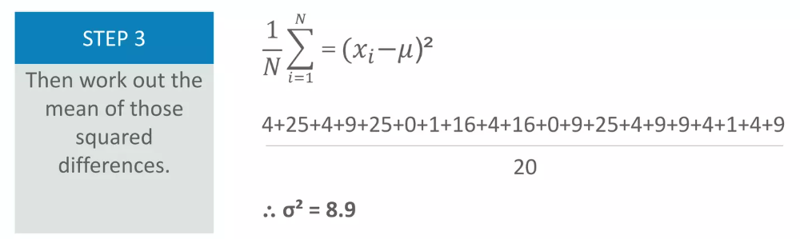
Statistical Measures for Descriptive Statistics
Measures of the Spread
Standard Deviation: is the measure of the dispersion of a set of data from its mean.
Ross has 20 Dinosaur figures. They have the numbers 9, 2, 5, 4, 12, 7, 8, 11, 9, 3, 7, 4, 12, 5, 4, 10, 9, 6, 9, 4. Work out the Standard Deviation.

Slide 34
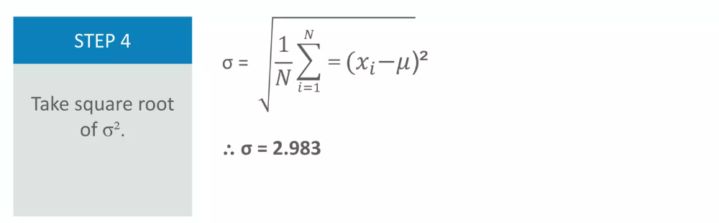
Statistical Measures for Descriptive Statistics
Measures of the Spread
Standard Deviation: is the measure of the dispersion of a set of data from its mean.
Ross has 20 Dinosaur figures. They have the numbers 9, 2, 5, 4, 12, 7, 8, 11, 9, 3, 7, 4, 12, 5, 4, 10, 9, 6, 9, 4. Work out the Standard Deviation.

Slide 35
Statistical Measures for Descriptive Statistics
A professor records the exam scores (out of 100) of 9 students:
72, 85, 78, 90, 88, 76, 95, 80, 66
Measures of Center
Compute the mean
Compute the median
Identify the mode (if any)
Measures of Spread
Compute the range
Compute the variance (sample variance)
Compute the standard deviation
Compute the Interquartile Range (IQR)

