Slide 1
Quiz 2 Review

Slide 2
Statistics & Visualization Review
Descriptive Statistics vs Inferential Statistics
  Difference between them
  Statistical Measures for Descriptive Statistics: Median, Mode, Variance, etc.
Probability Concepts
  Difference between discrete distribution and continuous distribution
  CDF: P(X ≤ x)
  PMF: discrete distributions
  PDF: continuous distributions
  Distribution Shape: Negatively skewed and Positively skewed
  Central Limit Theorem
Parameter Estimation
  MLE
  MoM
  KDE

Slide 3
Statistics & Visualization Review
Correlation
  Pearson, Spearman, and Kendall coefficient
  Range of coefficient: strong positive & strong negative
Hypothesis Testing
  Definition of null hypothesis & alternative hypothesis
  One-tailed, two-tailed test
  Statistic test: t-test, ANOVA, and Chi-Square Test
  Meaning of p-value

Slide 4
Statistical Measures for Descriptive Statistics
A professor records the exam scores (out of 100) of 9 students:
72, 85, 78, 90, 88, 76, 95, 80, 66
Measures of Center
Compute the mean
Compute the median
Identify the mode (if any)
Measures of Spread
Compute the range
Compute the variance (sample variance)
Compute the standard deviation
Compute the Interquartile Range (IQR)

Slide 5
Definitions of Probability
Bayes Theorem:
Example: Medical Test
Suppose:
1% of people have a disease
Test accuracy:
  99% positive if the person has the disease
  5% false positive if the person does not have the disease
We want:
P(Disease | Positive)

Slide 6
Exercise 4
The exam scores in a statistics class follow a normal distribution with: Mean μ=70, Standard deviation σ=10. A student scored 85.
Compute the z-score.
Is the score above or below average?

Slide 7
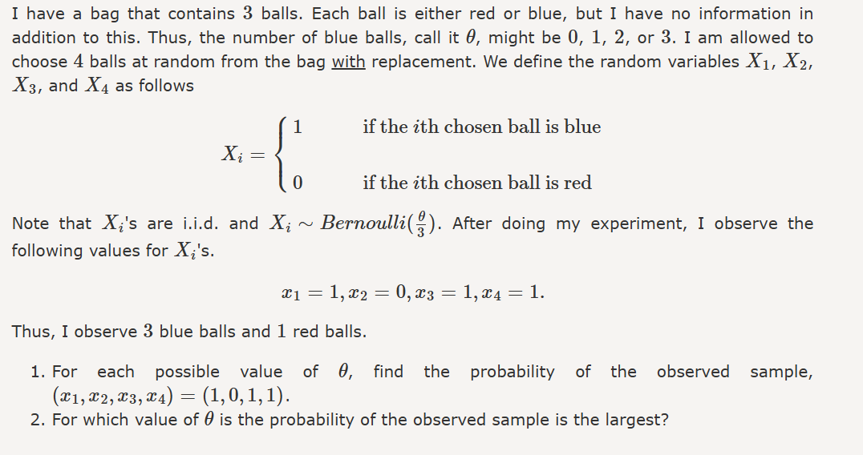
Probability Density Estimation
Test your understanding…

Slide 8
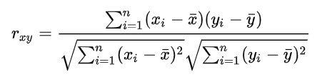
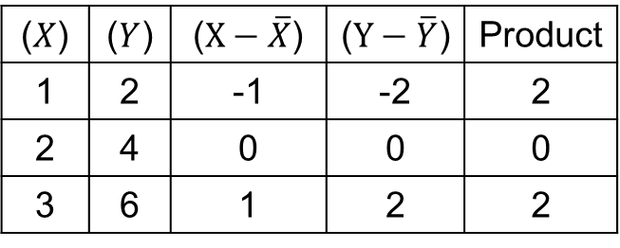


Correlation
Pearson r Correlation: Example
X=[1,2,3], Y=[2,4,6]
$$\overline{X}=2, \overline{Y}=4$$
($X$) | ($Y$) | ($X−\overline{X}$) | ($Y−\overline{Y}$) | Product
1 | 2 | -1 | -2 | 2
2 | 4 | 0 | 0 | 0
3 | 6 | 1 | 2 | 2
$$r=\frac{4}{\sqrt{2}×\sqrt{8}}=1$$

Slide 9
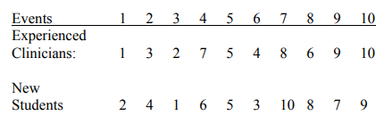
Correlation
Spearman ρ Correlation: Example
In a study of diagnostic processes, entering clinical graduate students are shown a 20-minute
videotape of children’s behavior and asked to rank-order 10 behavioral events on the tape in the order of
the importance each has for a behavioral assessment. (1 = most important.) The data are then averaged to
produce an average rank ordering for the entire class. The same thing was then done using experienced
clinicians. The data follow:
Use Spearman correlation to measure the agreement between experienced and novice clinicians.

Slide 10


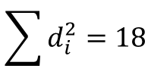

Correlation
$d_{i}:$ -1 -1 1 1 0 1 -2 -2 2 1
$$\sum{d_{i}^{2}}=18$$

Slide 11



Correlation
Total Pairs: $C_{n}^{2}=C_{10}^{2}=45$
Concordant pairs = 40
Discordant pairs = 5

Slide 12
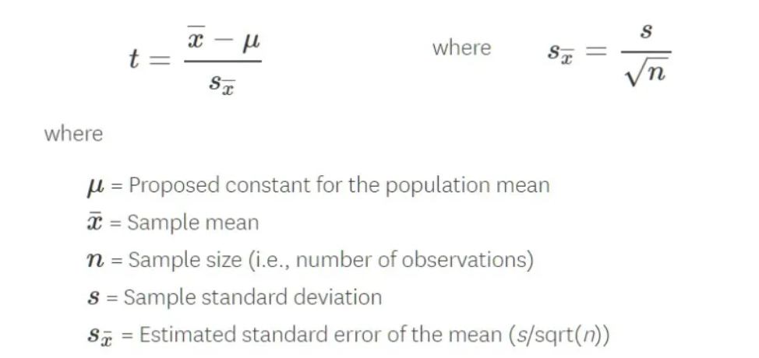
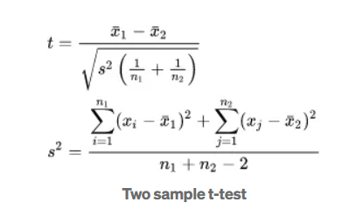
Hypothesis Testing
T-Test

Slide 13

Hypothesis Testing
T-Test: Independent Two-Sample t-test Example
  Compare average exam scores of two groups:
  Group A: 78, 82, 85, 90, 88
  Group B: 72, 75, 78, 70, 74

Slide 14
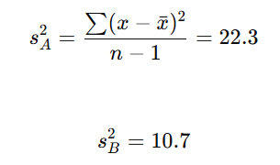
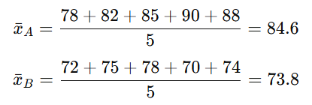

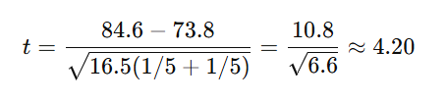
Hypothesis Testing
Group A: 78, 82, 85, 90, 88
Group B: 72, 75, 78, 70, 74
Notes:
df = 5 + 5 -2 = 8
t0.025,8​≈2.306

Slide 15




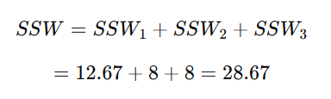

Hypothesis Testing
ANOVA Test: Example
  Compare 3 teaching methods:
  Group 1: 85, 88, 90
  Group 2: 78, 82, 80
  Group 3: 92, 94, 96
$$F=\frac{\frac{294.6}{2}}{\frac{28.67}{6}}=30.82$$
Notes:
K = 3 represents the number of independent groups
N = 9
Df1 = 2
Df2 = 9 – 3 = 6
F0.05,(2,6)​≈5.14

Slide 16


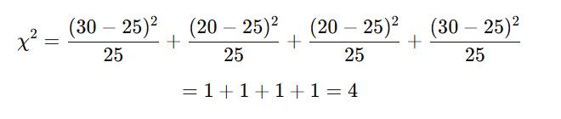

Hypothesis Testing
Chi-Square Test: Example
Test if gender and preference are independent:
 | Like | Dislike | Total
Male | 30 | 20 | 50
Female | 20 | 30 | 50
Total | 50 | 50 | 100
If 4 > Critical value, reject $H_{0}$
Notes:
Df = (r-1)(c-1)=(2-1)(2-1)=1
χ0.05,12​≈3.84

