Slide 1
Re/Introduction to Python
CSC 405/605

Slide 2
File Handling in Python
File is a named location on disk to store related information
It is used to permanently store data in non-volatile memory
In Python, a file operation take place in the following order
  Open a file
  Read or write (perform operation)
  Close the file

Slide 3
File Handling in Python
Once a file is opened ,we have one file object, which contain various info related to that file
1. file.closed-Returns true if the file is closed, False otherwise
2. file.mode-Returns access mode with which file was opened
3. file.name- Name of the file
f = open(‘test.txt’, ‘w’)

Slide 4
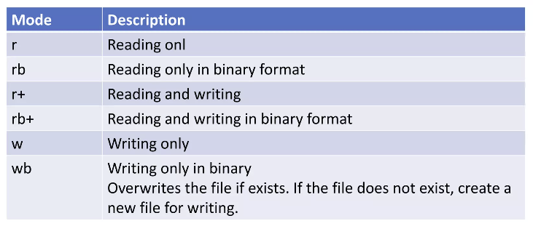
File Handling in Python
Modes for opening a file

Slide 5
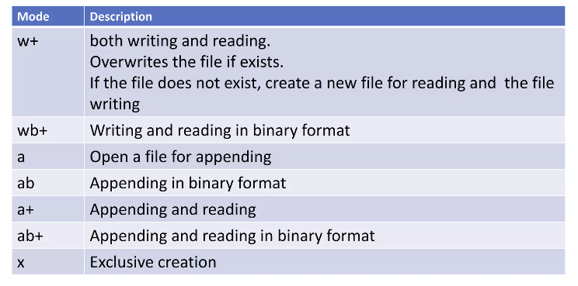
File Handling in Python
Modes for opening a file

Slide 6
File Handling in Python
File closing is done with close() method
f = open(‘test.txt’, ‘w’)
f.close()

Slide 7
File Handling in Python
File object includes the following methods to read data from the file.
  read(chars): reads the specified number of characters starting from the current position.
  readline(): reads the characters starting from the current reading position up to a newline character.
  readlines(): reads all lines until the end of file and returns a list object.

Slide 8
File Handling in Python
Similarly, for writing data to files, we have to use open() with 'w' mode;
Also, we have to use the write() function to write into a file.
We can also use the write() function to write into a non-exist file.
f = open(‘test.txt’, ‘w’)
f.write(‘Hello World!’)

Slide 9
File Handling in Python
The os module Python provides methods that help to perform file-processing operations, such as renaming and deleting.
To rename an existing file, rename() method is used
It takes two arguments, current file name and new file name
import os
os.rename(current file name,new file name)

Slide 10
File Handling in Python
We can delete a file by using remove() method.
import os
os.remove(file name)

Slide 11
Reading and writing csv file in Python
CSV (stands for comma separated values) format is a commonly used data format used by spreadsheets.
The csv module in Python's standard library presents classes and methods to perform read/write operations on CSV files.

Slide 12
Reading and writing csv file in Python
Reading from a CSV file is done using the reader object. The CSV file is opened as a text file with Python’s built-in open() function, which returns a file object.
Explanation:
with open(...) or file = open() opens the CSV file in read mode safely using a context manager.
csv.reader(csvfile) turns the file into a CSV reader object.
next(csvreader) extracts the first row as column headers.
Loop through csvreader to append each row (as a list) to rows.

Slide 13
Reading and writing csv file in Python
To write to a CSV file, we first open the CSV file in WRITE mode. The file object is converted to csv.writer object and further operations takes place.
Explanation:
fields defines the column headers and rows contains the data as a list of lists.
with open(..., ‘w’) or file = open(..., ‘w’) opens the file in write mode using a context manager.
csv.writer(csvfile) creates a writer object for writing to the CSV.
writerow(fields) writes the header row to the file.
writerows(rows) writes all data rows to the CSV at once.

Slide 14
Test Your Understanding…
Exercise: CSV Data Processing Practice
1. Download ‘fast_food_consumption_health_impact_dataset.csv’ from the project folder.
2. Read the CSV file using Python.
3. Extract the first numeric column (‘Age’ attribute) and convert it into a list of integers.
4. Compute the maximum, minimum, and average values of the Age list.
5. Extract the second categorical column (‘Gender’ attribute) into a list.
6. Count how many times each gender category appears.
7. Write all the results into a .txt document.
Do not use external libraries such as pandas.
Use Python basics: csv, list, dict, for loops, and if statements.

