Slide 1
Re/Introduction to Python
CSC 405/605

Slide 2
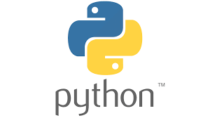
What is Python?
Python is a general-purpose programming language that is often applied in scripting roles. So, Python is programming language as well as scripting language.
Python is also called as Interpreted language.

Slide 3
Differences between program and scripting language
Program
  A program is executed (i.e. the source is first compiled, and the result of that compilation is expected)
  A "program" in general, is a sequence of instructions written so that a computer can perform certain task.
Scripting
  A script is interpreted
  A "script" is code written in a scripting language. A scripting language is nothing but a type of programming language in which we can write code to control another software application.

Slide 4

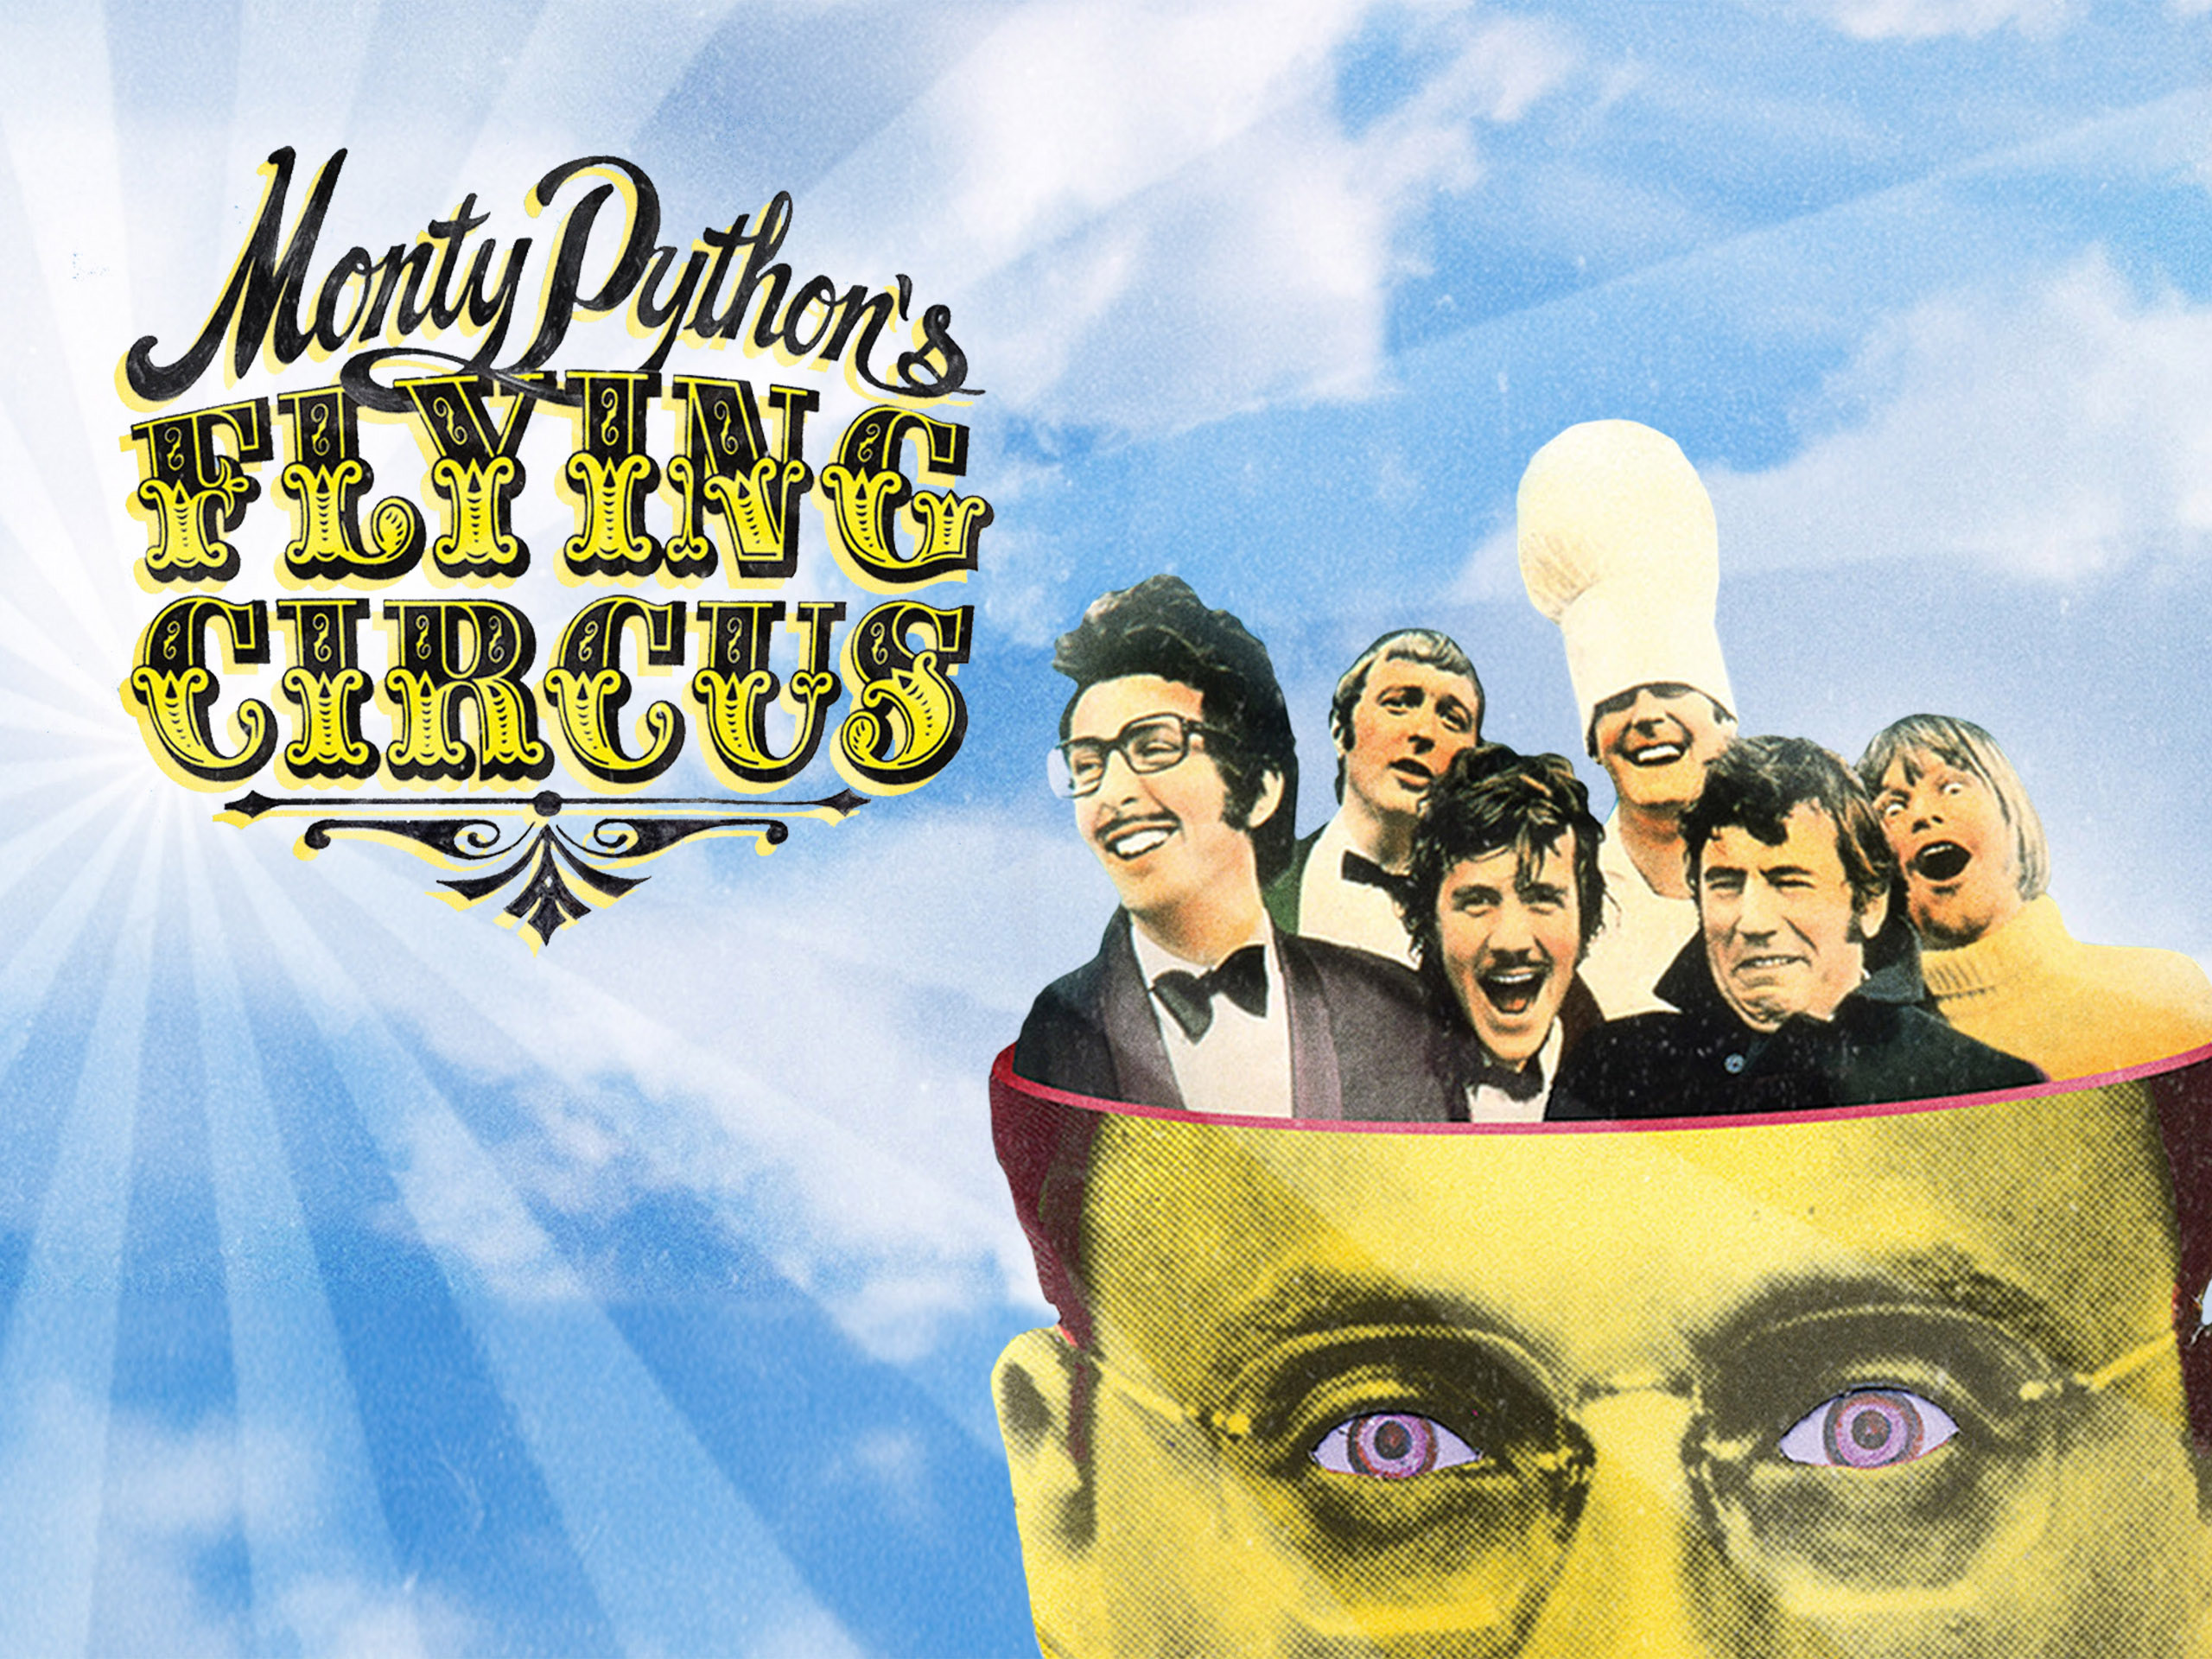
History
Invented in the Netherlands, early 90s by Guido van Rossum
Python was conceived in the late1980s and its simple implementation was started in December 1989
Guido Van Rossum is fan of ‘Monty Python's Flying Circus’, this is a famous TV show in Netherlands
Named after Monty Python
Open sourced from the beginning

Slide 5
History
“Python is an experiment in how much freedom programmers need. Too much freedom and nobody can read another’s code; too little and expressiveness is endangered.”
— Guido van Rossum

Slide 6
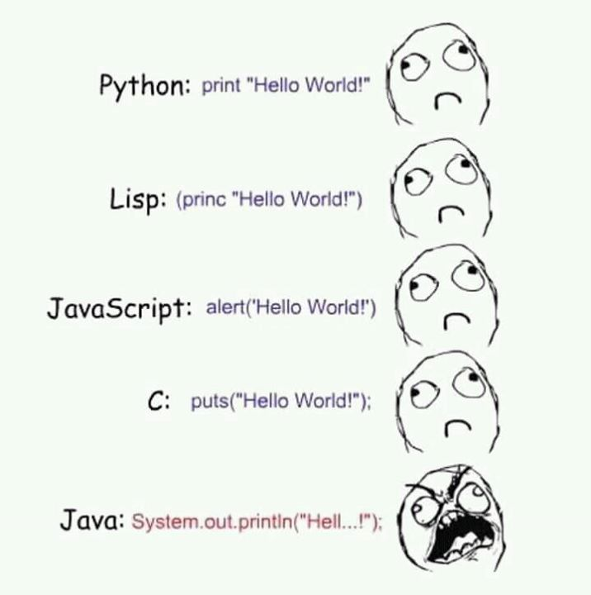
Hello World Program
>>> print (‘Hello World!’)
>>> print(‘Welcome to Python Programming!’)

Slide 7
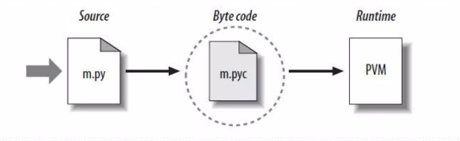
Python Code Execution
Python's traditional runtime execution model: source code you type is translated to byte code, which is then run by the Python Virtual Machine. Your code is automatically compiled, but then it is interpreted.
Source code extension is .py
Byte code extension is .pyc

Slide 8
Python Code Execution
Unlike many other languages, Python does not use {} to define code blocks.
It relies on indentation instead.
While the number of spaces can vary, all lines in the same block must be indented consistently.

Slide 9
Python Identifiers
Identifier is the name given to entities like class, functions, variables etc.
Rules for writing identifiers
  Identifiers can be a combination of letters in lowercase (a to z) or uppercase (A to Z) or digits (0 to 9) or an underscore( ).
  An identifier cannot start with a digit.
  Keywords cannot be used as identifiers.
  We cannot use special symbols like !, @, #, $, % etc. in our identifier.

Slide 10
Python Keywords
Keywords are the reserved words in Python.
We cannot use a keyword as variable name, function name or any other identifier.
They are used to define the syntax and structure of the Python language.
Keywords are case sensitive.
There are 33 keywords in Python 3.3.

Slide 11
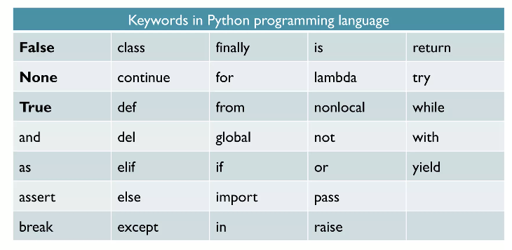
Python Keywords
All the keywords except True, False and None are in lowercase

Slide 12
Python Variables
A variable is a location in memory used to store some data (value).
They are given unique names to differentiate between different memory locations. The rules for writing a variable name is same as the rules for writing identifiers in Python.
We don't need to declare a variable before using it.
In Python, we simply assign a value to a variable and it will exist.
We don't even have to declare the type of the variable. This is handled internally according to the type of value we assign to the variable.

Slide 13
Python Variables
We use the assignment operator (=) to assign values to a variable.
Any type of value can be assigned to any valid variable.
In Python, multiple assignments can be made in a single statement.

Slide 14
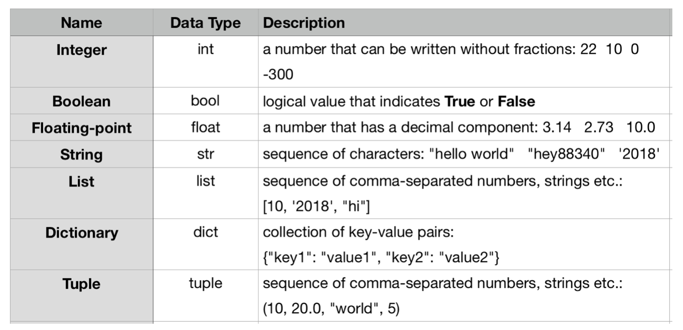
Data Types in Python
Every value in Python has a data type.
Since everything is an object in Python
Data types are actually classes and variables are instance (object) of these classes.
type() function can be used to know which class a variable or a value belongs to.

Slide 15
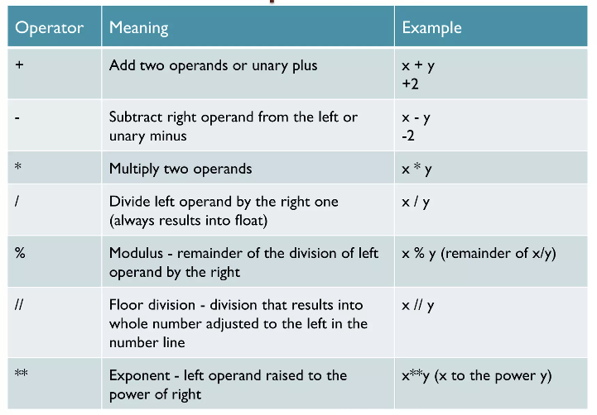
Arithmetic Operators in Python

Slide 16
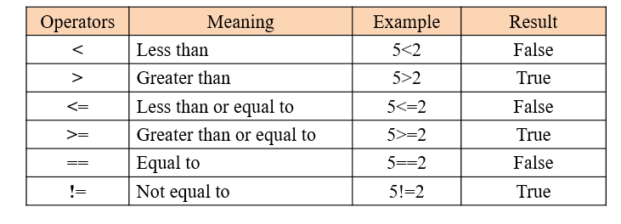
Comparison Operators in Python

Slide 17
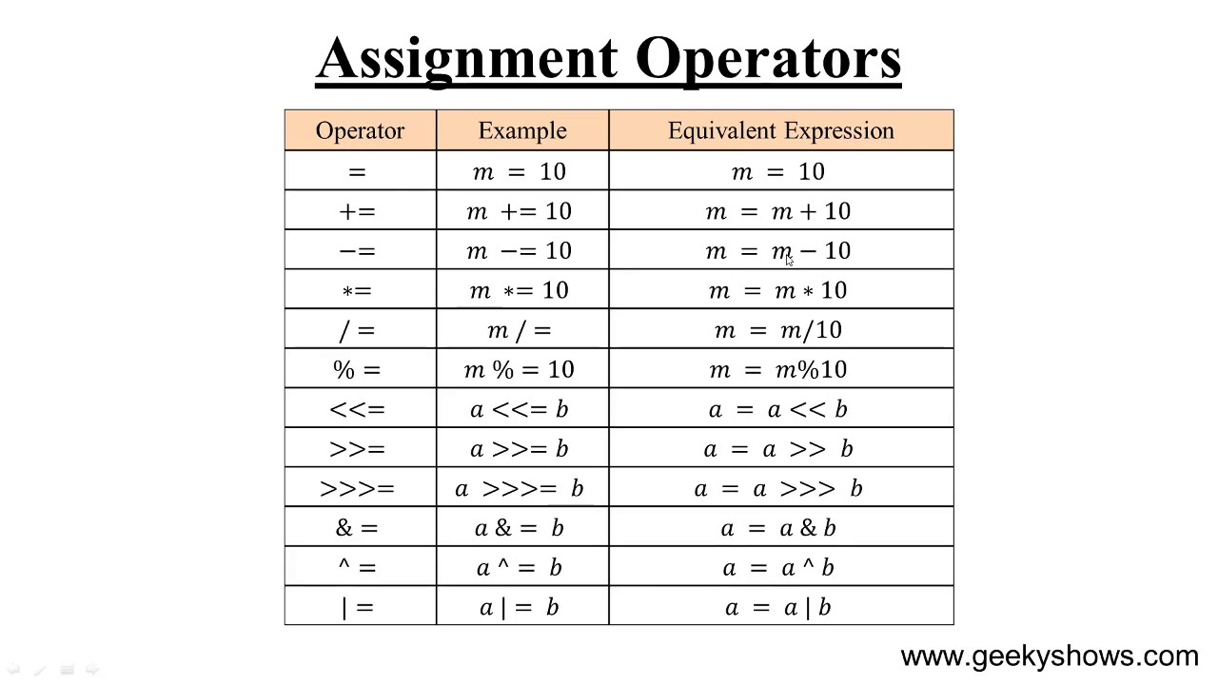
Assignment Operators in Python

Slide 18
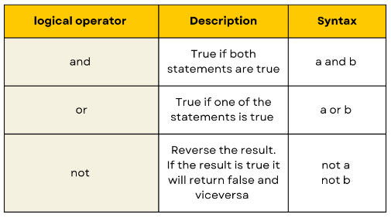
Logical Operators in Python

Slide 19
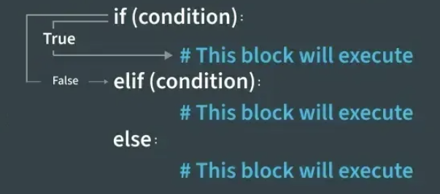
Conditional Statements in Python

Slide 20
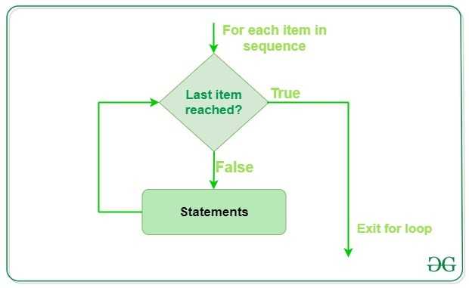
Loops in Python

Slide 21
Now, Write Your Own Code
Warm Up
Input: a = "Hello", n = 5
Output: HelloHelloHelloHelloHello
Explanation: a is printed n=5 times in a single line without space between them.

Slide 22
Now, Write Your Own Code
Warm Up
Count how many even numbers are between 1 and 50.

Slide 23
Now, Write Your Own Code
Warm Up
Print numbers from 1 to 30
# If divisible by 3 → print "Fizz"
# If divisible by 5 → print "Buzz"
# If divisible by both → print "FizzBuzz"

Slide 24
Now, Write Your Own Code
Warm Up
Ask users to input username and password.
Print “Login successful” only if username is "admin" and password is "secure123"

Slide 25
Now, Write Your Own Code
Exercise
You are given a sorted array arr[] containing positive integers. Your task is to remove all duplicate elements from this array such that each element appears only once. Return an array containing these distinct elements in the same order as they appeared.
Examples :
Input: arr[] = [2, 2, 2, 2, 2]
Output: [2]
Explanation: After removing all the duplicates only one instance of 2 will remain i.e. [2] so modified array will contains 2 at first position and you should return array containing [2] after modifying the array.
Input: arr[] = [1, 2, 4]
Output: [1, 2, 4]
Explation: As the array does not contain any duplicates so you should return [1, 2, 4].
Constraints:
1 ≤ arr.size() ≤ 10⁵
1 ≤ arr[i] ≤ 10⁶
https://www.geeksforgeeks.org/problems/remove-duplicate-elements-from-sorted-array/1?page=3&company=Microsoft&sortBy=submissions

Slide 26
Now, Write Your Own Code
Exercise
Given an array arr[] containing only non-negative integers, your task is to find a continuous subarray (a contiguous sequence of elements) whose sum equals a specified value target. You need to return the 1-based indices of the leftmost and rightmost elements of this subarray. You need to find the first subarray whose sum is equal to the target.
Note: If no such array is possible then, return -1.
Examples:
1. Input: arr[] = [1, 2, 3, 7, 5], target = 12
Output: 2, 4
Explanation: The sum of elements from 2nd to 4th position is 12.
2. Input: arr[] = [1, 2, 3, 4, 5, 6, 7, 8, 9, 10], target = 15
Output: 1, 5
Explanation: The sum of elements from 1st to 5th position is 15.
3. Input: arr[] = [5, 3, 4], target = 2
Output: -1
Explanation: There is no subarray with sum 2.
Constraints:
1 <= arr.size()<= 106
0 <= arr[i] <= 103
0 <= target <= 109
https://www.geeksforgeeks.org/explore?page=1&sortBy=submissions

Slide 27
Now, Write Your Own Code
Exercise
Given an array arr[] containing only non-negative integers, your task is to find a continuous subarray (a contiguous sequence of elements) whose sum equals a specified value target. You need to return the 1-based indices of the leftmost and rightmost elements of this subarray. You need to find the first subarray whose sum is equal to the target.
Note: If no such array is possible then, return -1.
Examples:
Input: arr[] = [1, 2, 3, 7, 5], target = 2
Output: 2, 2
Explanation: The sum of elements from 2nd to 2nd position is 2.
https://www.geeksforgeeks.org/explore?page=1&sortBy=submissions

