Slide 1
Introduction to Pandas
CSC 405/605

Slide 2
Data Cleaning with Pandas
Data cleaning means fixing bad data in your dataset.
Bad data could be:
Missing data
Data in wrong format
Wrong data/ Outliers
Duplicates

Slide 3
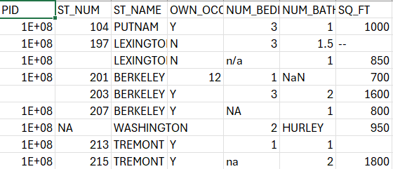
Data Cleaning with Pandas
Missing Data

Slide 4
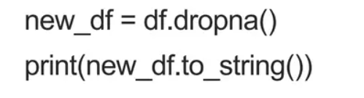
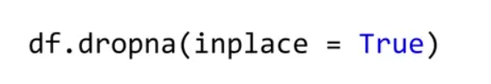
Data Cleaning with Pandas
Missing Data: Fill in missing values or delete rows/columns containing missing values.
Remove Rows
By default, the `dropna()` method returns a new DataFrame without modifying the source data. If you want to modify the source DataFrame, you can use

Slide 5


Data Cleaning with Pandas
Missing Data: Fill in missing values or delete rows/columns containing missing values.
Replace all missing data with a specific data
Replace missing data with a specific data in a specific row
Replace missing data with Mean/Median of the column
df[“col_name”]=df[“col_name”].fillna(130)
Deprecated starting from Pandas 2.1.0

Slide 6

Data Cleaning with Pandas
Data in wrong format : Convert data types or perform unit conversions, such as date format conversion.
Convert into a Correct Format
In newer versions of pandas, pd.to_datetime() requires specifying format='mixed' when the format is inconsistent.

Slide 7
Data Cleaning with Pandas
Wrong data/ Outliers: Identify and handle outliers, such as extreme values ​​and error values.
Manually replace data with incorrect ages
Set conditional statements to filter data
Delete the rows containing erroneous data.

Slide 8
Data Cleaning with Pandas
Duplicates: Check and remove duplicate data to ensure that each piece of data is unique.
duplicated(): If the corresponding data is duplicated, duplicated() will return True; otherwise, it will return False.
drop_duplicates() : remove duplicate

Slide 9
Data Cleaning with Pandas
In-class exercise
Download Staff.csv and read file using Pandas
Handle missing values:
Replace missing values in Age with the number 30.
Replace missing values in Salary with the mean salary.
Remove duplicated rows from the dataset.
Handle outliers:
Replace any salary greater than 200000 with the median salary of the column.
Replace any age greater than 120 with 120.
Standardize data types
Convert Age to integer type.
Write clean data to a csv file

