Slide 1
Introduction to Pandas
CSC 405/605

Slide 2
Tabular Data
Tabular data = information organized into rows and columns, like a table.
Name | Age | Grade
Alice | 25 | A
Bob | 23 | B+
Charlie | 24 | A-
Columns = variables/features/attributes (name, age, grade)
Rows = observations/records (each student is one record)
CSV, Excel, SQL tables, pandas DataFrame → all are tabular data formats.

Slide 3
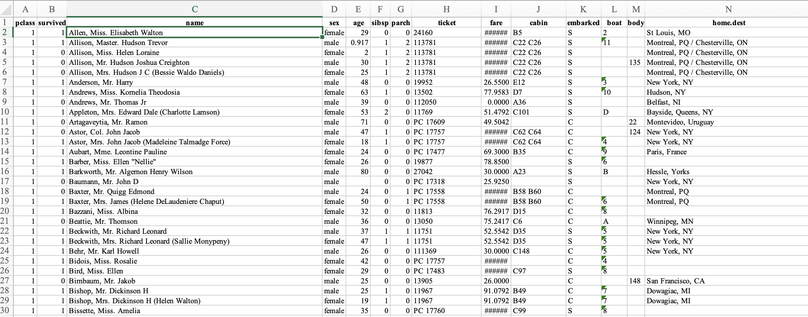
Tabular Data
Data rarely comes clean.
Outliers
Missing Values

Slide 4
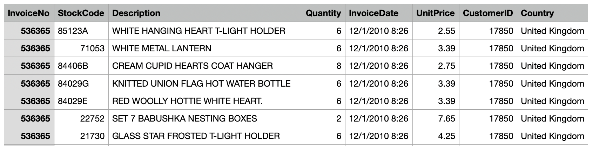
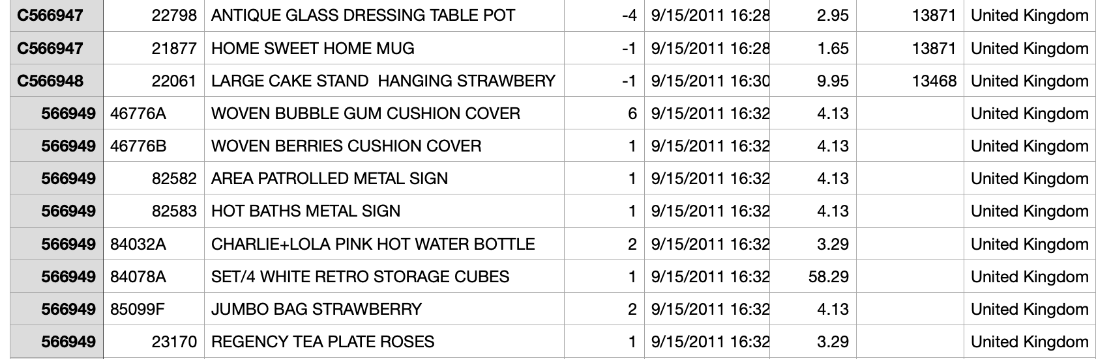
Tabular Data
Data rarely comes clean.
Inconsistent format
Outliers

Slide 5
Tabular Data
Data rarely comes clean.
Need: Tools to organize & clean data.

Slide 6
Python Without Pandas
Lists → good for sequences, bad for tables.
Dicts → useful, but hard for analytics.
Example:
data = [{"name":"Alice","age":25,"grade":88},
{"name":"Bob","age":23,"grade":75}]
❌ Hard to compute average grade.

Slide 7

Pandas Overview
Created by Wes McKinney in 2008, now maintained by many others.
Powerful and productive Python data analysis and Management Library
Panel Data System
The name is derived from the term "panel data", an econometrics term for datasets that include both time-series and cross-sectional data
Its an open-source product.

Slide 8
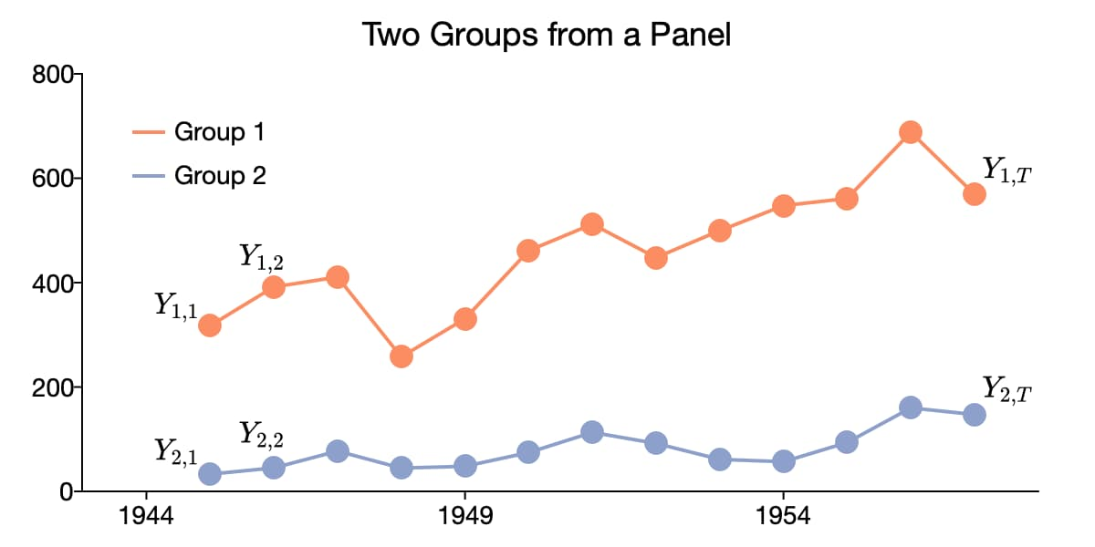
Pandas Overview
An example of Panel Data

Slide 9
Pandas Overview
Python Library to provide data analysis features similar to: R, MATLAB, SAS
Rich data structures and functions to make working with data structure fast, easy and expressive.
It is built on top of NumPy
Key components provided by Pandas:
Series
DataFrame
from pandas import Series, DataFrame
import pandas as pd

Slide 10
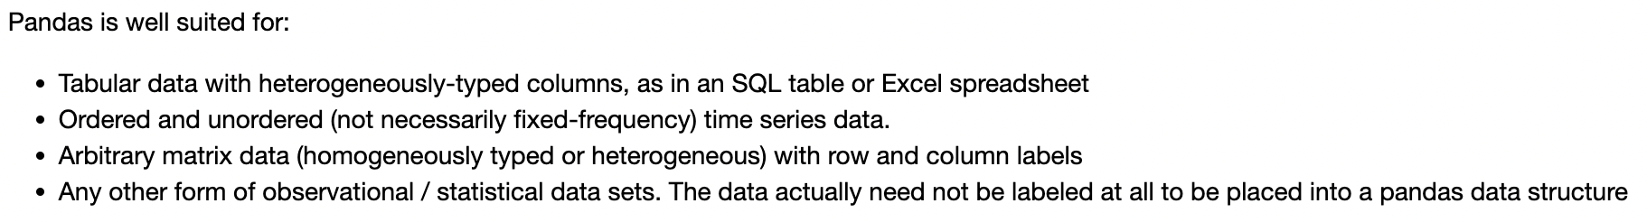
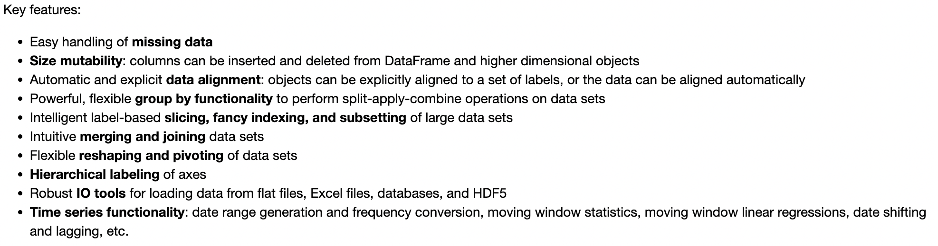
Pandas Overview

Slide 11

Pandas Overview
Modeling
Visualization
High Performance Computing
Big Data
Statistical Computing
Numerical Computing
Data Mining
Text Processing
Computing Language

Slide 12
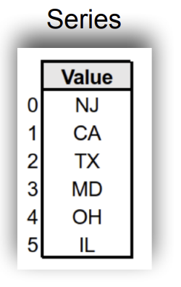
Series: One-Dimensional Labeled Data
One dimensional array-like object
It contains array of data (of any NumPy data type) with associated indexes. (Indexes can be strings or integers or other data types.)
By default , the series will get indexing from 0 to N where N = size -1

Slide 13
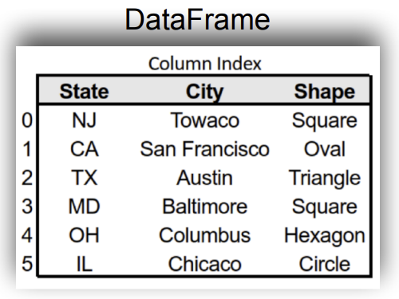
DataFrame: Two-Dimensional Tabular Data
A DataFrame is a tabular data structure comprised of rows and columns, akin to a spreadsheet or database table.
It can be treated as an ordered collection of columns
Each column can be a different data type
Have both row and column indices

Slide 14
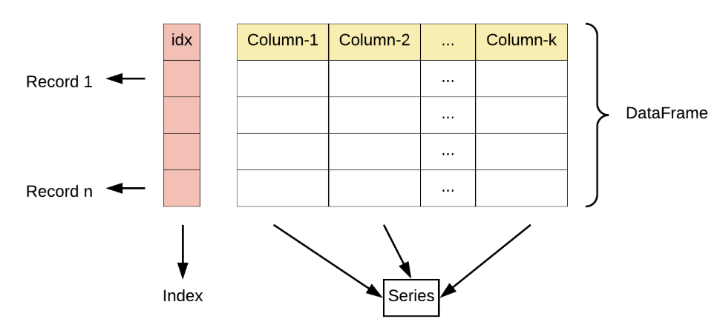
DataFrame: Two-Dimensional Tabular Data

Slide 15
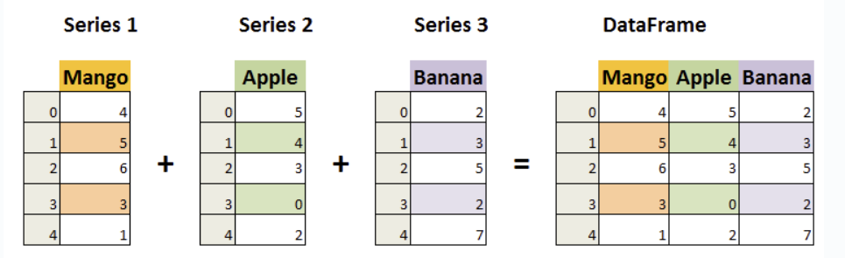
DataFrame: Two-Dimensional Tabular Data

Slide 16
Test Your Understanding…
Create a pandas DataFrame called df1 with the following student scores:
Name | Math | English
Alice | 85 | 78
Bob | 90 | 88
Cindy | 78 | 82
Compute the mean score of the Math column.
Compute the mean score of the English column.
Print both mean values.
A new student joins the class, Concatenate df1 and df2 by rows to form a new DataFrame df.
Name | Math | English
David | 92 | 95

