Slide 1
Data Modeling in Data Science
CSC 405/605

Slide 2
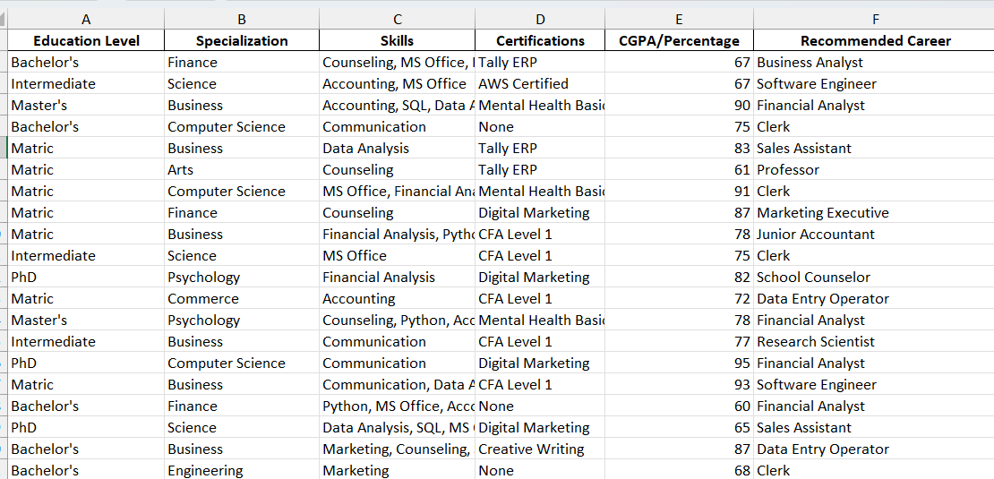

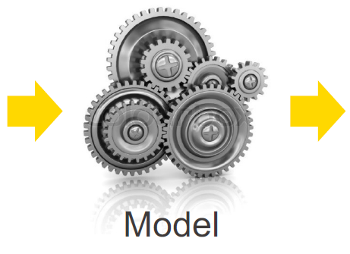
How Data Modeling is Used
Features
Label
Career Recommendations
This lecture is adapted from materials by KNIME AG:
https://www.knime.com/sites/default/files/2021-08/l4-ml-slides.pdf © 2021 KNIME AG. All rights reserved.

Slide 3
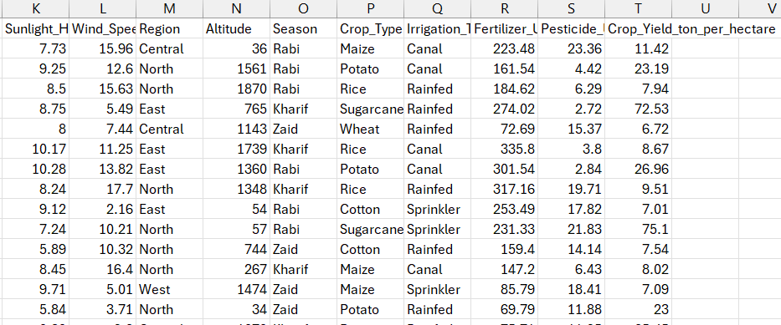

How Data Modeling is Used
Features
Label
Crop Yield Prediction
This lecture is adapted from materials by KNIME AG:
https://www.knime.com/sites/default/files/2021-08/l4-ml-slides.pdf © 2021 KNIME AG. All rights reserved.

Slide 4
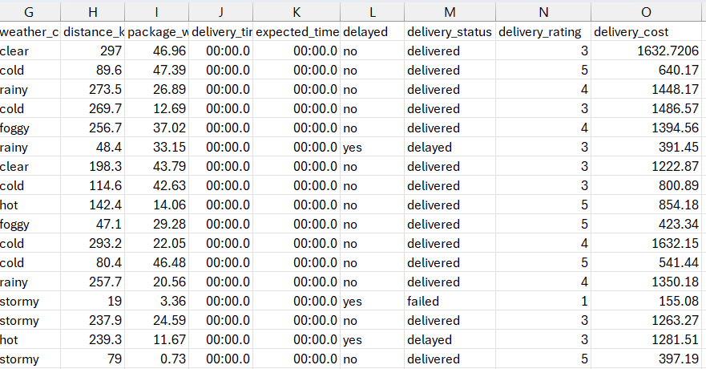
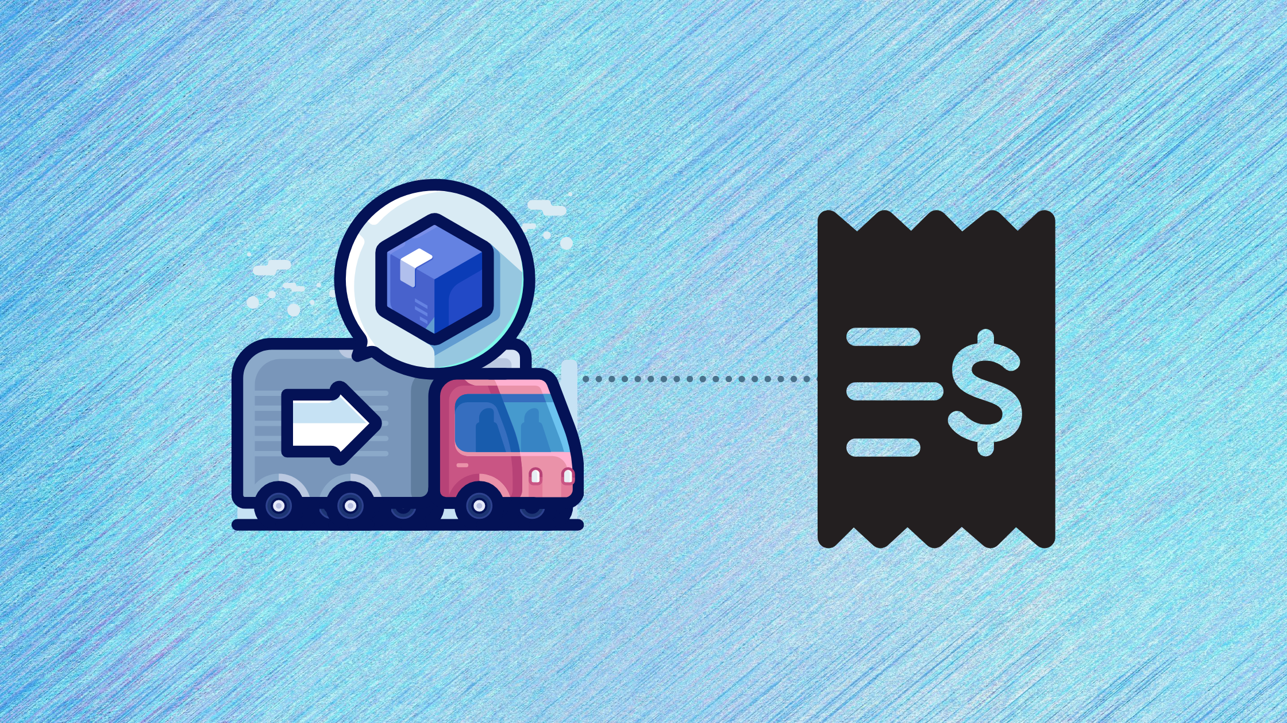
How Data Modeling is Used
Features
Label
Delivery Cost

Slide 5
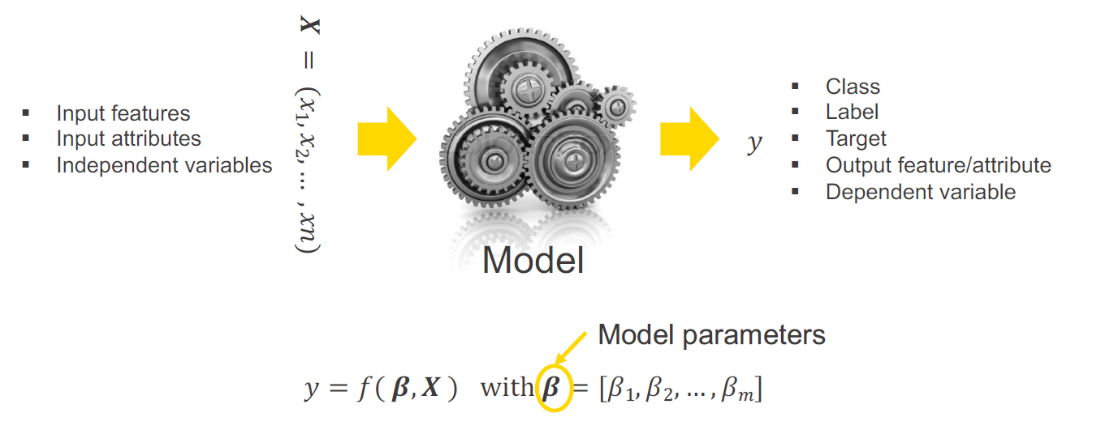
What is a Learning Algorithm?
A learning algorithm adjusts (learns) the model parameters 𝜷 throughout a
number of iterations to maximize/minimize a likelihood/error function on 𝑦.

Slide 6
Algorithm Learning
The model learns during the training phase to produce the right answer y (a.k.a., label)
That is why machine learning
Many different algorithms for three ways of learning:
Supervised
Unsupervised
Semi-supervised

Slide 7
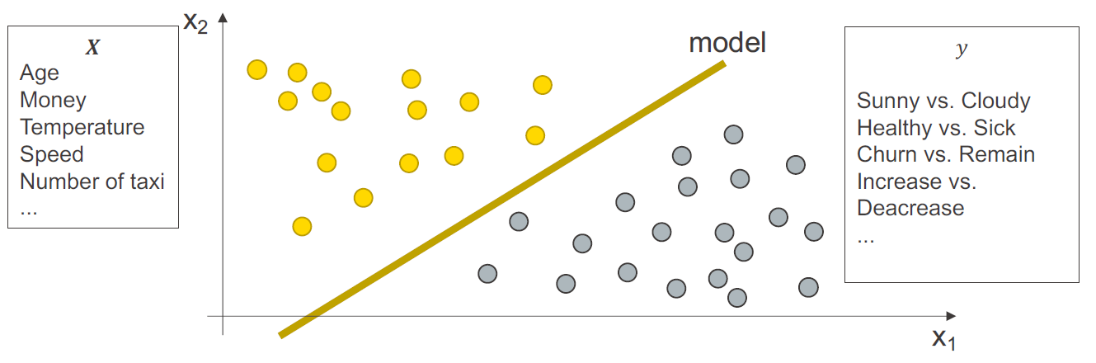
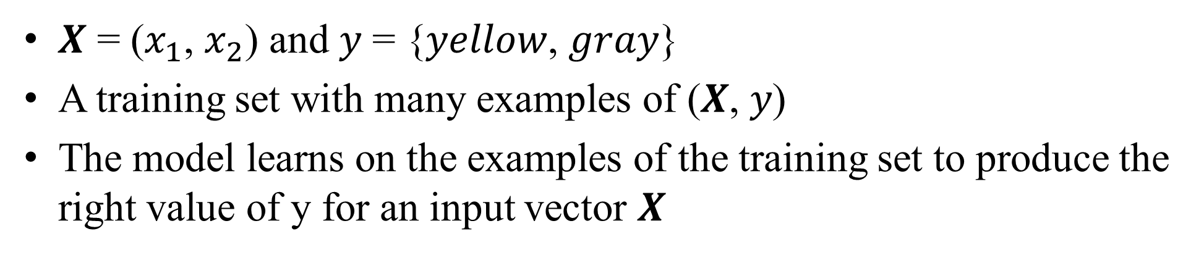
Supervised Learning
𝑿 = ($x_{1}$, $x_{2}$) and 𝑦 = {𝑦𝑒𝑙𝑙𝑜𝑤, 𝑔𝑟𝑎𝑦}
A training set with many examples of (𝑿, 𝑦)
The model learns on the examples of the training set to produce the right value of y for an input vector 𝑿

Slide 8
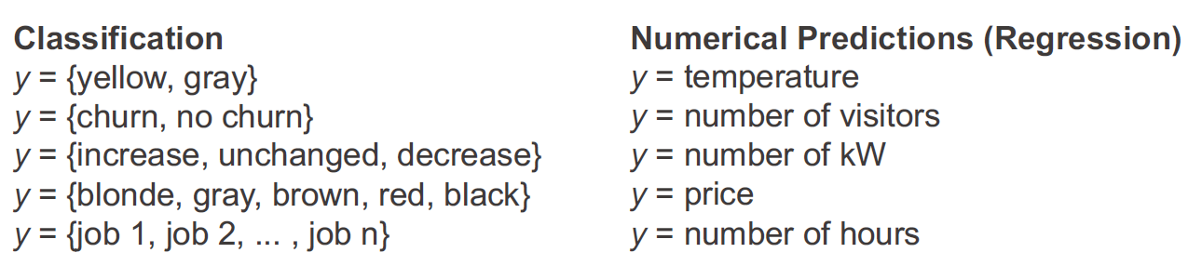
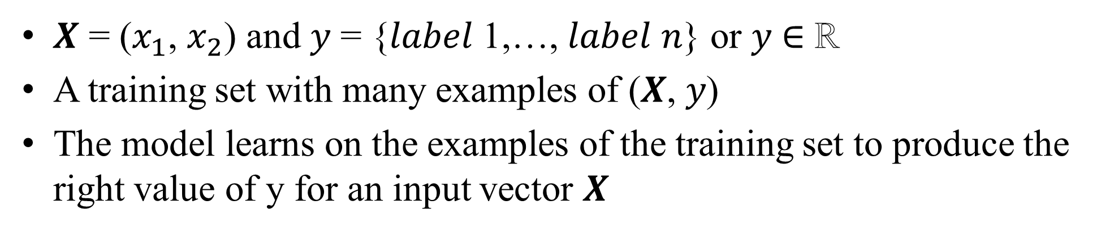
Supervised Learning: Classification vs. Regression
𝑿 = ($x_{1}$, $x_{2}$) and 𝑦 = {𝑙𝑎𝑏𝑒𝑙 1,…, 𝑙𝑎𝑏𝑒𝑙 𝑛} or 𝑦 ∈ ℝ
A training set with many examples of (𝑿, 𝑦)
The model learns on the examples of the training set to produce the right value of y for an input vector 𝑿

Slide 9
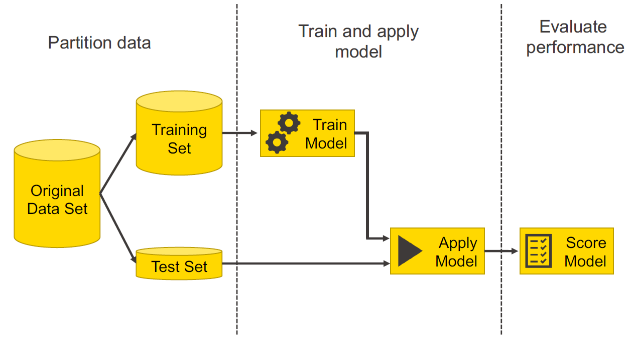
Supervised Learning: Process Overview

Slide 10
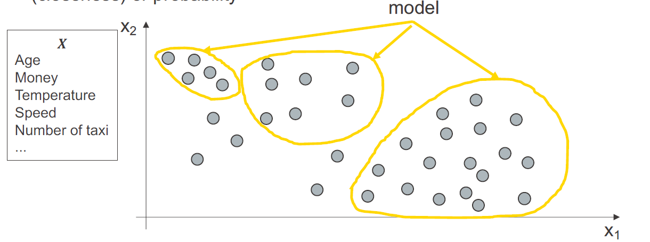
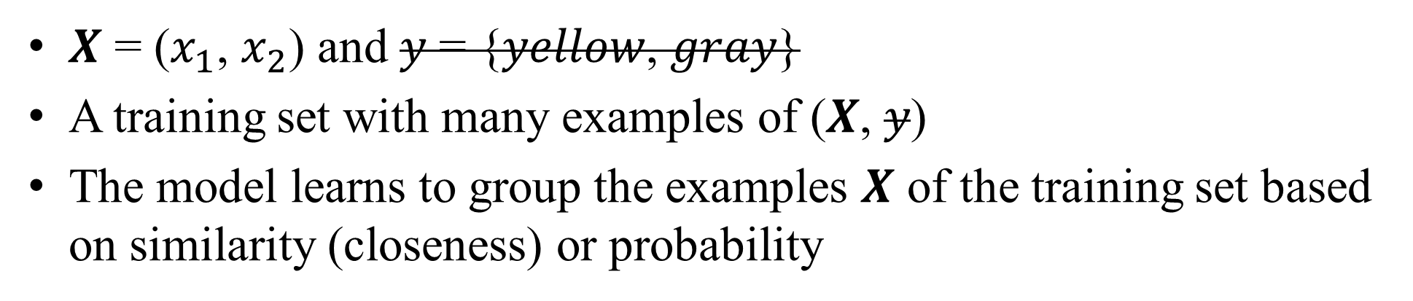
Unsupervised Learning
𝑿 = ($x_{1}$, $x_{2}$) and 𝑦 = {𝑦𝑒𝑙𝑙𝑜𝑤, 𝑔𝑟𝑎𝑦}
A training set with many examples of (𝑿, 𝑦)
The model learns to group the examples 𝑿 of the training set based on similarity (closeness) or probability

Slide 11
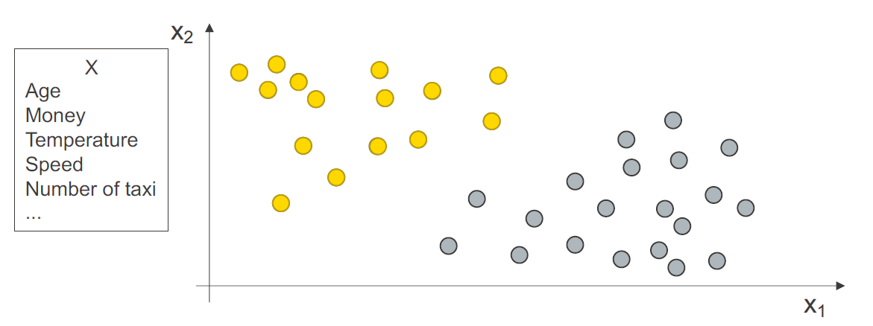
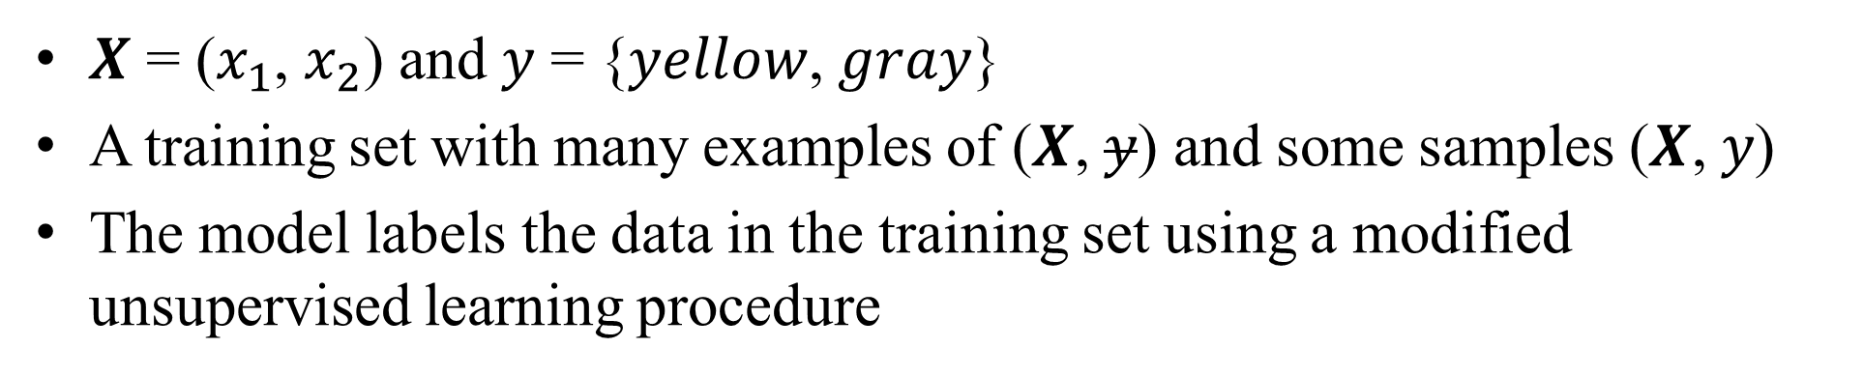
Semi-Supervised Learning
𝑿 = ($x_{1}$, $x_{2}$) and 𝑦 = {𝑦𝑒𝑙𝑙𝑜𝑤, 𝑔𝑟𝑎𝑦}
A training set with many examples of (𝑿, 𝑦) and some samples (𝑿, 𝑦)
The model labels the data in the training set using a modified unsupervised learning procedure

Slide 12
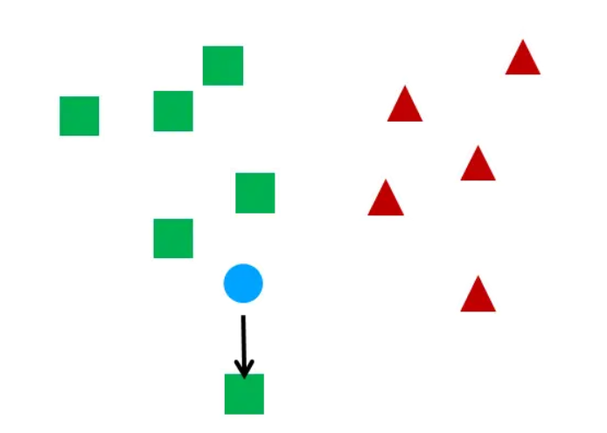

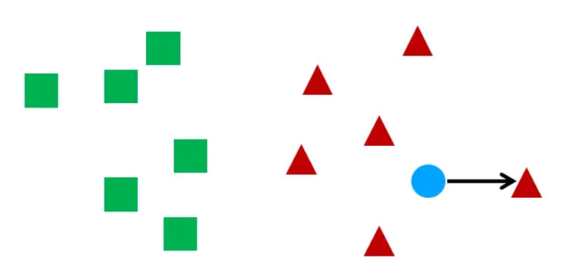

Semi-Supervised Learning

Slide 13
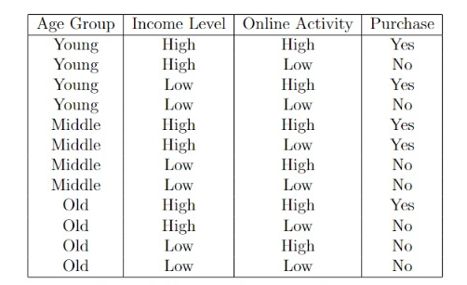
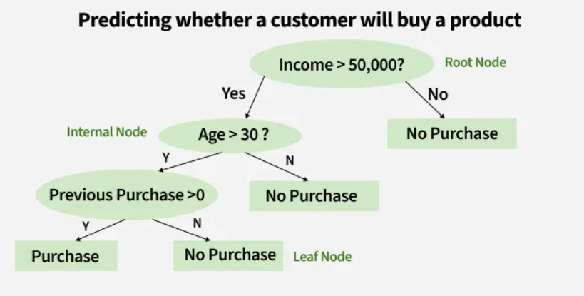
Decision Tree Algorithm
How can we measure which is the best feature for a split?

Slide 14
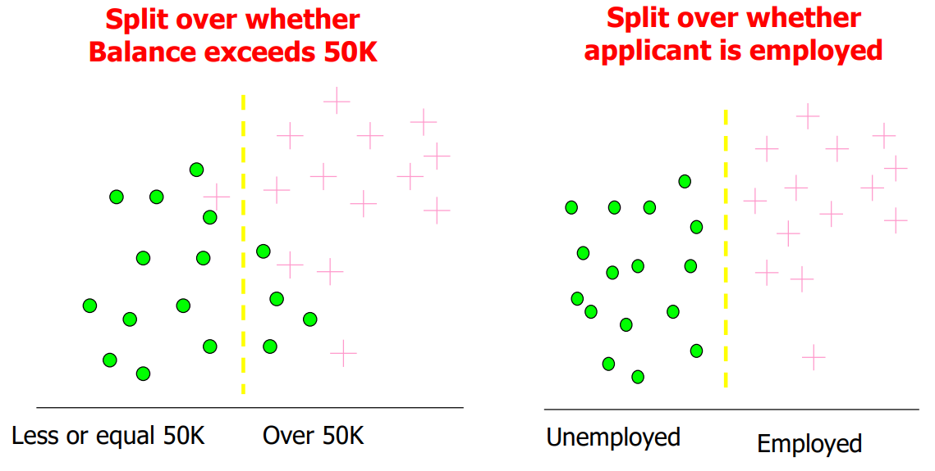
Decision Tree Algorithm: Information Gain
Which test is more informative?

Slide 15
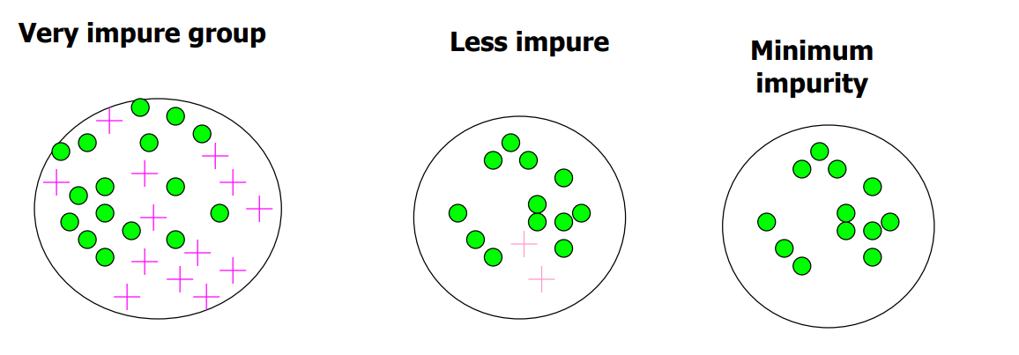
Decision Tree Algorithm: Information Gain
Impurity/Entropy
– Measures the level of impurity in a group of examples

Slide 16
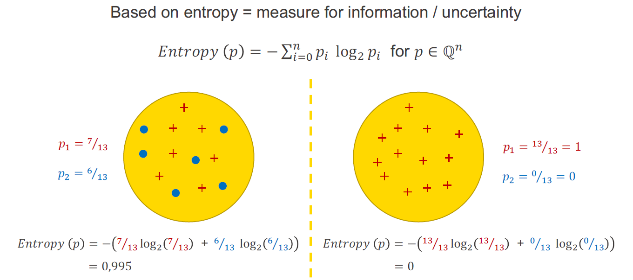
Decision Tree Algorithm: Information Gain
Impurity/Entropy
– Measures the level of impurity in a group of examples

Slide 17
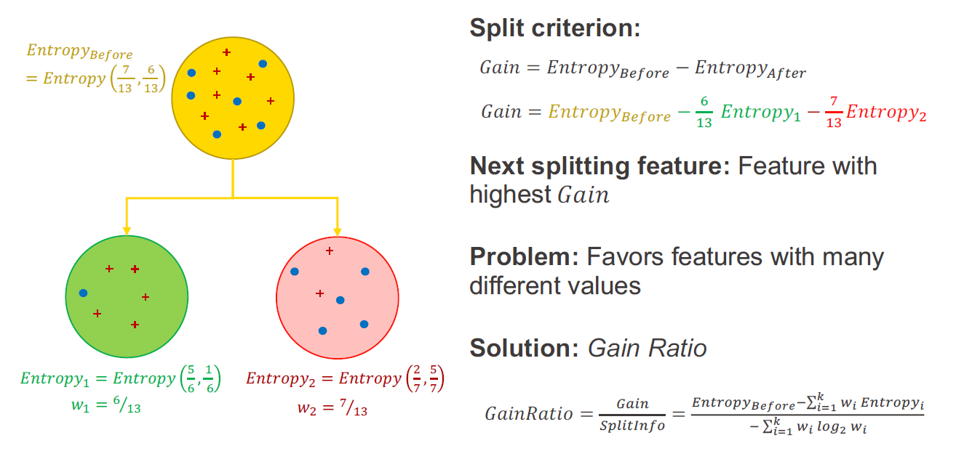
Decision Tree Algorithm: Information Gain
Possible Split Criterion: Gain Ratio

Slide 18
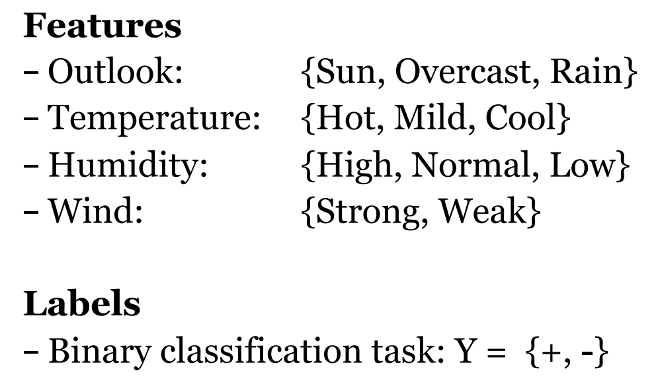
Decision Tree Algorithm: Information Gain
Will I play tennis today?

Slide 19
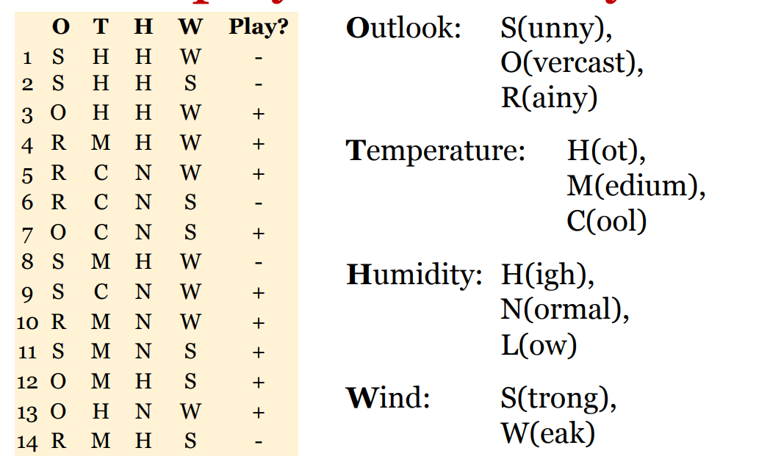
Decision Tree Algorithm: Information Gain
Will I play tennis today?

Slide 20
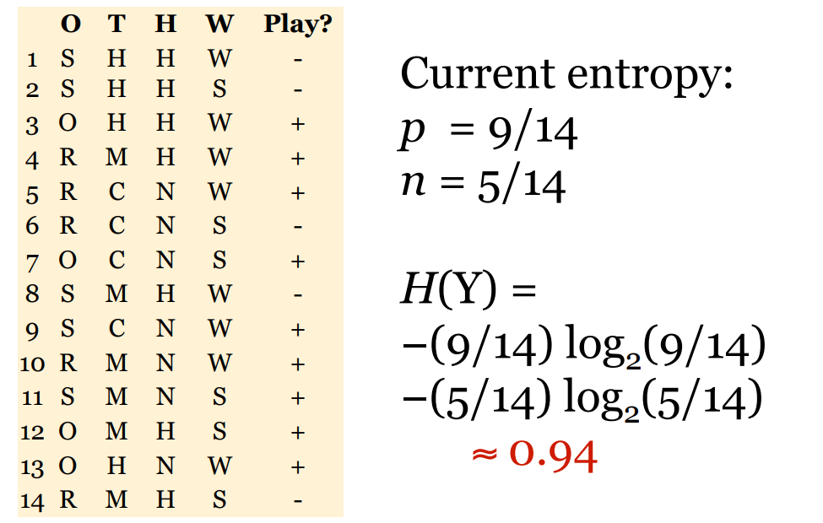
Decision Tree Algorithm: Information Gain
Will I play tennis today?

Slide 21
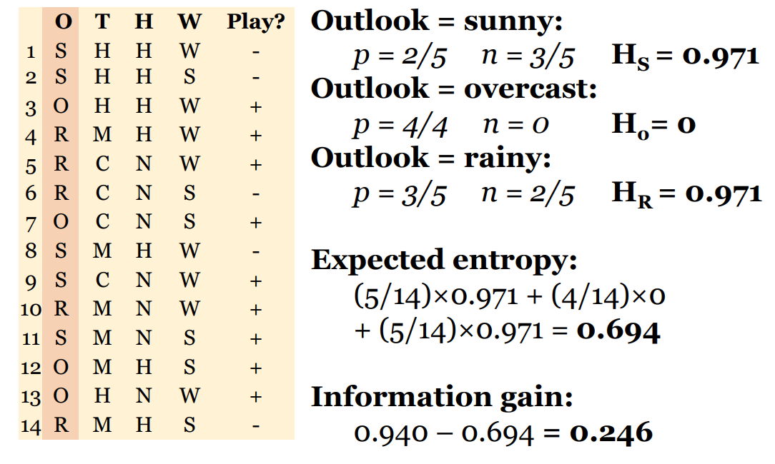
Decision Tree Algorithm: Information Gain
Will I play tennis today?

Slide 22
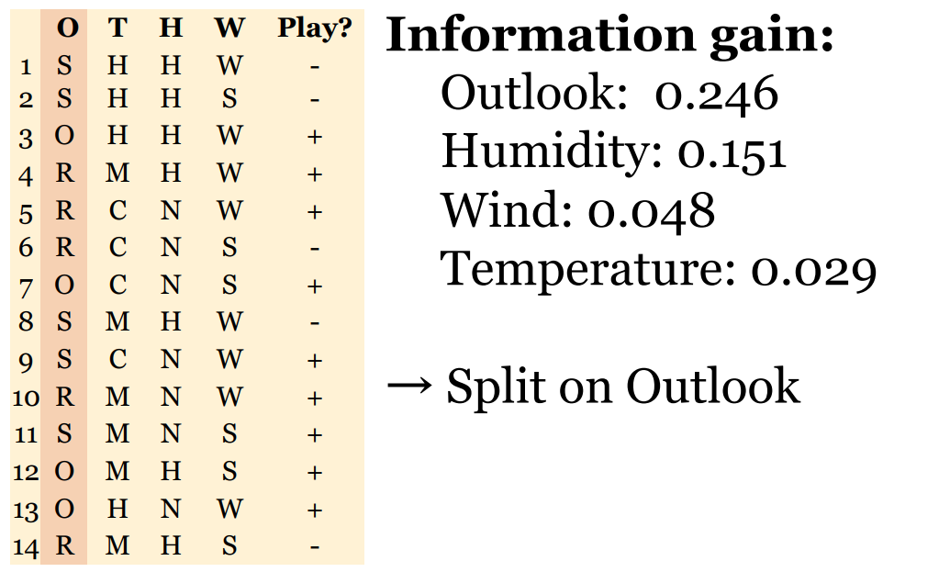
Decision Tree Algorithm: Information Gain
Will I play tennis today?

Slide 23
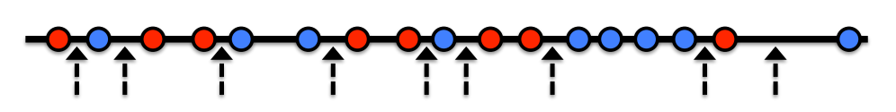
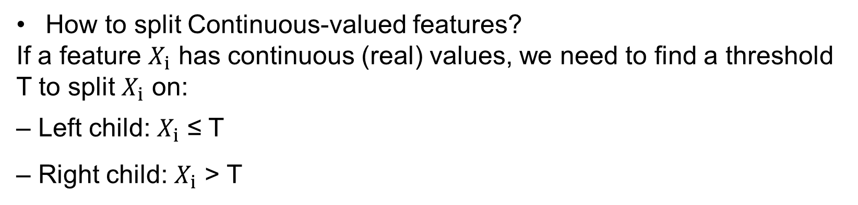
Decision Tree Algorithm: Information Gain
How to split Continuous-valued features?
If a feature $X_{i}$ has continuous (real) values, we need to find a threshold T to split $X_{i}$ on:
– Left child: $X_{i}$ ≤ T
– Right child: $X_{i}$ > T

Slide 24
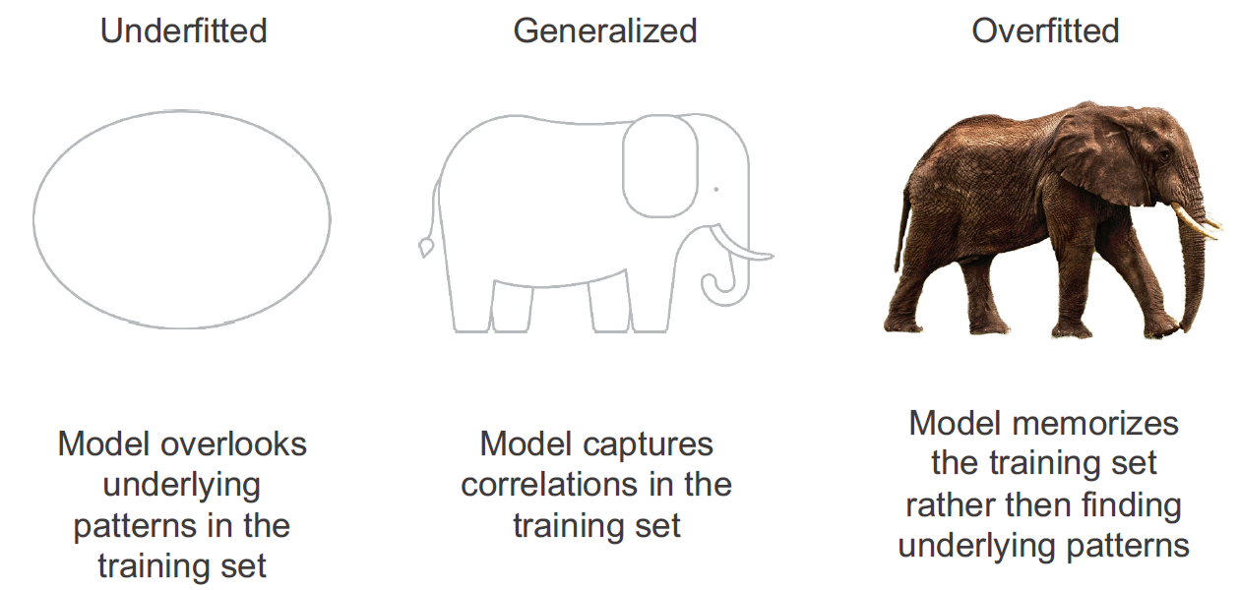
Decision Tree Algorithm: Overfitting vs Underfitting

Slide 25
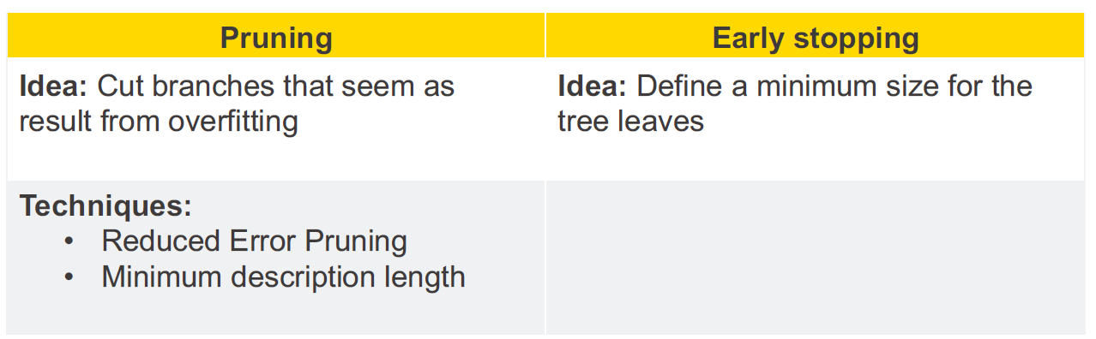
Decision Tree Algorithm: Overfitting vs Underfitting
Goal: Tree that generalizes to new data and doesn’t overfit

Slide 26
Advanced Decision Tree Algorithm
Suppose one decision tree is not accurate enough. What can we do?
Bagging: Trees built independently
Boosting: Trees built sequentially, each one fixes previous mistakes

Slide 27
Advanced Decision Tree Algorithm
Bagging” (Bootstrap AGGregatING): Instead of training one model, we train many models on slightly different datasets, then average their predictions.
Given a dataset with 𝑁 samples:
Sample 𝑁 points with replacement
This creates a new dataset (same size, but with duplicates)
For regression → average predictions
For classification → majority vote
About 63% of original data appears in each bootstrap sample
About 37% is left out (called out-of-bag data)

Slide 28
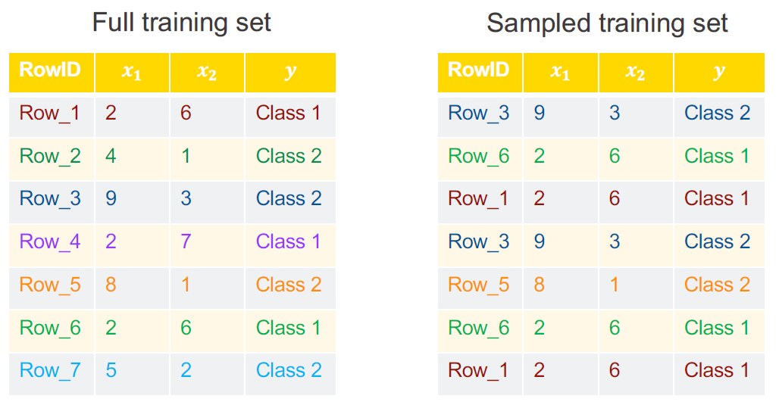
Advanced Decision Tree Algorithm
Bagging” (Bootstrap AGGregatING): Instead of training one model, we train many models on slightly different datasets, then average their predictions.

Slide 29
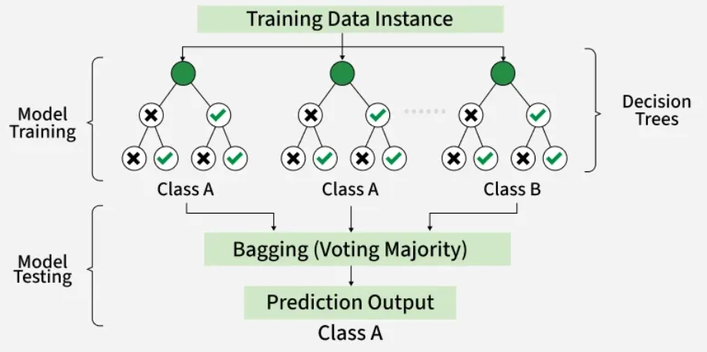
Advanced Decision Tree Algorithm
Random Forest: each tree looks at different random parts of the data and their results are combined by voting for classification or averaging for regression.

Slide 30
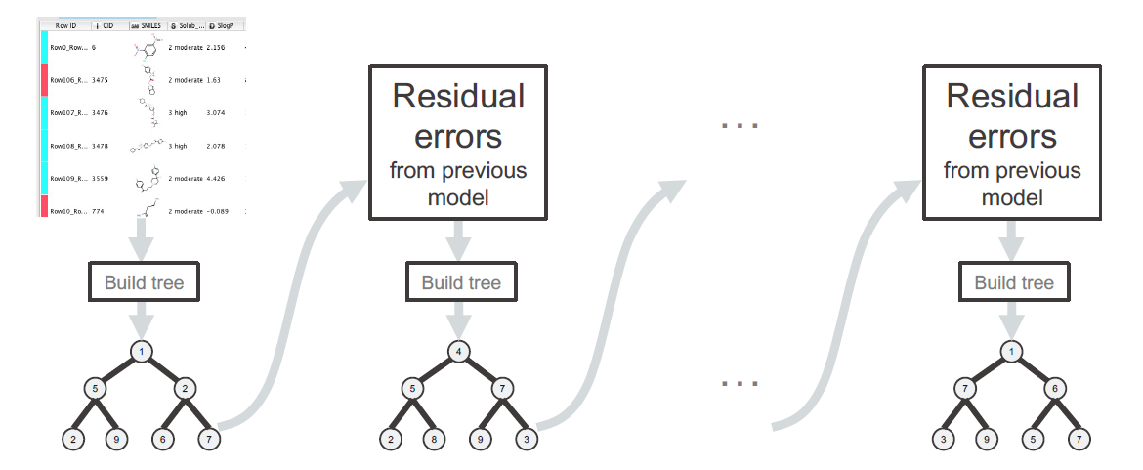
Advanced Decision Tree Algorithm
Boosting:
Starts with a single tree built from the data
Fits a tree to residual errors from the previous model to refine the model sequentially

Slide 31
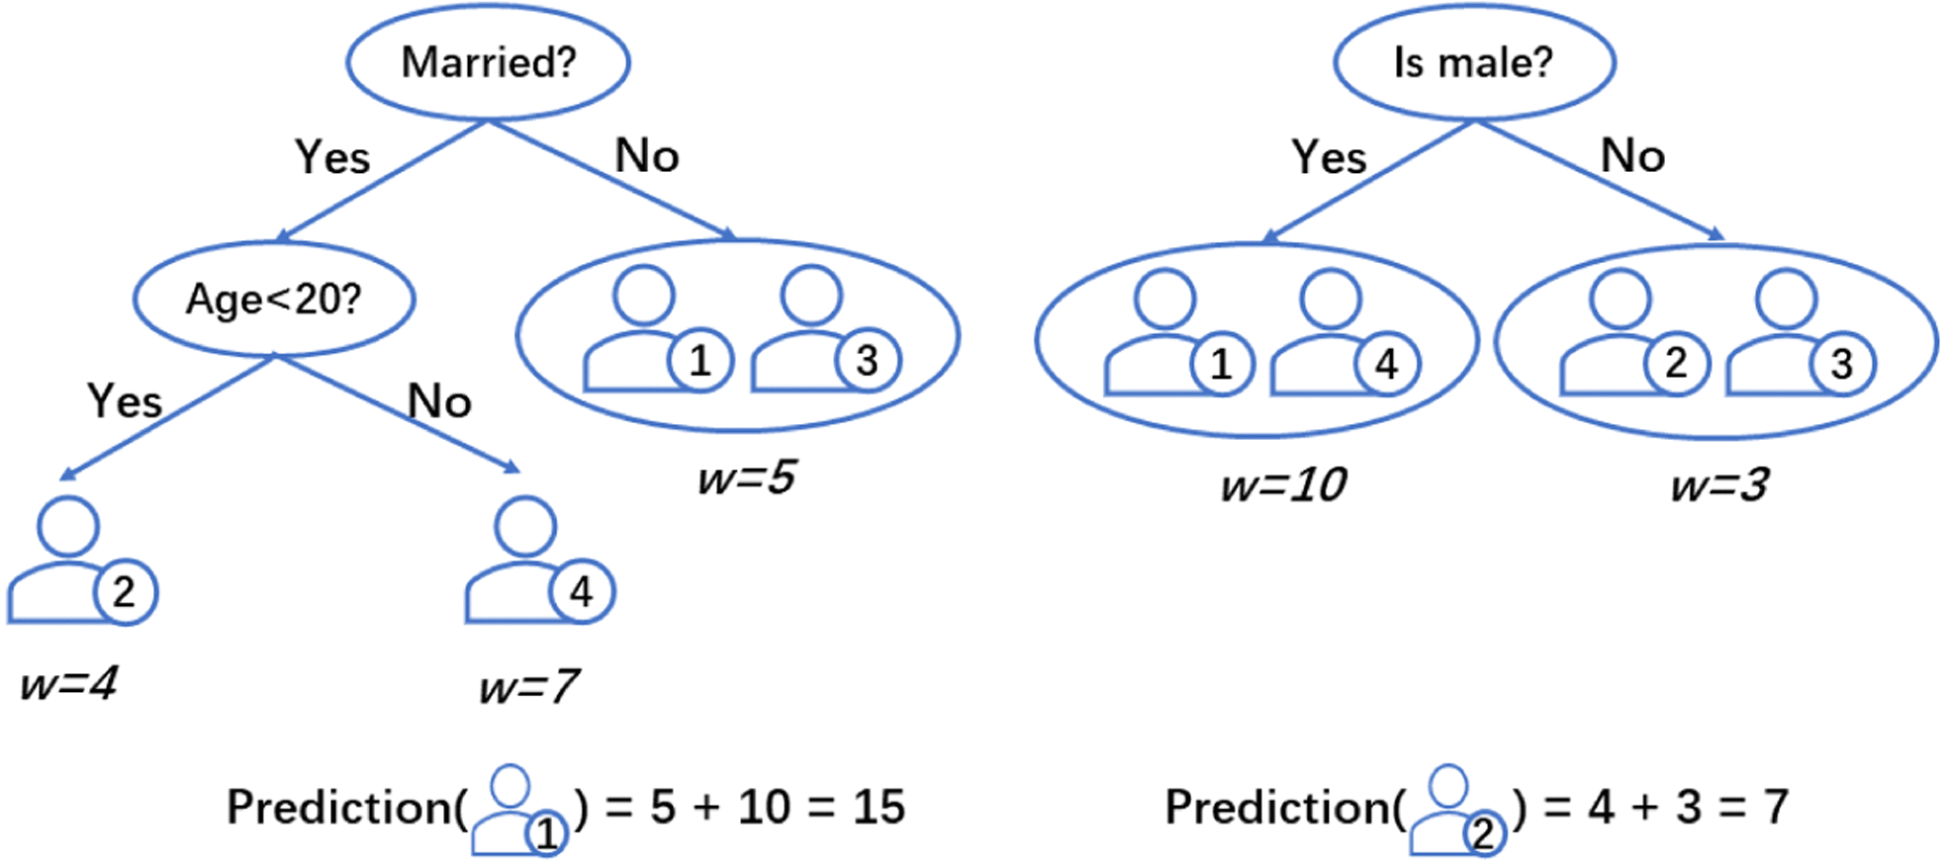
Advanced Decision Tree Algorithm
Gradient-Boosted Decision Trees (GBDT): builds a strong model by sequentially adding trees that fit the errors (gradients) of previous models.

Slide 32
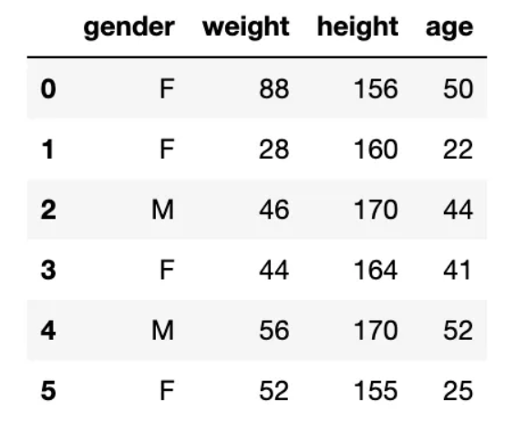
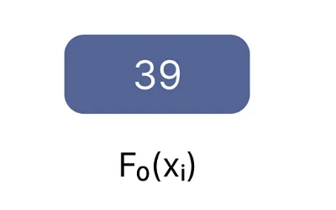
Advanced Decision Tree Algorithm
Gradient-Boosted Decision Trees (GBDT)
https://medium.com/@ruchi.awasthi63/gradient-boosted-decision-tree-clearly-explained-bd1d8c7d9923

Slide 33
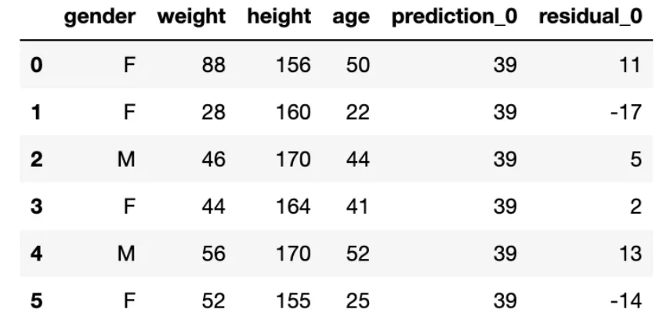
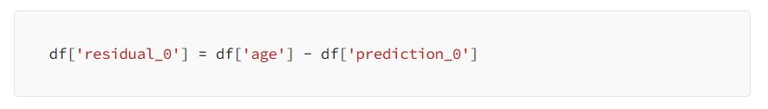
Advanced Decision Tree Algorithm
Gradient-Boosted Decision Trees (GBDT)

Slide 34
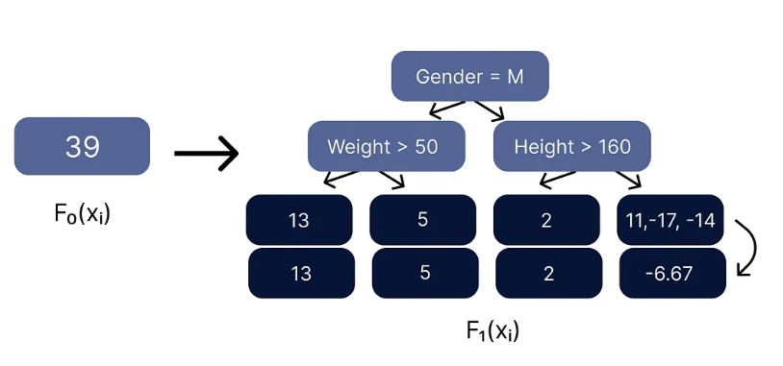
Advanced Decision Tree Algorithm
Gradient-Boosted Decision Trees (GBDT)

Slide 35
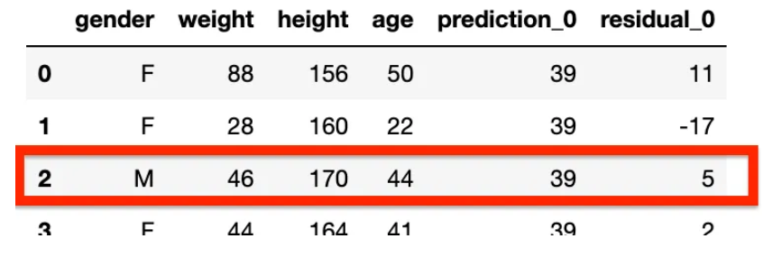
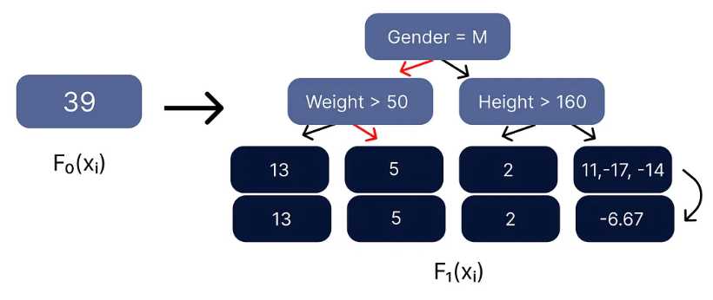
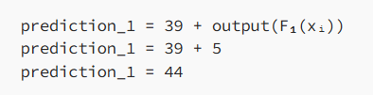
Advanced Decision Tree Algorithm
Gradient-Boosted Decision Trees (GBDT)

Slide 36



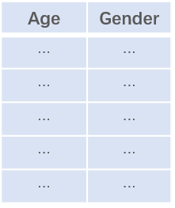



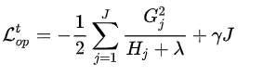









Advanced Decision Tree Algorithm
Gradient-Boosted Decision Trees (GBDT)
Find split points: Minimize the loss function during each iteration and continuously fit the residuals through multiple iterations.
The gain of the split：
Find the optimal split point that maximizes $G_{split}$
Age<20
Yes
No
Gradient Statistics
$$g_{1},h_{1}$$
Is Male?
$$g_{2},h_{2}$$
$$g_{3},h_{3}$$
Yes
No
$$g_{3},h_{3}$$
$$g_{4},h_{4}$$
$$g_{5},h_{5}$$
$$g_{4},h_{4}$$
Loss Function：
$$g_{5},h_{5}$$
$$g_{2},h_{2}$$
$$g_{1},h_{1}$$

Slide 37
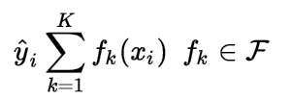
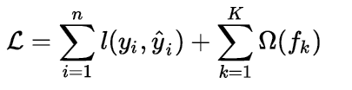


Advanced Decision Tree Algorithm
In each iteration, a regression tree is trained to fit the residuals from the previous iteration; after k iterations, the model consists of k regression trees. The model's predictive output is the sum of the outputs from these k regression trees.
$$=$$
The objective loss function to be minimized can be expressed as
At the t-th iteration of model training, the model's predicted output is:

Slide 38
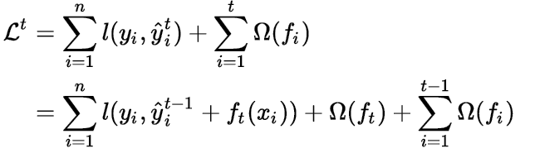
Advanced Decision Tree Algorithm
In each iteration, a regression tree is trained to fit the residuals from the previous iteration; after k iterations, the model consists of k regression trees. The model's predictive output is the sum of the outputs from these k regression trees.
$$=$$
The objective loss function to be minimized can be expressed as
At the t-th iteration of model training, the model's predicted output is:

Slide 39

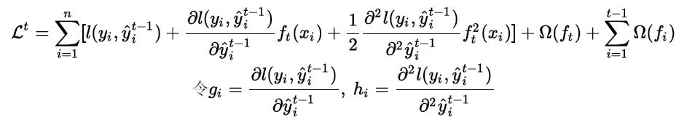

Advanced Decision Tree Algorithm
GBDT fits the first-order derivative of the Taylor expansion, while XGBoost fits the second-order derivative; Here, the expansion proceeds based on the second-order Taylor series.
https://dl.acm.org/doi/10.1145/2939672.2939785

Slide 40



Advanced Decision Tree Algorithm
Consider the loss of all samples falling on the j-th leaf node:

Slide 41




Advanced Decision Tree Algorithm
For a fixed tree structure, where $w_{j}$ represents the weight of the specific leaf node to be determined, setting the first derivative of the loss function to zero yields:
Calculate the split point that minimizes the sum of the loss values ​​of the two resulting subsets after dividing the dataset in two

Slide 42


Simple Linear Regression
Simple Linear Regression: predict a quantitative response Y on the basis of a single predictor variable X.
Assumes there is an approximately linear relationship between X and Y
Estimate βs using training data: (x(1), y(1)), (x(2), y(2)), … (x(n), y(n))
Once βs are estimated, we denote them using “hats”.
For a particular realization of X, aka X = x, the predicted output is denoted “y-hat”:

Slide 43

Simple Linear Regression
Simple Linear Regression:
Optimization goal: minimize sum of squared residuals

Slide 44

Simple Linear Regression
Simple Linear Regression:
Optimization goal: minimize sum of squared residuals

Slide 45

Simple Linear Regression
Multiple Linear Regression: What if our dataset contains multiple input dimensions Xj?
Predict the response variable using more than one predictor variable

Slide 46

Simple Linear Regression
Multiple Linear Regression: What if our dataset contains multiple input dimensions Xj?
You can also use matrix notation to write a linear regression.

Slide 47

Polynomial Regression
Polynomial regression: an extension of linear regression that models the relationship between the dependent variable and the independent variable(s) as an n-th degree polynomial.

Slide 48

Logistic Regression
Logistic Regression: a supervised ML algorithm used for classification problems.
It is used for binary classification where the output can be one of two possible categories such as Yes/No, True/False or 0/1.
It uses sigmoid function to convert inputs into a probability value between 0 and 1.

Slide 49



Logistic Regression
Instead of just predicting the class, give the probability of the instance being that class – i.e., learn $p(y|x)$.
Takes a probabilistic approach to learning discriminative functions (i.e., a classifier)

Slide 50



Logistic Regression

Slide 51




Logistic Regression
How can we Find the Best Coefficients $θ$
Maximize the product of the probabilities -> Likelihood function
$$θ$$

Slide 52

Learning Rate / Step Length
If we denote learning rate as $∆s$

Slide 53
Evaluation of Classification Models
Overall Accuracy: The proportion of correct classifications
Downsides:
Only considers the performance in general and not for the different classes
Therefore, not informative when the class distribution is unbalanced

Slide 54

Evaluation of Classification Models
Confusion Matrix: Arbitrarily define one class value as POSITIVE and the remaining class as NEGATIVE
Use these four statistics to calculate other evaluation metrics, such as overall accuracy, true positive rate, and false positive rate

Slide 55

Evaluation of Classification Models
ROC Curve: shows the false positive rate and true positive rate for different threshold values
False positive rate (FPR)
Negative events incorrectly classified as positive
True positive rate (TPR)
Positive events correctly classified as positive

Slide 56

Evaluation of Regression Models
MAE, MSE, RMSE, and R-Square
MAE (Mean Absolute Error): less sensitive to outliers, optimization is a complex process
MSE (Mean Squared Error)/RMSE (Root Mean Squared Error):
: Differentiable, more sensitive to outliers
R-square: tells how much of the variation in the data is explained by the model.

