Slide 1
Jupyter Notebook
CSC 405/605

Slide 2

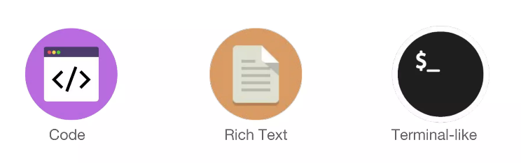
What is Jupyter Notebook
Jupyter Notebooks are documents that contain both code and rich text with some of the magic of the terminal

Slide 3

What is Jupyter Notebook

Slide 4

What is Jupyter Notebook
IPython Notebook (before 2014)
Originally part of the IPython project, designed only for Python.
Provided an interactive web-based notebook environment for mixing code, text, and visualization.
Jupyter Notebook (after 2014)
Evolved version of IPython Notebook.
Supporting more languages through kernels.
IPython continues to exist as the Python kernel within Jupyter.

Slide 5

What is Jupyter Notebook

Slide 6
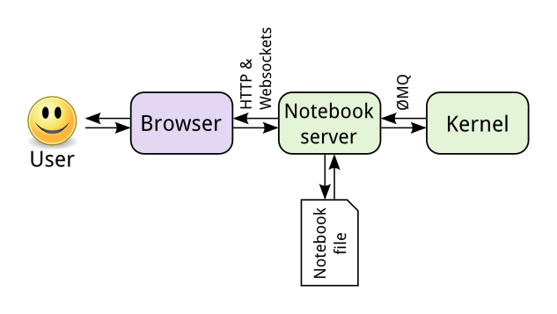
How does Jupyter Notebook work?
It can run locally on your own computer for lightweight use.
It can also run on big servers, which we access remotely through the browser, for heavy computation.
The browser is on the local computer and accesses the server program (on our machine) through a local web connection. The server accesses relevant notebook files, and talk with the kernel to execute the code, that we write, and displays the result in the browser.

Slide 7
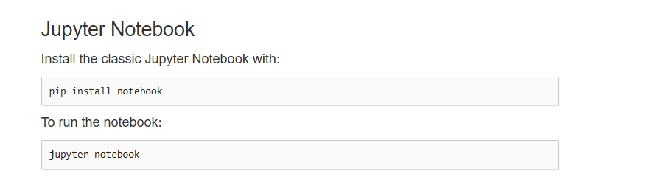
Installing Jupyter
https://jupyter.org/install

Slide 8
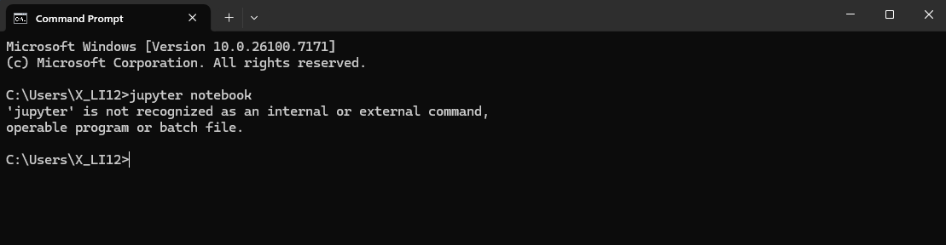
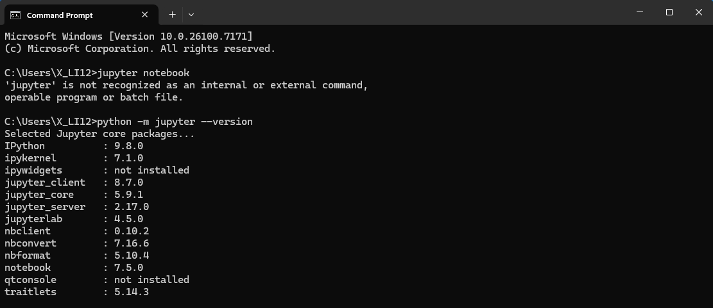
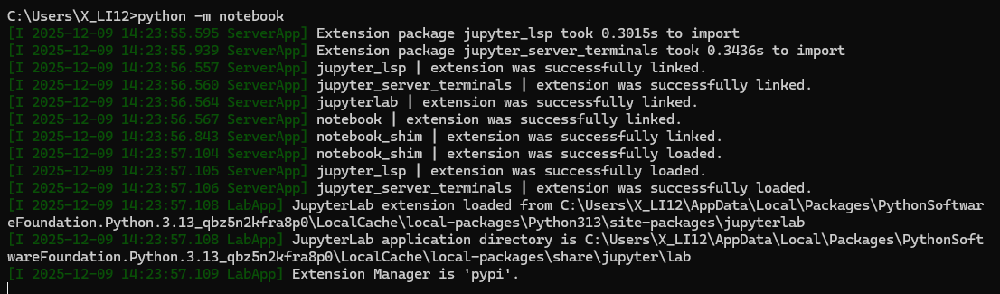
An Error You May Encounter
How to resolve:

Slide 9

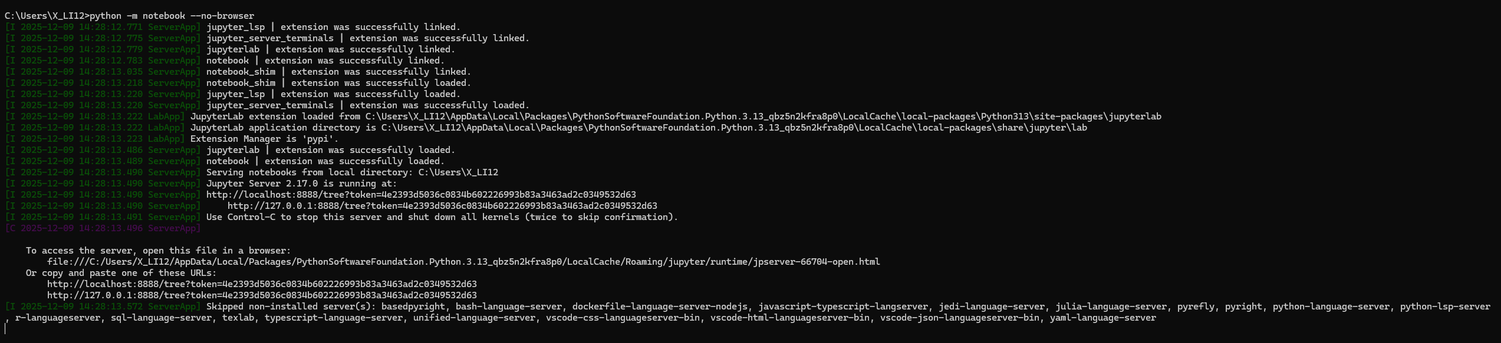
An Error You May Encounter
If you see an error page, try manually opening the browser…

Slide 10
Jupyter Notebook Shortcuts
Edit Mode (Typing/Code Actions)
Enter: Enter Edit Mode.
Tab: Code completion or indent.
Shift + Tab: Show function docstring/tooltip.
Ctrl + /: Comment/uncomment lines.
Ctrl + ]: Increase indent.
Ctrl + [: Decrease indent.
Ctrl + Z: Undo.
Ctrl + Shift + Z or Ctrl + Y: Redo.
Ctrl + F: Find.
Command Mode (Cell Actions)
Esc: Enter Command Mode.
A: Insert cell Above.
B: Insert cell Below.
D, D: Delete cell (press D twice).
X: Cut selected cell(s).
C: Copy selected cell(s).
V: Paste cell(s) below.
Z: Undo cell deletion
Shift + M: Merge selected cells.
Y: Change cell to Y (Code).
M: Change cell to Markdown.
R: Change cell to Raw.
Shift + Enter: Run cell and select cell below.
Ctrl + Enter: Run selected cell(s).
Alt + Enter: Run cell and insert cell below.
S: Save notebook (also Ctrl + S).

Slide 11
A good tutorial/reference
https://www.dataquest.io/blog/jupyter-notebook-tutorial/

